Slide 1
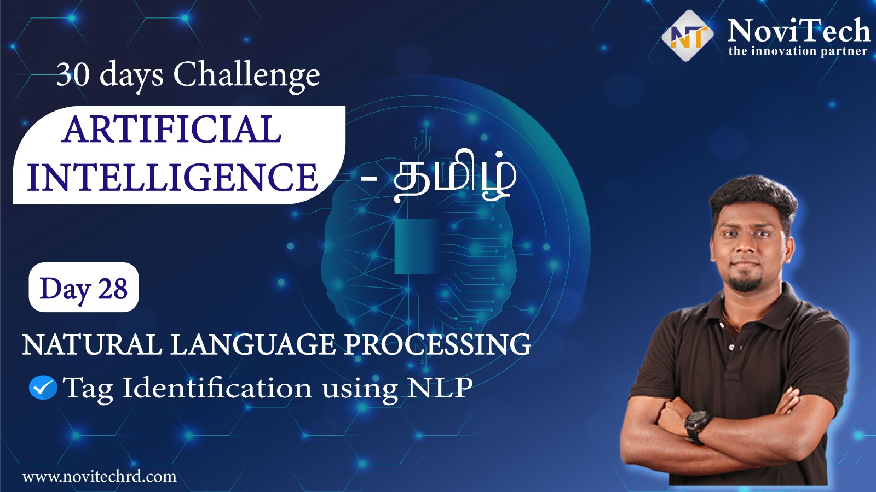

Slide 2

Tag identification using NLP
The main purpose of a title is to entice people to make them read your work. A good title helps in garnering all the attention that your article deserves

Slide 3
NLTK
NLTK stands for Natural Language Toolkit.
This toolkit is one of the most powerful NLP libraries which contains packages to make machines understand human language and reply to it with an appropriate response.
Tokenization, Stemming, Lemmatization, Punctuation, Character count, word count are some of these packages which will be discussed in this tutorial.

Slide 4
Html5lib & Bs4 – Beautiful soup
html5lib is a pure-python library for parsing HTML. It is designed to conform to the WHATWG HTML specification, as is implemented by all major web browsers.
Beautiful Soup is a Python package for parsing HTML and XML documents. It creates a parse tree for parsed pages that can be used to extract data from HTML, which is useful for web scraping.

Slide 5
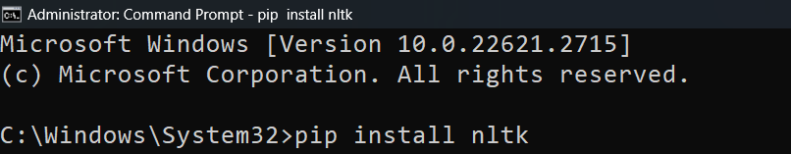
Installing Libraries
OpenCV-Contrib : pip install nltk

Slide 6
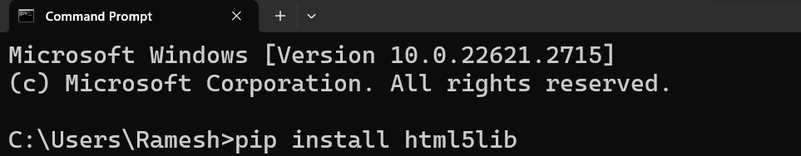
Installing Libraries
OpenCV-Contrib : pip install html5lib

Slide 7
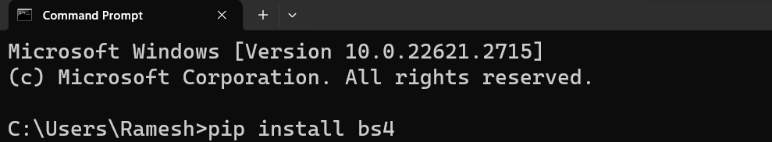
Installing Libraries
OpenCV-Contrib : pip install bs4

Slide 8


NLP
Tag identification using NLP

Slide 9




THANK YOU☺
NOVITECH COIMBATORE
novitechresearchanddevelopment

