Slide 1

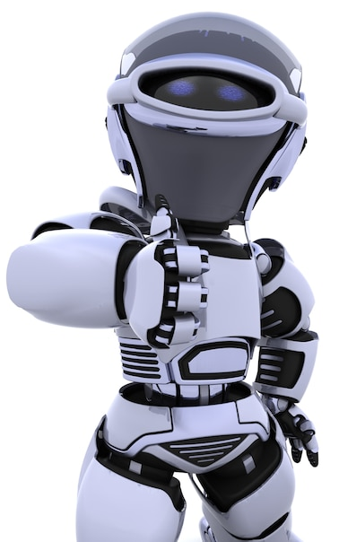
Artificial Intelligence – 30 Days Challenge - தமிழ்
Intro to Computer Vision |
CV Libraries | Basic programs
DAY 3 / 30

Slide 2
Prerequisites for this Course
Laptop with Good Internet
No basic knowledge is required.
Note & Pen

Slide 3


Computer
Vision
Intro | Libraries | Basic programs

Slide 4
Ready For Hands On

Slide 5
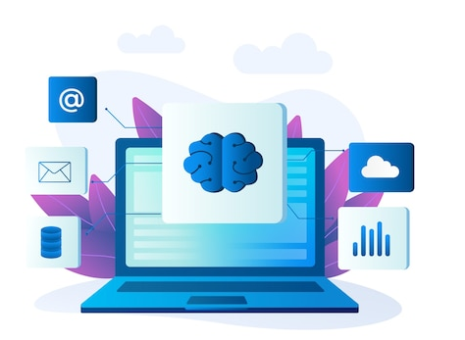
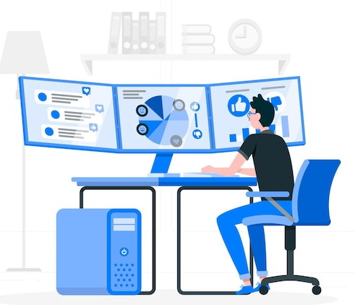
Basic programs on Computer Vision

Slide 6
Read, Show & Write an Image
import numpy as np
import cv2
img = cv2.imread(‘sample2.jpg') cv2.imshow(‘show',img)
cv2.imwrite(‘photo.jpg',img)
cv2.waitKey(0)
cv2.destroyAllWindows()

Slide 7
Converting Color Image to Greyscale Image
import cv2
image = cv2.imread(‘sample1.png’)
greyImage = cv2.cvtColor(image, cv2.COLOR_BGR2GRAY)
cv2.imwrite('gray_image.png', greyImage)
cv2.imshow(‘Color_image',image)
cv2.imshow(‘Grey_image', greyImage)

Slide 8
Image Properties
Import cv2
img = cv2.imread(‘sample2.jpg’)
print (img.shape) #(342, 548, 3)
print (img.size) #562248

Slide 9
Mindset of the Day
Success is the progressive realization of a worthy ideal

Slide 10
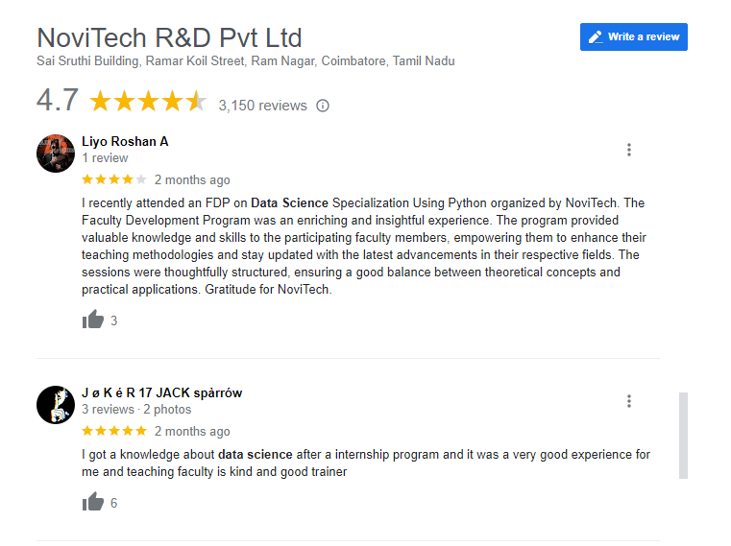

Google Review

Slide 11




THANK YOU☺
NOVITECH COIMBATORE
novitechresearchanddevelopment

