Slide 1


Slide 2


Introduction to
Matplotlib

Slide 3
Evaluation Metrics
-Classification

Slide 4

Evaluation Metrics-Classification
To determine the Performance of a classification model
Accuracy
Precision
Recall
F1 Score

Slide 5
Let We Know!!!...
100%
(data)
70%
(Data to train the model)
30%
(Data to test the model)

Slide 6
Confusion Matrix
Primary Building Blocks Of Classification Evaluation
True Positive
False Positive
False Negative
True Negative
Eg:-
Covid Test Results Should Be Taken As a Dataset

Slide 7
Cont…
1.True Positive(TP) | 2.False Positive(FP)
Actual :Covid Model :Covid Outcome :Patient Admitted | Actual :Non-Covid Model :Covid Outcome :Patient Admitted
3.False Negative(FN) | 4.True Negative(TN)
Actual :Covid Model :Non-Covid Outcome :Patient Not Admitted. Rick of infecting Others | Actual :Not-Covid Model :Not-Covid Outcome :Patient Not Admitted
Covid : Positive Class
Non-Covid : Negative Class

Slide 8
Cont…
SI.NO | Temperature | Oxygen Level | Actual | Prediction
1 | 99 | 99 | 0 | 0
2 | 98 | 98 | 0 | 0
3 | 97 | 97 | 0 | 0
4 | 99 | 99 | 0 | 0
5 | 99 | 99 | 0 | 0
6 | 97 | 97 | 0 | 0
7 | 99 | 99 | 0 | 0
… | … | … | … | …
… | … | … | … | …
95 | 97 | 97 | 0 | 1
96 | 102 | 50 | 1 | 0
97 | 101 | 60 | 1 | 0
98 | 102 | 70 | 1 | 0
99 | 102 | 70 | 1 | 0
100 | 103 | 60 | 1 | 1

Slide 9
Cont…
Non-Covid - 0
Covid - 1
Total no of Sample - 100
Non-Covid - 91
Covid - 9
Imbalanced Dataset

Slide 10
Accuracy
No.Of.Correct Predictions
Accuracy =
Total No.Of.Predictions
TP+TN
No.Of.Correct Predictions =
TP+FP+TN+FN

Slide 11
Cont…
1.True Positive(TP) | 2.False Positive(FP)
Actual :Covid Model :Covid Outcome :Patient Admitted | Actual :Non-Covid Model :Covid Outcome :Patient Admitted
3.False Negative(FN) | 4.True Negative(TN)
Actual :Covid Model :Non-Covid Outcome :Patient Not Admitted. Rick of infecting Others | Actual :Not-Covid Model :Not-Covid Outcome :Patient Not Admitted
1
1
8
90

Slide 12
Accuracy
1+90
No.Of.Correct Predictions =
1+1+8+90
91%(Accuracy

Slide 13
Precision
TP
Precision =
TP+FP
1
Precision =
1+1
=
O.5
1
If(FP=0) ,Precision =
1+0
=
1(100%)

Slide 14
Recall
TP
Recall =
TP+FN
1
Recall =
1+8
=
O.11
1
If(FN=0) ,Precision =
1+0
=
1(100%)

Slide 15
F1 Score
Summarize Precision and Recall in Single Value
GOOD MODEL – It has Good Precision and Recall
For Eg:-
Recall = 0.5 ; Precision = 1
0.5+1
F1= = 0.75 (0----0.5—0.75--1)
2

Slide 16
Cont…
Average or Mean
A+B 95+5
= = 50
2 2
A - Higher Value
B - Lower value

Slide 17
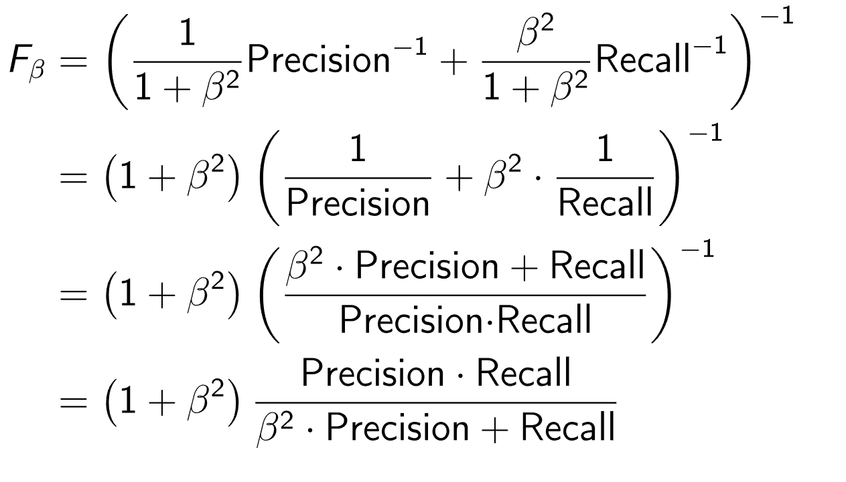
Harmonic Mean
2(A*B) 2( 95*5 )
= = 15
A+B 95+5
(1+1²)PR
F1 =
1² (P+R)

Slide 18
Cont…
 | PRECISION | RECALL
F1 SCORE(HIGH) | HIGH | HIGH
F1 SCORE(LOW) | HIGH | LOW
F1 SCORE(LOW) | LOW | HIGH

Slide 19
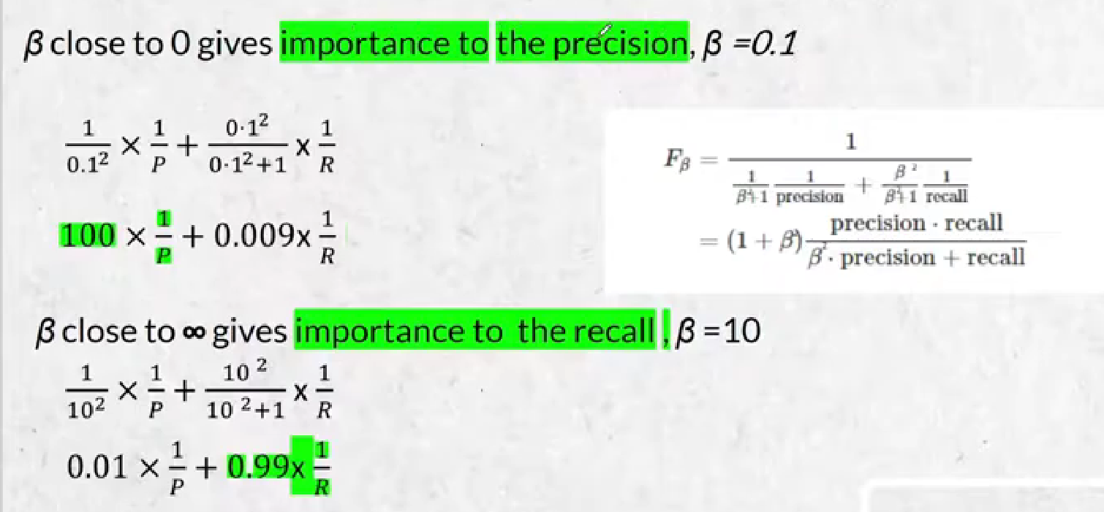
Why we are sub Beta value as 1?
Beta Value : Low – Gives Important to Precision
Beta Value : high – Gives Important to Recall

Slide 20
Cont…
Beta Value : 1 – Gives Equal Important to Precision and Recall
(1+1²)PR
F1 =
1² (P+R)
2PR
F1 =
P+R

Slide 21




THANK YOU☺
NOVITECH COIMBATORE
novitechresearchanddevelopment

