Slide 1
Secure Image-Based Data Hiding Using Steganography
CAPSTONE PROJECT
Presented By: Tangella Sree Chandan
Student Name: Tangella Sree Chandan
College Name & Department: Amrita University & TIFAC CORE in Cyber Security

Slide 2
OUTLINE
Problem Statement
Technology used
Wow factor
End users
Result
Conclusion
Github Link
Future scope

Slide 3
PROBLEM STATEMENT
In today’s digital world, securing sensitive information is crucial. Traditional encryption methods can be detected, making steganography an effective alternative. This project focuses on embedding secret text messages into images using the Least-Significant-Bit (LSB) steganography technique to ensure confidentiality without raising suspicion.

Slide 4
TECHNOLOGY USED
Programming Language: Python
Libraries: OpenCV, NumPy, Tkinter
File Types: PNG (for encrypted images), JPG (for input images)
Methodology: Least-Significant-Bit (LSB) Image Processing

Slide 5
WOW FACTORS
Secure & Undetectable – Hidden data inside images without visible distortion
Passcode Protection – Only users with the correct passcode can decrypt
User-Friendly GUI – Simple Tkinter-based interface for encryption & decryption
Lossless Image Storage – Ensures image quality is maintained

Slide 6
END USERS
Cybersecurity Professionals – Secure communication & data hiding
Journalists & Activists – Concealing sensitive information
Forensic Experts – Digital watermarking & covert messaging
General Users – Personal data security

Slide 7
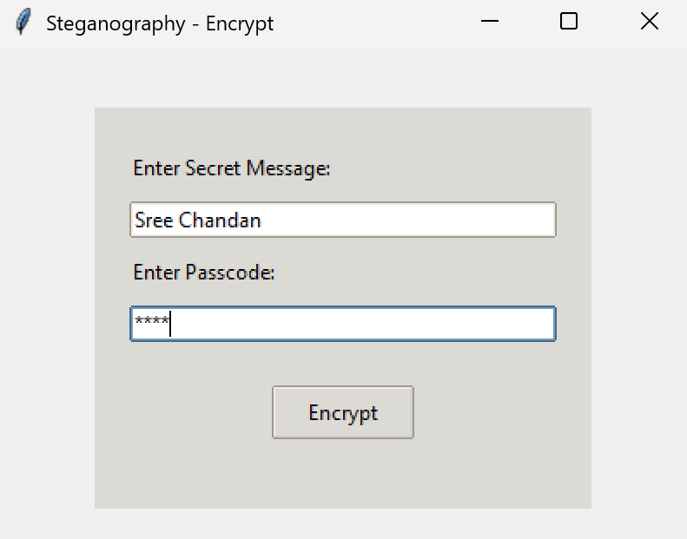
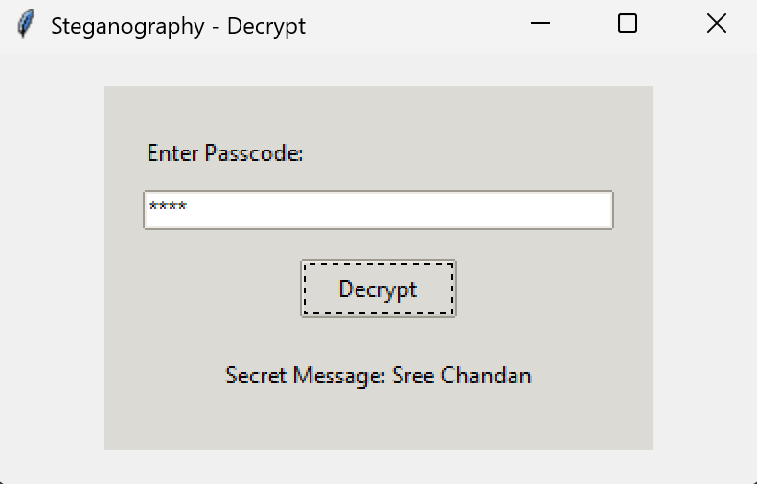
RESULTS
Encryption GUI: User inputs a secret message & passcode
Decryption GUI: Retrieves hidden message using passcode

Slide 8

RESULTS
Comparison: Original vs. Encrypted image
Encrypted image
Original image

Slide 9
CONCLUSION
This project demonstrates the effectiveness of LSB-based steganography for securely embedding secret messages in images. It provides an efficient, user-friendly, and undetectable method of information hiding, making it valuable for secure communications.

Slide 10
GITHUB LINK
https://github.com/SreeChandan2022/Secure-Image-Based-Data-Hiding-Using-Steganography

Slide 11
FUTURE SCOPE(OPTIONAL)
Implementing audio & video steganography
Enhancing encryption mechanisms to strengthen security
Supporting multiple image formats beyond PNG/JPG
Developing a mobile-based application

Slide 12
THANK YOU

