Slide 1

StudyBuddy
BECOME JOB READY
TEAM : The_Loosers
ABHISHEK KUMAR
K SHREE CHARAN (Leader)
SHIVANI SATAPTHY
SUSHIL KUMAR VERMA

Slide 2

The gap between education and employment
Embarking on a successful career journey involves navigating numerous challenges related to time and resources. The vast array of information, combined with the lack of personalized learning paths, can be overwhelming, while the complexities of interview preparation add to the difficulty. Job seekers often face the tedious task of finding relevant opportunities, hackathons, and lectures, compounded by fragmented resources and insufficient guidance. Additionally, the process of building an effective resume that meets modern Applicant Tracking System (ATS) standards presents a significant hurdle, often causing qualified candidates to be overlooked. To address these issues, there is a pressing need for an integrated platform that offers comprehensive solutions, streamlining learning, interview preparation, job discovery, and resume optimization.

Slide 3





KEY FEATURES
PERSONALISED LEARNING ROADMAPS
Achieve end goal as per your time duration and level preferences
STUDENT DASHBOARD
Unified dashboard from all platforms
INTERACTIVE INTERVIEW PREPARATION
One stop solution for interview preparation and analysis
RESUME BUILDER AND ATS DETECTOR
Automated resume building and ATS detection as per job preference
JOBS/ HACKATHONS/ EXAMS OF INTEREST
Filter resources from all over the internet as per your liking

Slide 4




COMPONENTS
KNOWLEDGE BUILDER
PROFILE BUILDER
JOB-HACK HUB

Slide 5
KNOWLEDGE BUILDER
Clean table format
Daily timetable
Resources
Question sheets
Recommendations
No need to look anywhere else for general doubts.
One stop AI powered mate for all your educational doubts
Run and debug
Ask for code of any problem through mic/ input text
Code translation
Generate questions from topic / video link / pdf chosen
Answer through mic and webcam
Individual question rating and overall rating
PERSONALISED ROADMAP
AI BOT
AI-POWERED CODING ASSISTANCE
MOCK INTERVIEW

Slide 6
PROFILE BUILDER
STUDENT DASHBOARD
RESUME BUILDER
MAIL/COVER LETTER
Automated resume building
Free of cost
AI based prompt
Unified dashboard for all your coding profiles
Contest , ratings, questions, projects
LINKEDIN PROFILE
ATS DETECTOR
Analysis of resume as per job description provided
Free of cost profile building and analysis
Enhancement and recommendation

Slide 7
JOB-HACK HUB
HACKATHONS
JOBS
EXAMS / SEMINARS
Hackathons from all sources
Filter as per your preference
Automated to fill user details.
One stop page for jobs all over the net.
Filter according to your requirement
Automated
Automated to fill exam forms.
Just one click review and submit

Slide 8
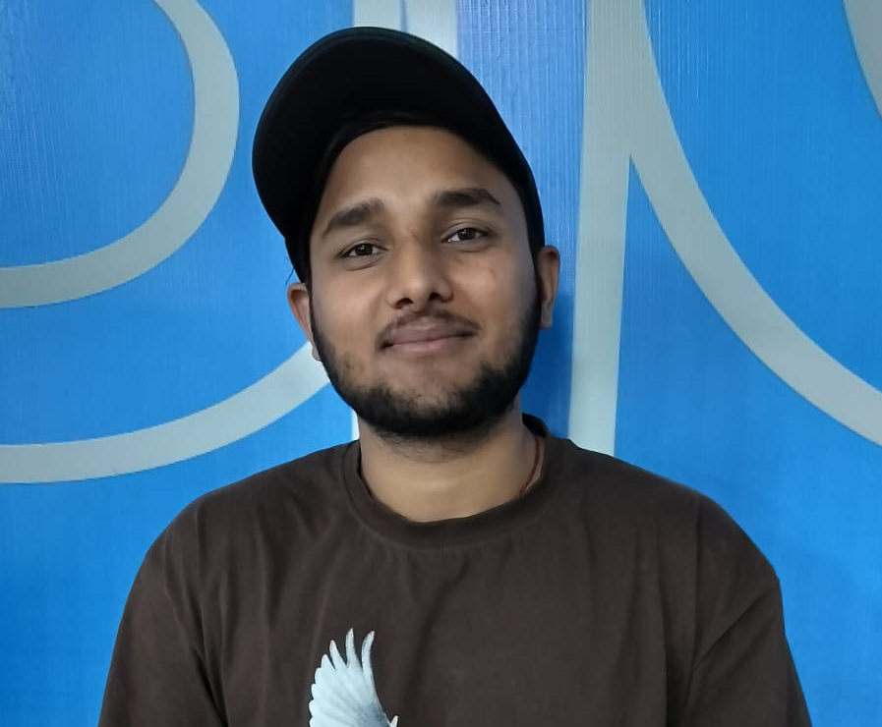
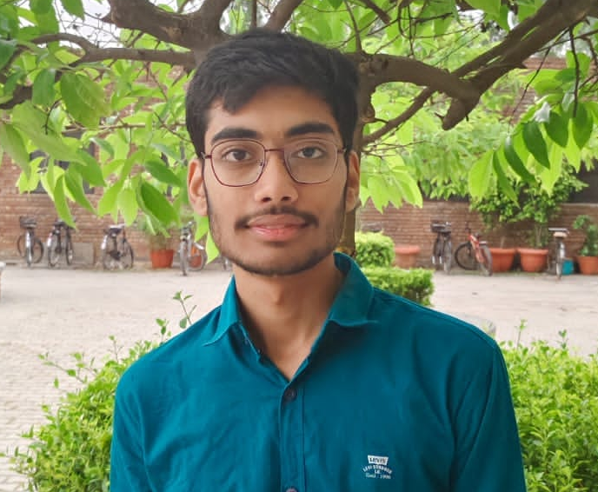

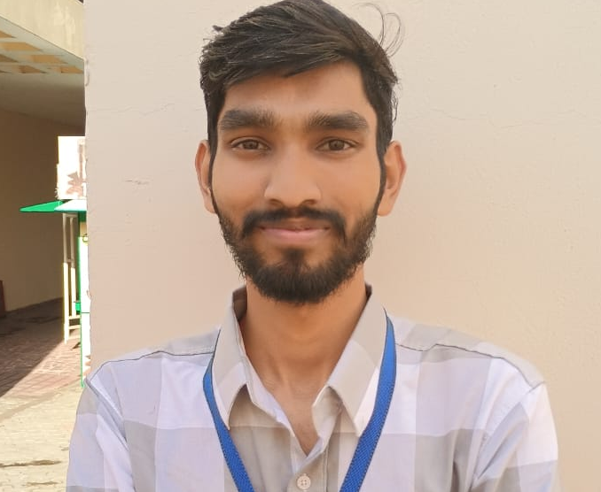
Meet our team
Abhishek Kumar
K Shree Charan
Shivani Satapathy
Sushil Kr. Verma
President
Chief Executive Officer
Chief Operations Officer
VP Marketing

Slide 9

THANK YOU

