Slide 1
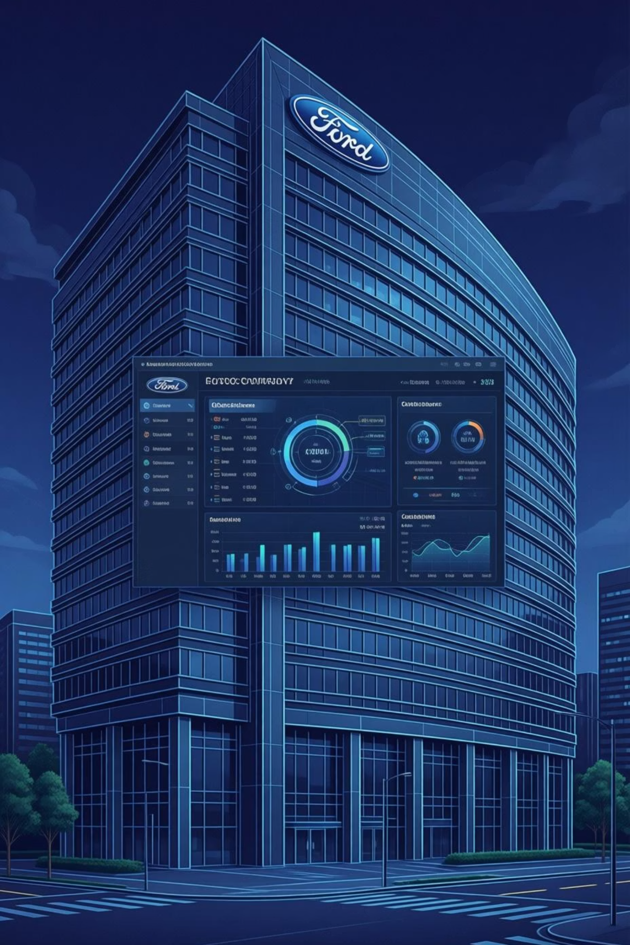
Applications of CRM Techniques at Ford Motor Company
22MIA1142 – SUJANA S
22MIA1159 – DAPHNI MICHELLE B
22MIA1167 – SREE DARSHNE J
22MIA1181 – HARIPRIYA T N

Slide 2
Introduction to Ford
Ford Motor Company is a global automobile and mobility solutions company focused on delivering innovative, sustainable, and customer-centric transportation. The company aims to enhance customer satisfaction, strengthen brand loyalty, and drive long-term business growth through advanced technology and digital transformation.
Ford uses Customer Relationship Management (CRM) systems to understand customer needs, personalize interactions, and manage relationships across marketing, sales, and after-sales services. The motivation for using CRM is to improve customer experience, increase retention, and maximize customer lifetime value while supporting Ford’s transition from a traditional automaker to a customer-focused mobility company.

Slide 3


HISTORICAL CONTEXT
Background & History of Ford: A CRM Perspective
Founded in 1903: Henry Ford's vision revolutionized manufacturing and made automobiles accessible to the masses.
Early Accessibility Focus: Initial strategies centered on affordability, creating a broad customer base and a foundational relationship with everyday Americans.
Dealer-Based Relations: Established strong, localized customer relationship systems through an extensive dealer network, emphasizing personal interaction.
Global Expansion: Expanded worldwide with adaptable, localized customer engagement strategies to meet diverse market needs.
Digital Transformation: Evolved from a traditional manufacturer to a digitally connected, customer-centric enterprise, embracing new technologies.
Modern Ownership Emphasis: Today's Ford prioritizes the entire long-term ownership experience and service relationships, moving beyond just vehicle sales.

Slide 4
CRM Evolution: Milestones & Recognitions
Early Dealer CRM Systems
1
Initial focus on strengthening customer ties through local dealership networks and personalized sales efforts.
2
Enterprise-wide CRM Integration
Transition to integrated platforms to unify customer data and streamline interactions across all touchpoints.
Launch of FordPass Ecosystem
3
Introduced a digital platform for connectivity, rewards, and vehicle management, enhancing the digital ownership experience.
4
Marketing Automation & Personalization
Utilized CRM data for highly targeted marketing campaigns and personalized communications to individual customers.
Industry Recognition
5
Received accolades for excellence in customer satisfaction and innovative digital strategies in the automotive sector.
6
Continuous CX Investment
Ongoing dedication to developing advanced connected customer experience technologies and future-proofing relationships.

Slide 5
CORE PRACTICES
Modern CRM Practices at Ford
1
2
3
Centralized Digital Platforms
Omni-channel Engagement
Automation & Communication
Ford integrates customer data from dealerships, websites, mobile apps, and service centers into unified digital CRM platforms.
Ensures consistent customer experiences across all physical and digital touchpoints, from initial inquiry to post-purchase support.
Automation tools manage marketing campaigns, service reminders, and personalized customer communications, ensuring timely and relevant interactions.
4
5
Connected Vehicle Data
Analytics & AI-Driven Insights
Vehicle data is integrated into CRM to enable proactive service, personalized offers, and enhanced driving experiences.
Leverages advanced analytics and artificial intelligence to predict customer needs, optimize engagement strategies, and improve overall satisfaction.

Slide 6
The Indispensable Role of CRM in Ford’s Business
Enhanced Customer Engagement
Proactive Service & Personalization
Strengthened Brand Loyalty
Cultivates long-term loyalty and emotional connections through consistent positive interactions and personalized offerings.
CRM fosters stronger relationships, leading to increased satisfaction and a more profound connection with the Ford brand.
Enables predictive maintenance alerts and highly personalized service experiences tailored to individual customer needs.
Optimized Retention & Purchases
Data-Driven Decision Making
Drives higher customer retention rates and encourages repeat purchases, maximizing the lifetime value of each customer.
Provides actionable insights from customer data, empowering strategic decisions across all business functions.

Slide 7





Key CRM Concepts Applied by Ford
Relationship Marketing
Continuous engagement strategies that extend far beyond the initial vehicle sale, building enduring connections.
Customer Lifetime Value (CLV)
Utilizing CRM for segmentation and targeted offers to maximize the total revenue a customer generates over their relationship with Ford.
Customer Equity
Shifting focus from single transactions to the aggregate value of customer relationships, viewed as a significant asset for Ford.
Customer Loyalty
Fostering devotion through personalized experiences, exclusive loyalty programs, and vibrant ownership communities.
Customer Retention
Implementing robust service programs and engaging digital platforms to ensure long-term customer relationships and repeat business.

Slide 8






Management Practices Supporting CRM at Ford
Customer-Centric Leadership
Ford's leadership instills a culture where customer needs are at the forefront of every decision and strategy.
Cross-Functional Alignment
Seamless coordination across sales, service, IT, and marketing ensures a unified approach to the customer journey.
Centralized Data Governance
Robust management of customer data ensures accuracy, privacy, and accessibility across the enterprise for personalized interactions.
Continuous Feedback Loops
Programs for gathering and acting on customer feedback drive continuous improvement in products and services.
CRM-Driven Strategy
Analytics from CRM inform product design, service offerings, and overall strategic direction, ensuring market relevance.
Dealer Network Integration
The extensive dealer network is fully aligned with CRM objectives, acting as a crucial touchpoint for customer engagement.

Slide 9
Business Operations & CRM Integration
Lead Management & Journey Tracking
Personalized Marketing Campaigns
Comprehensive Service Management
CRM systems meticulously track leads from initial interest through purchase and beyond, ensuring no customer falls through the cracks.
Utilizing CRM analytics, Ford crafts highly targeted marketing campaigns that resonate with individual customer preferences and behaviors.
Service CRM handles everything from routine maintenance scheduling and warranty management to recall notifications and customer feedback.
Seamless Online & Dealership Experience
Proactive Engagement Workflows
CRM integrates digital platforms with physical dealerships, creating a cohesive and convenient customer experience regardless of the touchpoint.
Automated workflows enable proactive service notifications and timely customer engagement, anticipating needs before they arise.

Slide 10


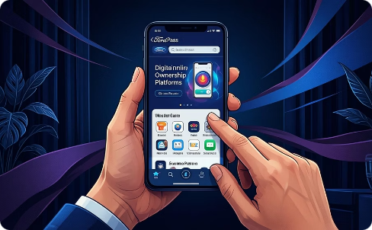


Products & Services Supported by CRM
Diverse Vehicle Lineup
Commercial & Fleet Solutions
Digital Ownership Platforms
After-Sales Service & Connected Services
From passenger vehicles and robust SUVs to powerful trucks and innovative electric vehicles, CRM supports every sale.
Tailored CRM strategies for business clients, managing large-scale fleet operations and specialized commercial needs.
Mobile apps and online portals provide seamless access to vehicle data, services, and exclusive content, enhancing the ownership experience.
CRM ensures efficient after-sales support, maintenance reminders, and personalized connected services for optimal vehicle performance.
Financial & Loyalty Initiatives
Integrated financing, insurance products, and exclusive loyalty programs are managed through CRM to retain and reward customers.

Slide 11
Conclusion: The Profound Impact of CRM at Ford
CRM is more than just a system at Ford; it's the strategic foundation underpinning every customer interaction and the cornerstone of our future growth.
Strategic Foundation: CRM is deeply embedded in Ford’s operations, guiding customer-centric decisions from product development to service delivery.
Strengthened Relationships: It significantly enhances customer retention, cultivates fierce loyalty, and drives unparalleled satisfaction levels.
Personalization & Proactive Engagement: CRM enables highly personalized experiences and proactive interactions, anticipating and fulfilling customer needs.
Increased Lifetime Value: By fostering deeper connections, CRM maximizes customer lifetime value and transforms customers into brand advocates.
Customer-Centric Leadership: This approach firmly positions Ford as a leader in the automotive industry, known for its dedication to customer excellence.
Sustainable Growth: Ultimately, CRM supports sustainable growth and builds enduring customer equity, securing Ford’s success in a dynamic market.

Slide 12
Daphni Michelle B (22MIA1159): Handled company background research and CRM evolution at Ford.
Sree Darshne J (22MIA1167): Designed slides, summarized findings, and refined the presentation.
Haripriya T N (22MIA1181):Analyzed CRM technologies, analytics, and business integration.
Sujana S (22MIA1142): Contributed to CRM concepts, objectives, and overall content organization.

Slide 13
THANK YOU !

