Slide 1
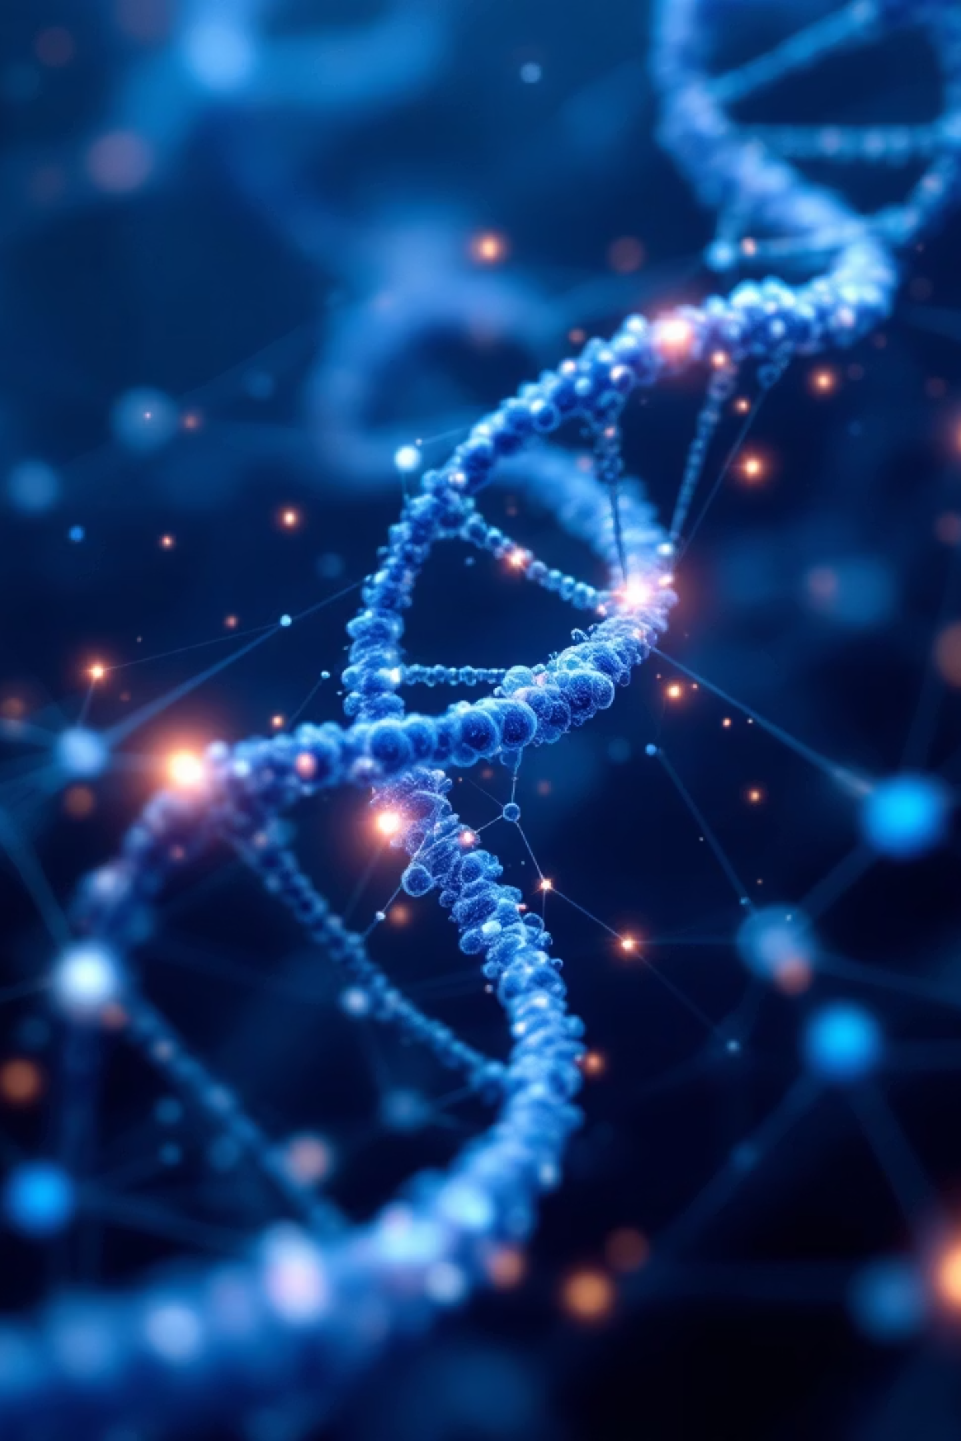
Graph-Driven Multi-Omics Network Modeling for Sickle Cell Disease Biomarker Discovery
Integrating transcriptomics and proteomics data through graph theory and explainable AI to uncover disease mechanisms and therapeutic targets

Slide 2
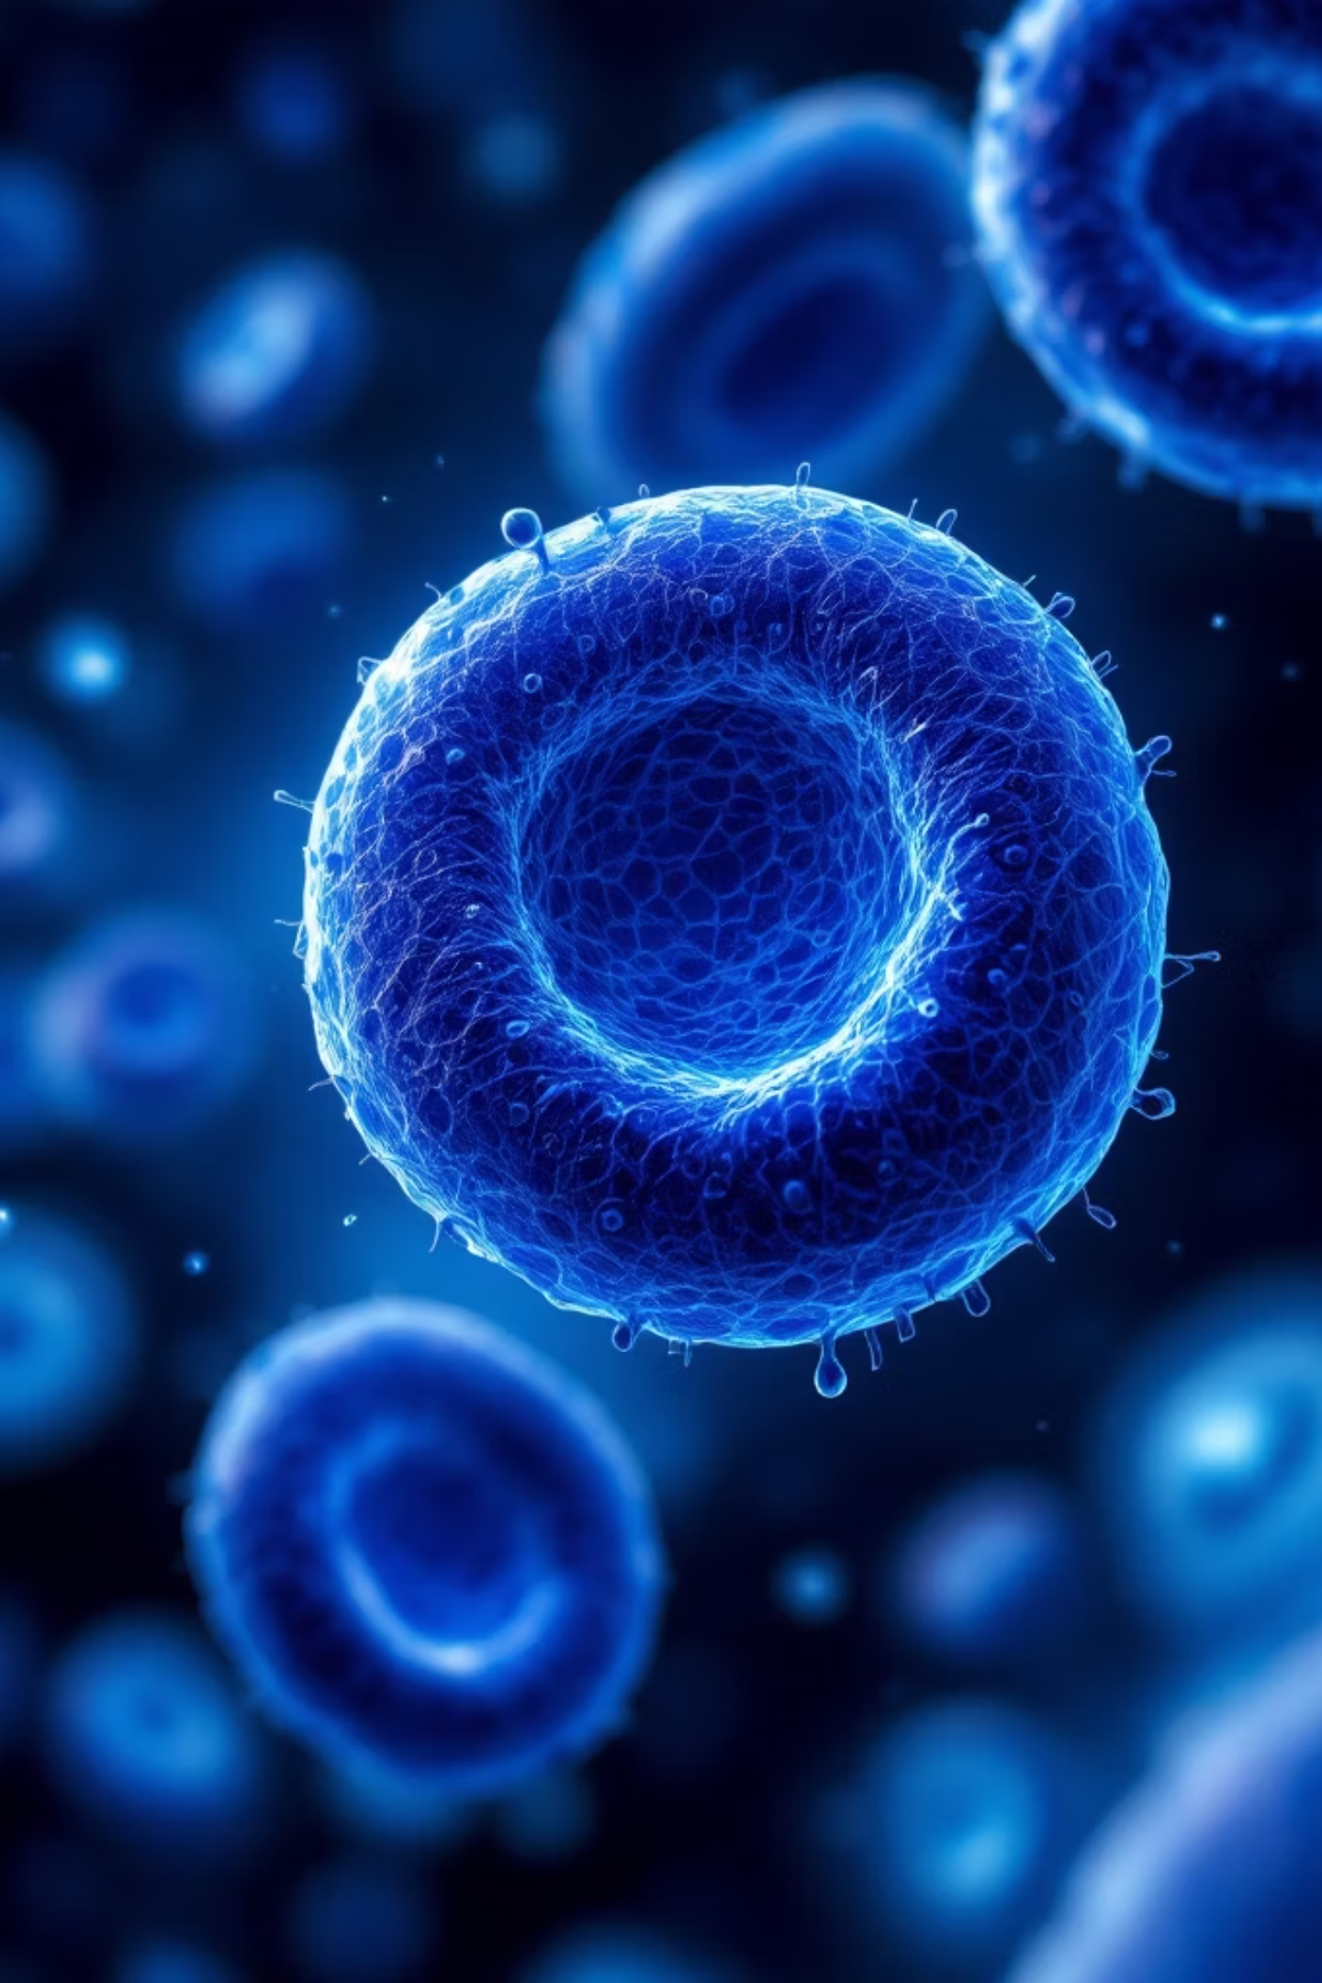
The Challenge: SCD's Molecular Complexity
Disease Characteristics
Computational Gap
Sickle Cell Disease is a hereditary blood disorder caused by mutations in the β-globin gene, leading to abnormal hemoglobin formation and chronic complications including hemolytic anemia, vaso-occlusive pain crises, and progressive organ damage.
High-throughput technologies generate massive transcriptomic and proteomic datasets, but traditional statistical approaches fail to capture the intricate interdependencies between molecular players driving disease progression.

Slide 3



Why Graph Theory?
Network Representation
Multi-Layer Integration
Hub Identification
Genes and proteins become nodes, interactions become edges—transforming complex biology into analyzable topology
Transcriptomics and proteomics data merge into unified heterogeneous networks revealing cross-omic relationships
Centrality metrics pinpoint regulatory genes and proteins orchestrating disease pathways
Graph analysis reveals disease-associated pathways, hub genes, and regulatory modules undetectable with conventional statistical approaches.

Slide 4

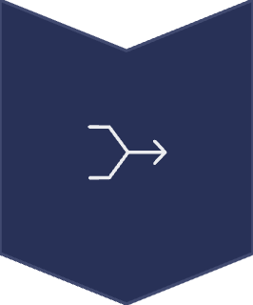


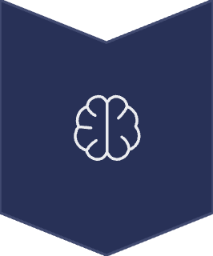
Methodological Framework
Data Acquisition
GEO transcriptomics and PRIDE proteomics datasets
Integration
Unified multi-omics matrix construction
Network Building
Heterogeneous graph from correlations and interactions
Analysis
Centrality and community detection
ML Prediction
Graph neural networks for biomarkers

Slide 5
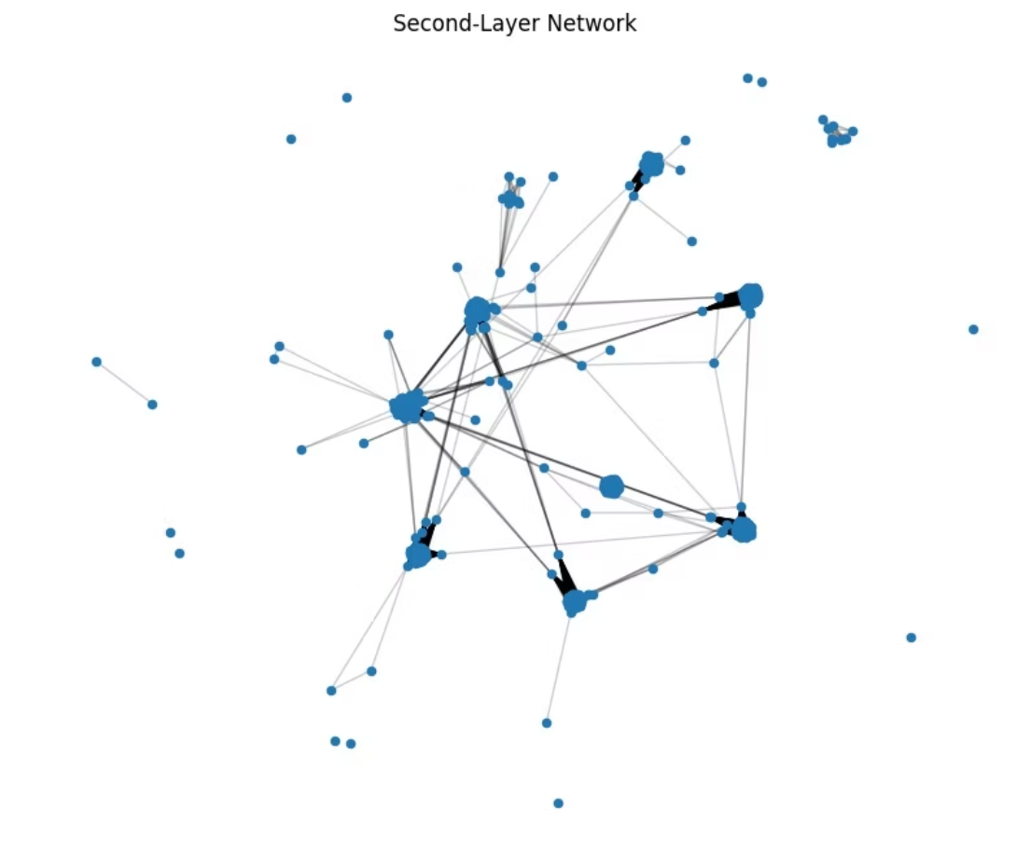
Data Integration Pipeline
Preprocessing Steps
Normalization, log transformation, and batch effect correction
Differential expression analysis for genes and proteins
Mapping proteins to genes via UniProt and Ensembl databases
Statistical matrix combination with dimensionality reduction
Dimensionality Reduction
Principal Component Analysis (PCA) and Autoencoders compress high-dimensional data while preserving biological signal, enabling efficient downstream analysis.

Slide 6




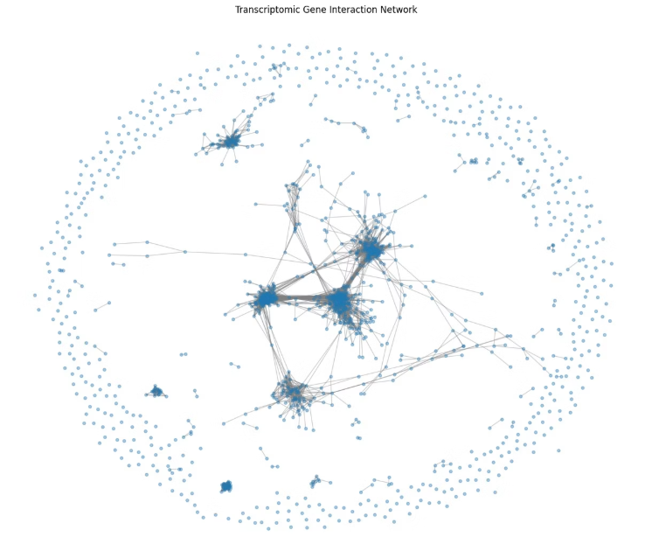
Graph Construction Strategy
Node Definition
Genes and proteins represented as graph vertices with expression attributes
Edge Formation
Co-expression correlations and curated protein-protein interactions establish connections
Multi-Layer Networks
Heterogeneous graph structure captures transcript-protein relationships
Annotation
Database-driven functional metadata enrichs node and edge properties
5

Slide 7
Network Analytics and Machine Learning
Topological Analysis
Graph Neural Networks
01
Outcome: Key disease-associated genes and proteins identified through supervised learning on labeled pathway data.
Degree Centrality
Identify highly connected hub nodes
02
Betweenness Centrality
Find bottleneck proteins in pathways
03
PageRank Algorithm
Detect influential regulatory genes
04
Community Detection
Cluster disease modules and pathways
GCN Architecture
GAT Implementation
Graph Convolutional Networks aggregate neighborhood information for node classification
Graph Attention Networks learn edge importance for link prediction

Slide 8
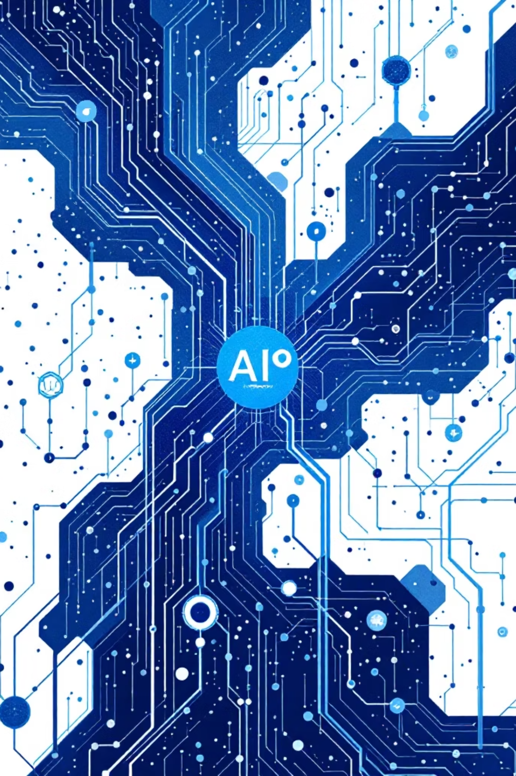
Explainable AI for Biological Interpretation
SHAP Values
GNNExplainer
SHapley Additive exPlanations quantify feature importance for model predictions, assigning attribution scores to genes and proteins
Subgraph visualization reveals critical pathways and interaction patterns driving neural network decisions
Biological Validation
Pathway enrichment analysis using KEGG and Gene Ontology databases confirms functional significance
Explainable techniques transform black-box predictions into testable biological hypotheses, enabling experimental validation.

Slide 9
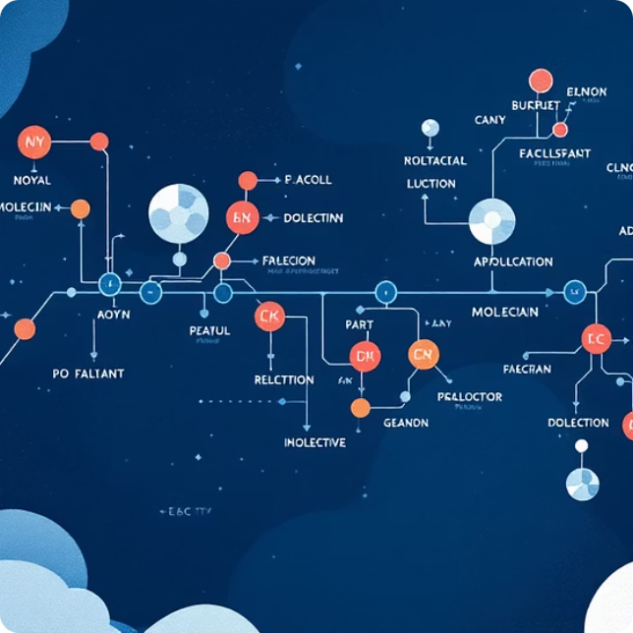
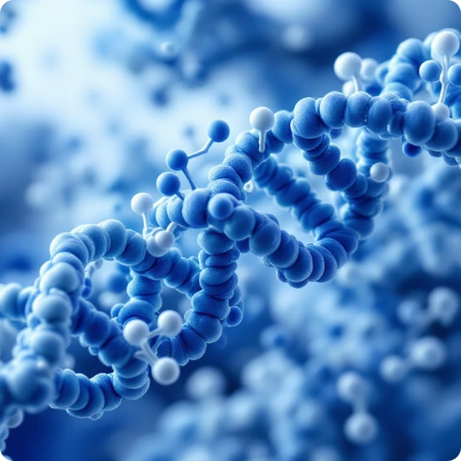

Expected Outcomes and Impact
Disease Modules
Therapeutic Targets
Clinical Biomarkers
Identify co-regulated gene-protein clusters driving SCD progression
Prioritize hub genes for drug development and gene therapy
Validate multi-omics signatures for disease severity prediction
8
2
3+
Integration Steps
Omics Layers
AI Techniques
From raw data to clinical models
Transcriptomics and proteomics unified
GNNs, SHAP, and interpretable ML

Slide 10

Contributions to Precision Medicine
Systems Biology Insights
This framework provides unprecedented systems-level understanding of SCD molecular mechanisms, revealing how transcriptomic dysregulation cascades to proteomic dysfunction through network topology.
Translational Pathway
Identified biomarkers undergo validation using literature mining and external datasets, bridging computational predictions to experimental verification and eventual clinical implementation.
Computational Innovation
Clinical Relevance
First application of explainable GNNs to SCD multi-omics data
Machine learning models predict disease severity using accuracy, ROC-AUC, and precision-recall metrics
Next Steps: Collaborate with wet-lab researchers to validate predicted biomarkers through functional assays and patient cohort studies.

