Slide 1
Exploring San Francisco Neighborhoods
by
Sree Lakshmi Gudreddi

Slide 2
Business Problem
Which neighborhood should I choose to live in
San Francisco?
How to choose?
Based on the life style i.e activities and interests.
Target Audience
Families with Children and Dog
Young and Urban Professionals
Artists

Slide 3
Data Description
Data Needed
San Francisco Neighborhood Data
Borough Name
Neighborhood Name
Latitude
Longitude
Information about Venues
Venue Name
Category Name
Latitude
Longitude

Slide 4
Data Sources
Wikipedia Page
https://en.wikipedia.org/wikiList_of_neighborhoods_in_San_Francisco
Foursquare API
Data Obtained
5 Boroughs
60 Neighborhoods
246 Venue Categories
1155 Venues

Slide 5
Data Set
Families with Children and Dog
'Park', 'Garden', 'Trail', 'Library', 'Dance Studio', 'Music School’,'Skating Rink', 'Athletics & Sports', 'Soccer Field', 'Mini Golf','Bookstore','Church', 'Veterinarian','Pet Store','Shopping Mall’,’Supermarket’
Young and Urban Professionals
Light Rail Station', 'Bus Stop', 'Gym / Fitness Center', 'Gym', 'Pilates Studio', 'Yoga Studio', 'ATM' ,'Flower Shop', 'Boutique', 'Electronics Store' ,'Paper / Office Supplies Store', 'Comic Shop', 'Beer Bar', 'Cocktail Bar','Karaoke Bar' ,'Jazz Club', ‘Nightclub'
Artists
History Museum', 'Art Museum', 'Art Gallery', 'Public Art', 'Sculpture Garden', 'Antique Shop' , 'Monument / Landmark', 'Outdoor Sculpture','Historic Site','Harbor / Marina', 'Beach', 'Mountain', 'Hobby Shop' ,'Arts & Crafts Store'

Slide 6
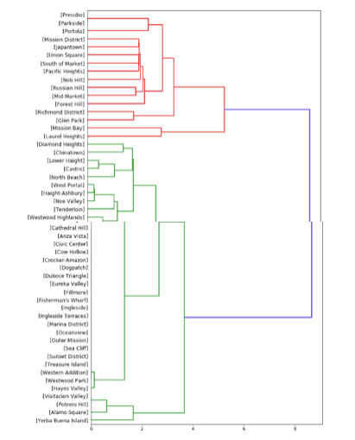
Data Analysis
Hierarchical Clustering: Families with Children and Dog
Clustered based on proximity to Venues
Leafs denote the neighborhoods
Branches denote the distance to venues
Divided into 4 clusters

Slide 7
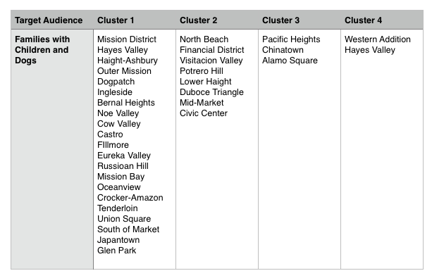
Results

Slide 8
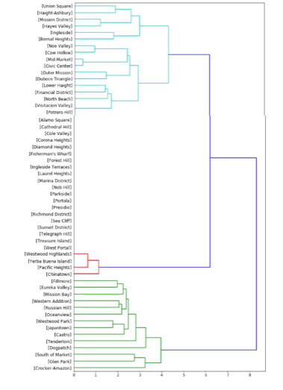
Hierarchical Clustering: Young and Urban Professionals
Clustered based on proximity to Venues
Leafs denote the neighborhoods
Branches denote the distance to venues
Divided into 3 clusters

Slide 9
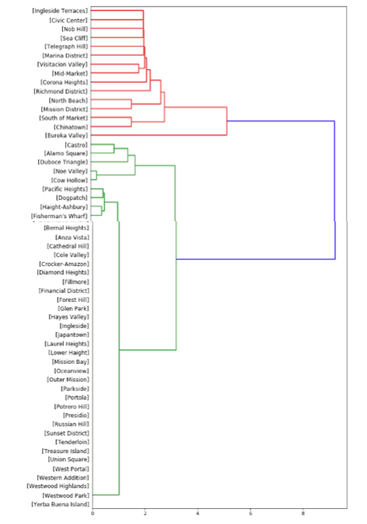
Hierarchical Clustering: Artists
Clustered based on proximity to Venues
Leafs denote the neighborhoods
Branches denote the distance to the venues
Divided into 3 clusters with one outlier

Slide 10
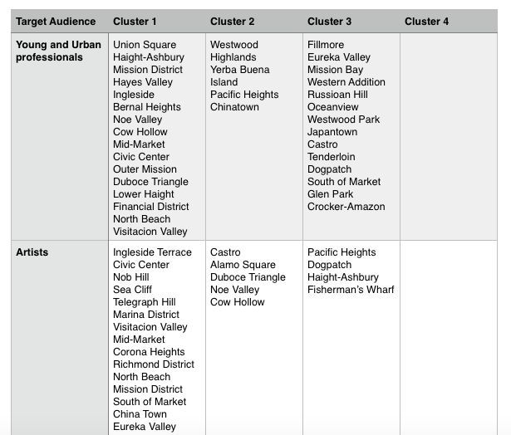
Results

Slide 11
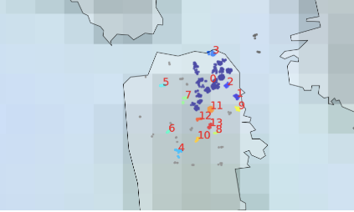
DBSCAN Clustering: Venue Location
Clusters are formed based on density of Venues located with in a set radius
Divided into 14 clusters with 1 outliner

Slide 12
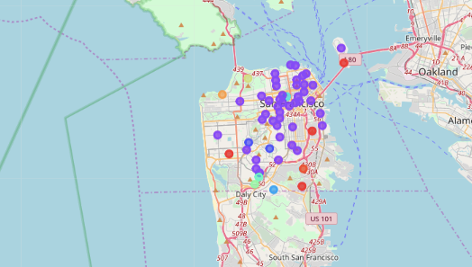
K-Means Clustering: Venue Categories
Number of clusters k = 10

Slide 13
K-Means Cluster Information
Cluster ID | Neighborhood | Categories
0 | 4 | Island/Park
1 | 43 | Coffee shop/Restaurant
2 | 2 | Trail
3 | 1 | Light Trail Station
4 | 1 | Cupcake Shop
5 | 1 | Playground
6 | 1 | Park
7 | 1 | Stables
8 | 1 | Beach
9 | 1 | Bus Station
Number of clusters k=10

Slide 14
Observations
Geocodes obtained for few neighborhoods were incorrect
Clusters are not of the same size which shows that the venues are concentrated in few neighborhoods
Same can be shown when finding k using the elbow method
Neighborhoods are grouped into one large closet and other small clusters.
Clustering helps target audience to identify the
neighborhoods with closer proximity to their interested
venues.

Slide 15
Conclusion
Neighborhoods are identified based on the following:
Venue Proximity
Focused on each group of target audience
Used Hierarchical clustering method
Venue Density
Based on venue’s geo spacial location
Used DBSCAN clustering method
Venue Category
Based on the type of venue categories
Used K-Means clustering method

