Slide 1
Predicting the Outcome of The service request based on the Agency and Method received
Sree Harsha Balusu
DATA 606
Summer 2022
Under the guidance of Dr. Chaojie Wang

Slide 2

All about 3-1-1
Well, Its like 9-1-1, but for non-emergencies.
It is how we can report issues within a city such as tree down, potholes on road, trash problems, also some cities rely on communities to help homeless that might need assistance.
311 is how citizens in a community can help bring awareness in non-emergency issues and make sure authorities are aware that they exist.
The open format allows municipalities to store and provide access to 311 data in a way that uses the same vocabulary, allowing it to be easily shared between providers, and aggregated across many location.

Slide 3
Objective
The main objective of this project is to predict the outcome of the service request received based on the agency type and the method it was received.
The Dataset is obtained from Open Baltimore. This website consists of all the open data related to the city of Baltimore, MD.
3-1-1 connects Baltimore citizens, businesses & visitors with a vast array of city services, programs, and information.
Customers can request a service either by a live-agent phone call or through the self-service web or mobile portal.

Slide 4
The key attributes of the dataset are:
SrType: Type of Service Requested
Methodreceived: How the service is received either by API, Phone or Internal.
SrStatus: Present Status of the Service
Agency: Agency to which the service belongs
Outcome: Outcome of the service

Slide 5
Data Cleaning
Some unwanted columns such as longitude, latitude are dropped as they have nothing to do with modelling and all.
Also, the rows which contains Null values are removed as they do not make any difference in further steps such as EDA and Model Building.
The column “Policepost” contains most of its values as Null values and so the column is dropped.
Later Exploratory Data Analysis is performed on the final data followed by Model building and Model Evaluation.

Slide 6
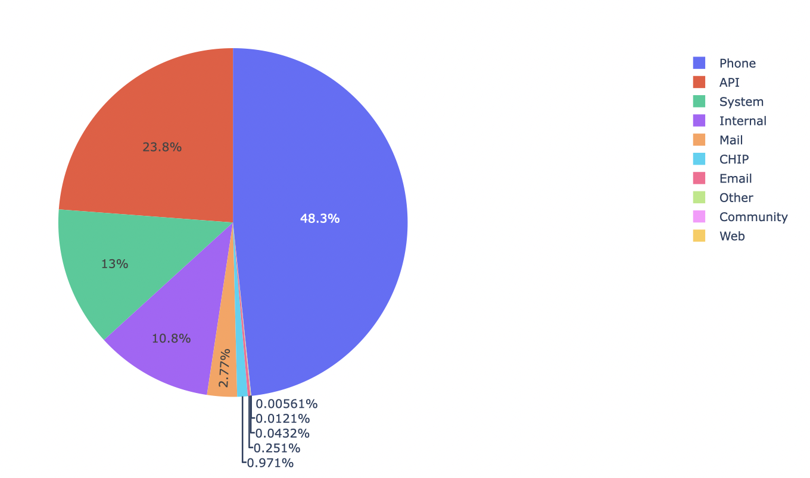
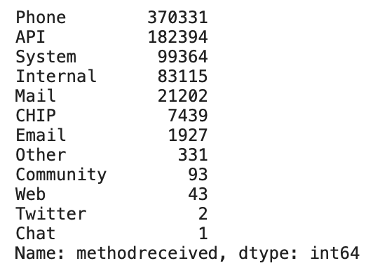
Method Received
We can see from the pie chart which is plotted for method received shows that most of the service requests are received by Phone followed by API, System and Internal when compared to the others.

Slide 7
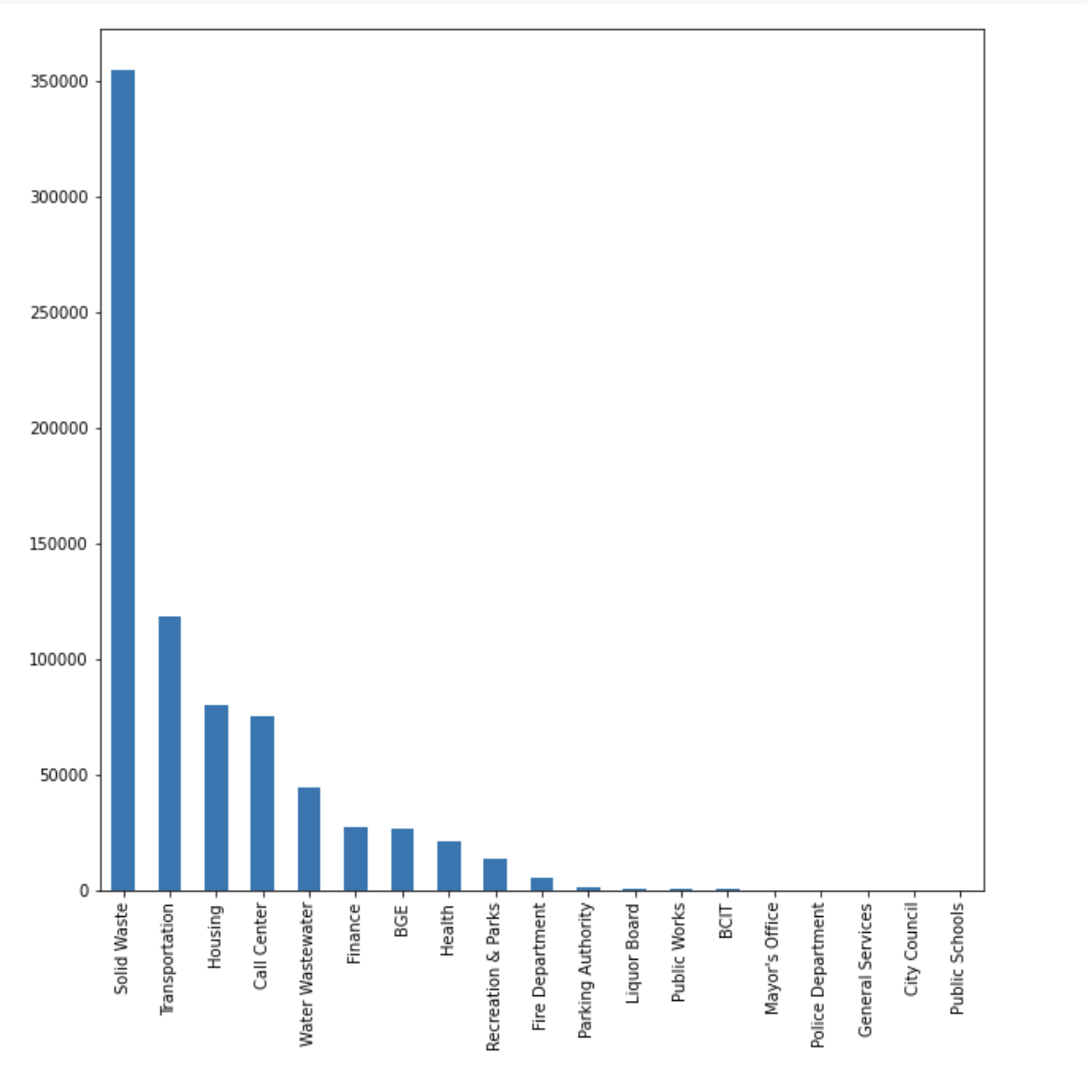
Agency types
Out of the 19 kinds of agencies present, only 10 of the agencies have a meaningfull value of requests when compared to the rest of the other agencies.

Slide 8
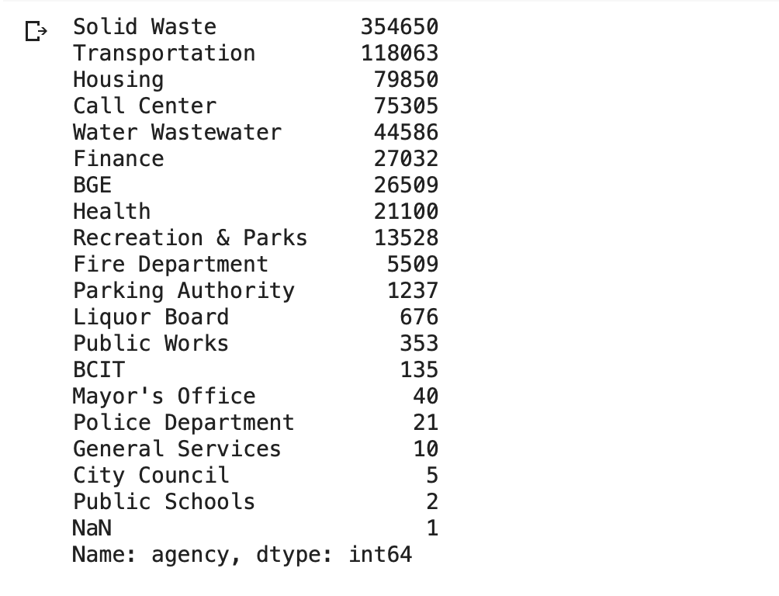
Agency Types
We can see some agencies such as Liquor Board, Public work, BCIT, Mayor’s Office, Police department, General Services, City Council, Public Schools have almost negligible values when compared to other agencies
So, we can get better modelling results if we drop the agencies with less values.

Slide 9
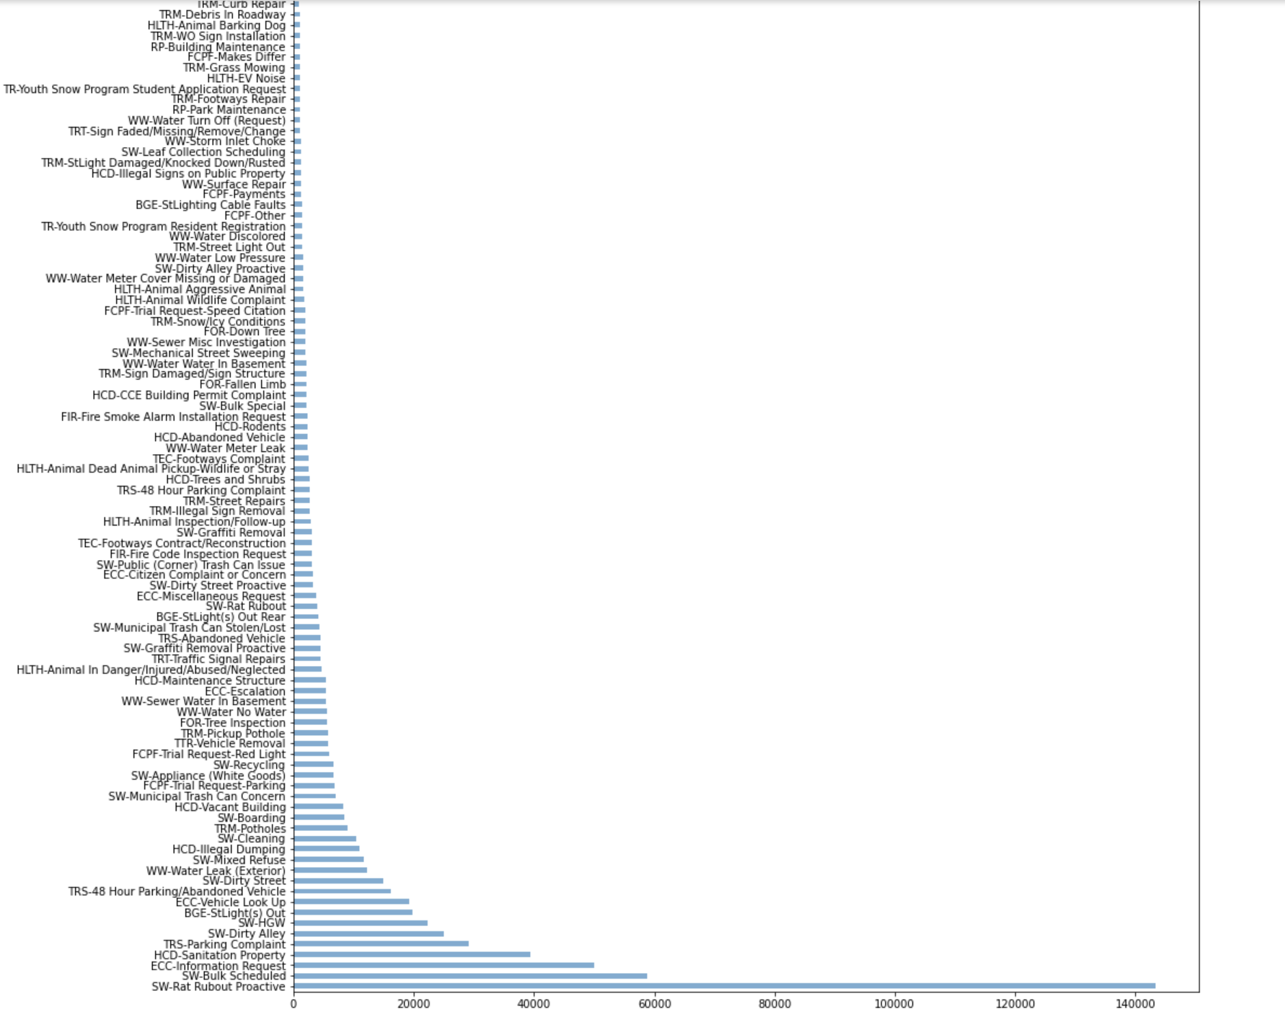
Service Type (Srtype)
There are 306 kinds of service types out of which only some have a reasonable value.

Slide 10
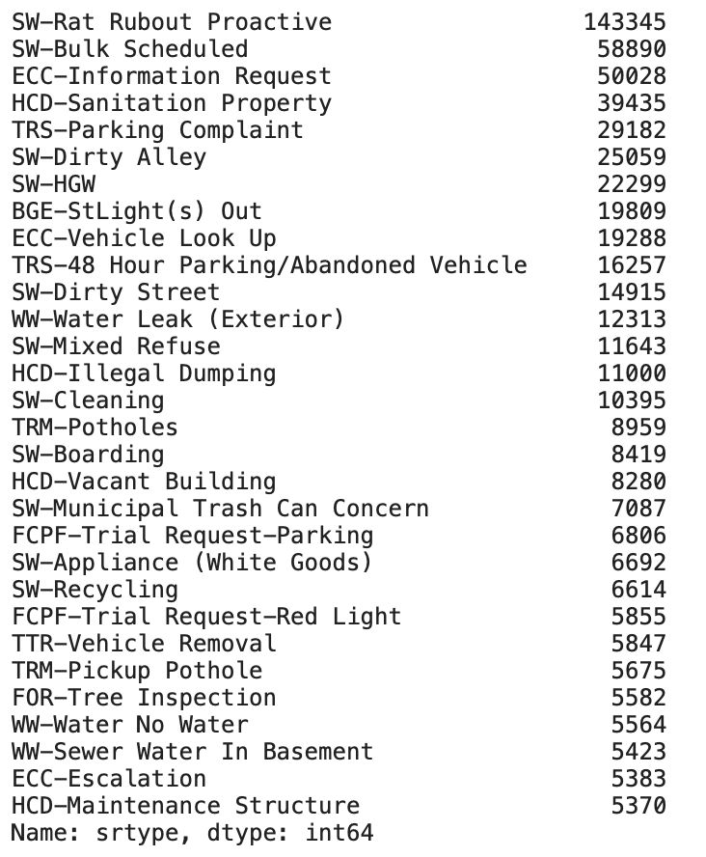
Various Service Requests
These are the value counts of Service requests with significant value among the other 306 kinds of service requests.

Slide 11
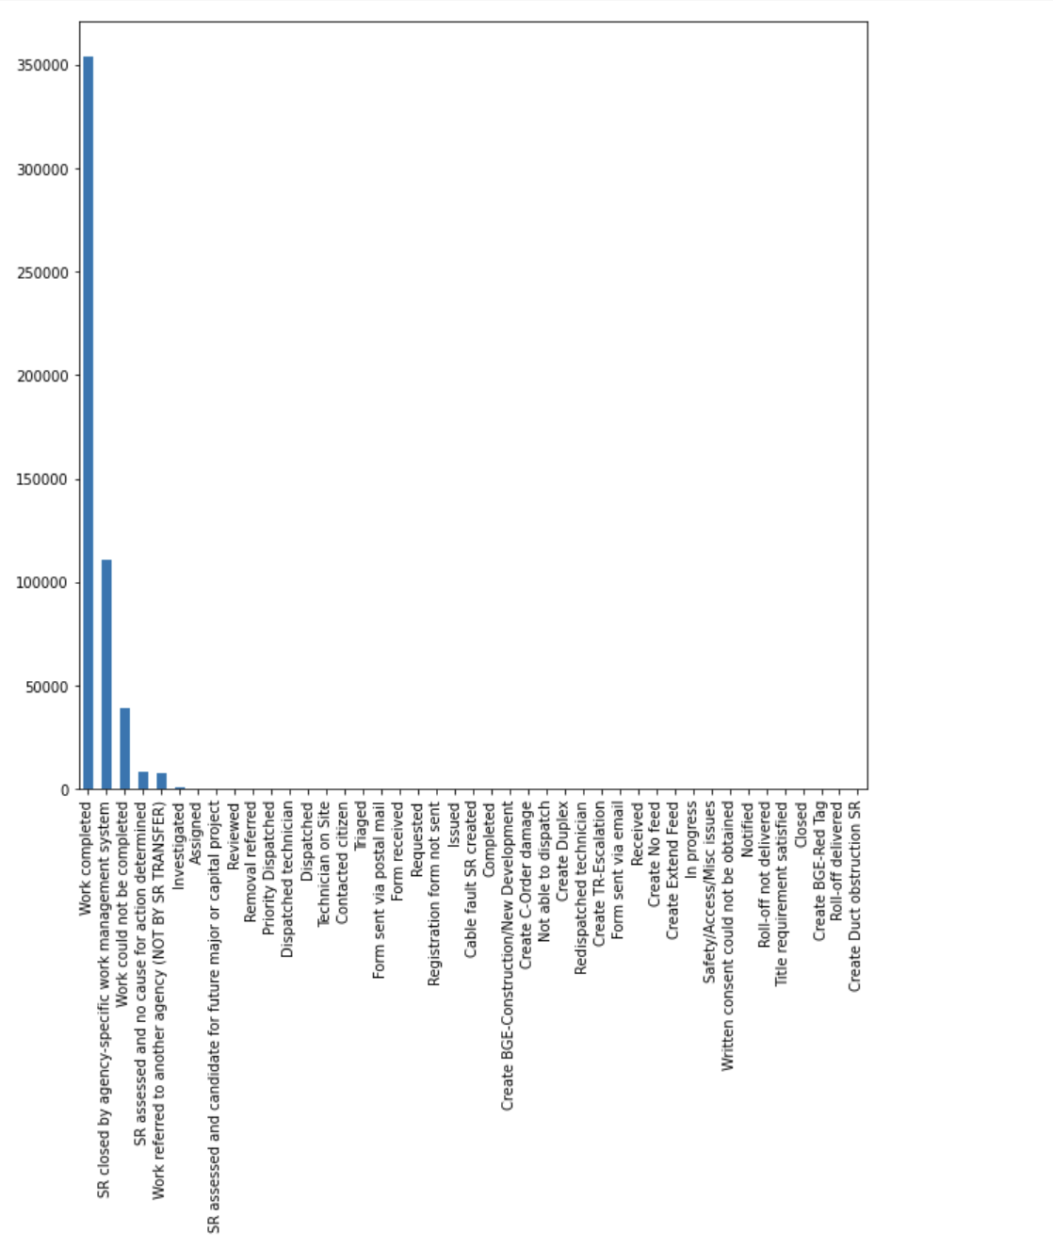
Various Outcomes
The major outcome of the service request are:
Work Completed
Sr closed by agency specific work management request
Work could not be completed
SR assessed and no cause for action determined
Work referred to another agency.

Slide 12
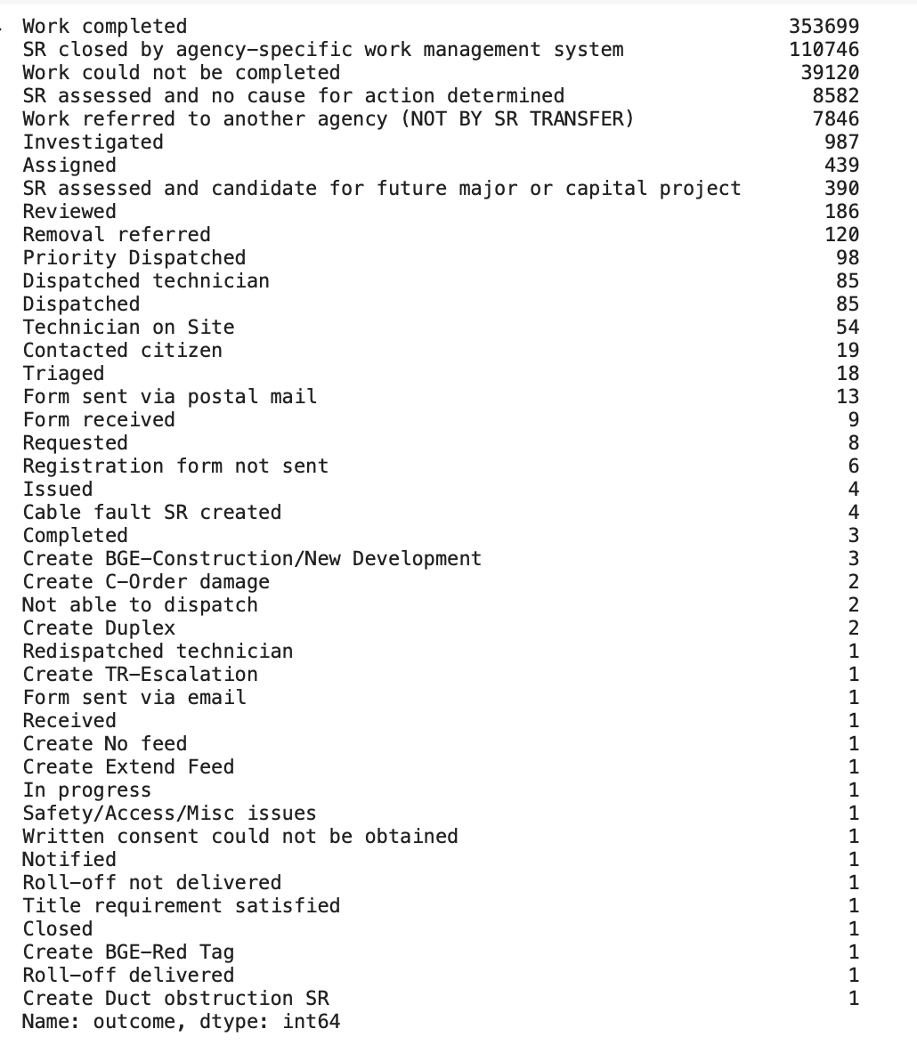
Value counts of Outcomes
Only the outcomes with highest values are considered for model evaluation as the remaining has negligible values

Slide 13
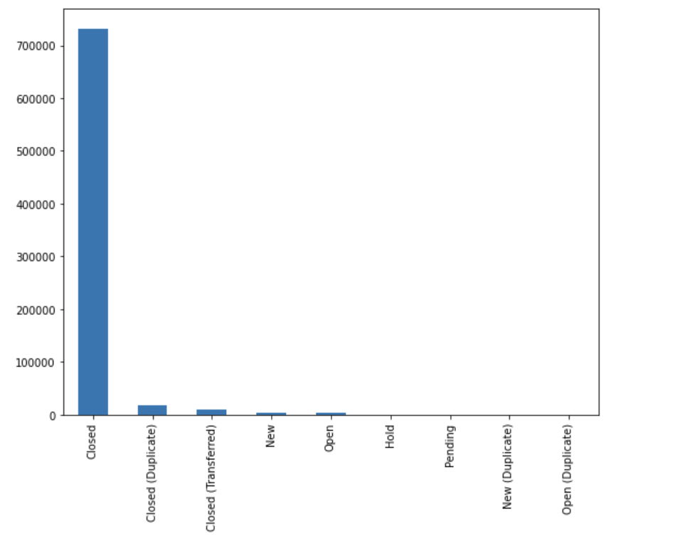
Service Status (SrStatus)
Most of the SrStatus values are “Closed” which means that the service request has been addressed and closed by specific agency.

Slide 14
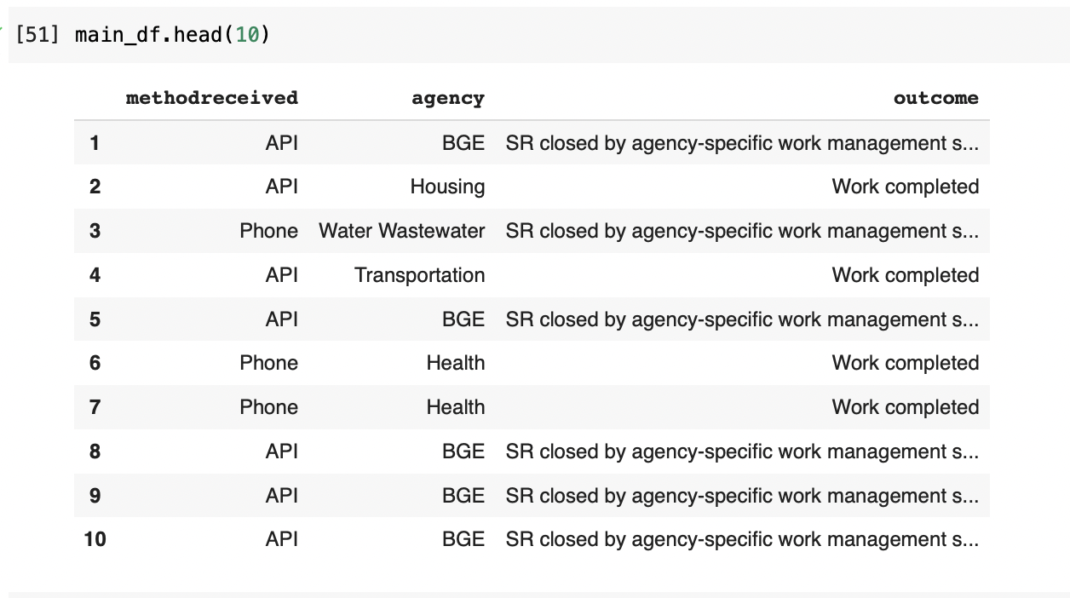
Choosing the attributes for model building

Slide 15
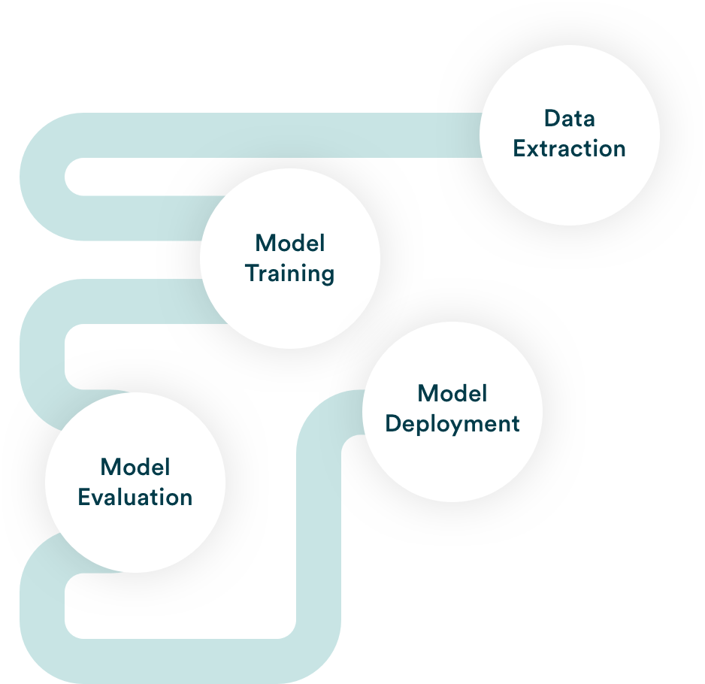
Model Building
Initially Label Encoding is performed to convert the columns outcome, method_received and agency into numeric values.
The data is then split into training and testing sets in the ratio of 67:33, respectively.
A pipeline is built using Pipeline object from sklearn.pipeline.
Machine Learning Pipeline includes raw data input, features, outputs, the machine learning model and model parameters, and prediction outputs.

Slide 16


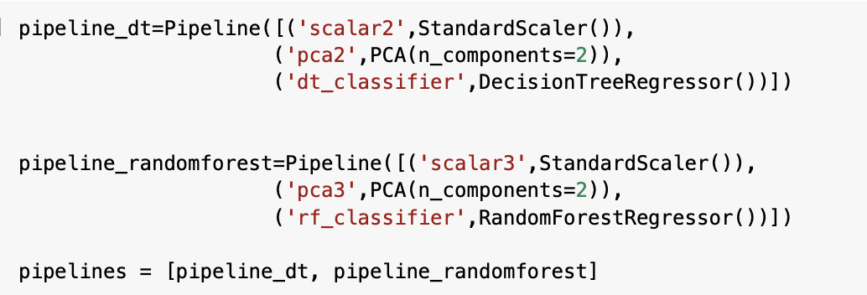
Code Snippets

Slide 17
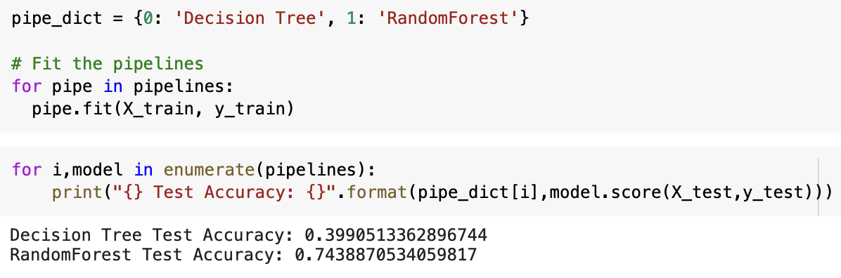
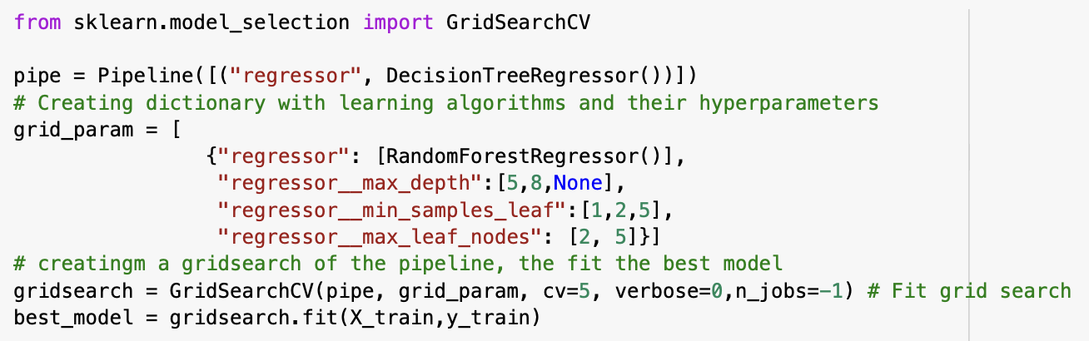

Slide 18
Model Evaluation
Different Regression algorithms like Decision Tree Classifier and Random Forest Classifier are fit in the pipeline as part of model building.
Grid search is performed in order to search for the best parameters using GridSearchCV() from sklearn.model_selection and the results from GridSearchCV() are analyzed.
The Decision tree Regressor accuracy score is 68%.
The accuracy score of Random Forest Regressor is found to be 73%.

Slide 19
THANK YOU

