Slide 1

Hound Vault -(A simple vault website)
Full Stack Training – Project Presentation/ Review - 02
Presented by:
-SREE KRISHNNAA A
ROLL NO :717821E151
DEPT :EEE

Slide 2
Profile
LinkedIn : https://www.linkedin.com/in/sree-krishnnaa-anand-8a029626a
GitHub : https://github.com/SreeKrishnnaa
Yet to develop profile in linkedIn…
Has a github profile with 17 current repositories.

Slide 3
Agenda
Objective
Abstract
Introduction
Required Functionalities
High Level Plan
Project Modules
Module Implementation
Use Case Diagram
Key Challenges
Demo

Slide 4
Objective
Creating a web app that stores materials for students and tutors online can encompass a variety of goals and benefits. Here are some,
Centralized Resource Repository: Provide a centralized platform for students and tutors to store and access educational materials.
Easy Access Anytime, Anywhere: Enable users to access stored materials from any device with an internet connection.
Security and Privacy: Implement robust security measures to protect user data and ensure the privacy of stored materials.
User-Friendly Interface: Design an intuitive and user-friendly interface for easy navigation and use.

Slide 5
Abstract
The proposed web application aims to streamline the organization and storage of educational materials for students and tutors through a user-friendly online platform. The primary focus revolves around user profile creation and efficient storage of individual study materials. Users, comprising students and tutors, will be able to create personalized profiles, allowing them to systematically upload, manage, and retrieve their educational resources in a secure digital environment.

Slide 6
Introduction
E-Learning: The project aligns with the e-learning domain, as it involves the online storage and management of educational materials
Educational Technology (EdTech):The application falls under the category of educational technology, as it leverages digital tools and platforms to enhance the educational experience for both students and tutors.
Resource Management: The core functionality of the web app revolves around the efficient management of educational resources, providing a centralized platform for storing, organizing, and accessing study materials.

Slide 7
Required Functionalities
User Authentication and Authorization: Implement user authentication to allow users (students and tutors) to create accounts and log in.
Material Upload and Storage: Implement a feature for users to upload various types of study materials, such as documents, images, and presentations.
Material Categorization and Organization: Allow users to categorize and organize their study materials into folders or tags for easy retrieval.
Search and Retrieval Functionality: Integrate a search mechanism to help users quickly locate specific study materials using keywords, tags, or categories.
Responsive User Interface (UI):Design a responsive and intuitive UI that adapts to different devices and screen sizes.
Security Measures: Implement robust security measures to protect user data and ensure the confidentiality of stored materials.

Slide 8
High Level Plan
Front end:
This application is built with React ( an open source JS library).
This is used because it allows developers to build reusable UI components and manage the state of an application efficiently.
Frontend framework:
MUI (Material –UI) is used because it would be visually appealing and has some built in react components.

Slide 9
The overall plan of the project is to create a simple, strong user friendly website with a decent and well-designed front end built using React and M-UI as framework.
After the Front end is developed, there are works to be done with Backend and connection of database.

Slide 10
Project Modules
Setting the Home Page, which is the appealing page and the index element of the project.
Following the Home page, other pages like Sign-in ,Signup ,About–us pages are created as separate components.

Slide 11
Alignment and Styling is done to the pages separately and the responsiveness is ensured for all the pages.
Finally, React Router is installed and the Route paths are created to navigate from one page to another. The Home page is set as the index element.
The Main page is created where the users upload and store their files.

Slide 12
Module status:
All the pages are created and the React router was installed and set.
Front end of the project is nearly completed including the main page.

Slide 13
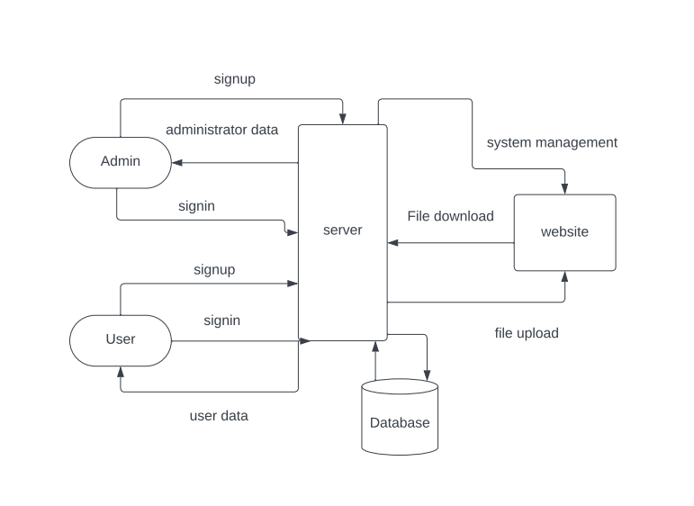
Flow -Diagram:

Slide 14
Key Challenges
Building a well responsive website with key features was the most challenging job which I almost achieved.
The next challenging job was setting router as the components were composed of buttons mostly (completed setting the routes by wrapping buttons inside hyperlinks).

Slide 15
PROJECT
DEMO
Let’s take a look at our web application!

Slide 16
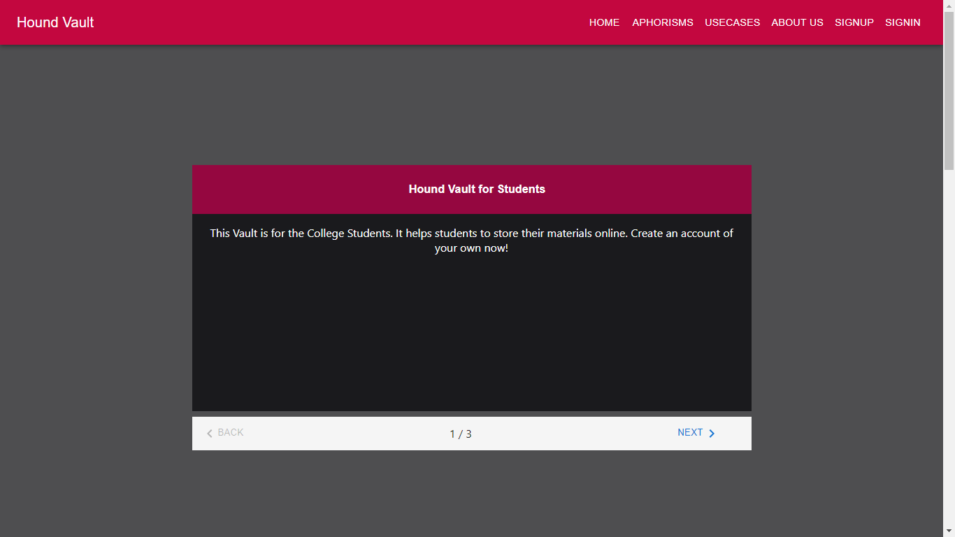

Slide 17
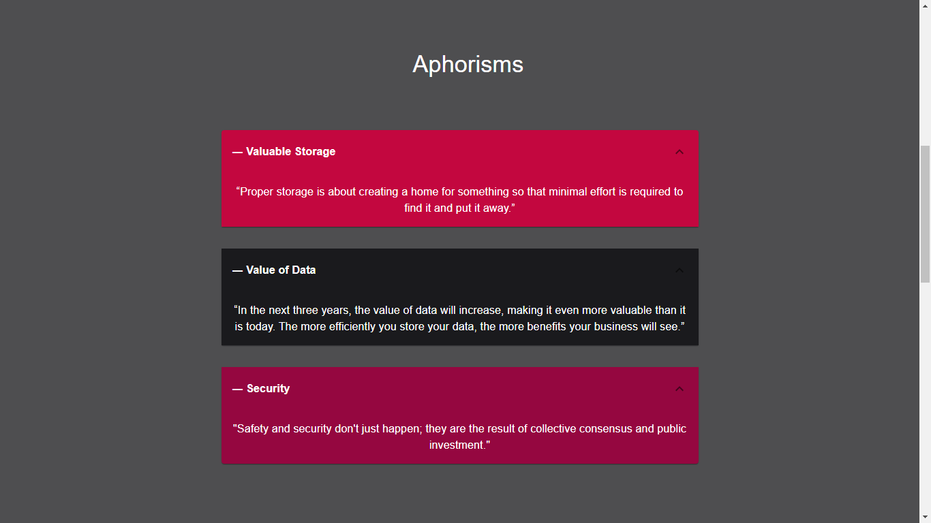

Slide 18
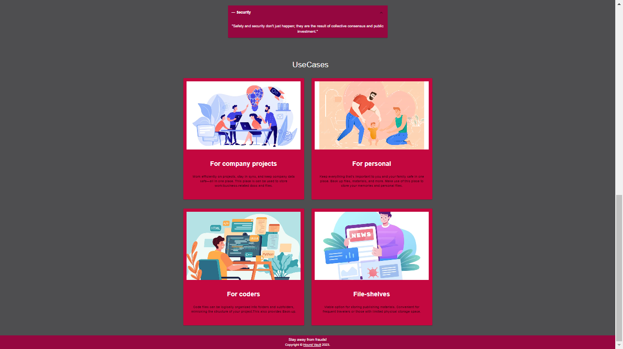

Slide 19
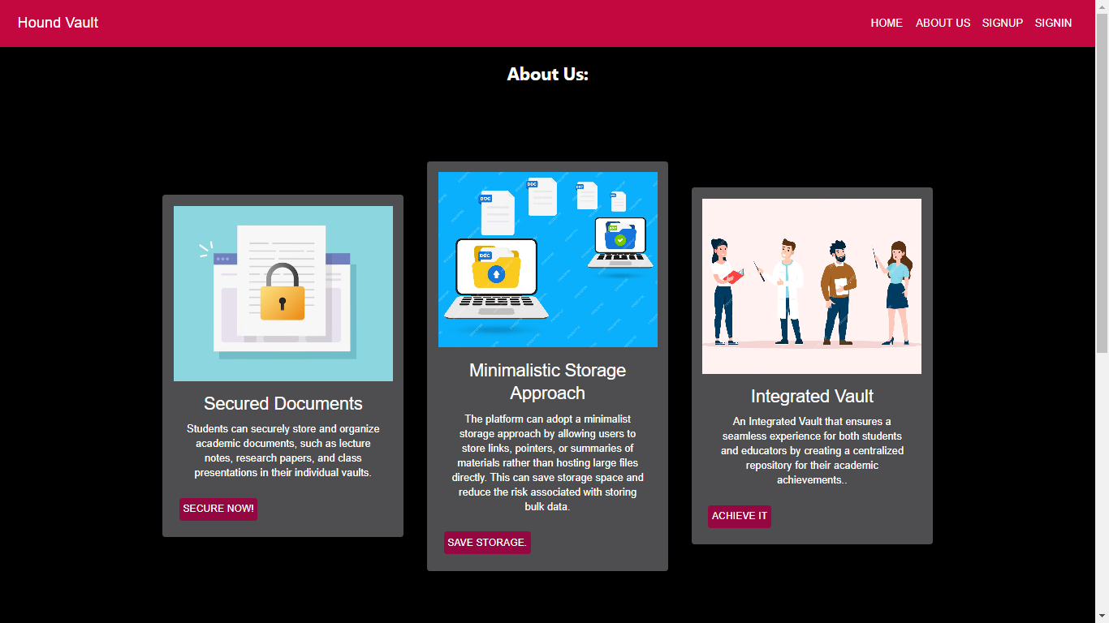

Slide 20
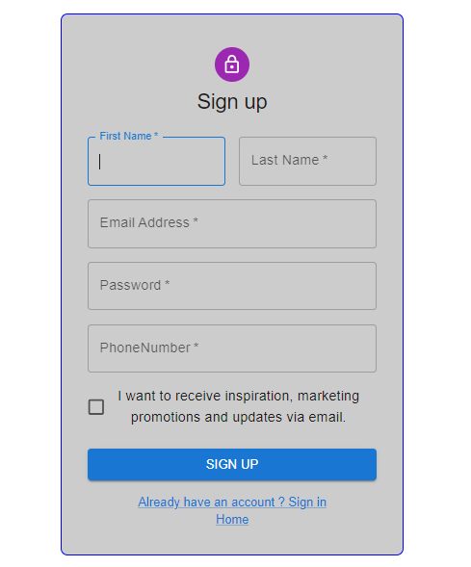
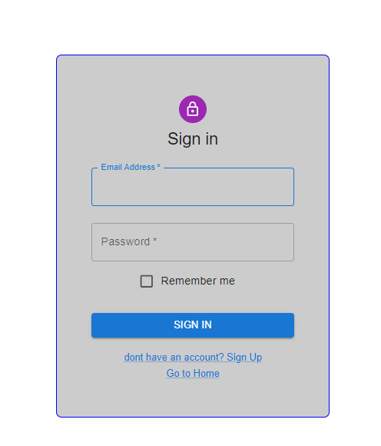

Slide 21
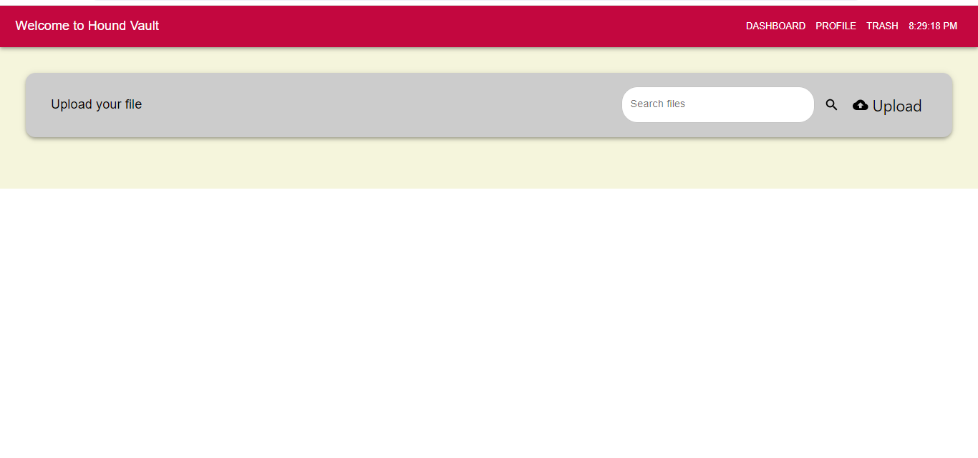

Slide 22
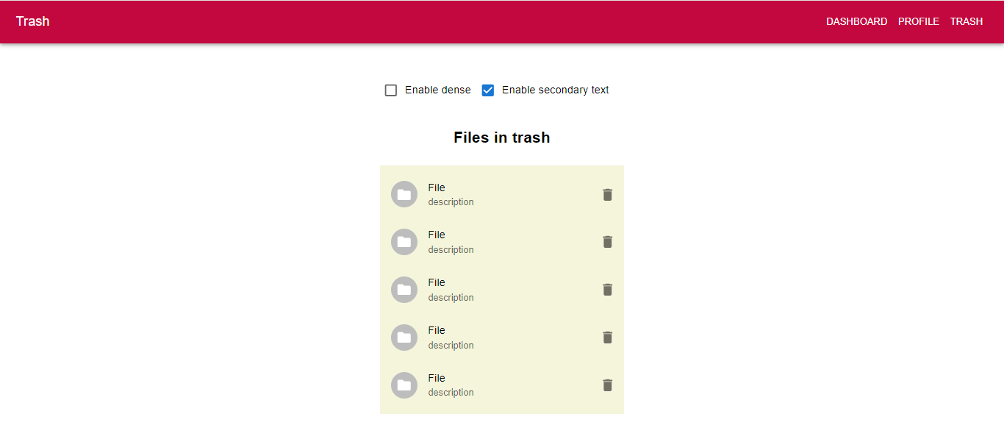
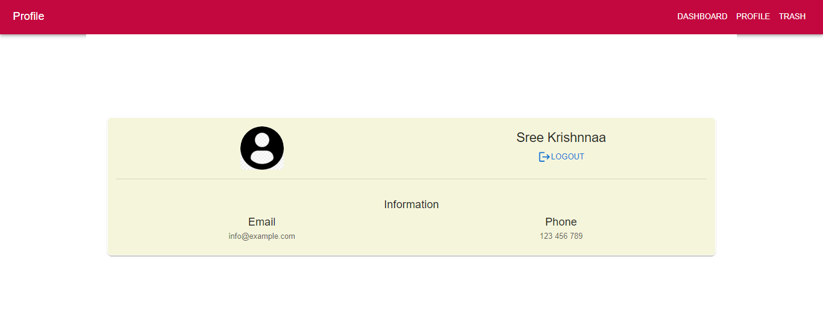

Slide 23

THANK YOU!
Have a great day!

