Slide 1
HW Saver LLP Machine Learning internship Assignment
Applicant Name: V. Sree Sai Bhavesh
College: VIT Vellore

Slide 2
Assignment Question
Situation / Storyline:
In a parallel universe, Amanda embarks on a journey to find a team of highly skilled software engineers for her startup. Mr. Robot and Silicon Valley were two of Amanda's favorite television series. But in this universe, Elliot Alderson works for the government, and Richard Hendricks does not destroy Pied Piper in the end. A world where a few lines of code could solve problems or create menace. She was intrigued when she got a chance to enroll in her first programming class. Unlike some other girls from her class, she was convinced that this was the path she wanted to take. During college, she completed multiple internships in Machine Learning, enhancing her skills and expertise. After her college, with a mission to build custom software for their clients, she started Amanda Coding LLC. She wants to build a team of highly skilled software engineers. For this, she wants to find teammates who meet all the technical skills as per the job requirement.

Slide 3
Assignment Question
While researching, she found a raw dataset of over 30k datapoints (Raw_Skills_Dataset.csv) which contain technical skills and a lot of jargon mixed in. Can you help her develop a code that can clean this dataset and extract Technical (Hard) skills?
Know a bit more
What does technical skill mean? Technical skills are demonstrable and quantifiable skills. They can be tested to prove their capacity in each hard skill an individual possesses. Sounded like blah, blah? We know, because it's much more difficult to explain this theoretically so how about we show what it means. We have attached some 900 random examples of technical skills (Example_Technical_Skills.csv), go through them to understand the pattern and sequence.

Slide 4
Situation Analysis: As we know here we are provided with two datasets one data set has technical(Core) skills while other has technical and jargon mixed in. Now we need to filter the main dataset we have which consists of technical and jargon mixed data.
The procedure to filter would be taking each row of our main dataset(Raw_Skills_Dataset.csv) and checking if that row present in the Example_Technical_Skills.csv dataset. To this we can merge the two datasets on condition of common row, for this purpose first we will make both dataset columns name same. We will assign the merged data to data our new dataset.
This dataset would have many duplicate rows as we performed merging of two datasets, again with help of pandas we can remove the duplicate rows and get our final productive dataset which is cleaned and have only technical(Hard) Skills.

Slide 5
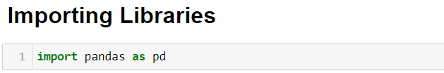
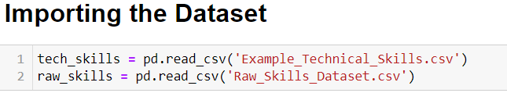
Solution Approach
Step 1:
Firstly, we need to import the libraries which all are needed to solve this problem. Here the situation and work is to handle the data. So, importing pandas is enough.
Step 2:
Now we need to import the datasets provided. This can be done with help of pandas.

Slide 6
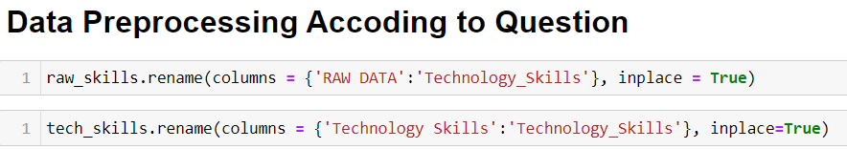
Step 3:
Now making the both datasets column names to same name (Technology_skills).
Step 4:
Merging both datasets for filtering the main dataset to have only hard skills.

Slide 7
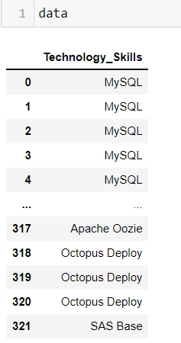
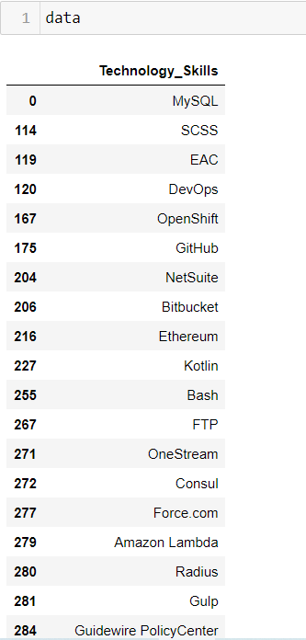
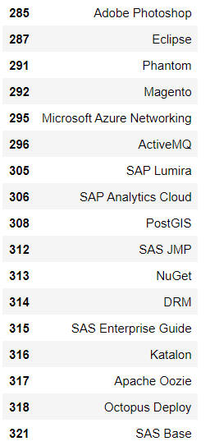
If we observe now we have duplicate values in our data.
Step 5:
Removing duplicate rows and having the productive data
With only hard technical skills.

