Slide 1
BANK FRAUD DETECTION
USING MACHINE LEARNING
INTEGRATING INTO A WEB-APP

Slide 2
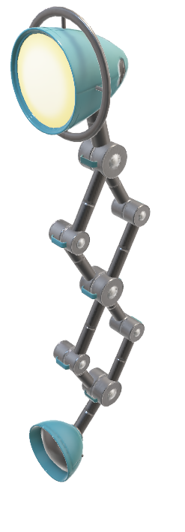
INDEX
Fraudulent activities
Incorporating Machine Learning
Applying Classification Algorithms
Tuning Data
Comparing Scores before and after Tuning
Most Optimal Algorithm
Prediction

Slide 3
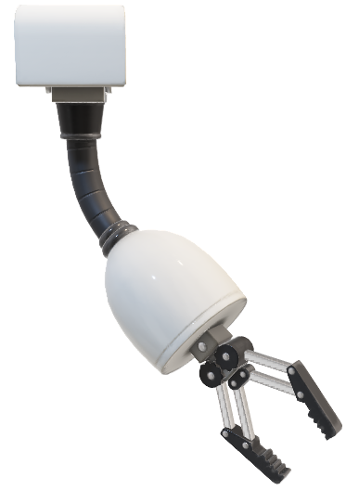
FRAUDULENT ACTIVITIES
The act of obtaining financial benefits by dishonest and unlawful means is known as financial fraud. Financial fraud can occur in a variety of settings, including the corporate, banking, insurance, and taxes sectors. Money laundering, financial transaction fraud, and other forms of financial fraud have recently become increasingly more of a concern for businesses and industries. We choose to find datasets used in ML-based financial fraud detection and identify transactions involving financial fraud using machine learning approaches.

Slide 4
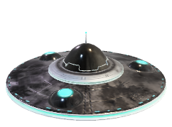
INCORPORATING MACHINE LEARNING
Machine learning (ML) refers to analytical methods that identify particular patterns without the assistance of a human expert. Several scholars have conducted extensive research utilizing ML techniques to detect financial fraud. SVM, ANN, HMM, KNN, Decision Tree, etc. are examples of this. Below are a few classification algorithms.
We used a total of 15 classification algorithms on the data provided to find conclusively, which algorithm fits the mounted data best.

Slide 5
APPLYING CLASSIFICATION ALGORITHMS
We used PyCaret, an auto ML application to apply all the previously selected classification algorithms on the mounted data.
Using this method, helped us in building an efficient and quick model that delivers its output almost instantly.
We were able to compare all the algorithms and their respective accuracy, precision, recall, and F1 Scores.
That in turn, enabled us to find out the algorithm that fits the data mounted the best.

Slide 6
TUNING DATA
Tuning is the process of maximizing a model’s performance without overfitting or creating too high of a variance. In machine learning, this is accomplished by selecting appropriate “hyperparameters.”
Hyperparameters can be thought of as the “dials” or “knobs” of a machine learning model. Choosing an appropriate set of hyperparameters is crucial for model accuracy, but can be computationally challenging.

Slide 7
COMPARING SCORES BEFORE AND AFTER TUNING
As described in the previous slide, tuning can be very effective on some models.
It is much sought after for its usefulness.
While it is effective on many datasets, it can be proven to have had insignificant results on a few datasets.
But tuning proved to be effective in our case and it can be observed distinctively in a few classification algorithms applied on the data mounted.

Slide 8
MOST OPTIMAL ALGORITHM
In the web app we developed, our model finds the best algorithm fit for the data mounted by utilizing the data from several comparisons of the previously calculated Accuracy, Recall, Precision, and F1 Scores.
It is one of the crucial steps to get the best predictions for the test data.

Slide 9
PREDICTION
This is the final step of every Machine-Learning Model.
In this step, the model will produce the prediction, say, the only dependent feature for the testing data previously split.
These results can be further analyzed to see the percentage of misclassified predictions.
Based on the analysis, we conclude if our model is accurate or otherwise in-efficient.

Slide 10
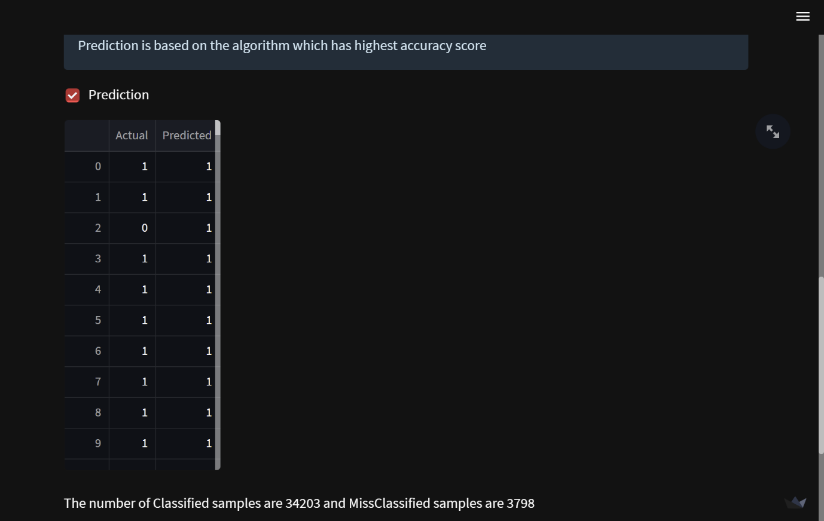
PREDICTION

Slide 11
THANK YOU!
Presented by: Puligilla Sree Vardhan
Intern at Skill Vertex.

