Slide 1

Introduction To Machine Learning
sssaa
Name: Puligilla Sree Vardhan
Course: B.tech CSE (3rd year)

Slide 2
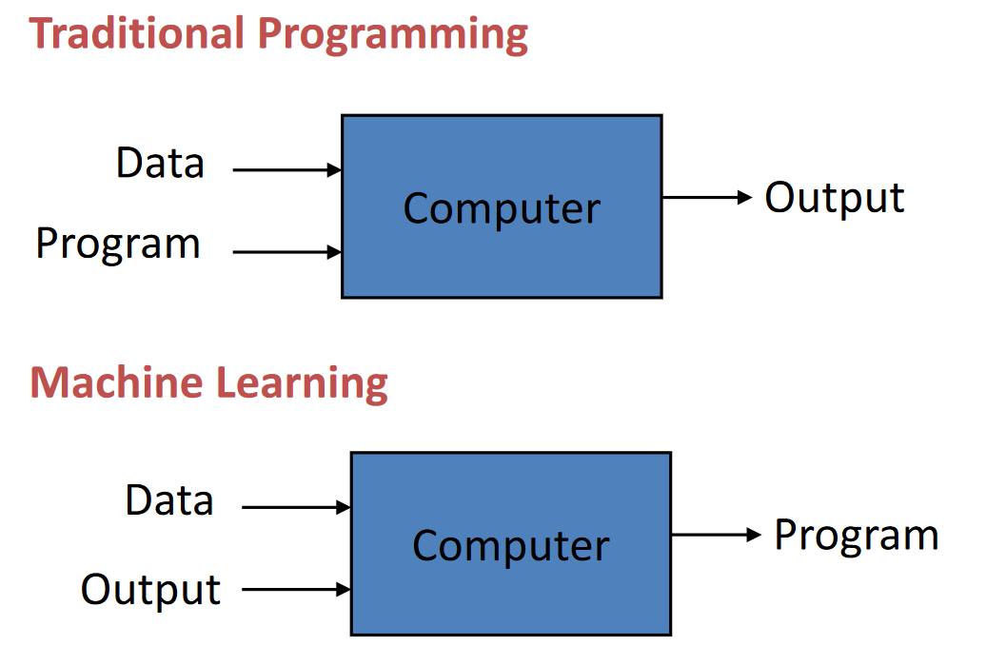
What is Machine Learning? “Learning is any process by which a system improves performance from experience.” -Herbert Simon

Slide 3
When Do We Use Machine Learning? ML is used when: •Human expertise does not exist(navigating on Mars) •Humans can’t explain their expertise ( speech recognition) •Models are based on huge amounts of data

Slide 4
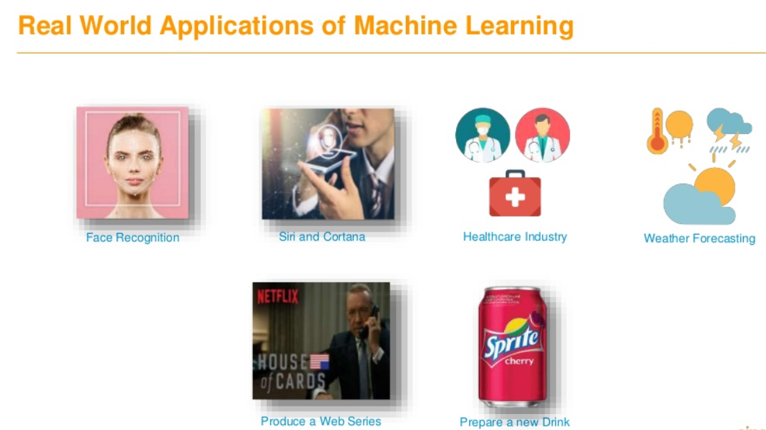

Slide 5

Types of Learning: •Supervised (inductive) learning–Given: training data + desired outputs (labels). •Unsupervised learning–Given: training data (without desired outputs). •Reinforcement learning–Rewards from sequence of actions.

Slide 6
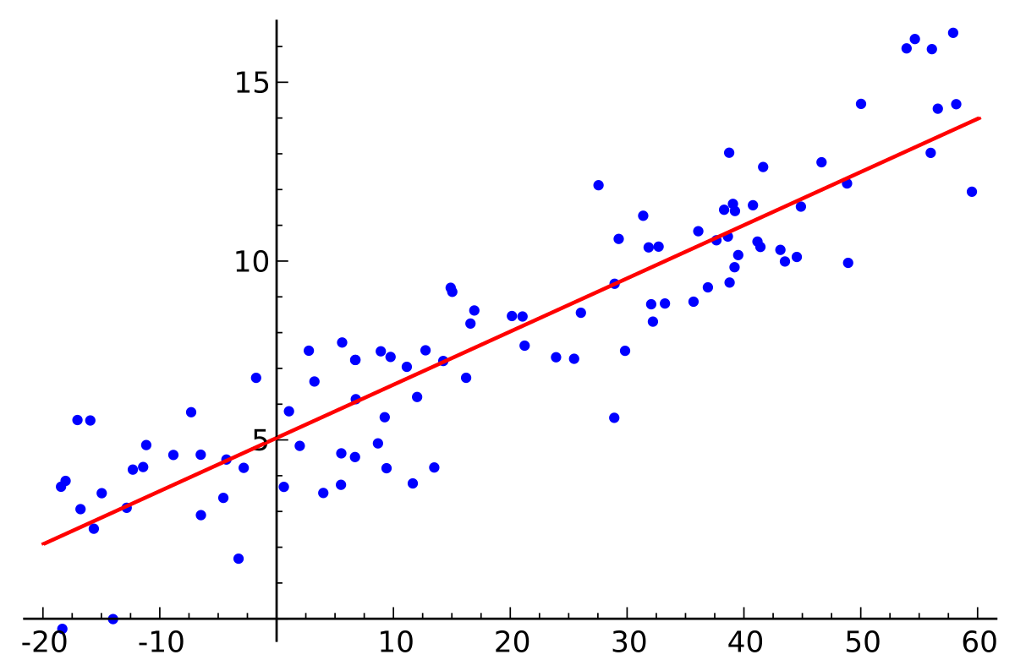
Supervised Learning: 1)Regression: •Given (x1, y1), (x2, y2), ..., (xn, yn) •Learn a function f(x) to predict y given x–yaxis real-valued == regression

Slide 7
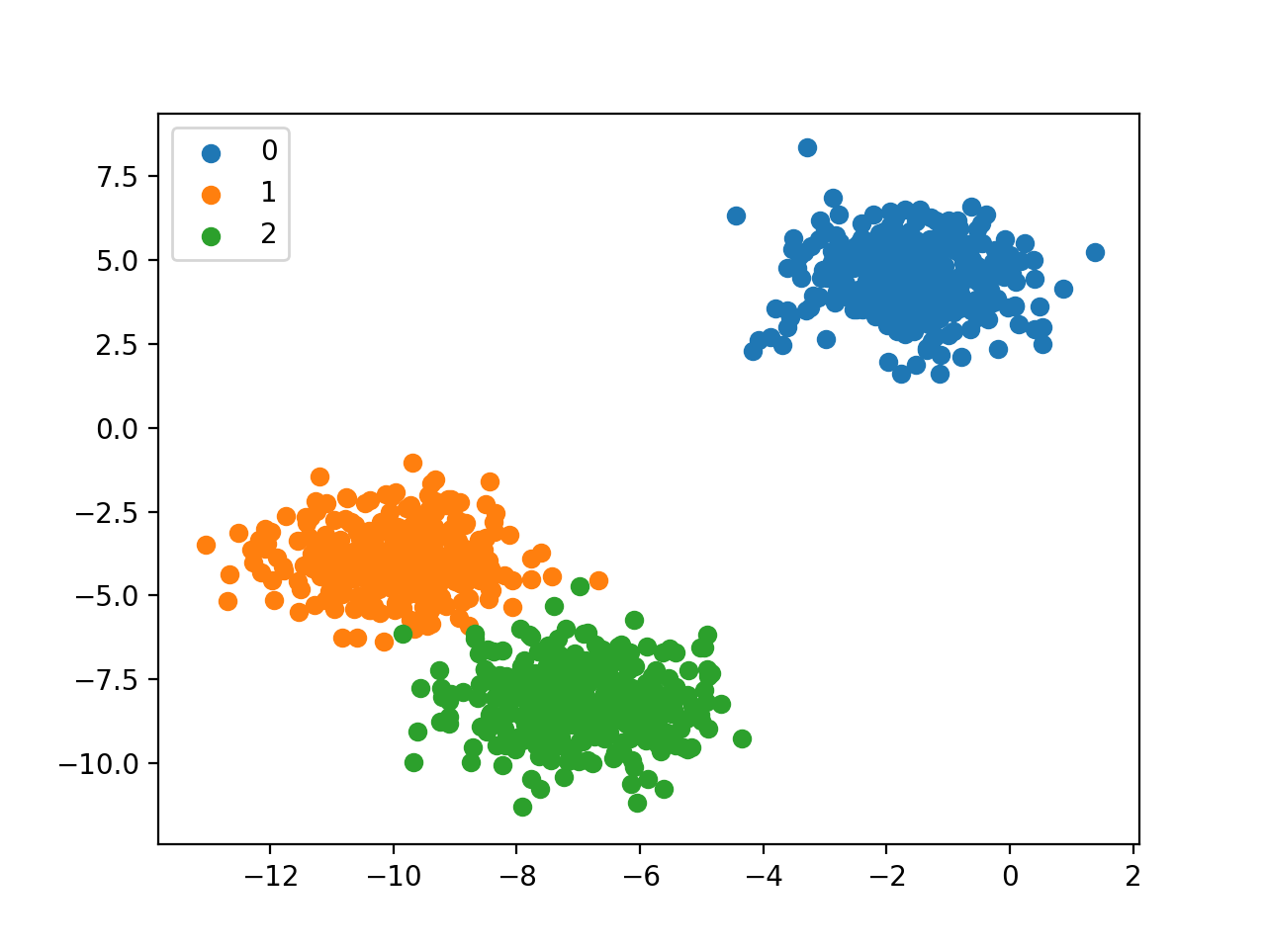
2)Classification: •Given (x1, y1), (x2, y2), ..., (xn, yn) •Learn a function f(x) to predict y given x–yaxis categorical == classification

Slide 8
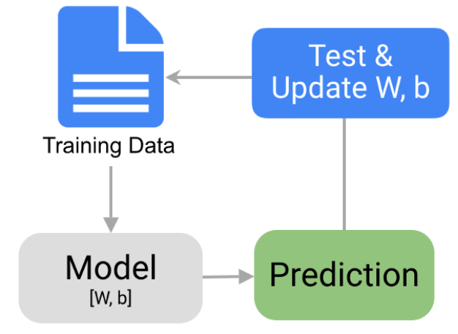
Steps to build model: 1 - Data Collection 2 - Data Preparation 3 - Choose a Model 4 - Train the Model 5 - Evaluate the Model 6 - Make Predictions

Slide 9
Python libraries used in Machine Learning: 1)Numpy 2)Pandas 3)Scikit-learn 4)Matplotlib 5)TensorFlow 6)Keras 7)PyTorch 8)Scipy 9)Seaborn

Slide 10
Iris Flower Data Set

Slide 11
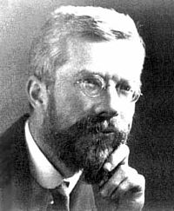
The Iris flower data set or Fisher's Iris data set is a multivariate data set introduced by Ronald Fisher in his 1936. It is sometimes called Anderson's Iris data set because Edgar Anderson collected the data to quantify the morphologic variation of Iris flowers of three related species. The use of this data set in cluster analysis ıs however uncommon, since the data set only contains two clusters with rather obvious separation.

Slide 12
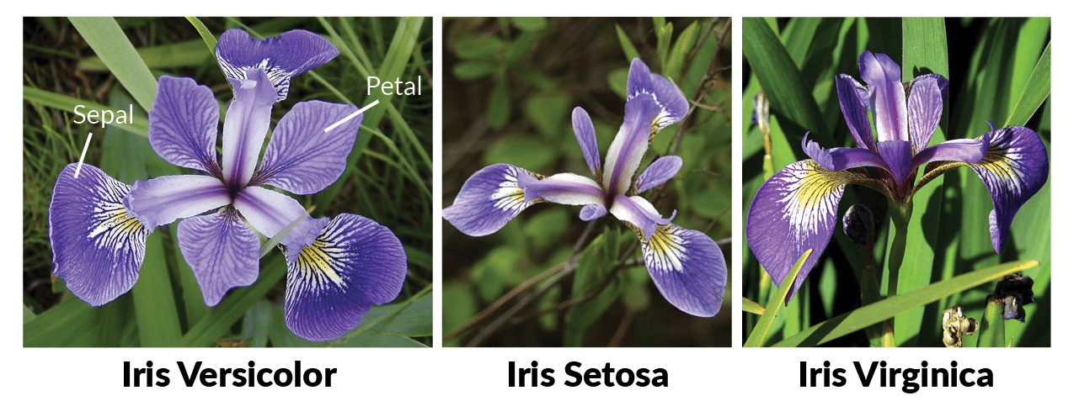
One of the clusters contains Iris setosa, while the other cluster contains both Iris virginica and Iris versicolor and is not separable without the species information Fisher used. It is multivariate(more than 2 dependent variable) data set Study of three related Iris flowers species. Data set contain 50 sample of each species(Iris-Setosa, Iris-Virginica, IrisVersicolor)

Slide 13
Features Used: 1. Sepal length in cm 2. Sepal width in cm 3. Petal length in cm 4. Petal width in cm

Slide 14
Data Analysis : 1. Descriptive statistics- SD, Min, Max etc . 2. Class Distribution (Species counts are balanced or imbalanced) – Balanced. 3. Univariate Plots:- Understand each attribute better.

Slide 15
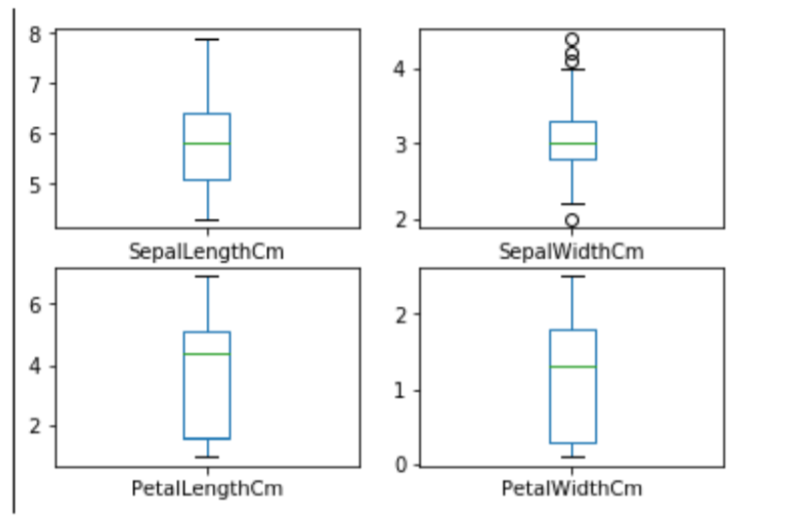
Box and whisker plots(Give idea about distribution of input attributes)

Slide 16
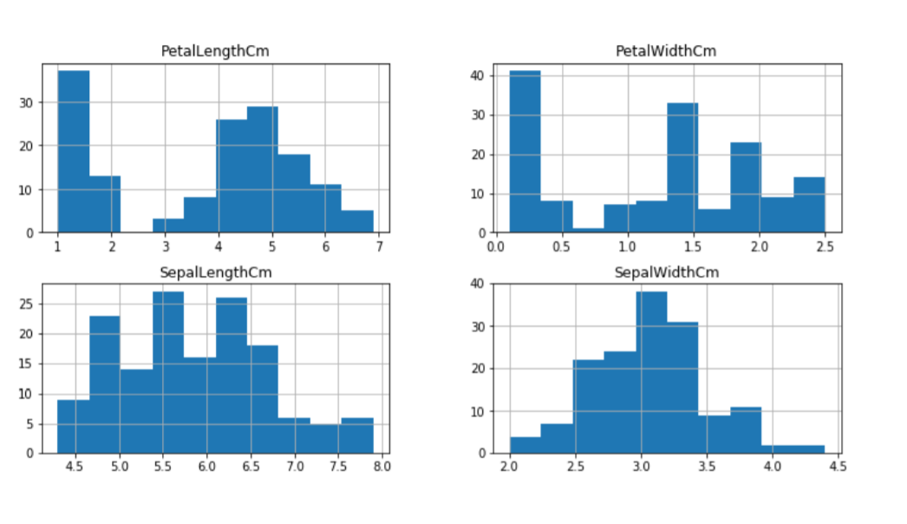
Plotting Histogram:

Slide 17
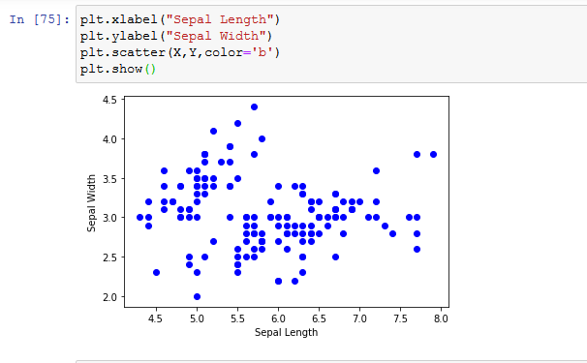
Plotting Scatter Graph Between Sepal Length and Sepal Width:

Slide 18
Observation: 1. Using Sepal_Lenght & Sepal_Width features, we can only distinguish Setosa flower from others. 2. Seperating Versicolor & Virginica is much harder as they have considerable overlap. 3. Hence, Sepal_Lenght & Sepal_Width features only work well for Setosa.

Slide 19

Implementation of Machine Learning.

Slide 20
Steps to implement Machine Learning: 1. Import Library 2. Analyze Data 3. Spliting the Data Set into train and test 4. Chossing right algorithm for training model 5. Test the algorithm with test data.

Slide 21
Algorithms Used: 1. Logistic Regression 2. Support Vector Machine 3. Classification and Regression Tree(CART) 4. Gaussion Naive Bayes(NB) 5. K-Nearest Neighbour(KNN) 6. Deision Tree

Slide 22
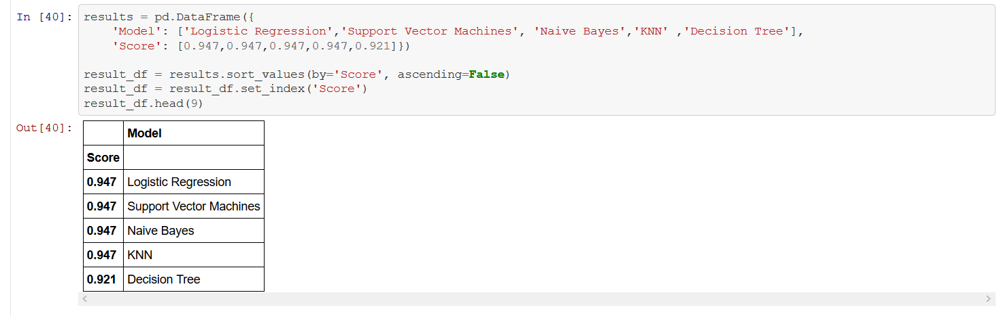
Final Evaluation Of All Models:

Slide 23


