Slide 1
MedMetaverse
Medical Care of Chronic Disease Patients and Managing Data Using Artificial Intelligence, Blockchain, and Wearable Devices State-of-the-Art Methodology
Presented by: XXX
Reg. No. : XXX
Seminar Guide: XXX
Seminar Co-ordinator: XXX

Slide 2
Contents
Introduction
Metaverse
Role of Wearable devices in healthcare
Importance of AI in healthcare industry
Blockchain’s role in healthcare industry
Interaction between AI, BC and WT to treat and manage chronic diseases
Existing System
Proposed MedMetaverse approach
Future enhancement and most important use cases
Benefits and challenges
Conclusion
References

Slide 3
Introduction
Why it Matters
More people have long-term health issues.
Families need better ways to manage health at home.
Top Chronic Diseases
Heart disease, cancer, high blood pressure, diabetes.
Tech Solutions
AI, BC, and WT are helping.
They track, analyze, and treat chronic illnesses.
Wearable Tech
Gadgets monitor health 24/7.
They record and analyze health data.

Slide 4
Introduction
AI Advantages
AI spots dangers early.
Learns from past data to improve.
Data Security
Blockchain keeps records secure and transparent.
Ensures accuracy and trust in medical data.
Benefits of Blockchain
Ensures safe and accurate information.
Builds trust among patients, doctors, and researchers.
Improving Care
Reduces hospital visits.
Enables personalized treatments.
Future Outlook
With advancing technology, managing chronic diseases will become more efficient and effective.

Slide 5
State-of-the-Art Methodology using
01
02
METAVERSE
WEARABLE TECHNOLOGIES
03
04
ARTIFICIAL INTELLIGENCE
BLOCKCHAIN

Slide 6
01
METAVERSE

Slide 7
Virtual Reality(VR)
Internet of Things (IoT) and Network
Augmented Reality (AR)
METAVERSE
Artificial Intelligence (AI)
Blockchain
Avatar

Slide 8
METAVERSE INFRASTRUCTURE AND APPLICATION TECHNOLOGY
i. Virtual Reality (VR): Utilizing immersive VR experiences to enhance patient engagement and facilitate diagnostics, treatment, and education in chronic disease management.
ii. Augmented Reality (AR): Makes visual changes to natural environment to improve medical procedures, including surgery and training for healthcare professionals.
iii. Internet of Things (IoT) and Network: collective network of connected devices and technology for remote patient monitoring and real-time data analysis, integrating seamlessly with the MedMetaverse platform.
.

Slide 9
METAVERSE INFRASTRUCTURE AND APPLICATION TECHNOLOGY
iv. Artificial Intelligence (AI): Harnessing AI for personalized treatment recommendations and advanced disease diagnosis using machine learning algorithms.
v. Blockchain: Implementing blockchain technology to ensure the security and integrity of patient data, providing immutable records for transparent healthcare transactions.
It provides encryption and access control.
vi. Avatar: Employing avatars as representations of individuals in the virtual world, facilitating telemedicine and virtual care delivery.

Slide 10
02
ROLE OF WEARABLE DEVICES IN HEALTH CARE

Slide 11
Wearable Devices in Healthcare
Wearable technology, encompassing devices like Fitbits and smartwatches, monitors various physiological parameters and activities.
Functions include tracking heart rate, blood pressure, body temperature, oxygen saturation, posture, motion, and even capturing scientific data through wearable cameras.
Wearable devices can be seamlessly integrated into various items such as footwear, eyewear, jewelry, clothes, gloves, and watches, enhancing accessibility and comfort for users.
These devices enable remote patient monitoring, real-time data transmission to healthcare providers, and personalized health insights.
Wearable devices play a crucial role in chronic disease management, providing continuous monitoring of vital signs and facilitating early intervention.
Examples include continuous glucose monitoring for diabetics, electrocardiogram (ECG) monitors for heart health, and electronic skin patches for wound care and motion sensing.

Slide 12
TOP DEVICES
Continuous Glucose Monitoring(CGM) Monitors
Electrocardiogram (ECG) Monitor
Sweat and Hydration Detectors
Baby and Pregnancy Tracking Devices
Smart Glasses and Head-Mounted Displays(HMDs
Smart Clothing
Smart Contact Lenses
Smart Wound Management
Smartwatches
Sports/Fitness Trackers
Wearable Blood Pressure (BP) Monitors
Drug Administration
Wearable Health Monitors
Temperature Monitors
etc

Slide 13
ADVANTAGES OF MEDICAL WEARABLES
a) Healthcare Benefit: Wearable tech, like smartwatches and health sensors, tracks patient health, aiding in monitoring even outside hospitals.
b) Patient Safety: Wearables improve patient safety, allowing them to track health, reducing injury risk, and enhancing caregiver communication.
c) Hospital Efficiency: Wearables benefit patients, doctors, and hospitals by improving treatment plans, communication, and overall efficiency.

Slide 14
ADVANTAGES OF MEDICAL WEARABLES
d) Worker Health: Healthcare workers benefit from wearables, tracking fatigue, improving communication, and enhancing workplace safety.
e) Health Improvement: Wearables aid sleep, memory, fitness, enable remote patient evaluation, and offer various health interventions.
f) Other Benefits: Wearables simplify health checks, engage patients, reduce healthcare costs, and generate health data for remote monitoring.

Slide 15
DRAWBACKS OF MEDICAL WEARABLES
Technical Challenges: Long-lasting batteries and compact designs pose challenges, requiring improvements in semiconductor technology.
Data Accuracy: Ensuring accurate health data is vital, with AI, Big Data, and IoT playing roles in data accuracy.
Privacy Concerns: Owners worry about privacy and security, especially during data transmission and storage, requiring compliance with regulations like HIPAA.
Device Misuse: Wearable sensors must be applied correctly for accuracy, but variations in application and environmental factors can affect data quality.

Slide 16
03
IMPORTANCE OF AI IN HEALTH CARE

Slide 17
ARTIFICIAL INTELLIGENCE IN HEALTHCARE
AI is revolutionizing healthcare by enabling more efficient and precise treatments for chronic diseases like cancer.
It offers advantages over traditional analytics and decision-making methods by learning independently from data and providing insights into patient outcomes, care processes, and treatment variability.
AI is expected to become a $8 billion industry in healthcare by 2026.
Governments and tech companies are investing in AI's potential applications in healthcare.
AI can streamline healthcare administration, clinical decision support, patient monitoring, and treatment.
Clinical decision support systems powered by AI can reduce medical errors and increase healthcare efficiency.

Slide 18
ARTIFICIAL INTELLIGENCE IN HEALTHCARE
AI can assist in patient follow-up, medication compliance, and personalized treatment plans.
AI aids in cancer detection, early detection of blood diseases, and rare disease treatment.
Service chatbots and virtual health assistants improve patient engagement and reduce administrative burdens.
AI automates redundant healthcare tasks, improves medical records management, and reduces medication errors.
It enhances robotic surgery precision, speeds up image diagnosis, and aids in fraud detection.
AI facilitates clinical trials, drug discovery, and expands access to healthcare services.

Slide 19
PROS AND CONS
PROS
CONS
improved efficiency
data privacy issues
accuracy
potential job displacement
cost-effectiveness
ethical concerns
prevention of sickness
algorithm bias.

Slide 20
04
BLOCKCHAIN’S ROLE IN HEALTHCARE INDUSTRY

Slide 21
BLOCKCHAIN IN HEALTHCARE INDUSTRY
1) Securing Medical Data:
Blockchain ensures secure storage and exchange of medical data.
Patient information is stored safely, with authorized access only.
Every transaction or update is recorded, creating a transparent history of data access and modifications.
2) Interoperability and Data Exchange:
Blockchain resolves interoperability issues(if one is from diff set) by providing standardized protocols and smart contracts.
It simplifies data sharing among healthcare providers and systems.
Smart contracts automate permission management and data sharing, making clinical trials and studies more efficient and reliable.
3) Supply Chain Management:
Blockchain improves the tracking of drugs and medical devices across the supply chain.
It helps eliminate fraud, verify product authenticity, and enhance pharmaceutical safety.

Slide 22
BLOCKCHAIN IN HEALTHCARE INDUSTRY
4) Payments and Invoicing:
Blockchain streamlines healthcare payments and invoicing processes.
It reduces administrative expenses, improves insurance claims processing, and reduces fraud.
5) Identity and Access Management:
Blockchain offers a secure and decentralized method for managing patient identities.
Patients control their health data, and only authorized parties can access it, ensuring privacy and easy identity verification.
6) Public Health Surveillance:
Blockchain aids in public health surveillance by securely gathering and analyzing data on disease outbreaks and epidemiological studies.
It facilitates tracking and monitoring of infectious diseases, leading to early detection and treatment.

Slide 23
INTERACTION BETWEEN AI, BC, AND WEARABLE TECHNOLOGIES TO TREAT AND MANAGE CHRONIC DISEASES

Slide 24
Real-Time Monitoring
Efficiency and Automation
Collaborative Care
AI, BC, and WT enable real-time monitoring of chronic conditions, allowing for passive therapy and active patient health tracking outside of traditional hospital settings.
AI automates processes in healthcare, speeding up data analysis and treatment planning. Wearables enhance efficiency by providing synchronous wireless computation speed for multiple sensors, solving challenges in multi-point detection health calculations.
The integration of AI, BC, and WT facilitates collaboration between medical experts, chemists, and nutritionists. This results in comprehensive and proactive management of chronic diseases, promoting health and wellness while minimizing disability.

Slide 25
Data Collection and Analysis
Privacy and Security
Ethical Considerations
Wearables collect vast amounts of patient healthcare data, which AI algorithms analyze for intricate correlations between human biology and disease. This improves the accuracy of diagnosis and treatment plans.
Blockchain technology provides a decentralized, secure, and trustworthy ledger for managing health data. It ensures patient confidentiality while enabling the secure transmission of data from wearables to medical institutions.
Despite the benefits, ethical considerations such as patient privacy, data integrity, and regulatory compliance must be addressed. Transparency and validation of AI models are essential for ethical implementation in healthcare.

Slide 26
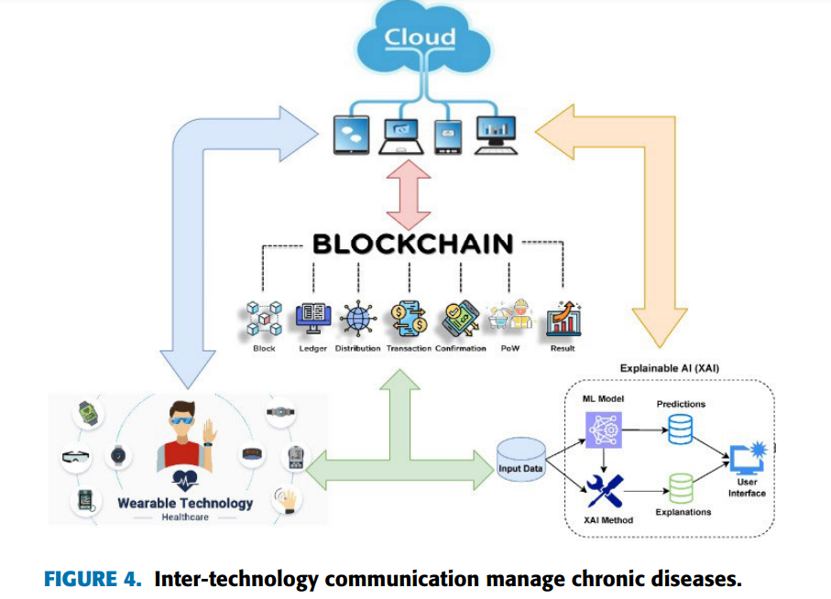

Slide 27
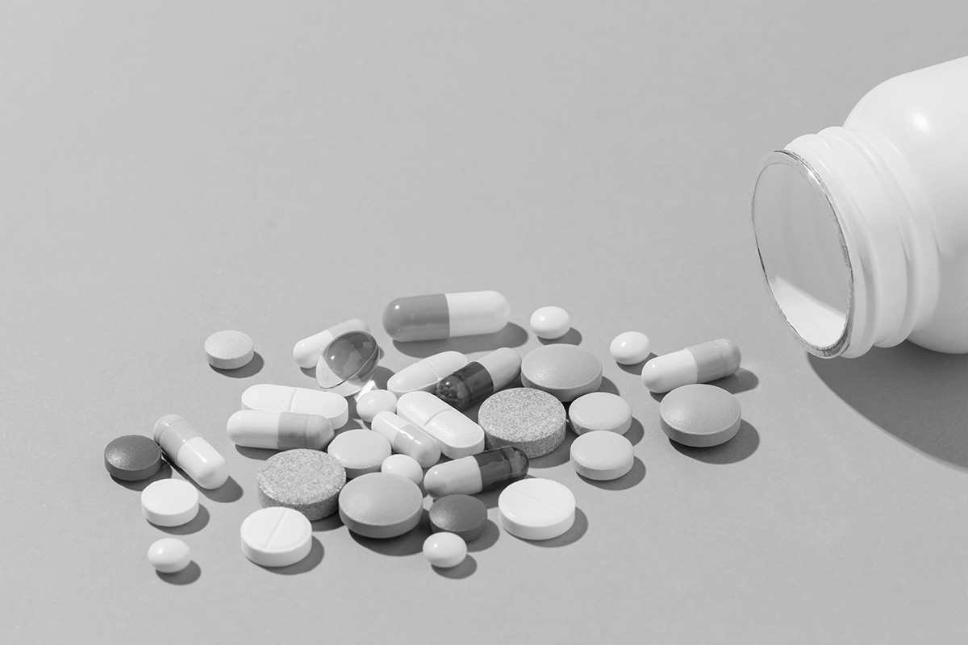

EXISTING SYSTEM
The current healthcare system operates with certain challenges and limitations.
Lack of access to care escalating costs and technological barriers. Doctors and nurses spend during their shifts entering data into electronic medical records performing tests or keeping patients informed on medication schedules
Examples of current healthcare practices include hospital workflows and patient-doctor interactions.

Slide 28
PROPOSED MEDMETAVERSE APPROACH TO TREAT AND MANAGE CHRONIC DISEASES

Slide 29
MEDMETAVERSE APPROACH
01
02
03
METAVERSE ENVIRONMENT
DOCTOR’S WORKING CONDITION
PATIENT’S SETTING

Slide 30
A. Metaverse Environment:
Healthcare Possibilities: Metaverse tech enables counseling and healthcare services, with AI predicting effects and monitoring health.
Precision Surgery: AI aids surgeons with precise procedures, using segmentation and annotations for accuracy.
Blockchain Security: Blockchain ensures secure storage and communication of patient data, enhancing privacy and traceability.
Virtual Healthcare: Avatars of patients and medical professionals interact in a virtual environment, with AI aiding diagnosis and treatment.
AI Assistance: AI predicts diagnoses and aids in surgical procedures, with blockchain ensuring data integrity and accessibility.

Slide 31
B. Doctor's Working Conditions:
Remote Access: Doctors working within these ecosystem can engage remotely using XR technology
Transaction Records: Blockchain employed to record all the interactions securely, ensuring transparency and security.
A new block representing a transaction is generated whenever a new user, such as a doctor, enters a system.
Trn = [IDc, Tnd, Ts, DSig(D)]
Trn is an abbreviation for a transaction, IDcc is an abbreviation for chain code identifier, Tnd is an abbreviation for transaction payload, Ts is an abbreviation for treatment duration, and DSig(D) is an abbreviation for physician digital signature.

Slide 32
C. Patient's Setting:
Convenient Access: Patients register and access virtual medical facilities, aided by caregivers and robots.
Blockchain Records: Patient information and treatment records are stored securely on the blockchain.
A block is formed when an IDp patient registers for treatment. The league in this scenario is as follows:
Trn = [IDcc, Tnp, Ts, DSig(P)]

Slide 33
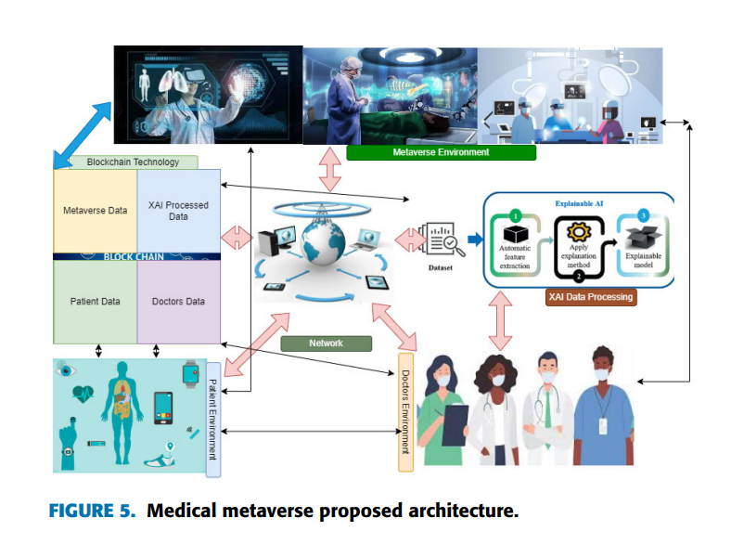

Slide 34
THE MOST IMPORTANT METAVERSE HEALTHCARE USE CASES AND FUTURE ENHANCEMENT

Slide 35
Surgery in the Metaverse
Therapy in the Metaverse
Virtual Clinics
Allows surgeons to practice complex procedures virtually.
Enables international collaboration in real-time surgery.
Offers immersive mental health therapy experiences.
Facilitates VR-powered exposure therapy and addiction treatment.
UAE's virtual hospital erases physical barriers for patient care.
Enables remote consultations and immersive patient experiences.

Slide 36
Digital Twins
Immersive Medical Education
Medical Proficiency and Education
Replicates real-world healthcare settings for optimization.
Provides personalized patient data for precise treatment planning.
Offers practical training for medical professionals using VR/AR.
Enhances learning experiences with anatomical models and simulations.
Utilizes mixed-reality technology for pandemic preparedness.
Enhances surgical skills and patient safety through VR training.

Slide 37
Quality and Patient Safety Education
Post-Traumatic Stress Disorder (PTSD)
Improves orthopedic surgery skills through VR training.
Establishes best practices for patient data protection.
Treats PTSD with interactive exposure therapy in virtual environments.
Provides safe reliving of traumatic experiences for therapy.

Slide 38
HEALTHCARE METAVERSE BENEFITS AND CHALLENGES

Slide 39
BENEFITS
A. Educational Training:
Simulation of real-life scenarios for training healthcare workers.
Enables remote education and training for distant healthcare professionals.
B. Fitness and Wellness:
Gamification of fitness and wellness applications.
Utilizes VR/AR for virtual coaching and mentorship.
C. Mental Health:
Provides immersive therapy experiences for addiction, anxiety, and depression.
Assists patients in facing their concerns through virtual reality.
D. Teleconsultation:
Improves telemedicine with virtual waiting areas and 3D doctor consultations.
Facilitates collaboration among doctors for complex surgeries.
E. Digital Twins:
Enhances medical technology development and testing.
Enables personalized treatment planning and drug development

Slide 40
CHALLENGES
A. Hardware Limitations:
Lack of lightweight, portable, and affordable devices for widespread adoption.
B. Editing Tools:
Current authoring tools have drawbacks and limitations for creating metaverse content.
C. Data Security and Privacy:
Concerns about data security and privacy, especially in healthcare settings.
Risk of personal data theft and unauthorized access in the metaverse environment.
D. Identity Theft and Authentication:
Challenges in authenticating users and preventing identity theft in virtual environments.
E. Mental Health and Addiction:
Risk of addiction and mental health issues due to excessive immersion in the metaverse.
Potential negative impacts on physical and mental well-being.

Slide 41
CHALLENGES
F. Digital Payments and Currency:
Security concerns regarding digital payments and transactions in the metaverse.
Handling various currencies and cryptocurrencies raises safety questions.
G. Law and Jurisdiction:
Need for regulations and laws to address virtual crimes and ensure fairness and safety in the metaverse.
Challenges in determining jurisdiction and governance in the virtual space.

Slide 42
Conclusions
In conclusion, integrating metaverse into the healthcare system holds immense promise for improving patient outcomes.
The future of healthcare is changing rapidly with medical techology. It can be tough to know how soon these technologies will hit mainstream use and become mainstays.
Adapting to technological advancements is crucial for staying relevant and effective in healthcare delivery.

Slide 43
References
MedMetaverse: Medical Care of Chronic Disease Patients and Managing Data Using Artificial Intelligence, Blockchain, and Wearable Devices State-of-the-Art Methodology; DILEEP KUMAR MURALA, SANDEEP KUMAR PANDA(Member, IEEE), AND SUJATA PRIYAMBADA DASH
A. Ahad, M. Tahir, and K. A. Yau, ‘‘5G-based smart healthcare network: Architecture, taxonomy, challenges and future research directions,’’ IEEE Access, vol. 7, pp. 100747–100762, 2019
The Metaverse Medic: A Novel of Virtual Reality and the Future of Medicine" by Dr. Simon H. Mercer
Virtual Healing: Exploring the Metaverse in Medicine" by Dr. Emily K. Chang
https://chat.openai.com/

Slide 44
THANKYOU

Slide 45
Q & A

