Slide 1
Object Detection and Tracking
Preya Patel, Sree Bhargavi Balija

Slide 2
Problem statement and motivation
In automated surveillance, autonomous navigation, and intelligent traffic management, computer vision systems must detect pedestrians and persistently preserve the trajectories across continuous video feeds.
Project objective
Experiment design
Detect pedestrians in MOT17 frames, pass the exact detector outputs into a tracker, and compare complete detector + tracker configurations under the same data.
3 detectors × 2 trackers = 6 pipeline configurations. Final evaluation uses two complete MOT17 training videos (02 and 09): 1,125 source frames in total.
Why two complete sequences?
What is measured?
MOT17-02 is dense (31.0 pedestrians/frame); MOT17-09 is lower density (10.1/frame). This provides a controlled comparison under different scene distributions.
Official TrackEval tracking metrics, motion-continuity assertion results, controlled CPU latency/FPS, and saved visual tracking outputs.
Milestone 1 focus: built end-to-end pipeline, compare quality and latency, and implement a tracking assertion.

Slide 3
Preparing MOT17: annotations and detections
Only train sequences have ground truth, so supervised steps apply to train alone.
Train (02, 04, 05, 09, 10, 11, 13)
Test (01, 03, 06, 07, 08, 12, 14)
Read seqinfo.ini for frame rate, width and height
Keep ground-truth rows with class_id = 1 and consider = 1
Drop or ignore boxes with visibility below 0.2
Use gt.txt identity IDs to crop patches for Re-ID training
No gt/gt.txt, to prevent leakage
Use det/det.txt as proposals for tracking-by-detection
Assign new sequential track IDs per sequence
Submit results to the MOT benchmark server
Steps on det.txt (train and test)
Step | Rule
Confidence threshold | Keep boxes with conf above a chosen threshold (DPM scores can be negative)
Clamp to image | x1 = max(0, left), y1 = max(0, top), x2 = min(W, x1 + w), y2 = min(H, y1 + h)
NMS | Remove duplicate overlapping proposals within each frame

Slide 4
Preparing frames and labels for each model
Read frames with OpenCV (BGR), apply the model’s input format, and convert boxes from MOT’s [left, top, w, h].
Model | Image pipeline | Box format
YOLO | Letterbox resize padded to stride 32, BGR to RGB, scale to [0, 1] | One .txt per frame: class, x_center, y_center, w, h, divided by W or H
Faster R-CNN FPN | BGR to RGB, tensor in [0, 1], resize (min 800, max 1333), ImageNet mean and std | Absolute [x1, y1, x2, y2], with x2 = x1 + w and y2 = y1 + h
DETR ResNet-50 | BGR to RGB, AutoImageProcessor (shortest edge 800, longest up to 1333), zero-padded batches with mask | Set by the processor from the annotations
Train only
Test only
Random flip, scale jitter, mosaic, crop, color jitter
Normalize boxes with W and H from seqinfo.ini
Deterministic resize and padding, no random augmentation
Set video fps from frameRate in create_video.py

Slide 5
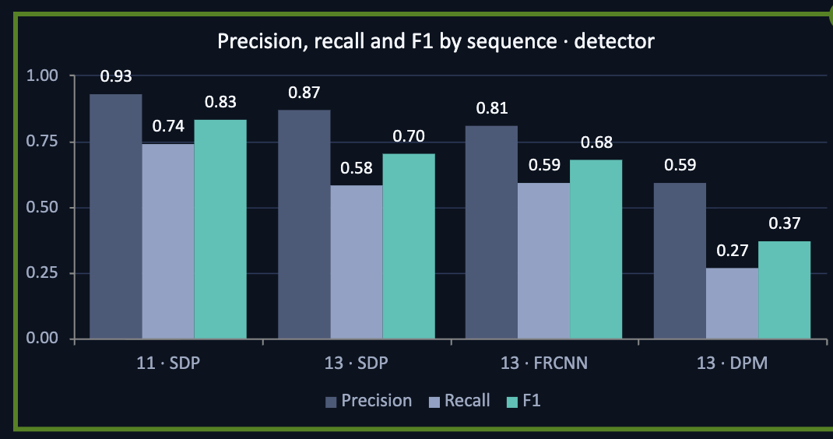
Ground truth is clean. Detections are not
MOT17 pedestrian tracking · 4 detector outputs scored against human annotation · IoU ≥ 0.5, valid pedestrians only
0.83
Best · seq 11, SDP
93% precise, 74% recall, tightest boxes (IoU 0.85)
0.70
Typical · seq 13, SDP / FRCNN
About 40% of pedestrians missed, most boxes right
0.37
Worst · seq 13, DPM
Only 27% of pedestrians found; 41% of boxes wrong
Ground truth: clean
Hidden people missed
DPM scores ≠ probabilities
Messy files
No duplicate rows or track gaps. Filter to valid pedestrians first.
Under 25% visible: only 17% found (seq 11).
57% are negative, so 0–1 thresholds fail.
FRCNN unsorted; 6–8 frames empty in DPM and SDP (seq 13).

Slide 6
Literature Review
Paper | Main Idea | Relevance to Our Project
ByteTrack (Zhang et al., 2022) | Uses both high- and low-confidence detections to maintain tracks during occlusion. | One of our main trackers; useful for comparing detector–tracker combinations.
OC-SORT (Cao et al., 2023) | Improves motion estimation and object association after temporary occlusion. | Second tracker in our pipeline; enables direct comparison with ByteTrack.
MOTChallenge (Dendorfer et al., 2021) | Introduces MOT17 benchmark and standard tracking metrics such as MOTA, IDF1, and HOTA. | Provides our dataset and evaluation framework.
BoT-SORT (Aharon et al., 2022) | Combines motion, appearance features, and camera-motion compensation. | Shows a stronger alternative tracker for future extension.
CenterTrack (Zhou et al., 2020) | Integrates object detection and tracking instead of keeping them fully separate. | Provides a comparison to our modular detector → tracker architecture.
Rahman et al. (2020) | Studies monitoring of object-detection performance after deployment. | Connects our vision pipeline to later MLOps monitoring and reliability tasks.

Slide 7
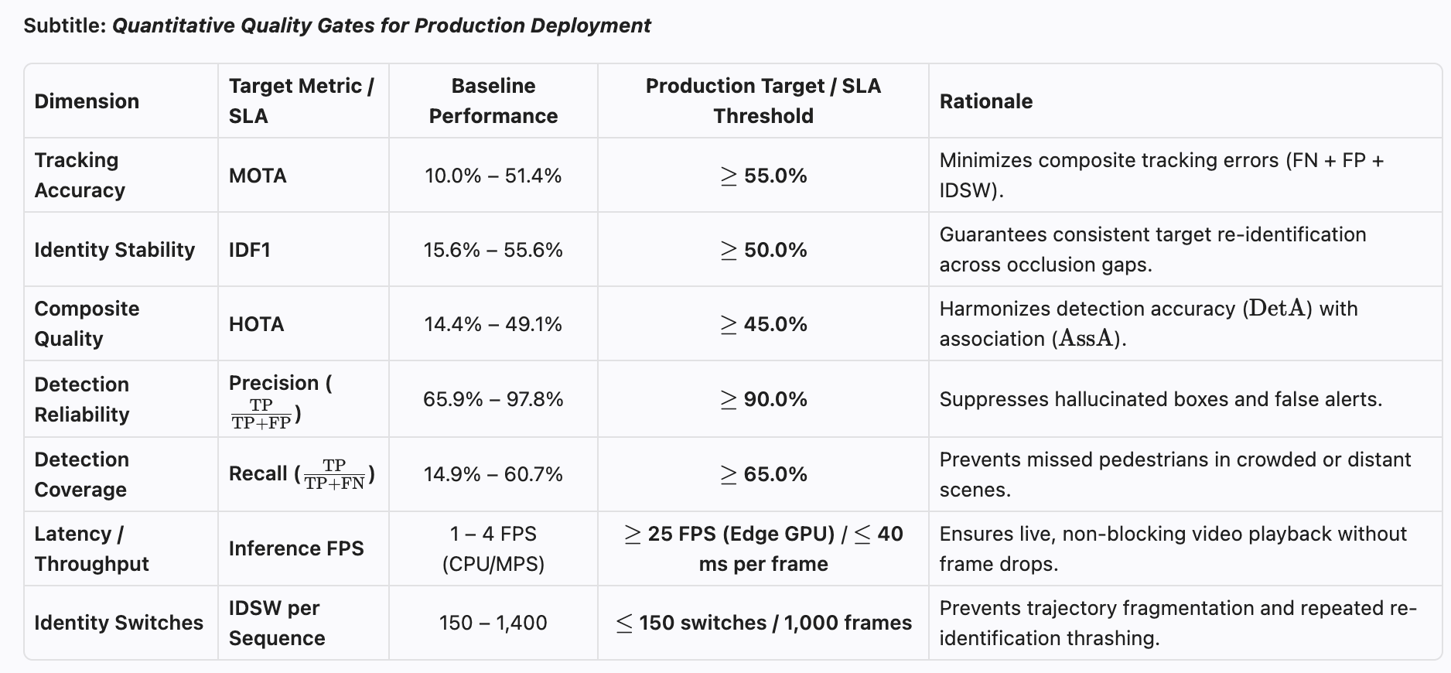
Reference Service Level Agreements (SLAs) & Target Key Performance Indicators

Slide 8
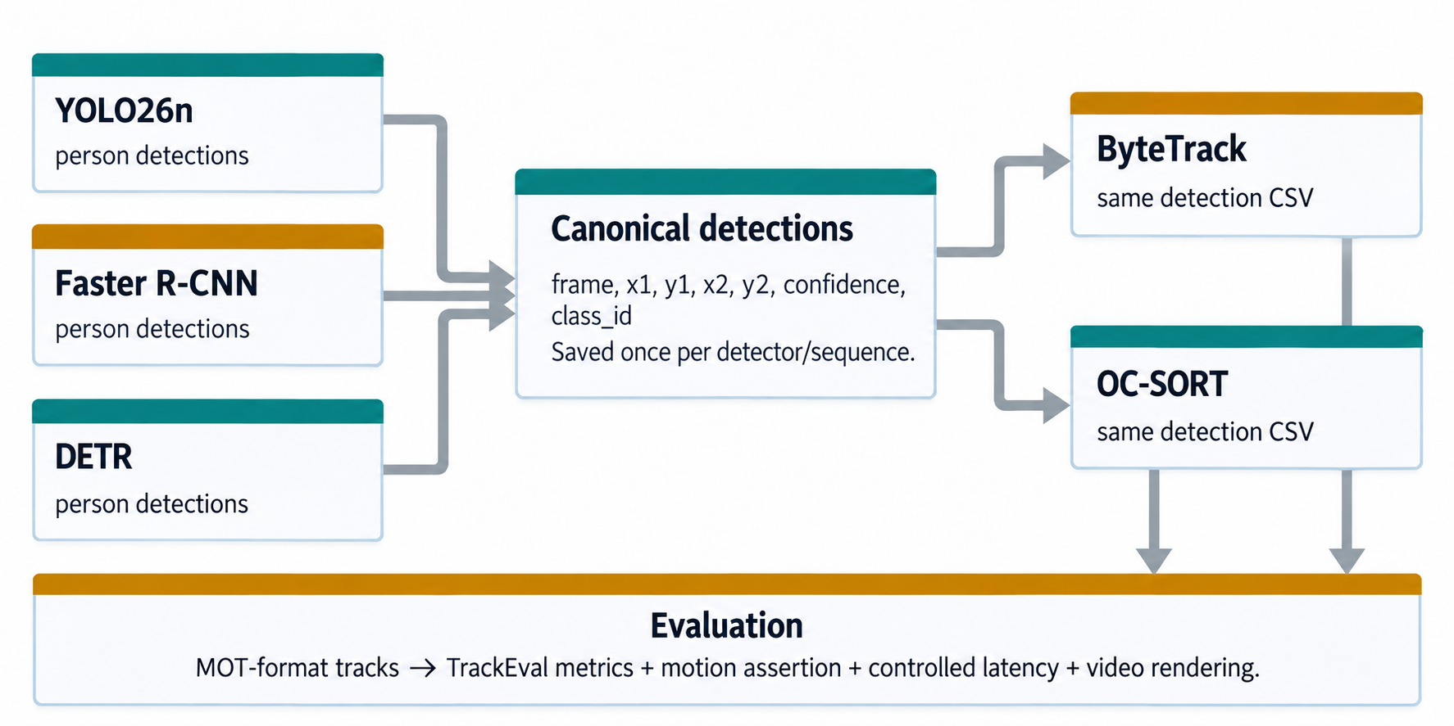
Object tracking pipeline architecture
Every detector writes the same canonical detection CSV; both trackers consume that identical saved file for a fair association comparison.

Slide 9
How detection and tracking is scored
Predicted trajectories are matched to gt.txt (pedestrians only: class_id = 1, consider = 1) at IoU ≥ 0.5.
TP, FP and FN
MOTA (CLEAR MOT)
Match = predicted box and GT box with IoU ≥ 0.5
MOTA = 1 − Σ(FN + FP + IDSW) / Σ GT
TP: GT pedestrian paired with a prediction
FP: predicted box with no GT pedestrian (spurious box)
FN: GT pedestrian the model missed
Precision = TP / (TP + FP), Recall = TP / (TP + FN)
IDSW: a track changes ID between frames
Dominated by detection errors; range up to 100%
Goes negative when false alarms are excessive
IDF1
HOTA (Luiten et al., IJCV 2021)
IDF1 = 2·IDTP / (2·IDTP + IDFP + IDFN)
HOTAα = √(DetAα · AssAα), averaged over α = 0.05 to 0.95
Global bipartite match of GT and predicted trajectories
Measures how long the same ID stays on the same person
Reflects trajectory consistency, unlike MOTA
DetA = TP / (TP + FP + FN): detection quality
AssA: how well detections are linked into correct tracks
Average over 19 thresholds; balances both aspects

Slide 10
Final combined model comparison
Two complete sequences combined with TrackEval sequence aggregation. Values are percentages except FPS.
Detector | Tracker | HOTA | MOTA | IDF1 | Prec. | Recall | FPS
YOLO26n | ByteTrack | 31.12 | 26.95 | 34.39 | 89.80 | 30.93 | 4.17
YOLO26n | OC-SORT | 31.87 | 26.86 | 36.07 | 89.52 | 30.97 | 4.15
Faster R-CNN | ByteTrack | 31.72 | 18.14 | 36.04 | 61.21 | 54.43 | 0.13
Faster R-CNN | OC-SORT | 30.68 | 17.36 | 35.62 | 60.75 | 54.55 | 0.13
DETR | ByteTrack | 28.02 | 4.80 | 28.87 | 54.37 | 53.15 | 0.24
DETR | OC-SORT | 26.69 | 2.15 | 26.66 | 53.33 | 52.86 | 0.24
Best balanced quality: YOLO26n + OC-SORT (HOTA 31.87, IDF1 36.07). Best MOTA and fastest controlled pipeline: YOLO26n + ByteTrack (MOTA 26.95, 4.17 FPS).

Slide 11
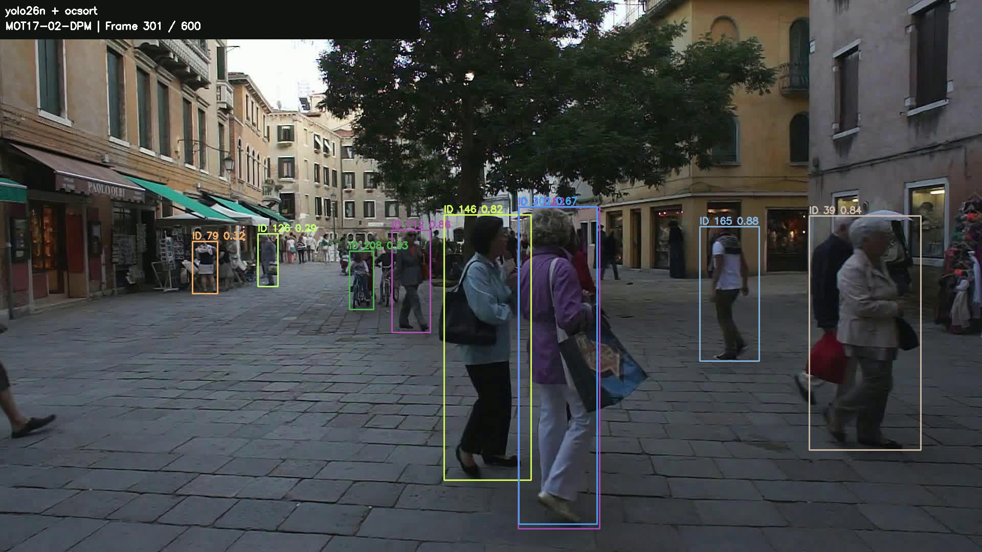
Sequence-specific performance
Tracking quality changes substantially with scene density and operating conditions.
MOT17-02-DPM
600 frames • 1920×1080 • 31.0 pedestrians/frame • dense large-square scene
Pipeline | HOTA | MOTA | IDF1
YOLO26n + BT | 26.18 | 18.98 | 27.08
YOLO26n + OC | 27.35 | 18.87 | 29.03
Faster R-CNN + BT | 27.57 | 12.13 | 31.75
Faster R-CNN + OC | 27.64 | 11.49 | 32.09
DETR + BT | 23.47 | -0.73 | 23.98
DETR + OC | 21.53 | -3.30 | 21.25
MOT17-02

Slide 12
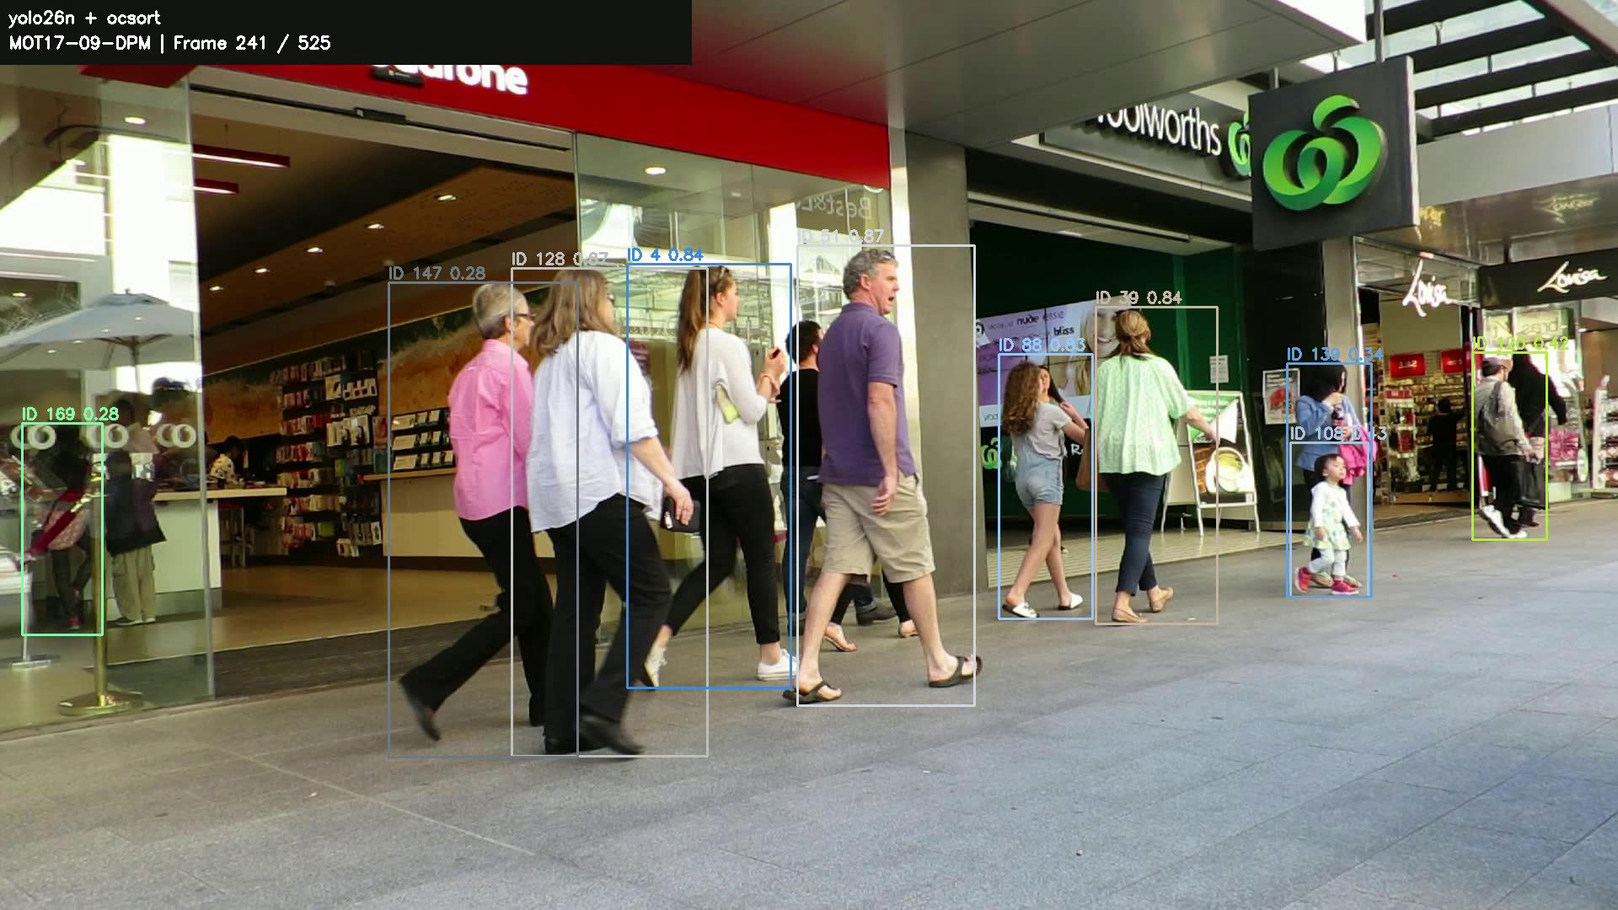
Sequence-specific performance
Tracking quality changes substantially with scene density and operating conditions.
MOT17-09-DPM
525 frames • 1920×1080 • 10.1 pedestrians/frame • lower-angle pedestrian street
Pipeline | HOTA | MOTA | IDF1
YOLO26n + BT | 43.39 | 54.76 | 52.71
YOLO26n + OC | 43.30 | 54.72 | 53.71
Faster R-CNN + BT | 43.30 | 39.12 | 49.32
Faster R-CNN + OC | 39.59 | 37.82 | 46.59
DETR + BT | 39.27 | 24.11 | 42.94
DETR + OC | 38.90 | 21.16 | 42.25
MOT17-09

Slide 13
Milestone 1 conclusion
The end-to-end comparison is complete and now supports a defensible model-selection decision.
Best balanced tracker – Quality Winner
Best operational choice – Speed/MOTA Winner
YOLO26n + OC-SORT
HOTA 31.87
IDF1 36.07
YOLO26n + ByteTrack
MOTA 26.95
4.17 FPS
Key trade-off
Milestone status
Faster R-CNN + ByteTrack reaches similar combined HOTA/IDF1, but is ~32× slower than YOLO under the controlled CPU latency test.
6 configurations evaluated
2 complete sequences
assertion
controlled latency
result videos.

Slide 14
Limitations and extensions
The experiment is complete for Milestone 1 comparison, but the current results should be interpreted within the tested scope.
Limitations
Extensions
Final accuracy uses two MOT17 training sequences, not the full seven-sequence train split or hidden test set.
Generic pretrained detectors; no MOT-specific fine-tuning.
Fixed collection/tracker thresholds; no hyperparameter optimization.
CPU-only inference; latency is not representative of optimized GPU deployment
Absolute MOT17 scores are moderate; conclusions are comparative within this experiment.
Run the remaining five unique MOT17 train scenes for broader distribution coverage.
GPU/quantization for deployment throughput.
Tune detector/tracker thresholds and test larger/specialized pedestrian detectors.
Add appearance/Re-ID features and temporal smoothing.
Package reproducibly with Docker, then proceed to deployment, monitoring and drift work in later milestones.

