Slide 1

Building a Language Understanding and Question Answering System from open-ended Trivia Data
Team Members
• Sreecharan Vanam
• James Cruz
• Sai Praneeth Kankanala
• Yashwanth Kirla
University of North Texas
Under guidance of Dr. Sayed Khushal Shah

Slide 2

Introduction
Importance of NLP in automating understanding and responses to human language.
Question answering (QA) as a key NLP application in search engines, virtual assistants, and customer service.
Project's aim to improve QA systems using BERT for deeper language comprehension.

Slide 3

Problem Statement
Traditional QA systems struggle with nuanced language and context-dependent answers.
Inconsistent performance across varied types of questions and topics.
We Propose that fine-tuning BERT on a comprehensive dataset like SQuAD can significantly enhance accuracy and adaptability on any given question that might be phrased like general human conversation which is very important.

Slide 4
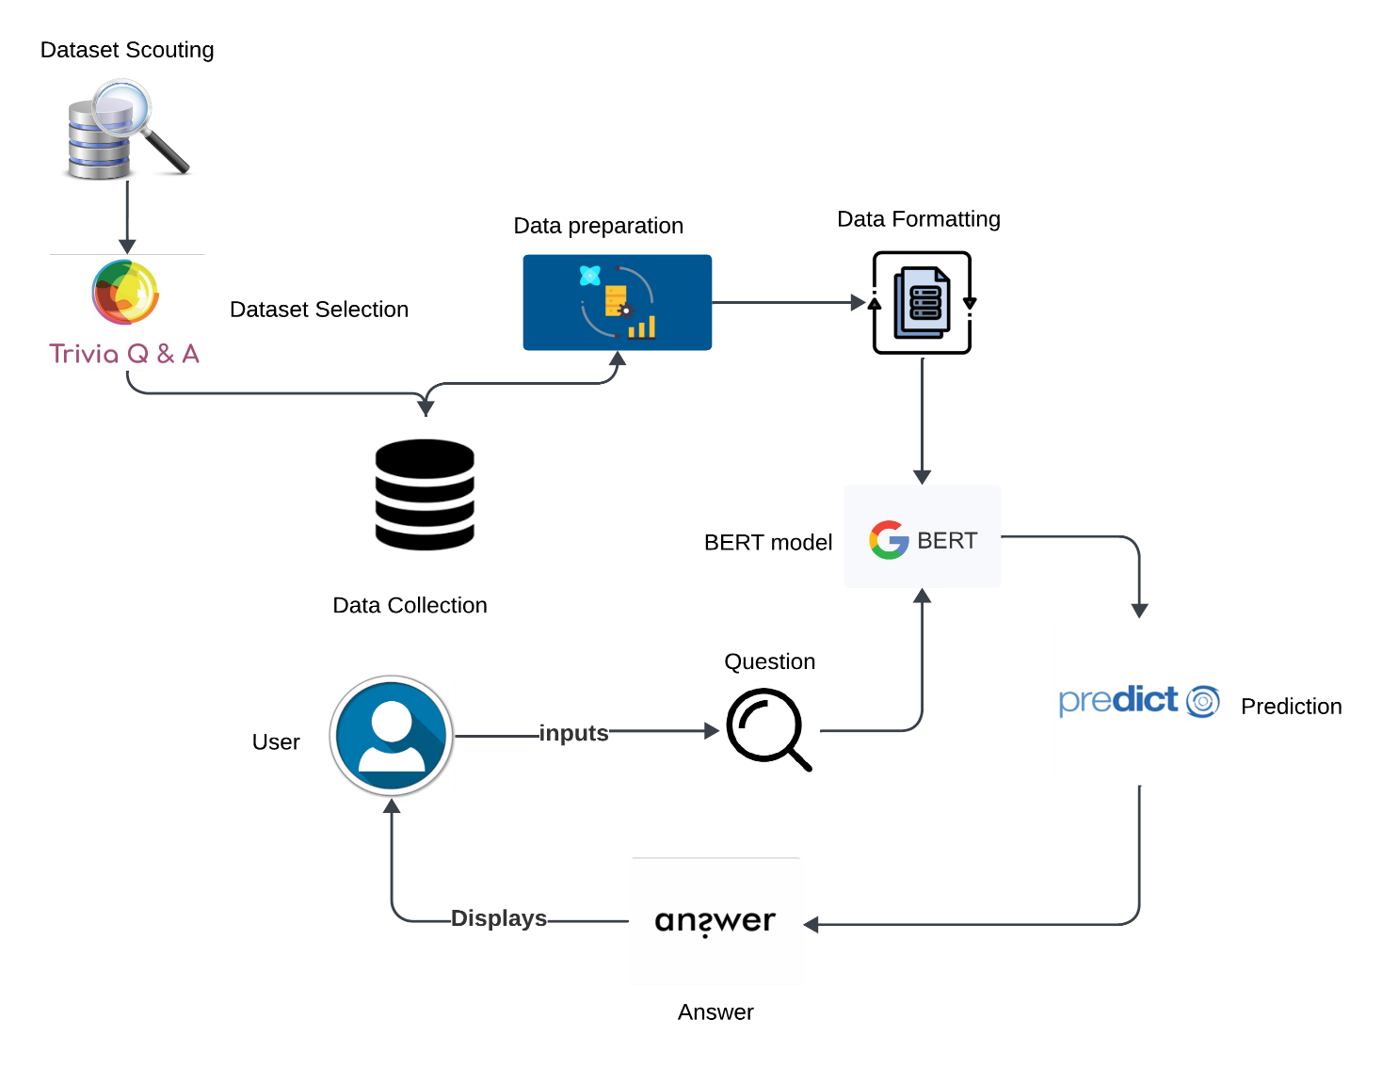
Methodology
Workflow diagram steps:
Dataset Scouting & Selection
Data Preparation
Data Formatting
Model prediction
User Interface to input questions and view the predicted answer

Slide 5
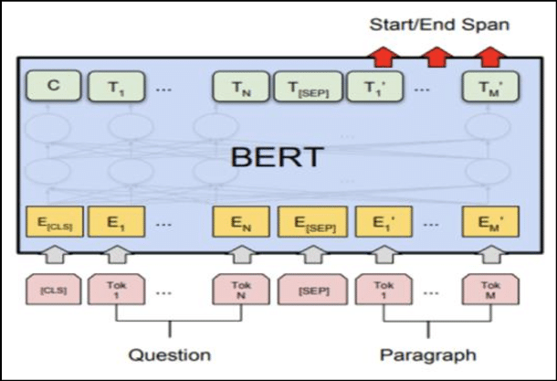
Architecture
Input Embeddings, [CLS] and [SEP] Tokens, Transformer Layers, Output Predictions, Fine-tuning Mechanism.
The BERT architecture uses input embeddings to convert tokens from questions and paragraphs into vectors, incorporating special tokens to differentiate between the two parts.
It employs a multi-layered transformer structure to process these embeddings and extract word relationships, which then predict the start and end points of answers within the text.
To specialize BERT for Trivia Q&A, the model undergoes fine-tuning with the Trivia dataset, enhancing its initial training on extensive text data.

Slide 6

Dataset
The data used here is an NLP and QA benchmark, the Stanford Question Answering Dataset (SQuAD) in json format.
SQuAD is very popular and continues to dominate machine learning research on NLP and QA tasks.
It was derived from human paraphrases of more than 500 Wikipedia articles and is made up of more than 100,000 question-answer pairs
Total number of articles: 21
Total number of paragraphs: 283
Total number of questions: 1000

Slide 7
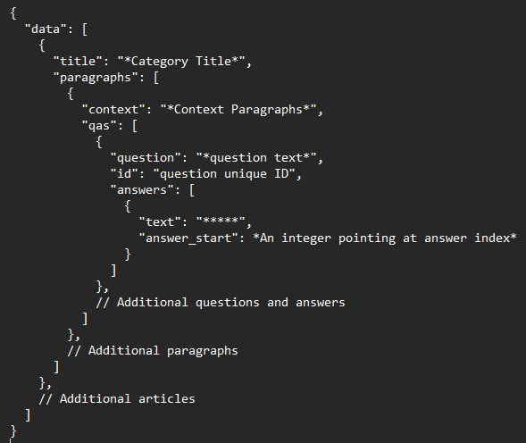
Squad Data Format

Slide 8
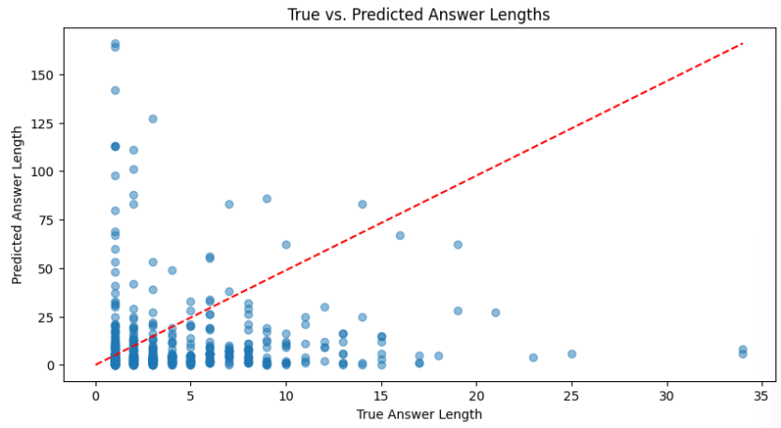
EDA
Visualization
our model's estimates of the length of the correct answers is better for short answers than for longer ones This suggests shortcomings that need to be accounted for to achieve higher accuracy levels of leading models.

Slide 9
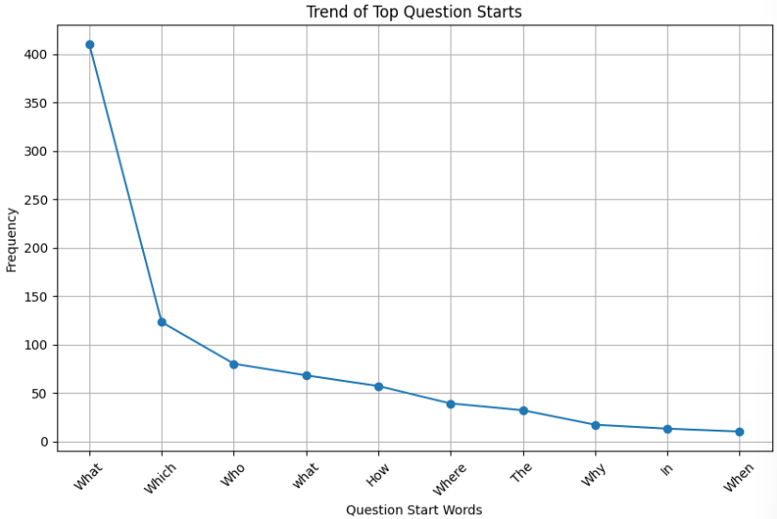
Trend of Top question starting words
line graph shows how often certain leading words in questions from our dataset resonated as the most frequent words (What being the most common). There is a steep fall off from that point, with other words such as How and When being much less frequent in our data, so using these as starting point might influence the model to produce accurate results.

Slide 10
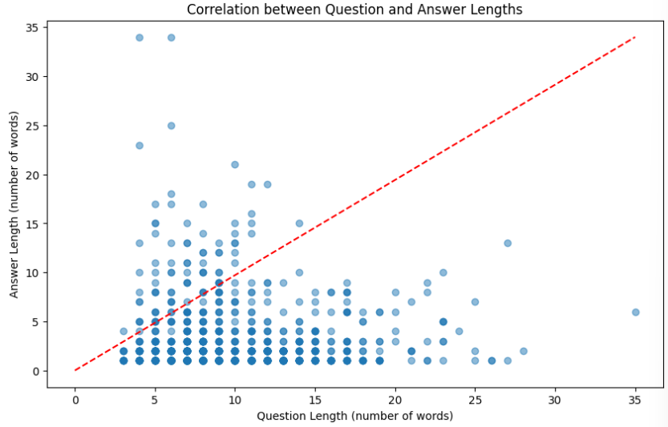
Correlation B/w Question and Answer Lenghts
The scatter plot depicts the length of question and the length of answer without a strong correlation as shown by the spread of data points.
We can see that the model doesnt predict longer answer as accurately as good as shorter ones.

Slide 11
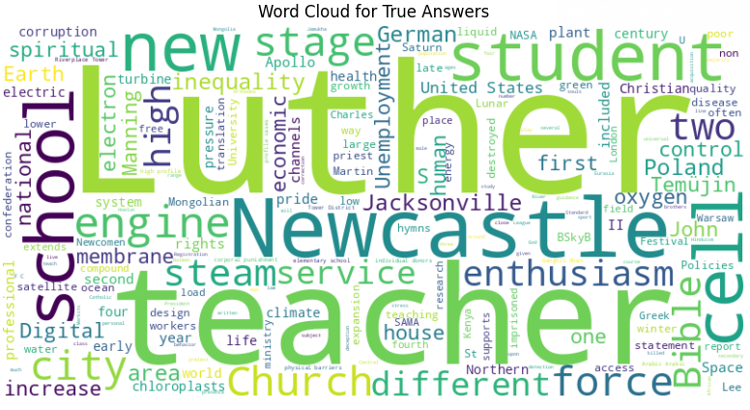
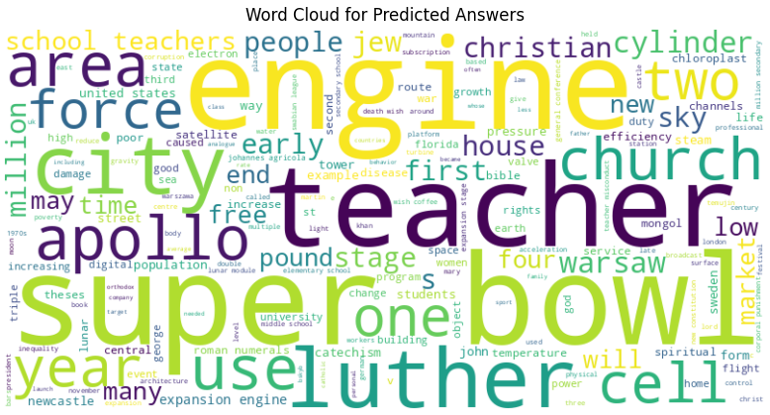
Word Cloud
Here, we can easily inspect the most repetitive words in true answers and predicted answers, we can observe that there are similar answers mostly appearing such as teacher, luther and cell.

Slide 12

Preprocessing
Our preprocessing included:
Tokenization, Cleaning, Normalization, Answer mapping, Truncation & Padding and Attention Masking.
Sentences from the dataset were tokenized into BERT's subword units, with textual cleaning and normalization to ensure uniform token interpretation.
Answers were mapped to their tokenized positions, essential for training the model to predict answer spans accurately.
Inputs were truncated or padded to fit BERT's fixed input length, and attention masks were used to direct the model's focus to relevant data during training.

Slide 13

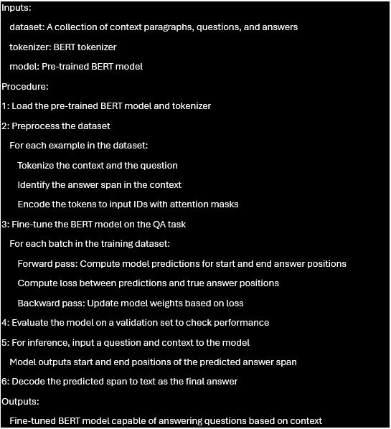
Implementation
Pseudocode

Slide 14
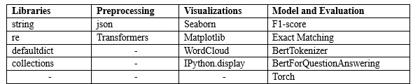
Libraries Used

Slide 15
Results
Exact Match (EM) and F1 scores were chosen for evaluation due to their relevance to QA systems, highlighting strict accuracy and balanced precision-recall performance, respectively.
EM, while indicative of complete matches, doesn’t fully account for the model's practical effectiveness, given the linguistic diversity and question paraphrasing in the SQuAD dataset.
The F1 score, reflecting both partial and full answer accuracy, offers a more holistic view of the model's real-world utility by acknowledging context variability and semantic correctness.

Slide 16

Work completed
Completed all the essential and proposed components of our project.
BERT Model Integration
Data Pre-processing Pipeline
Model Training and Evaluation
User Interface Development
Visualization and report.

Slide 17
Issues/Concerns
Data Quality: Certain inconsistencies in the SQuAD dataset required additional pre-processing steps to ensure data integrity.
Model Overfitting: Initial training phases indicated a tendency for the model to overfit, which was mitigated through regularization techniques and hyperparameter adjustment.
Computational Resources: Given the complexity of BERT, we faced constraints with computational resources, necessitating efficient resource management and scheduling.
User Experience: Ensuring that the user interface was both functional and user-friendly posed challenges, which were overcome through iterative design and testing.

Slide 18
Conclusion
Our project successfully fine-tuned the BERT model for the Trivia Q&A system, achieving an Exact Match of 23.1% and an F1 score of 34.07%, indicating reliable performance in context interpretation and answer accuracy.
While effective in many scenarios, the results also point towards the need for improvements in handling diverse linguistic expressions and longer answer spans to match human-like understanding.
Future work will focus on expanding the training dataset, refining the model to better grasp complex queries, and exploring advanced algorithms to bridge the gap between AI and natural human language comprehension.

Slide 19

References
[1] https://adversarialqa.github.io/
[2] https://github.com/ad-freiburg/large-qa-datasets
[3] Devlin, J., Chang, M., Lee, K., & Toutanova, K. (2019). BERT: Pre-training of Deep Bidirectional Transformers for Language Understanding. North American Chapter of the Association for Computational Linguistics.
[4] Radford, A., & Narasimhan, K. (2018). Improving Language Understanding by Generative Pre-Training.
[5] Peters, M.E., Ruder, S., & Smith, N.A. (2019). To Tune or Not to Tune? Adapting Pretrained Representations to Diverse Tasks. ArXiv, abs/1903.05987.
[6] Wynter, A.D., & Perry, D.J. (2020). Optimal Subarchitecture Extraction For BERT. ArXiv, abs/2010.10499.
[7] Wang, W., Bi, B., Yan, M., Wu, C., Bao, Z., Peng, L., & Si, L. (2019). StructBERT: Incorporating Language Structures into Pre-training for Deep Language Understanding. ArXiv, abs/1908.04577.
[8] Rajpurkar, P., Zhang, J., Lopyrev, K., & Liang, P. (2016). SQuAD: 100,000+ Questions for Machine Comprehension of Text. Conference on Empirical Methods in Natural Language Processing.
[9] Liu, X., Cheng, H., He, P., Chen, W., Wang, Y., Poon, H., & Gao, J. (2020). Adversarial Training for Large Neural Language Models. ArXiv, abs/2004.08994.

