Slide 1
Improving CIFAR-10 Image Classification with Diverse Architectures Using Ensemble Learning
By
Sreecharan Vanam
Rohit Suddala
Mukunda Krishna Ramisetti
at University of North Texas

Slide 2
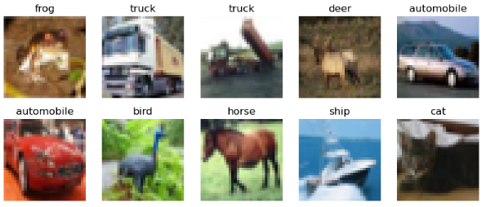
Introduction
Background: Deep learning revolutionizes image recognition, pushing the boundaries of what machines can understand in order to classify any entity in an image.
Challenge: CIFAR-10's small 32x32 pixel images present unique classification challenges due to their low resolution and high variability.
Objective: Our goal is to enhance classification performance by implementing an ensemble of diverse deep learning architectures.
Overview of CIFAR-10 dataset

Slide 3
Motivation
Why Ensemble Learning for CIFAR-10 Image Classification?
Challenges with CIFAR-10:
The CIFAR-10 dataset consists of small 32x32 pixel images which pose significant challenges in terms of image recognition accuracy due to limited resolution and high intra-class variation.
Common issues include overfitting and inadequate generalization when using traditional single-model approaches.
This research is motivated by the need for higher accuracy and robustness in image classification tasks, particularly in datasets with high variability like CIFAR-10.

Slide 4
Advantages
Ensemble methods combine the strengths of multiple learning algorithms, thereby improving the accuracy and robustness over individual models.
We are using other models' advantages in detecting small features that might not be considering by CNN to build an ensemble model.
By integrating diverse architectures (CNN, RNN, VGG16), the ensemble approach seeks to leverage their unique capabilities to address different aspects of the image classification task.

Slide 5
Previous Works
Traditional approaches primarily use CNNs for image classification tasks due to their effectiveness in recognizing hierarchical image features.
Previous models often struggled with the variability and complexity of CIFAR-10. Ensemble learning introduces a way to utilize the collective intelligence of multiple models to enhance predictive performance.
Single model approaches often face challenges like overfitting and limited generalization on complex datasets like CIFAR-10.
Recent research has shown that ensemble methods, which combine multiple models, can significantly improve accuracy and robustness.

Slide 6
Approach
Ensemble Learning: Leveraging strengths of multiple models (CNN, RNN, VGG16) to improve classification accuracy and robustness.
Model Diversity: Using a combination of convolutional and recurrent networks alongside transfer learning to capture a broad spectrum of features.
Synergy: The ensemble method aims to integrate the unique advantages of each model, compensating for their individual weaknesses.

Slide 7
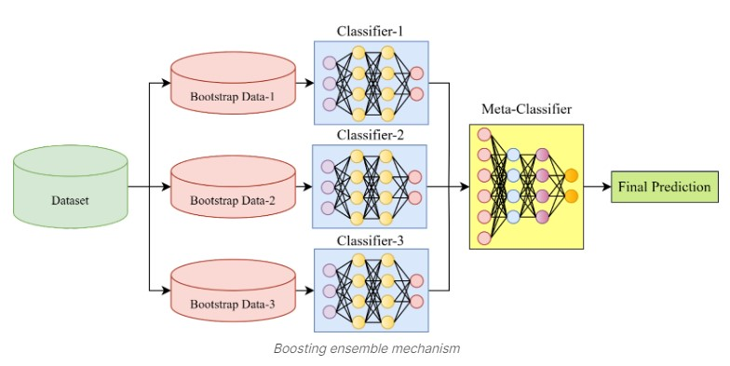
Meta model Architecture
Classfier-1 : CNN
Classifier-2 : RNN
Classifier-3 : VGG16
Stacking ensemble architecture

Slide 8
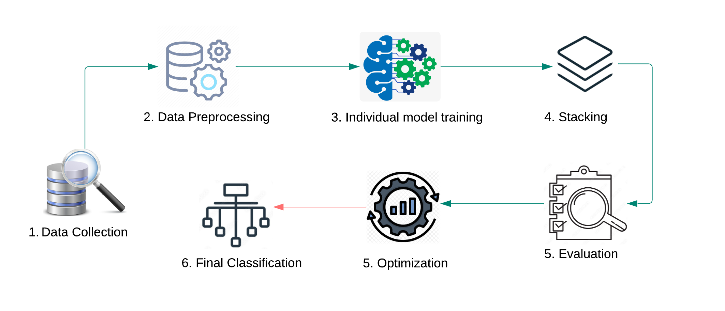
Workflow

Slide 9
Methodology
Model Selection: Choosing models based on their proven performance in similar tasks - CNN for spatial features, RNN for sequences, VGG16 for transfer learning.
Training Methods: Utilizing advanced techniques like Adam optimization and data augmentation to improve model training and generalization.
Optimization Techniques: Employing Adam optimizer for adaptive learning rate adjustments, enhancing convergence speeds.
Regularization Methods: Integrating dropout, batch normalization, and weight decay to prevent overfitting and ensure robust model training.
Techniques Used: Exploring different ensemble techniques such as averaging, bagging, boosting, and stacking.
Stacking Architecture: Stacking involves training a meta-model to optimally combine the predictions from base models, enhancing overall prediction accuracy.
Metrics: Utilizing accuracy, precision, recall, and F1-score to evaluate model performance comprehensively.
Validation Strategy: Applying rigorous cross-validation methods to assess the generalization capabilities of the ensemble model.

Slide 10
Training and Optimization
Optimization Techniques: Employing Adam optimizer for adaptive learning rate adjustments, enhancing convergence speeds.
Regularization Methods: Integrating dropout, batch normalization, and weight decay to prevent overfitting and ensure robust model training.

Slide 11

Experiments
Model Performance: Individual models achieved varying levels of success, with CNN outperforming RNN and VGG16 in initial tests.
Ensemble Advantage: The ensemble model demonstrated superior performance, achieving a significant improvement in accuracy and robustness over individual models.

Slide 12
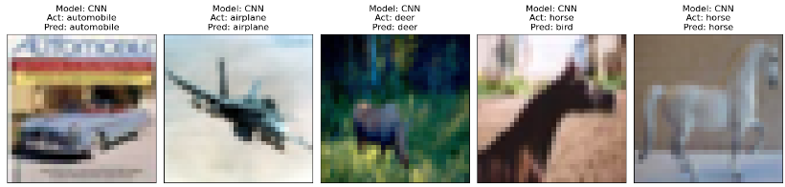
CNN
Accuracy: 78.91%, Precision: 80.69%
Key Observation: Some misclassifications noted due to feature overlap (e.g., color and texture similarities leading to a horse being labeled as a bird).
Insight: Highlights the challenge of distinguishing classes with overlapping features in complex datasets.

Slide 13
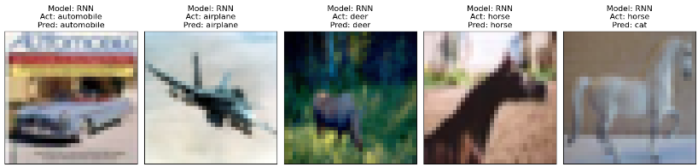
RNN
Accuracy: 49.86%, Precision: 49.98%
Key Insight: RNN's design, inherently biased towards temporal patterns, struggles with spatial feature recognition.
Potential for Improvement: Results suggest a significant opportunity for enhancing model performance. Struggles to classify correctly.

Slide 14
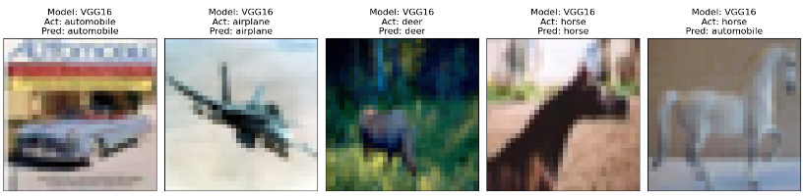
VGG16
Accuracy: 61.51%, Precision: 61.13%
Key Insight: Although not as high as CNN, the performance confirms that transfer learning provides a substantial improvement over random guessing.
Comparison to CNN: Indicates room for improvement in handling CIFAR-10 complexities compared to CNN.

Slide 15

Ensemble Model
Accuracy: 83.52%, Precision: 83.52%
Key Insight: Combining the strengths of CNN, RNN, and VGG16 models enhances overall model performance, leveraging their individual advantages for superior results.
Implication: The ensemble's robust performance confirms the benefit of integrating diverse modeling approaches for complex classification tasks.

Slide 16
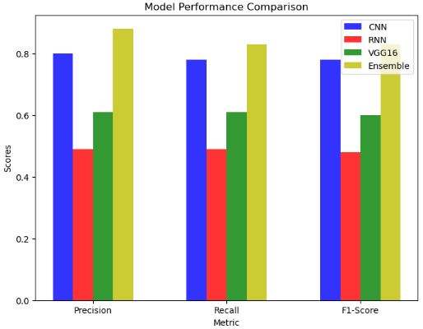
Performance Comparison
We can clearly see that the Ensemble model significantly outperformed all individual models, demonstrating the efficacy of our approach.

Slide 17
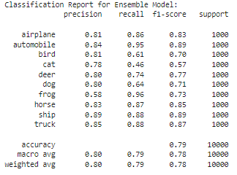
Performance across classes
We can see that the ensemble model has high precision, recall and F1 scores across most classes, showing that its performance is generally very good, especially in detecting automobile and ship.

Slide 18
Limitations
Computational Intensity: Ensemble models require more resources and time.
Overfitting Potential: There's a risk of overfitting with complex base models.
Limited Scalability: Adding more models complicates deployment and maintenance.

Slide 19
Conclusion
Findings: Our ensemble approach markedly enhances CIFAR-10 image classification, setting a new benchmark for future studies.
Future Directions: Further research could explore the integration of additional model types and deeper ensembles to tackle even more complex classification tasks.

Slide 20

Questions and Discussion
Thank you for your attention. We welcome any questions or feedback regarding our approach and findings.

