Slide 1
TEACHING WITH 18THCONNECT
TONYA-MARIE HOWE * DANIELLE SPRATT
MARYMOUNT U CAL STATE NORTHRIDGE

Slide 2
OVERVIEW
Introductions & invitations
What is TypeWright? Why use it in a classroom?
Sample assignments & outcomes (how to use 18thConnect in various iterations): Project management & Pitfalls
Transitioning to a digitized text
Editing, Workshopping, & Discussion

Slide 3
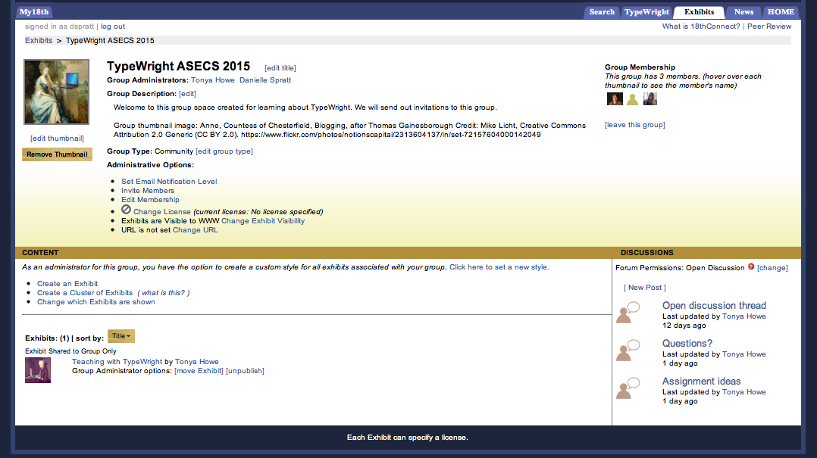
INTRODUCTIONS: JOIN OUR GROUP!

Slide 4
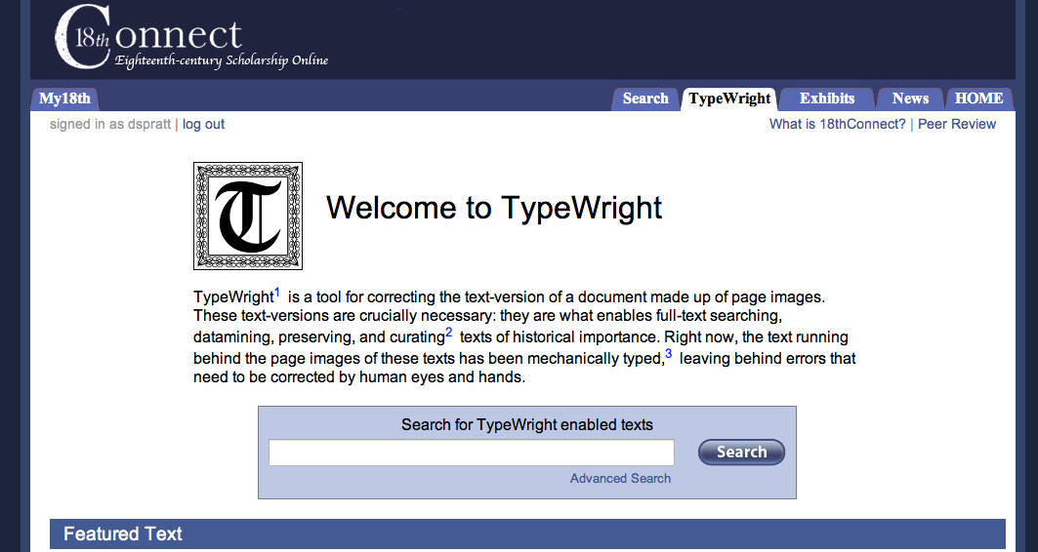
WHAT IS TYPEWRIGHT?

Slide 5
18THCONNECT AS ENGAGED LEARNING
Using 18thConnect and framing it as part of a DH/engaged learning project allows students to understand better:
the broader literary marketplace/material culture
the intertextual conversations among works from the period
the value of creating machine-readable texts (access) – how literature engages with multiple audiences across time periods
the complementary nature of close and distant reading practices

Slide 6
18THCONNECT AS SERVICE-LEARNING
Students consider the definition of community engagement/service learning:
Service Learning is a teaching and learning strategy that integrates meaningful civic engagement activities with instruction and reflection to enrich the learning experience, teach civic responsibility, and strengthen communities.
Value of preservation & access

Slide 7
SPACES OF TEXTS
Moretti’s “Distant reading” vs. 18thConnect’s hyper-close reading
Students can use corrected OCR to better perform tasks of distant reading (word clouds/data analysis/text analysis)
Students can compare the nature of their reading practices across texts
Notes:
Moretti: “The trouble with close reading (in all of its incarnations, from the new criticism to deconstruction) is that it necessarily depends on an extremely small canon. . . . And if you want to look beyond the canon (and of course, world literature will do so: it would be absurd if it didn’t!), close reading will not do it. . . . It’s a theological exercise . . . Whereas what we really need is a little pact with the devil: we know how to read texts, now let’s learn how not to read them. Distant reading: where distance, let me repeat it, is a condition of knowledge: it allows you to focus on units that are much smaller or much larger than the text: devices, themes, tropes—or genres and systems. (“Conjectures on World Literature,” 48-9).

Slide 8
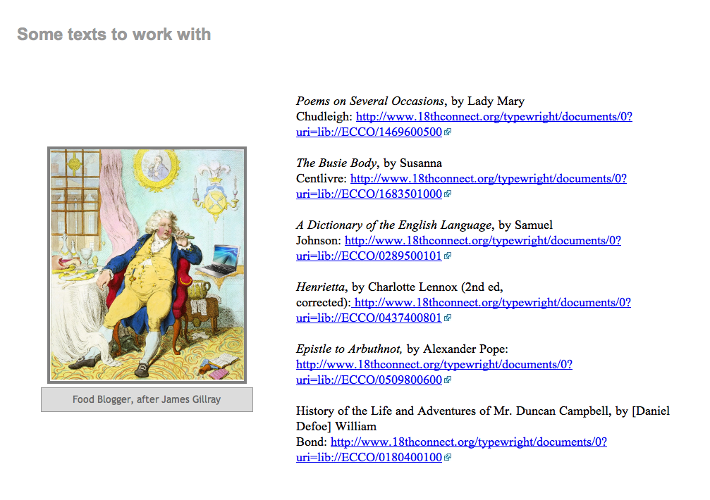
EXPLORING TYPEWRIGHT

Slide 9
TEACHING WITH TYPEWRIGHT
Multiple types of approaches
Single assignment, optional assignment, research project, etc.
Key to teaching with DH-related models: PROJECT MANAGEMENT (starting with an overview of how to use TypeWright)

Slide 10
18THCONNECT AS AN ENGAGED DH ASSIGNMENT (Tonya’s model)
EN490 Dr. Howe
Term Project and Evaluation Criteria
Option 1: Researched Wikipedia page on an approved work by Pope or Montagu, with a 4-page reflective essay on the experience. You can work on a page that already exists, or you can create a new page.
work must be researched and accurate, and
written for a general audience in the manner established by Wikipedia (both formally and in terms of content)
make a new or improved contribution to the store of public knowledge
educate the audience about the narrative and thematic content of the piece, its formal qualities, and important critical conversations about it
reflective essay must be well-organized, stylistically polished, (4 pages,)
and it must logically and effectively connect the themes of the class with the project as a whole

Slide 11
18THCONNECT AS AN ENGAGED DH ASSIGNMENT (Tonya’s model, continued)
Option 2: Librivox Recording of an approved Pope and/or Montagu piece(s), with a 5-page researched critical introduction to the work itself. If you work with a partner on the recording, each must have distinct parts to play (roles in the speaking, based on the text), and it must be of substantial length.
You should create a recording of a piece that does not already have a recording.
recording must be well-produced and accurately read
make a useful contribution to the number of free and openly-accessible audio recordings of our literary inheritance, thereby making that inheritance more accessible in the manner established by Librivox
critical introduction must be researched and accurate (and 5 pages)
written for an audience of advanced undergraduate students, with the goals of
1. educating the reader about the narrative and thematic content of the piece, its formal qualities, and important critical conversations about it and 2. modeling good writing.

Slide 12
18THCONNECT AS AN ENGAGED DH ASSIGNMENT (Tonya’s model, continued)
Option 3: 18thConnect.org Typewright OCR correction of an approved Pope or Montagu piece, with a 5- page researched critical introduction to the work itself. You can choose to work on the OCR correction with another member from your club, if the OCR correction is between 25-50 pages.
It must make a useful contribution to the number of free, reliable, and openly-accessible scholarly materials currently available only in ECCO by
editing and correcting the Optical Character Recognition of early-edition electronic facsimiles of a key work by Pope or Montagu
according to the stylesheets combining 18th Connect and the Donne Variorum guidelines
reflective essay must be well-organized, stylistically polished, (5 pages)
and it must logically and effectively connect a key theme of the class with the editing experience in part
by describing important conventions of 18th century printing
The term project for this class is team-based (let’s think of them as clubs, as the eighteenth century is a most “clubbable” era!), but you will be responsible for your own work. That is, your teams will only be organized around the option you choose to complete, so that you can offer feedback on methodology and research. You should use your fellow club members as resources to help you when you have questions and need constructive feedback.

Slide 13
18THCONNECT AS AN ENGAGED DH ASSIGNMENT (Tonya’s model, continued)
Proposal and annotated bibliography due ______:
Your proposal should be a 1-page, well-written statement of your option and chosen text, any ideas for group division of labor (if necessary), and a detailed assessment of what you will need to do in order to complete this assignment.
Your annotated bibliography should be composed of at least 5 scholarly essays and/or books (or book chapters) researched through our library. Each annotation should have an MLA-formatted bibliographic entry and a 1-2 paragraph SUMMARY of the resource in its entirety, with a brief 1-2 sentence statement of how it will be used in your introduction to the piece. Will it provide background information on printing or publishing in the 18c? Will it provide background information on the writing of this piece? On the genre it represents? On 18th century verse? On…? You may use materials assigned as options in this class, but they will be EXTRA to the required 5 sources. Your materials in the bibliography cannot contain encyclopedia entries or other “common knowledge” sources.

Slide 14
TEACHING ITERATIONS OF 18THCONNECT @ CSUN
Undergraduate (Singular Assignment) | Undergraduate 2 (Core project: 1/2 semester) | Graduate/Seminar (Core project: 1/2 semester)
OCR Correction | OCR Correction | OCR Correction
Compare/contrast group assignment & presentation | Reading/researching context of documents | Reading/researching context of documents
 | Group assignment (or alternate version) & presentation | Working in archives
 |  | Creating annotations & editorial apparatus (examples of project management)
 |  | Basic web design → Countess of Dellwyn Digitization Project
Notes:
Potential pitfall: reading TOO closely (letter and word level/lack of sentence- or paragraph-level context. To help negotiate close reading v distant reading: scaffolding assignments

Slide 15
18THCONNECT @ CSUN
Undergraduate core project
Undergraduate assignment
Graduate core project/Countess of Dellwyn
C18 Scriveners

Slide 16
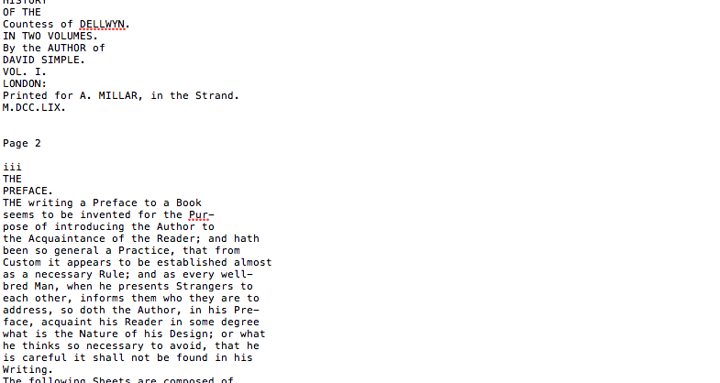
DIGITIZING TEXTS

Slide 17
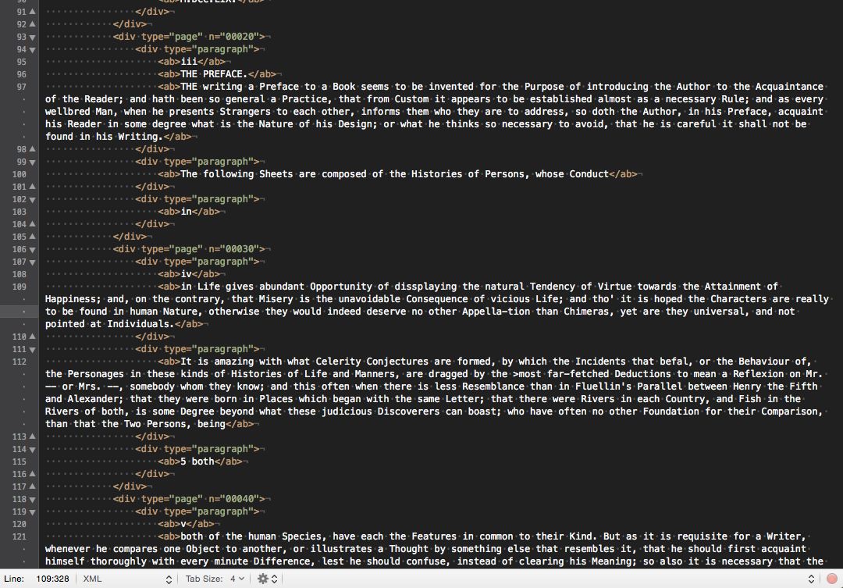
DIGITIZING TEXTS

Slide 18
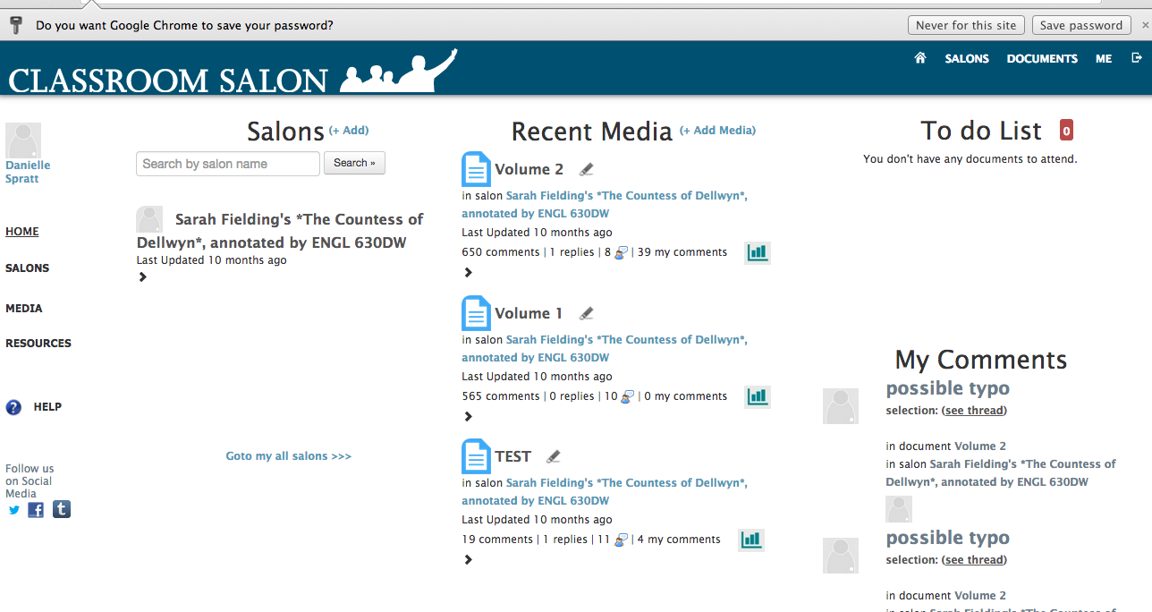
DIGITIZING TEXTS

Slide 19
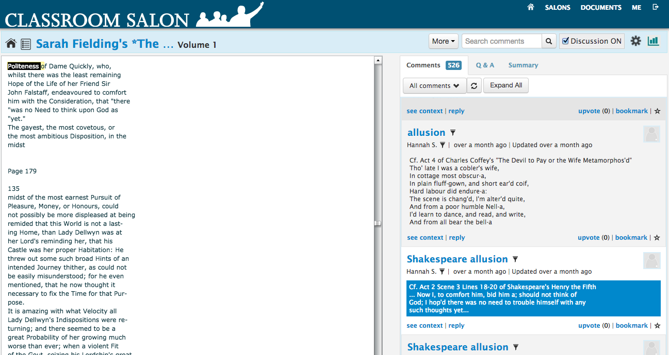
DIGITIZING TEXTS

Slide 20
OTHER HELPFUL RESOURCES
Scalar
Rap Genius
Annotation Studio
Weebly
Wix

Slide 21
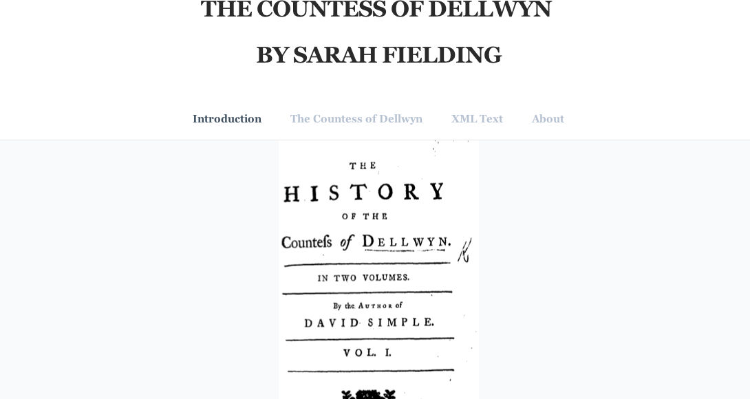
DIGITIZING TEXTS

Slide 22
BRAINSTORMING & ASSIGNMENT DRAFTING
Use this time to share ideas and work on potential assignments and projects for your classes!

