Slide 1
Linear Regression Model to predict car price and determine factors which has direct impact on car price
Done by:
Sreeharsh Nair
IIT MADRAS
Ph:8281400538
harshnair34@gmail.com

Slide 2
Case study overview
1. Problem definition
There has been an increasing demand of cars and it is the job of automotive manufacturers to satisfy the demands of public. A new Indian automobile company wants to produce cars and to get an idea of the market, it is necessary to determine the factors that affects the car price and to determine which variables are significant in predicting the price of a car.
2. Objectives
Required to model the price of cars with the available independent variables. To first understand the data, to clean data, to prepare data and to build a linear regression model to predict the car price. Also, to make the model simple by feature reduction and identify critical features.

Slide 3
Methodology – CRISP Modelling
Identify the problem
Data collection
& understanding
Data manipulation ( to find missing data)
Feature creation for model (data preparation)
Model building
Feature reduction ( to choose optimal no. of variables)
Model evaluation and validation

Slide 4
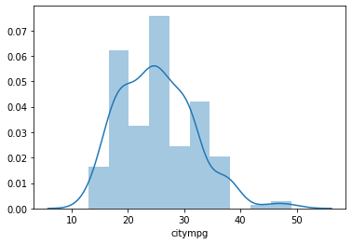
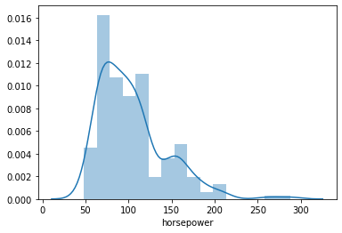
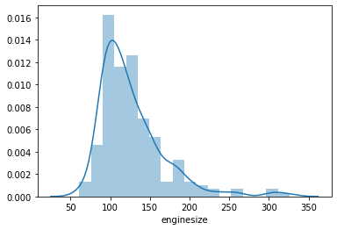
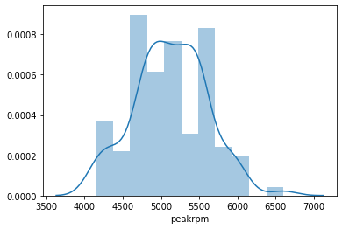
Data understanding and exploration
The data set contains 205 entries and 29 columns.
To create a probability density function distribution plot with respect to selected variables ( enginesize, peakrpm, citympg, HP).
To understand how different variables are correlated to each other and price variable.( plots in slide no. 5).
Also, to plot correlations on a heatmap.
There were no missing values in the data that we prepared for our analysis.
Replaced CarName with carcomp variable which lists name of company from carnames and also replaced wrongly spelled carnames.

Slide 5
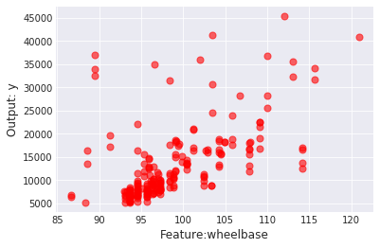
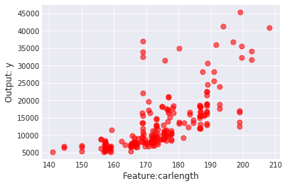
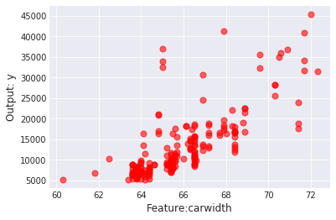
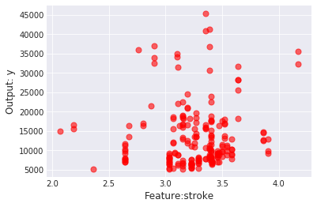
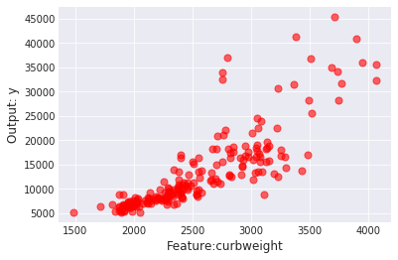
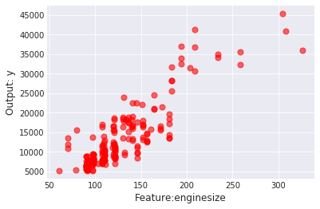
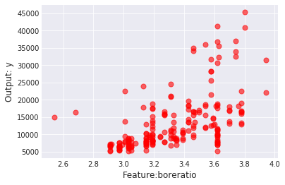
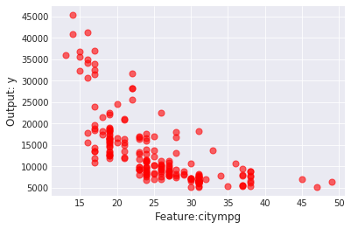
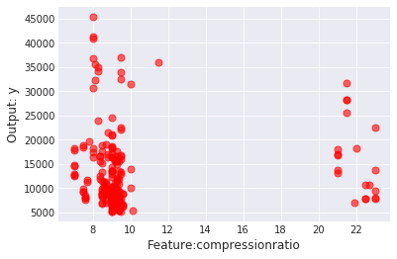
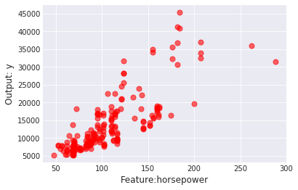
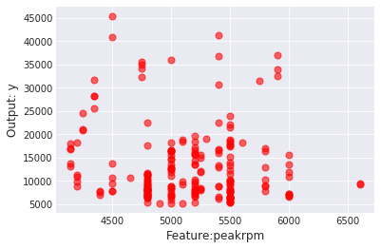
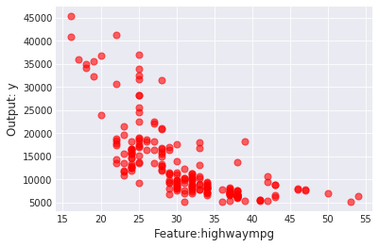

Slide 6
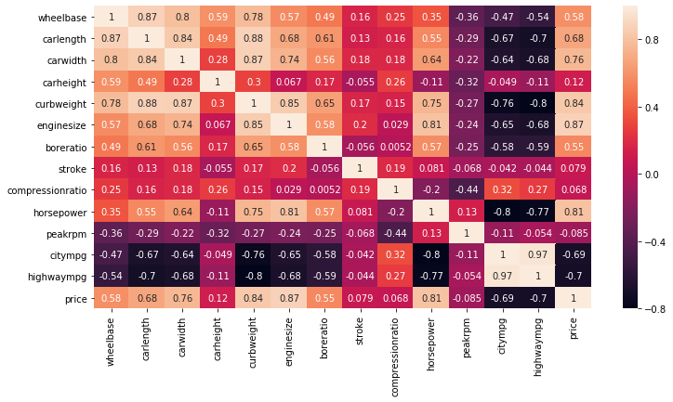
Price is positively correlated with wheelbase, carlength, carwidth, curbweight, enginesize, horsepower, as found in the individual correlations graph in the earlier slide.
Also could be used to establish relation among independent variables.

Slide 7
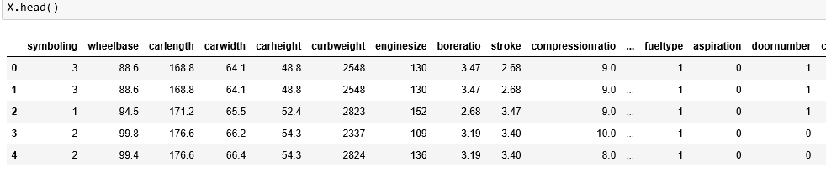
MODEL FITTING AND PREDICTION
Prepared data for building model – x and y.
Also converted objects(strings) into categorical data (int) using LabelEncoder function from preprocessing library.
Used train-test-split ratio to divide x and y for training and testing the model.
Fitting and prediction by linear regression model.
Training R² value = 0.9215
Predicted(Testing) R2 value = 0.7839.

Slide 8
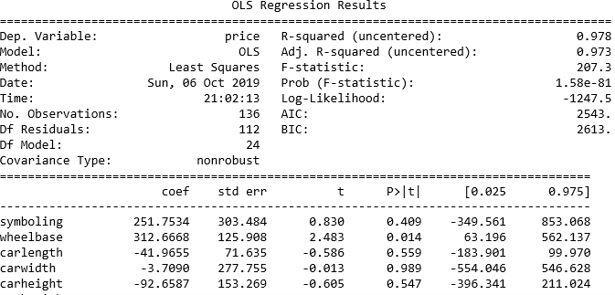
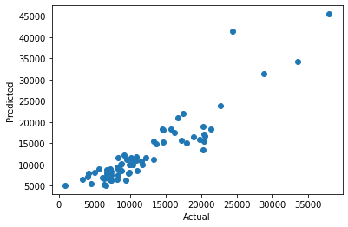
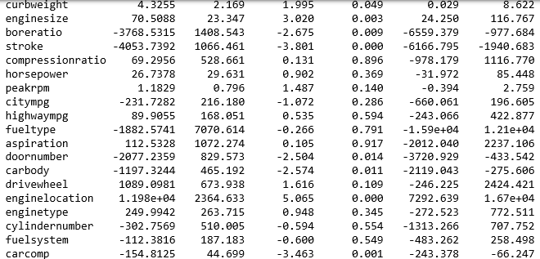
Ordinary least square (OLS) regression:
Training R² value = 0.978
Predicted(Testing) R2 value = 0.8280

Slide 9
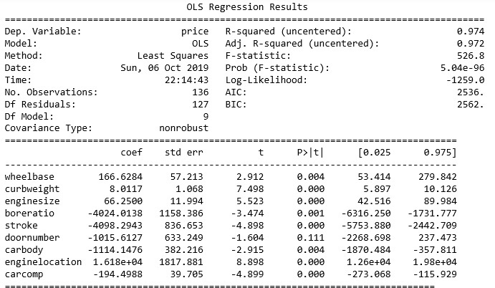
FEATURE REDUCTION
Based on p value from OLS regression results, we did feature reduction to identify which features had an impact and also helps in choosing the optimal number of features.
p-value>0.05 rejected.
Hence, from initial screening the features chosen are wheelbase, curbweight, enginesize, boreratio, stroke, doornumber, carbody, enginelocation, carcomp ( some already related through graphs in slide 5 & 6).
The OLS was performed with new x and y.
New R² value = 0.974.
In this, doornumber had p – value greater
than 0.05 and hence this has to be rejected.
The above regression could be done again to
get a better R2 value.

Slide 10
Conclusion and insights
Was able to develop a linear regressor model to predict car price.
Was able to identify critical independent variables which have an impact on the car price.
Was able to perform feature reduction and hence test the model with reduced number of features.
The following features could affect car price after comparing results from correlation graphs and linear regression (OLS) study:
Curbweight
Wheelbase
Enginesize
carcomp

Slide 11
THANK YOU!

