Slide 1

REVIEW-3 on
Biometric Data Privacy Vault
NAGA SREEJA KODALI – 2410030076
BIJJU ADITHI YADAV – 2410030228
LIKITHA THUMMA – 2410030229
ESHA MANOGNA H – 2410030232
MALREDDY MANOGNA – 2410030430
Computer Science and Engineering Department
KL Hyderabad Off Campus, Aziz Nagar ,Hyderabad
Under the guidance of
Dr. Pavan Kumar Pagadala
Assistant Professor

Slide 2
Introduction
A Biometric Privacy Vault is designed for secure file protection.
Combines face authentication with AES-256 file encryption.
Only registered users can unlock and manage encrypted files.
Uses image similarity to verify faces before granting access.
Provides dual-layer protection:
  Biometric authentication → ensures authorized access.
  Strong AES encryption → keeps files unreadable if stolen.
Useful for protecting sensitive files in academic, personal, and professional use.

Slide 3
Problem Statement
In today’s digital era, sensitive data is highly vulnerable to cyberattacks, unauthorized access, and breaches, making traditional password-based protection insufficient. Without a secure mechanism, critical files can be exposed even if stored locally. There is a growing need for a robust system that not only restricts access to legitimate users through biometric verification but also ensures that stored files remain unreadable and secure through strong encryption techniques.

Slide 4
Objectives of the Project
To design a Biometric Privacy Vault using face authentication and AES-256 encryption.
To ensure that only authorized users can access sensitive files.
To provide a dual-layer security mechanism: biometric verification + strong encryption.
To enable users to securely encrypt and decrypt files after successful authentication.
To safeguard data privacy and integrity against unauthorized access.
To develop a system that is easy to use in academic, personal, and professional contexts.

Slide 5
PROPOSED METHODOLOGY
User Registration
Capture and store user face images in greyscale for biometric enrollment.
Preprocess face images using feature extraction techniques.
Face Authentication
Capture input face image during login.Compare with stored images using similarity/matching algorithms.
If matched, grant access to the vault.
File Encryption
Generate a secure AES-256 key.
Encrypt user-selected files using AES in Galois/Counter Mode (GCM).Store encrypted files in the vault.
File Decryption
Upon successful authentication, allow users to decrypt files.
Verify data integrity using AES-GCM authentication tags.
Vault Access Control
Only authenticated users can perform encryption/decryption operations.
Even if files are accessed directly, they remain unreadable without authentication.

Slide 6
TECHNIQUES USED
Image Processing APIs – For capturing and processing face images.
Java Cryptography - provides APIs for secure encryption, decryption, hashing, and key management.
AES-256 (GCM Mode) – Ensures secure file encryption with confidentiality & integrity.
SecureRandom Class – Generates secure keys and initialization vectors.
Core Java (JDK) – Main programming platform for system development.
File I/O (java.io / java.nio.file) – For handling file encryption, decryption, and storage.

Slide 7
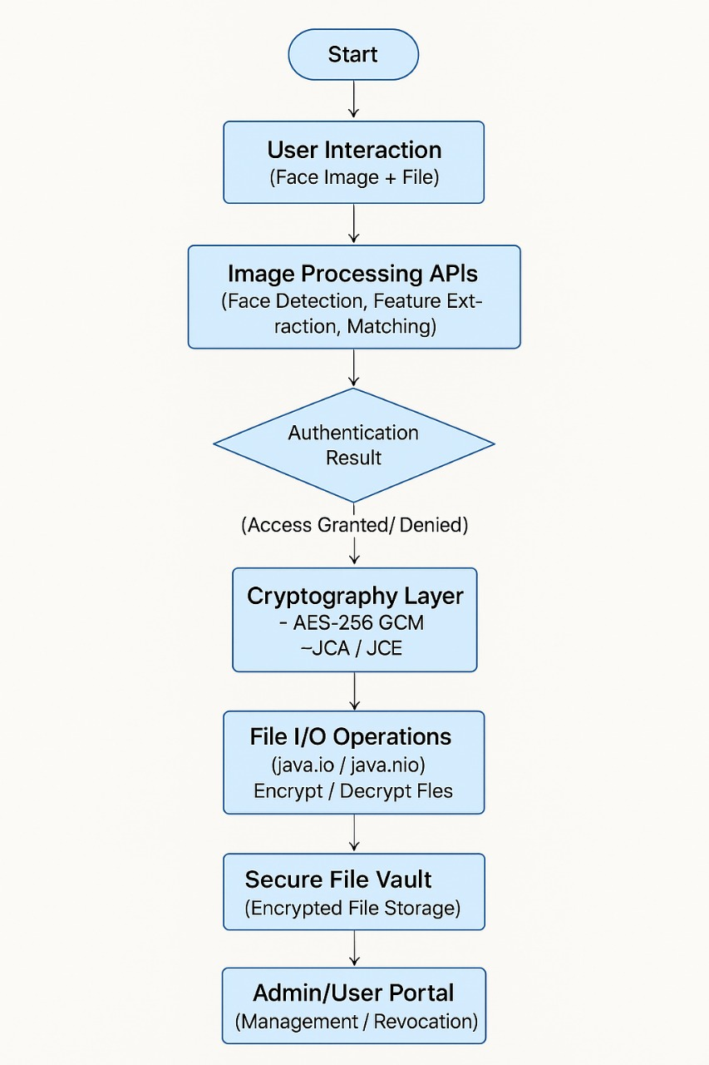
Design

Slide 8

Step1:

Slide 9
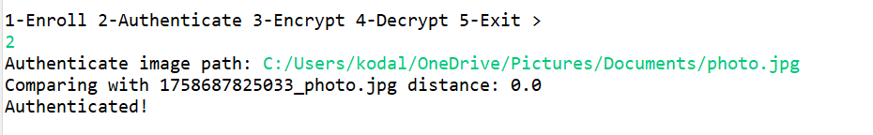
Step2:

Slide 10
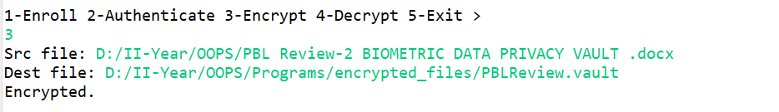
Step3:

Slide 11
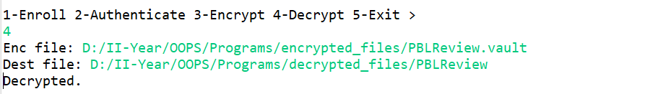
Step4:

Slide 12
THANK YOU

