Slide 1

Hospital Patient Management System

Slide 2
Abstract
The Hospital Patient Management System is designed to simplify patient registration, appointment scheduling, medical records management, and billing processes. It ensures accuracy, efficiency, and better coordination among doctors, staff, and patients.

Slide 3
Problem Statement
Manual hospital processes such as patient registration, appointment handling, and records management are time-consuming, error-prone, and inefficient. There is a need for an automated system to manage hospital operations effectively.

Slide 4
Introduction
The Hospital Patient Management System is a software solution that provides a centralized platform for managing hospital operations. It improves efficiency by automating patient data handling, reduces paperwork, and enhances patient care through quick access to records.

Slide 5

Background
Manual systems: registers, paper files → slow & errors
Semi-automated: basic software → no full hospital integration
Integrated systems: connect patients, doctors, labs, pharmacy, billing
Benefits: faster service, less paperwork, accurate records, cost savings
Research shows: efficiency ↑ 30–40%, better patient satisfaction
Challenges: high cost, training needs, data privacy & security
Latest trends:
AI for diagnosis & patient monitoring
IoT wearables for real-time health data
Cloud storage & Big Data for predictions
Gap: Small/rural hospitals need simple, low-cost solutions

Slide 6
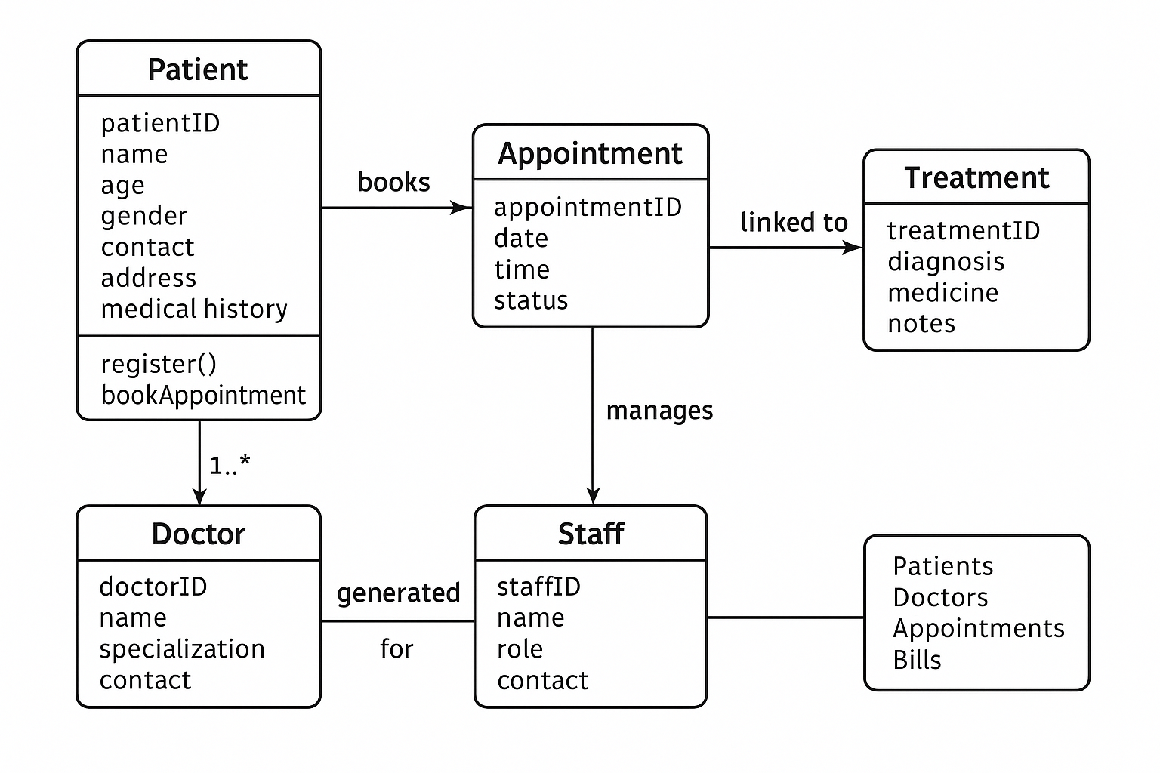
SYSTEM ARCHITECTURE

Slide 7
ER Diagram
Patient
Attributes: Patient_ID, Name, Age, Gender, Contact, Address, Medical_History
Doctor
Attributes: Doctor_ID, Name, Specialization, Contact, Availability
Appointment
Attributes: Appointment_ID, Date, Time, Status
Treatment / Prescription
Attributes: Treatment_ID, Diagnosis, Medicine, Notes
Bill / Payment
Attributes: Bill_ID, Amount, Date, Status
Staff / Admin
Attributes: Staff_ID, Name, Role, Contact

Slide 8
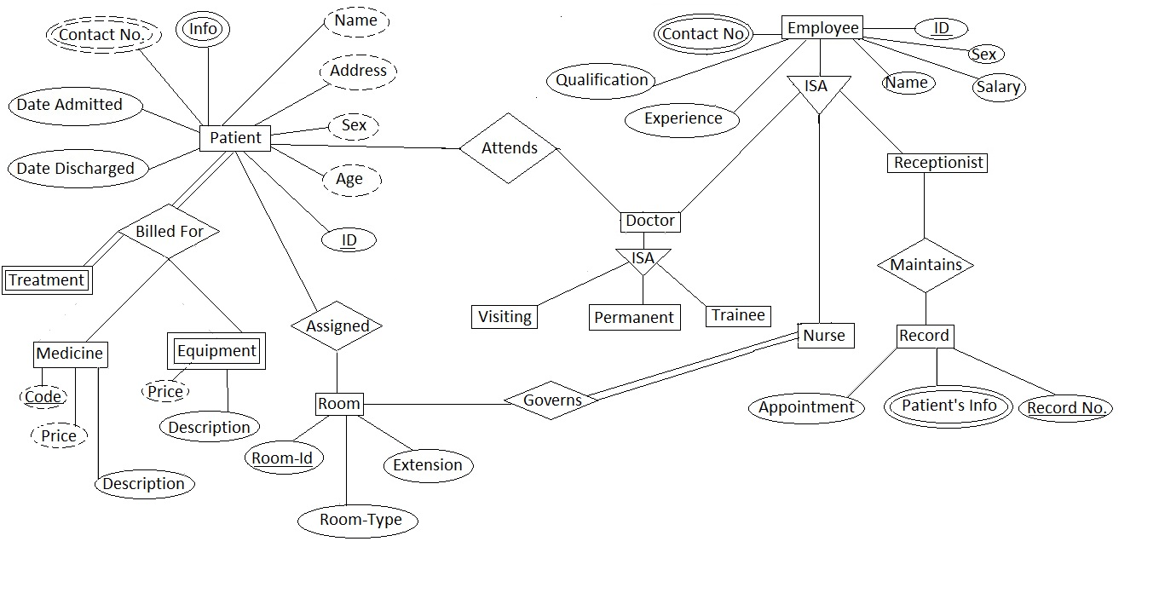
ER Diagram

Slide 9
THANK YOU!

