Slide 1
Book Recommendation System
Sai Sreeja Mukka

Slide 2
Context
Problem statement
Technologies used
Architecture
Components
Screenshots

Slide 3
Problem Statement
A Book Recommendation System that suggest books to users based on their genres of interest.
The system will provide personalized recommendations and allow users to explore books from various genres.

Slide 4
Technologies used
Scala
Play framework
Docker
Kafka
MySQL

Slide 5
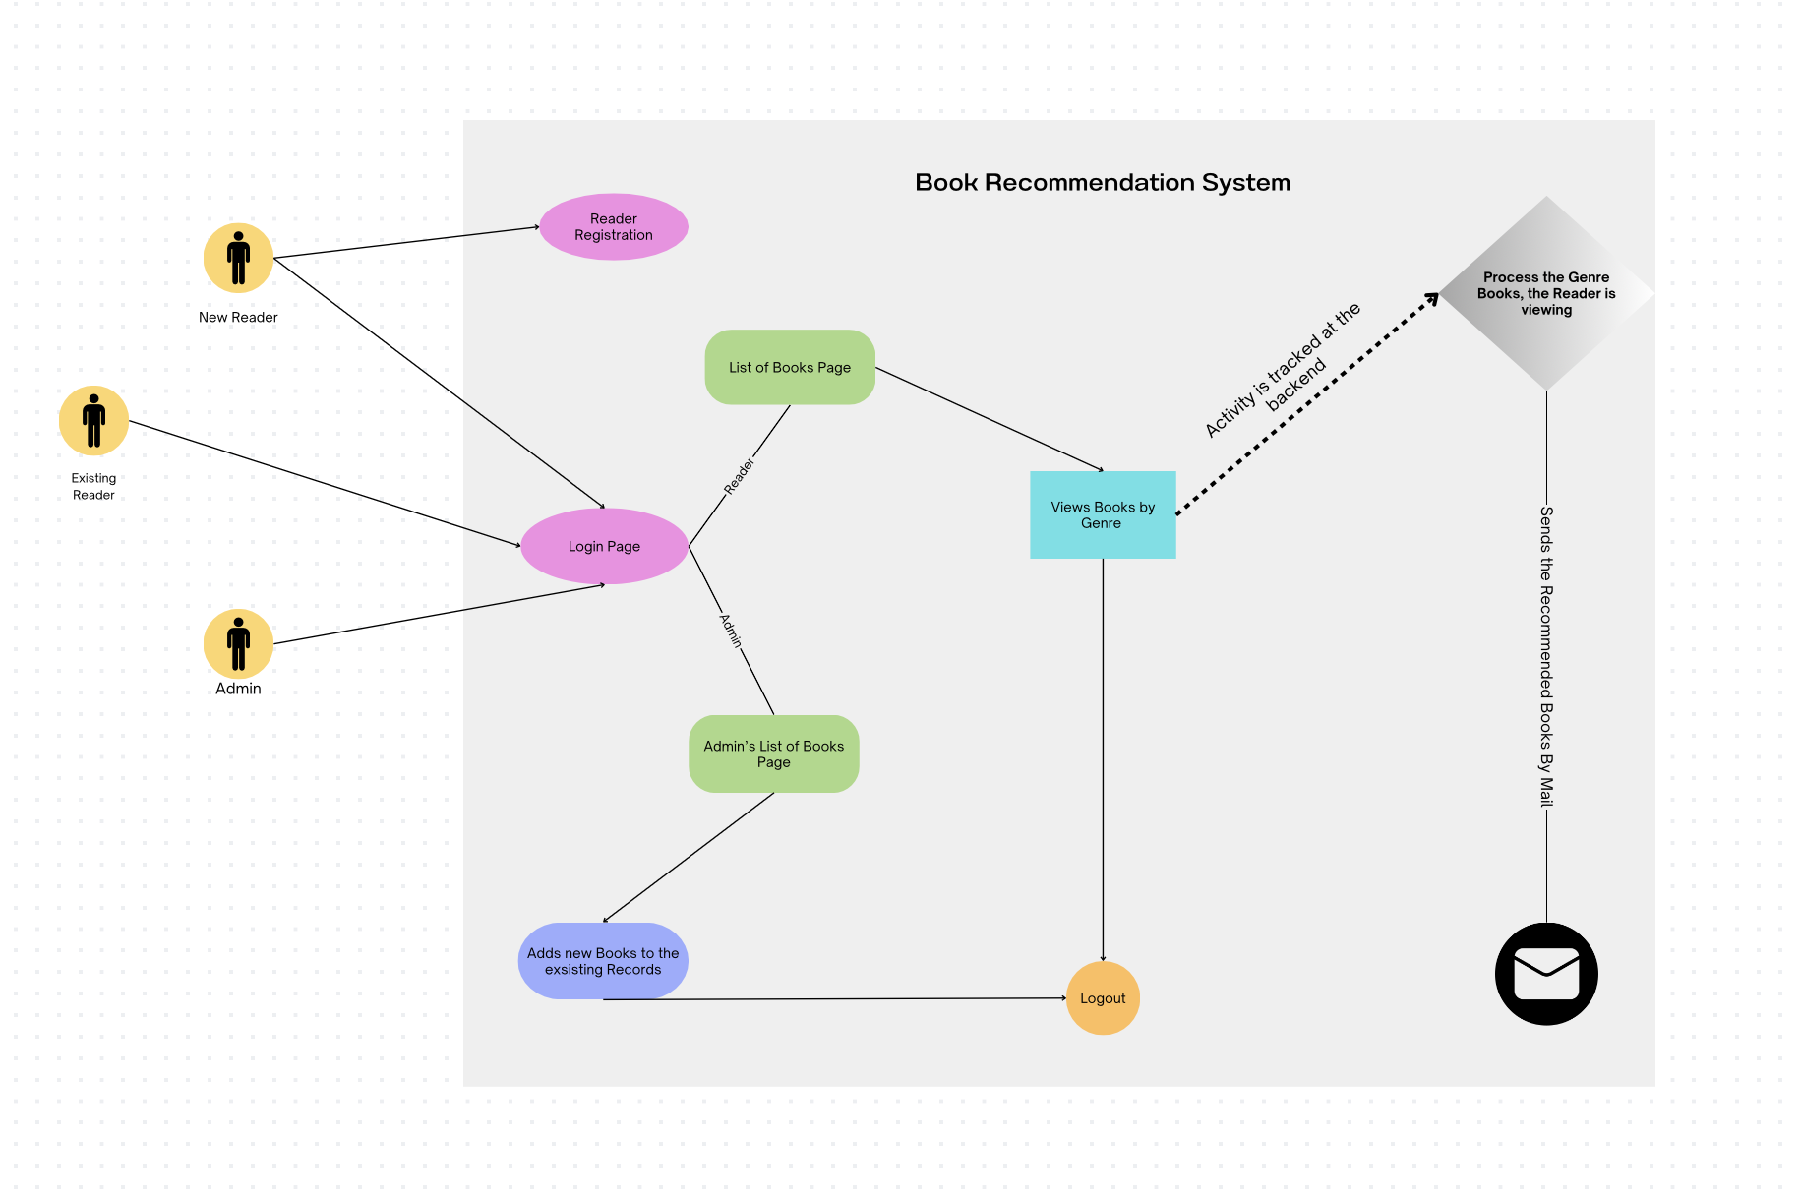
Architecture

Slide 6
Components
MicroServices:
User Service
Books Service
Recommendation Service
Models:
Book
User
Notes:
Talk about the what each services do.

Slide 7
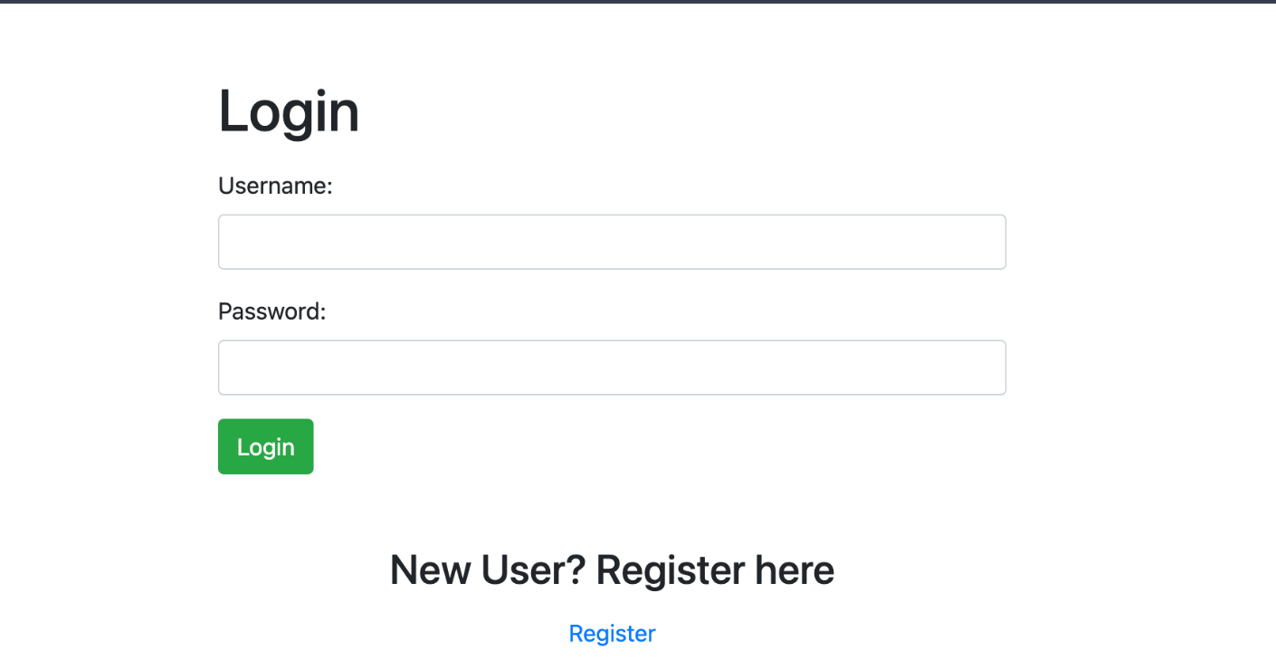
Login Page

Slide 8
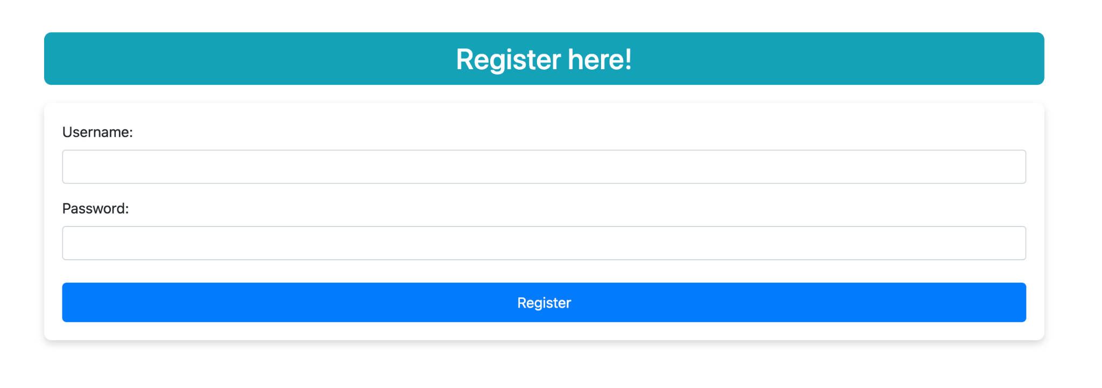
Register Page

Slide 9
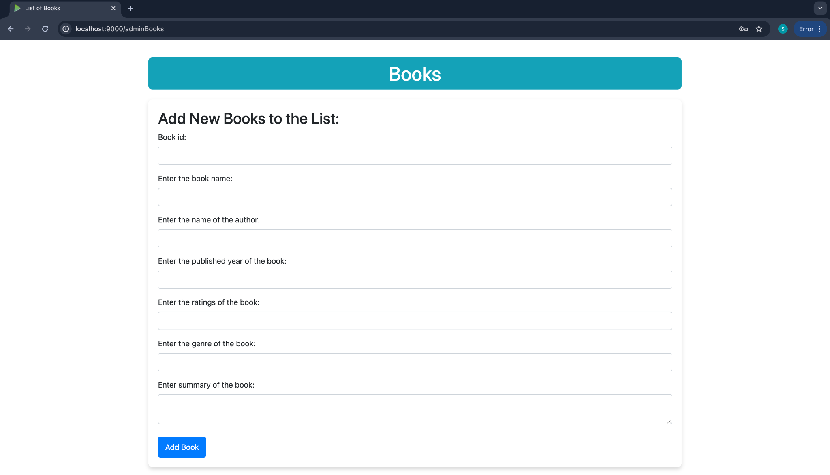
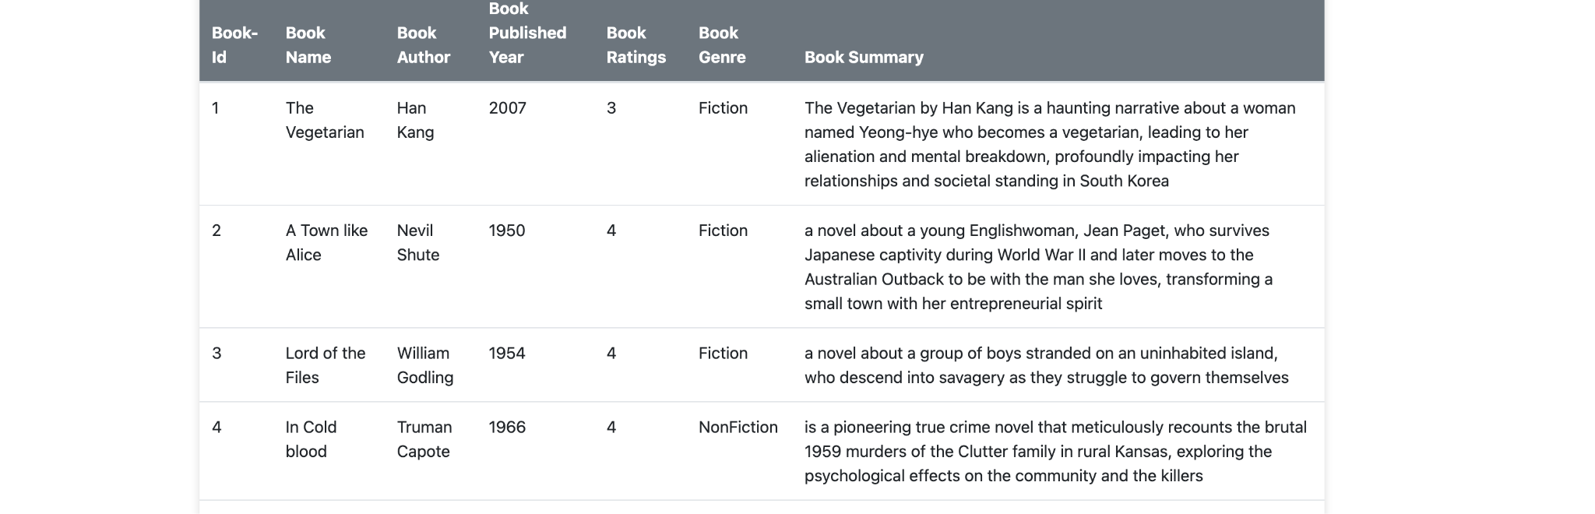
Admin Pages

Slide 10
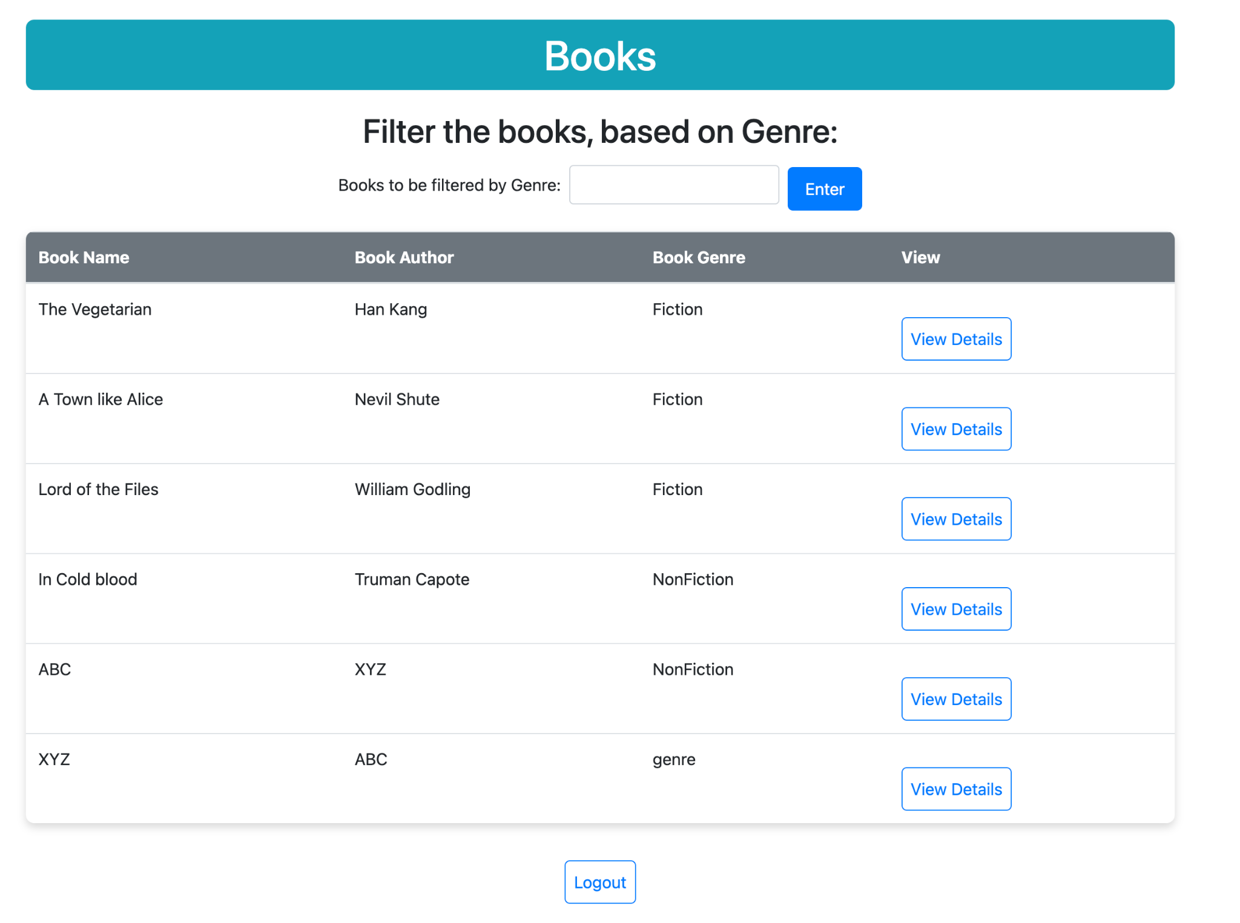
Users Book Page

Slide 11
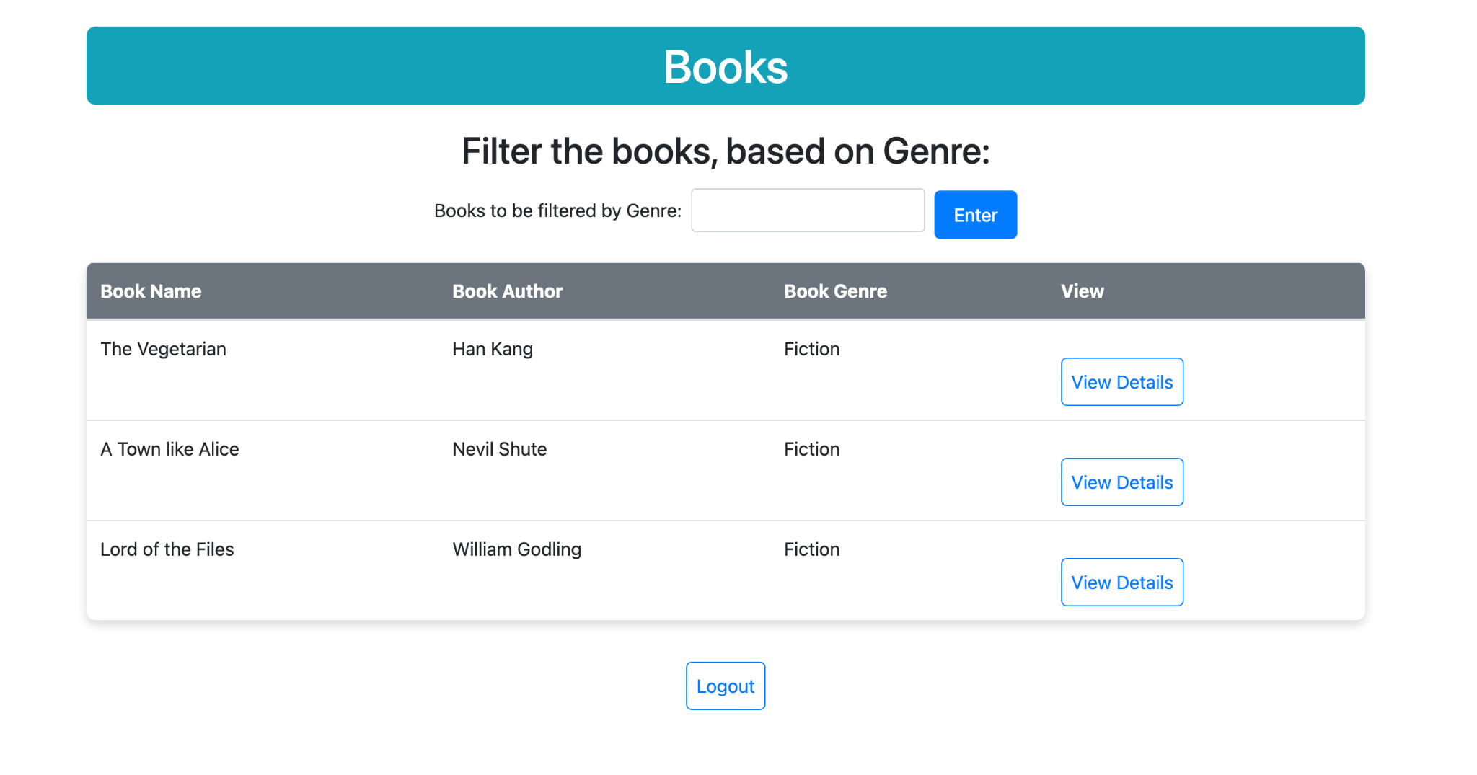

Slide 12
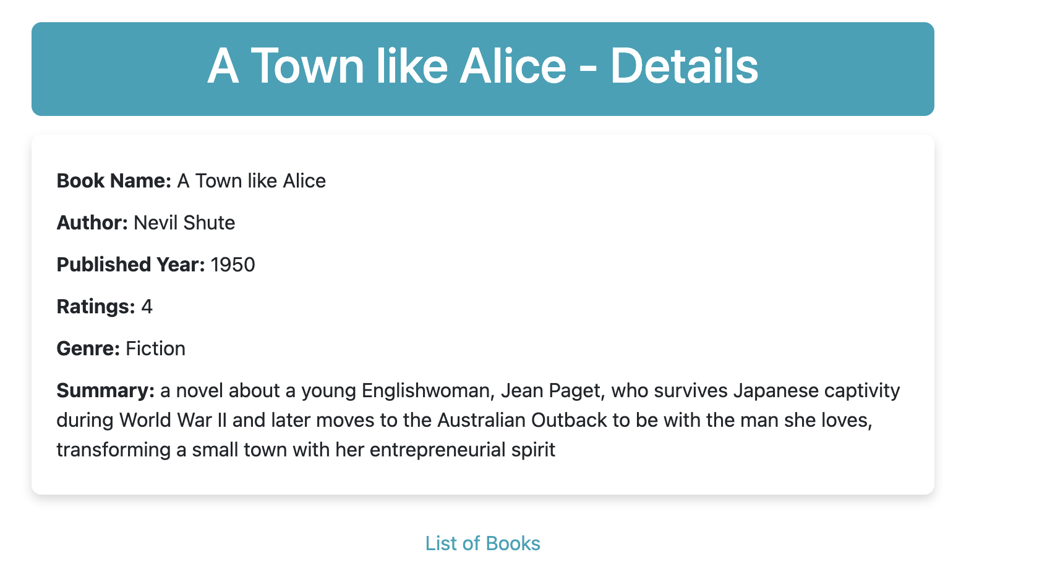

Slide 13
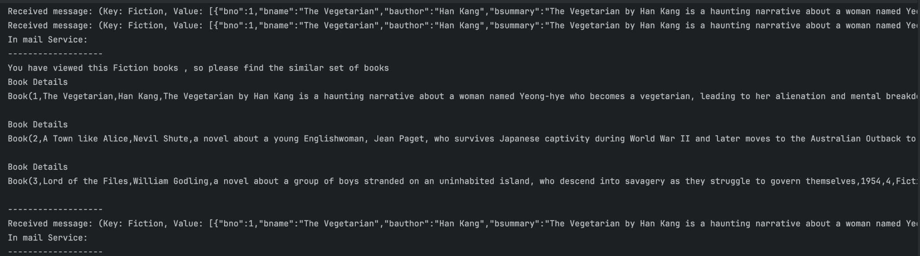
Mail Recommendation

Slide 14
Thank you

