Slide 1

FAQ Maker for Products
Project Presentation
Team:
Madhura Mathkar
Graduate Student
School of Computing
University of Utah
Pranav Shah
Graduate Student
School of Computing
University of Utah
Sreeja Pillai
Graduate Student
School of Computing
University of Utah

Slide 2
Presentation Outline
Introduction
Problem Statement
Motivation
Project Scope
Dataset
Methodology
IR Model
Pre-Processing
Vector Space Model
Cosine
BM25
Evaluation and Applications
Results
Evaluation Measures
Applications
References

Slide 3
Introduction
Customers may ask a few product relevant questions to seller or read FAQ’s.
Hence, it is the seller's responsibility to provide all the necessary information a customer might be looking for.
Additionally, the seller might find it difficult to survey the online market for similar products and check all user asked questions/suggestions.
The project aims at creating a model that generates questions related to any specific product for the seller.
Hence, seller can use these to make product description more informative.
The seller can also use this questions to get an idea about user’s perspective over other products.
Problem Statement:
Products may be difficult to use, hence a proper product description is necessary.
Finding a solution to a question may be difficult when there is too much information
Manufacturers/Sellers need to address such questions efficiently
In the era of e-commerce, getting a market survey is not easy and comparing thousands of products to get user’s perspective is extremely difficult.
Introduction
Dataset & Methodology
Evaluation and Applications
References

Slide 4
Motivation:
Understand the perspective of the Manufacturers/Sellers
Manufactures need to have insight to the user’s perception of the product and other similar products in market.
Reduce redundancy when there are many similar questions from users.
Generate a set of questions so that users can find relevant information.
Project Scope:
Help create a question bank for a particular product description using the amazon Q/A and description dataset.
Related Works:
Every Q/A models involves using Q/A set.
They suggest questions based on fixed answers.
Our Contribution:
Providing questions based on real-world data.
Focusing on questions more and product description than answers. To those questions.
Introduction
Dataset & Methodology
Evaluation and Applications
References

Slide 5
Dataset
Amazon Product Dataset^{[2]} – It consists of product meta-data.
Amazon Review/Rating Dataset^{[2]} – It consists of product ratings, review and q/a for each product.
We used the following features from the Datasets:
ASIN (Product id)
Question
Description
Category
Title
Brand
We used Electronics dataset to build our model.
Dataset and Methodology
Introduction
Evaluation and Applications
References

Slide 6
Methodology
The developed IR model includes the following components:
Data Fetch and Pre-processing
Descriptions (Description, category, title, brand)
Question
Query
TF – IDF
Cosine Similarity and Ranking
BM25
Evaluation of this IR model will be discussed in the later sections.
Dataset and Methodology
Introduction
Evaluation and Applications
References

Slide 7
IR Model:
Description dataset
Description dataset
Keywords!
Data
Pre-Processing
Start
Data
Pre-Processing
Questions dataset
Figure 1: FAQ Maker model
Dataset and Methodology
Introduction
Evaluation and Applications
References

Slide 8
IR Model:
Description dataset
Description dataset
Vector Representation!
Data
Pre-Processing
TF-IDF
Start
Data
Pre-Processing
Questions dataset
Figure 1: FAQ Maker model
Dataset and Methodology
Introduction
Evaluation and Applications
References

Slide 9
IR Model:
Output!
Relevant Questions
End
Description dataset
Description dataset
Data
Pre-Processing
TF-IDF
Cosine Distance
& Ranking
Start
Vector Representation!
Query!
Data
Pre-Processing
Query
Pre-Processing
Query Set
Questions dataset
Figure 1: FAQ Maker model
Dataset and Methodology
Introduction
Evaluation and Applications
References

Slide 10
IR Model:
Description dataset
Description dataset
Data
Pre-Processing
Start
Data
Pre-Processing
BM25
Model
BM25 Model!
Questions dataset
Figure 1: FAQ Maker model
Dataset and Methodology
Introduction
Evaluation and Applications
References

Slide 11
IR Model:
Description dataset
Description dataset
Data
Pre-Processing
Query!
Start
Data
Pre-Processing
BM25
Model
Query
Pre-Processing
Query Set
Questions dataset
Output!
Relevant Questions
End
Figure 1: FAQ Maker model
Dataset and Methodology
Introduction
Evaluation and Applications
References

Slide 12
IR Model:
Relevant Questions
End
Description dataset
Description dataset
Data
Pre-Processing
TF-IDF
Cosine Distance
& Ranking
Start
Data
Pre-Processing
BM25
Model
Query
Pre-Processing
Query Set
Questions dataset
Relevant Questions
End
Figure 1: FAQ Maker model
Dataset and Methodology
Introduction
Evaluation and Applications
References

Slide 13
Preprocessing
Pre-processing means to bring the text into a form that is analyzable for our task^{[1]}.
Pre-processing also helps removes noise from the data.
The steps in Pre-processing are:
Tokenization: Split a text into individual tokens
Stemming: Reducing inflected word to their base or root form.
Stop-words: Removing frequent unusual words, called stopwords.
Special characters and URL removal: Using Regex
POS tagging
Dataset and Methodology
Introduction
Evaluation and Applications
References

Slide 14
Pre-processing:
['NN', 'NNP', 'CD', 'NNS', 'JJ', 'NNPS', 'VBD', 'POS']
Dataset
POS tagging
URL removal
Tokenization
Stemming
Removing special characters, symbols and XMLtags
Stopwords
Output
Example input:
[\'CISCO 2509 CISCO Router\', \'<div style="text-align:center;width:100%;margin:22px 0;height:1px;border-top:1px solid #DDDDDD"></div> <center><div class="transparency-container aplus-content-container"> <a href="/b?node=12691228011"><h3><img src="https://images-na.ssl-images-amazon.com/images/G/01/img16/pc/easychoice/landing/easychoice_landing_header.jpg" width="65%"/></h3></a></center></div> <div style="text-align:center;width:100%;margin:22px 0;height:1px;border-top:1px solid #DDDDDD"></div>\']
Example Output: ['cisco', '2509', 'cisco', 'route']
Dataset and Methodology
Introduction
Evaluation and Applications
References

Slide 15
Vector Space Model
Description dataset
Questions dataset
Data
Pre-Processing
Term Frequency Calculation
Inverse Document Frequency Calculation
Data
Pre-Processing
TF-IDF Matrix calculation
To Cosine Similarity
Dataset and Methodology
Introduction
Evaluation and Applications
References

Slide 16
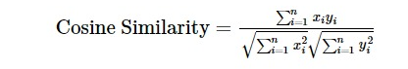
Cosine
Where:
x: Query
y: A row from TF-IDF vector
Dataset and Methodology
Introduction
Evaluation and Applications
References

Slide 17

BM25
BM25 Model:
BM25 is probabilistic model that is developed by Stephen E. Robertson, Karen Sparck Jones, and others.
BM stands for ‘best match’.
BM25 model doesn’t use a single function, it use set of functions.
Where:
tf: Frequency of term occurrences
N: Total number of documents in the collection
dft: Number of documents containing the term
qtf : frequency of occurrences of a term t in the query,
k1: parameters influencing the frequency of terms that is adjusted to 1.2 by default
nb: Normalization factor = (1-b) + b * (tl/tlavg)
tl: Number of terms in the document (document length)
tlavg: Average number of terms in the document
Dataset and Methodology
Introduction
Evaluation and Applications
References

Slide 18
Results
Query: 'Features 22nm Intel Celeron N2807 to deliver to the most intuitive and integrated operating systems in the world Supports 2.5" thickness 7.0/9.5mm Hard Drives (1 x 3Gbps SATA2) Ultra compact PC design - 0.69L(56.1x 107.6 x 114.4mm) 1x SO-DIMM DDR3L Slots (1333 MHz) Preinstall IEEE 802.11 b/g/n Wi-Fi / Bluetooth 4.0 Mini-PCIe card Supports dual displays via a VGA and a HDMI port Gigabit LAN Audio jack (Headphone/MIC) VESA mounting bracket (75 x 75mm + 100 x 100mm)'
Original | Cosine | BM25
Possible using 220v AC power? | I have PCIe 2.0 slot, will this card fit? | Can this shell be used with 18650 batteries (Dimensions: 2.56 x 0.71" / 6.5 x 1.8 cm (L x Dia)?
Will it run Linux (Debian 7, Ubuntu 14.04 or Mint 17)? | Is this Bluetooth 4.0? | can I use it on a TV with VESA 100 x 100?
Does this support 1600 MT/s 204-Pin DDR3 Notebook Memory? | Will this case fit my ASUS ROG G750JS (16.1 x 12.5 x 0.7 ~2.0) | I have PCIe 2.0 slot, will this card fit?
Does it come with power supply and cord? | Does this keyboard have USB 2.0 or 1.0 ports? | who\'s the exact length of the lens? the description says "82.0 x 100.0 x 3.2 inches," but obviously not correct. what is the length specifically?
does it have any fans? | can I use it on a TV with VESA 100 x 100? | Does this have a barrow size of 2.1 mm x 5.5 mm. (Just double checking one of the reviews that said 2.1 x 5.0)?
Is it possible to boot from a usb thumb drive instead of a SSD? | I found the same product on Home Depot and the dimensions say .5 x 1.5 x 1.25. Amazon says 1 x 4.75 x 9 inches. Which is correct? | Will this case fit my ASUS ROG G750JS (16.1 x 12.5 x 0.7 ~2.0)
Will this boot ChromeOS? ie: run as a Chromebox? | Will it work with OS X Yosemite? | I found the same product on Home Depot and the dimensions say .5 x 1.5 x 1.25. Amazon says 1 x 4.75 x 9 inches. Which is correct?
included power supply? 120/240 Vac at 50/60 Hz. | Can this shell be used with 18650 batteries (Dimensions: 2.56 x 0.71" / 6.5 x 1.8 cm (L x Dia)? | Does this keyboard have USB 2.0 or 1.0 ports?

Slide 19
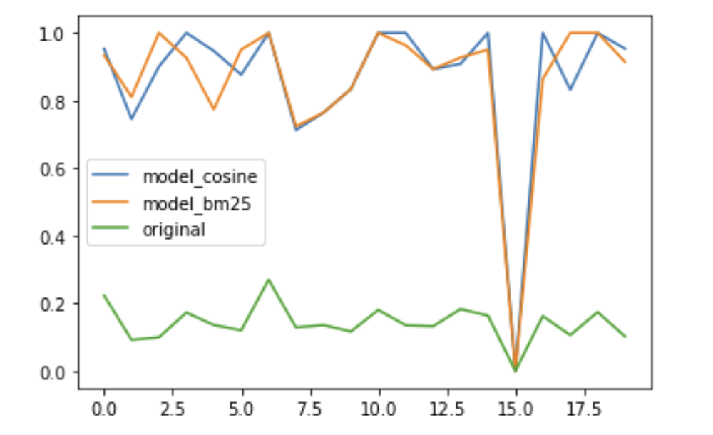
Evaluation
Evaluation:
We trained the model with 28795 questions and 2610 unique descriptions.
We tested the model for 20 unseen Queries from the dataset.
Evaluation Technique:
We ran evaualtion by calculating semantic scores.
We calculated semantic similarity between:
Query and Cosine Generated Questions
Query and BM25 Generated Questions
Query and Original Questions
The Scores for these evaluations are as follows:
Query – Cosine = 0.865760
Query – BM25 = 0.861166
Query – Original = 0.141647
Similarity score between Generated and Original Questions:
Cosine: 0.251
BM25: 0.252
Evaluation and Applications
Introduction
Dataset & Methodology
References

Slide 20
Applications
Applications:
This model can be highly useful to manufacturers and sellers.
Generates many Questions which are like the users' questions on similar products.
Manufacturers can get an idea about user’s perspective of different products in the market.
Manufacturers can create their FAQ to be useful for marketing the product.
It can also act as a question filter, which can help rank questions and show only relevant information.
Relevant questions generated can be used to build an informative product description.
Evaluation and Applications
Introduction
Dataset & Methodology
References

Slide 21
Future Scope
Involving Deep Learning or Machine Learning techniques and algorithms to improvise the model.
Combining more features from dataset to build a better model.
Testing the model on bigger machines to include maximum training data.
Using SPACY or NLTK tools to improvise the model and data pre-processing.
Evaluation and Applications
Introduction
Dataset & Methodology
References

Slide 22
References:
https://towardsdatascience.com/all-you-need-to-know-about-text-preprocessing-for-nlp-and-machine-learning-bc1c5765ff67
http://jmcauley.ucsd.edu/data/amazon/qa/
A. Tamrakar and S. K. Vishwakarma, "Analysis of Probabilistic Model for Document Retrieval in Information Retrieval," 2015 International Conference on Computational Intelligence and Communication Networks (CICN), Jabalpur, 2015, pp. 760-765, doi: 10.1109/CICN.2015.155.
https://pypi.org/project/rank-bm25/
https://www.nltk.org/howto/wordnet.html
https://www.crummy.com/software/BeautifulSoup/bs4/doc/
https://www.tutorialexample.com/best-practice-to-extract-and-remove-urls-from-python-string-python-tutorial/
https://towardsdatascience.com/natural-language-processing-feature-engineering-using-tf-idf-e8b9d00e7e76
References
Introduction
Dataset & Methodology
Evaluation and Applications

Slide 23
Questions?

Slide 24
Thank You ☺

