Slide 1
Accident Analysis and Severity Prediction
Sreeja Eluka (SS95256)
Bhaswanth Aditya Kanaparthi (BN34971)
Bhargav Reddy Kummetha (AN85258)

Slide 2
Introduction:
The goal of this project is to analyze and predict road accident severity using real-time traffic and weather data. By analyzing historical accident records and integrating real-time data, we aim to build a machine learning model capable of predicting the likelihood and severity of accidents. The model will be deployed in an interactive web application, allowing users to input weather conditions, time of day, and location to view accident predictions and accident hotspots on a map.
Why did we choose this project?
This project was chosen because road accidents affect so many lives, causing injuries, loss of loved ones, and huge financial burdens. In a world where we use data science for everything from recommending what movie to watch next to optimizing shopping experiences, it's essential to use these powerful tools to tackle real problems like road safety. By predicting where and when accidents are likely to happen, we can help save lives and make our communities safer. It's about using technology for something that truly matters and making a difference in everyday life.

Slide 3
Existing Projects in Accident Prediction: A Brief Overview
Existing projects in accident prediction primarily utilize traditional machine learning models like logistic regression, decision trees, and random forests. These models work well with structured datasets, using factors such as weather, road conditions, and historical accident data. However, they often struggle with capturing complex interactions between variables. More recent efforts include deep learning models, such as LSTMs for time-series traffic data and CNNs for spatial data, which enhance prediction accuracy by learning non-linear relationships. While some platforms, like Google Maps, provide real-time traffic updates, they do not specifically predict accidents or analyze accident severity. Many research projects focus on predicting accidents based solely on historical data, often overlooking real-time data integration and failing to offer user-friendly visual insights.
How is it different?
Our project sets itself apart by incorporating real-time weather and traffic data using external APIs to make dynamic predictions. We aim not only to predict the occurrence of accidents but also to classify their severity (minor, major, fatal), offering a more comprehensive analysis. Additionally, we will create an interactive web application featuring a dynamic map that visualizes accident-prone areas. Users can input parameters like weather conditions and time of day to receive tailored accident risk predictions, making our project a practical tool for public use.

Slide 4
Introduction to Dataset:
Dataset: https://www.kaggle.com/datasets/sobhanmoosavi/us-accidents
Records:7.4M
Features:46
['ID', 'Source', 'Severity', 'Start_Time', 'End_Time', 'Start_Lat',
'Start_Lng', 'End_Lat', 'End_Lng', 'Distance(mi)', 'Description',
'Street', 'City', 'County', 'State', 'Zipcode', 'Country', 'Timezone',
'Airport_Code', 'Weather_Timestamp', 'Temperature(F)', 'Wind_Chill(F)',
'Humidity(%)', 'Pressure(in)', 'Visibility(mi)', 'Wind_Direction',
'Wind_Speed(mph)', 'Precipitation(in)', 'Weather_Condition', 'Amenity',
'Bump', 'Crossing', 'Give_Way', 'Junction', 'No_Exit', 'Railway',
'Roundabout', 'Station', 'Stop', 'Traffic_Calming', 'Traffic_Signal',
'Turning_Loop', 'Sunrise_Sunset', 'Civil_Twilight', 'Nautical_Twilight',
'Astronomical_Twilight']
This is a countrywide car accident dataset that covers All states of the USA. The accident data were collected from February 2016 to March 2023, using multiple APIs that provide streaming traffic incident (or event) data.

Slide 5
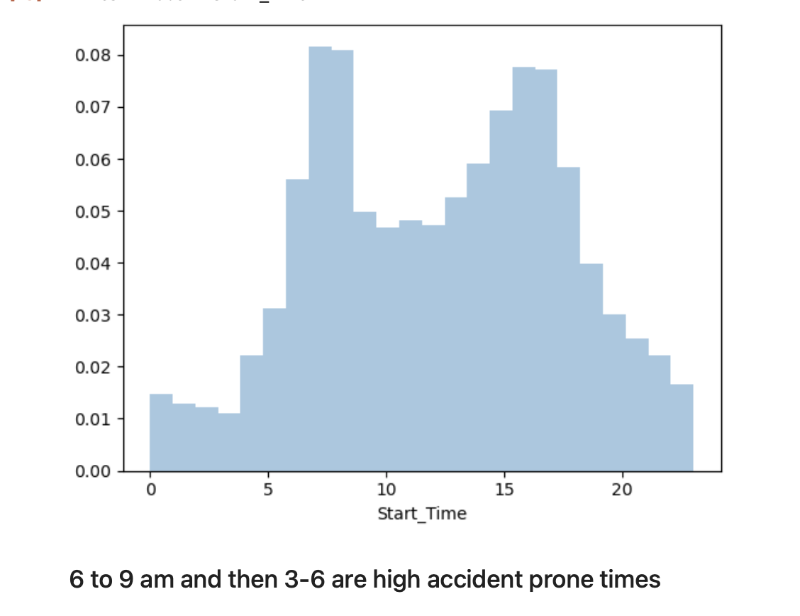
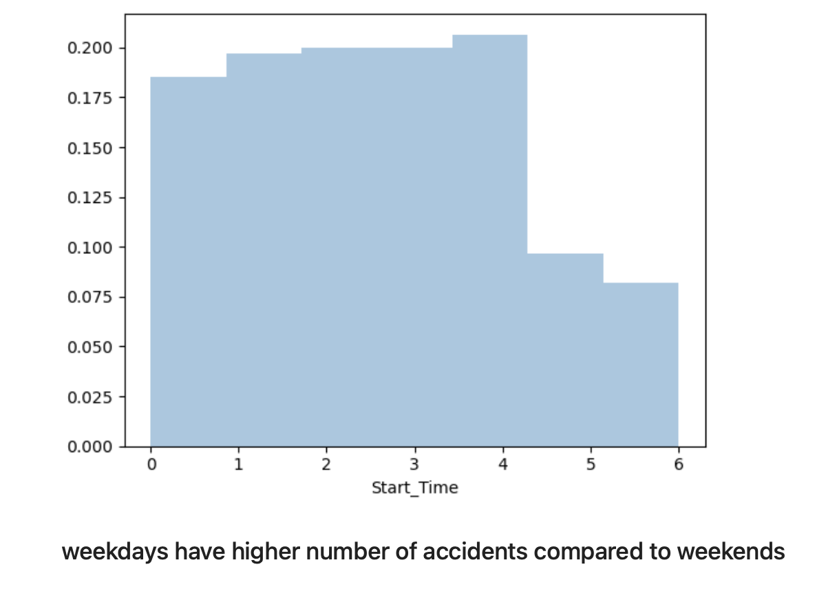
EXPLORATORY DATA ANALYSIS

Slide 6
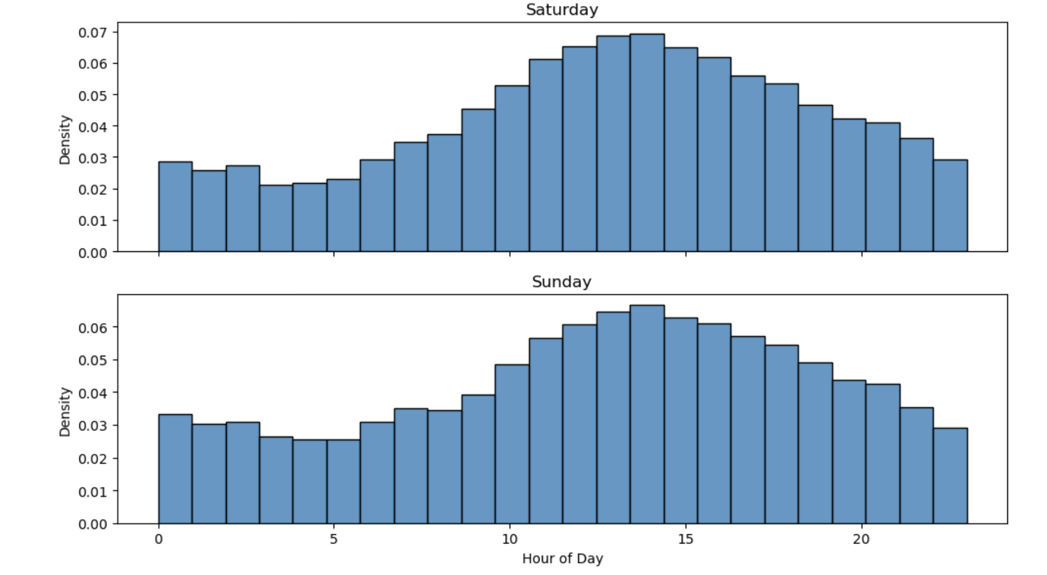
On weekends, the peak occurs between 10 am and 3 pm, unlike weekdays¶

Slide 7
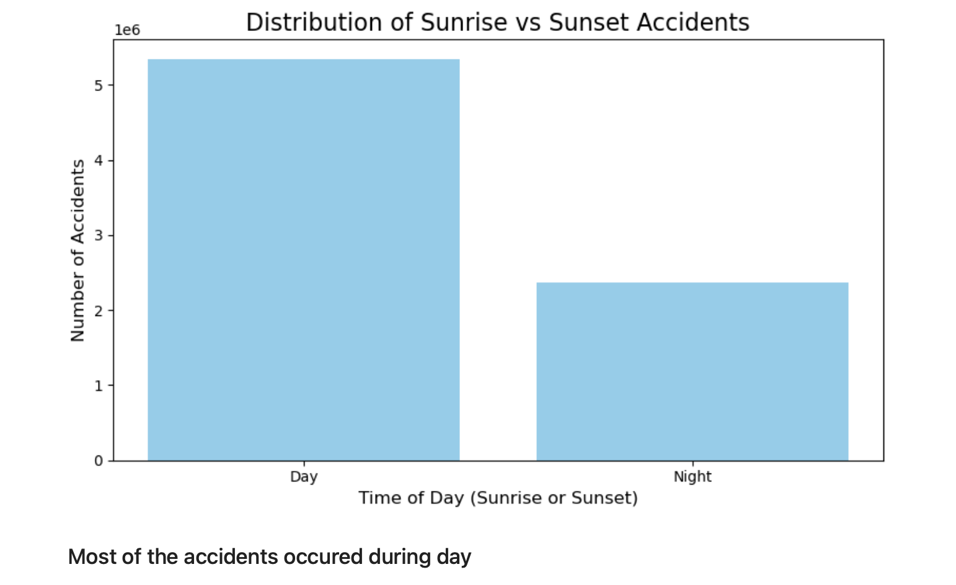

Slide 8
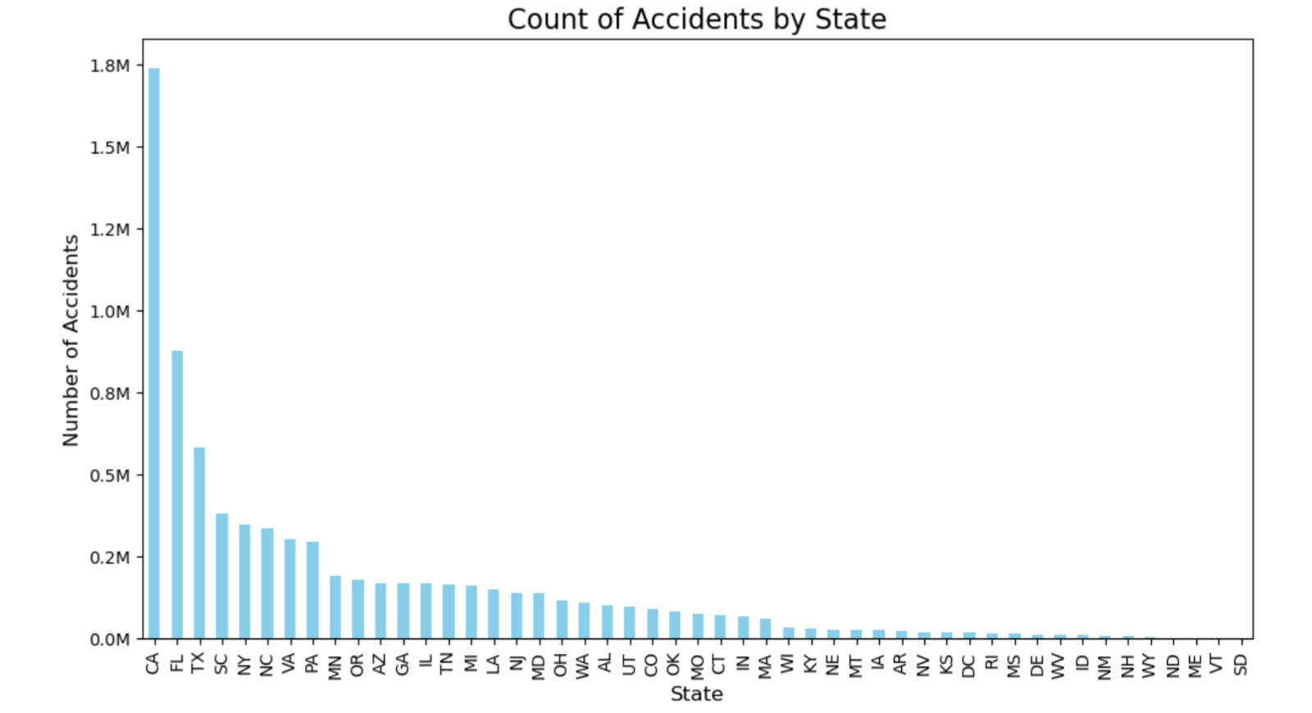

Slide 9
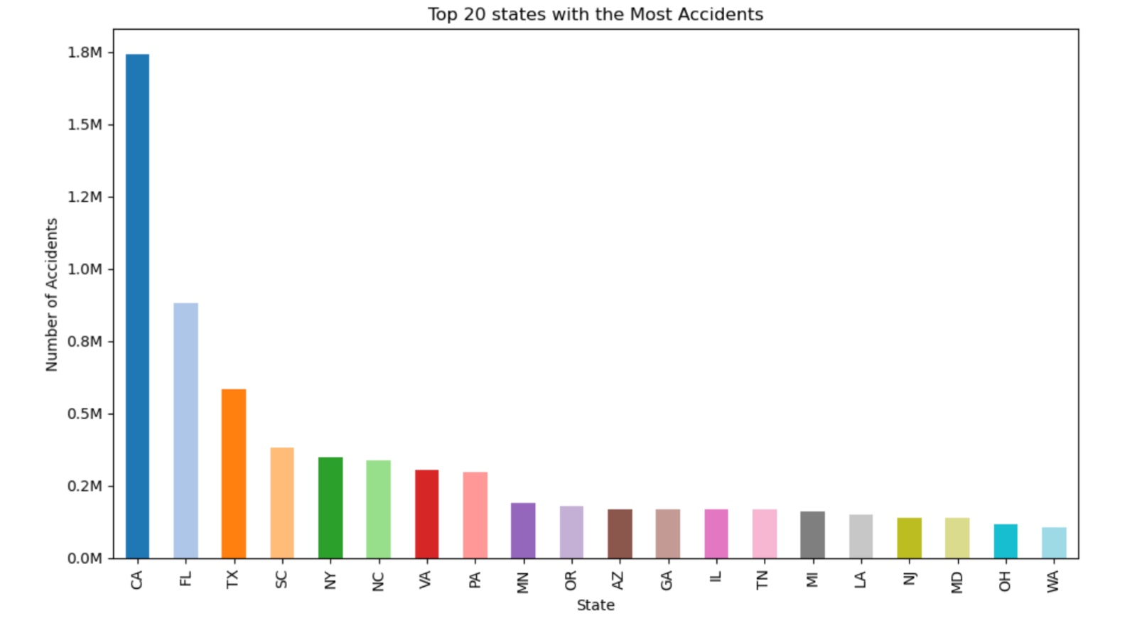

Slide 10
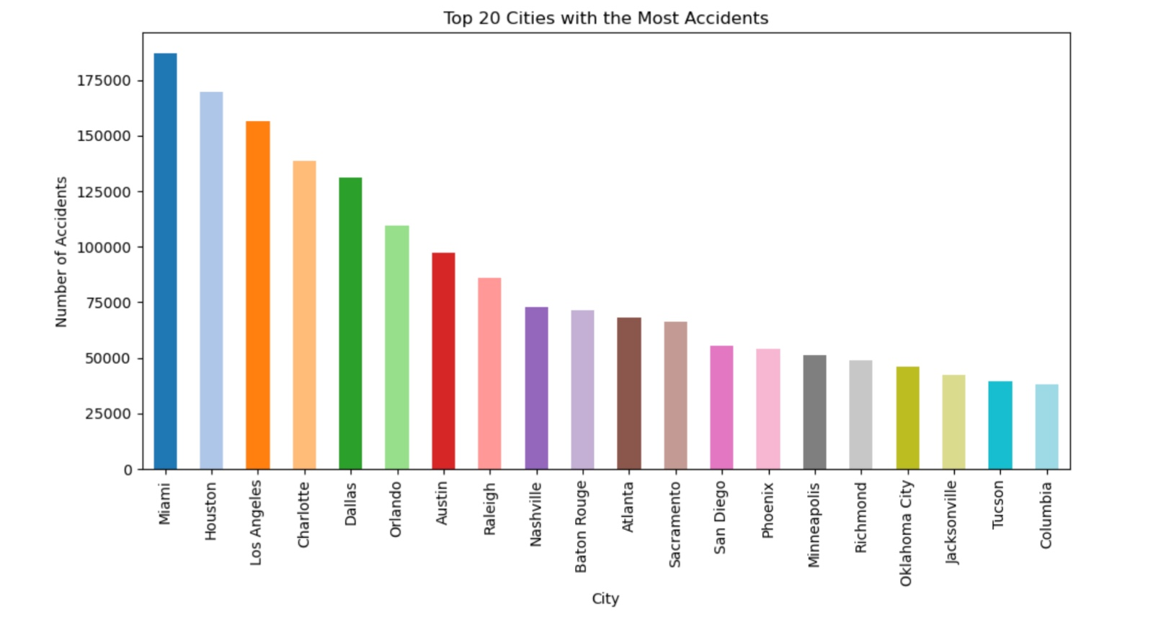

Slide 11
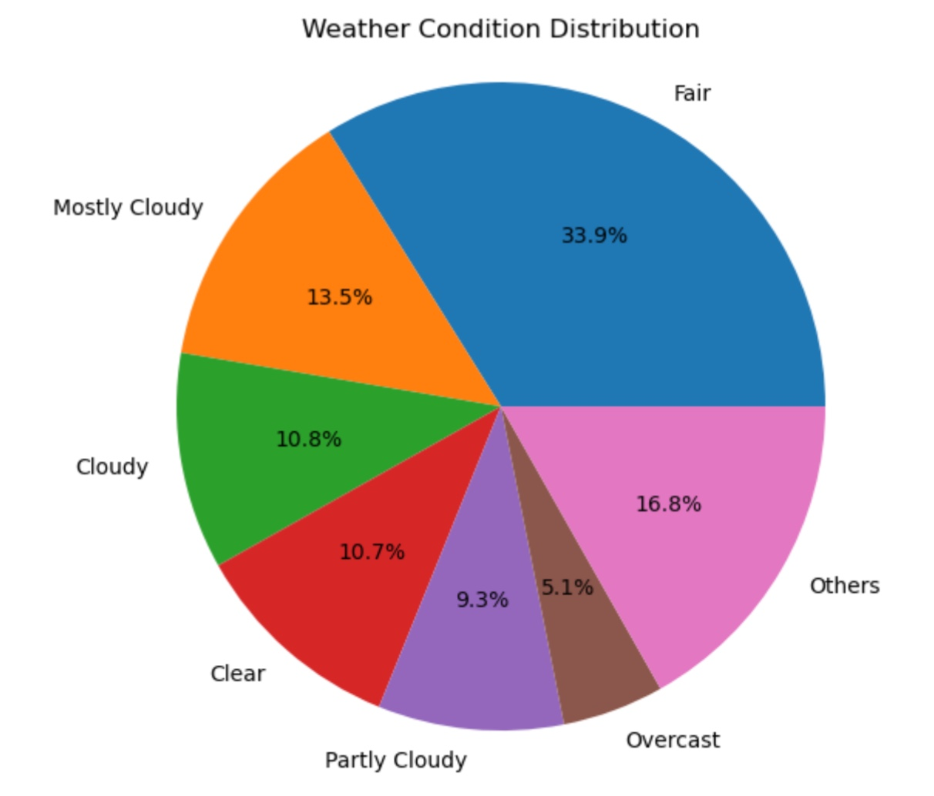

Slide 12
Conclusions from EDA
80% of accidents are of 2nd level Severity
8% of cities have more than 1000 yearly accidents.
Around one third of cities have less than 10 accidents
weekdays have higher number of accidents compared to weekends
Period of day :- Day(69%) & Night(31%)
Time zone based on the location of the accident :- US/Eastern(46%) & US/Pacific(27%)
Weather condition (rain, snow, thunderstorm, fog, etc.) :- Fair(33%) & Mostly Cloudy(13%)
Presence of crossing in a nearby location:- True(11%) & False(89%)
Presence of traffic signal in a nearby location:- True(15%) & False(85%)
A high percentage of accidents occur between 6 am to 10 am (probably people in a hurry to get to work) Next highest percentage is 3 pm to 6 pm
On weekdays, the peak occurs between 10 am and 3 pm, unlike weekdays
Weekdays have higher number of accidents compared to weekends
Much data is missing for 2016. Maybe even 2017.
December is the highest accident recorded month followed by November
Friday have the most accidents on week

Slide 13
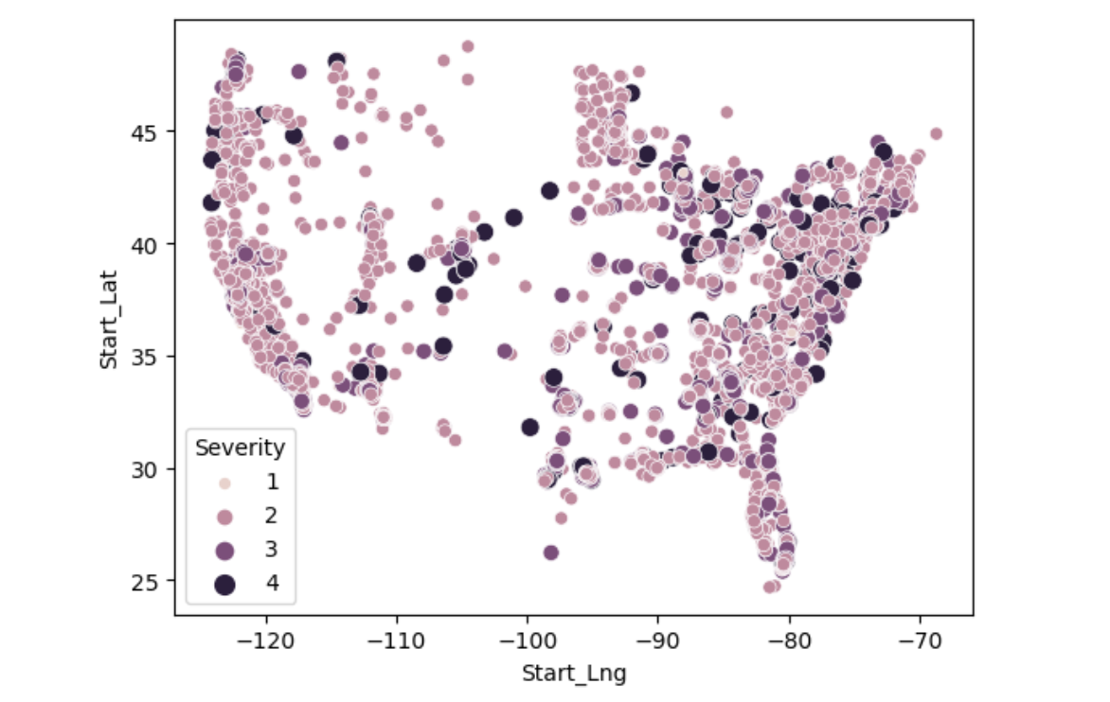
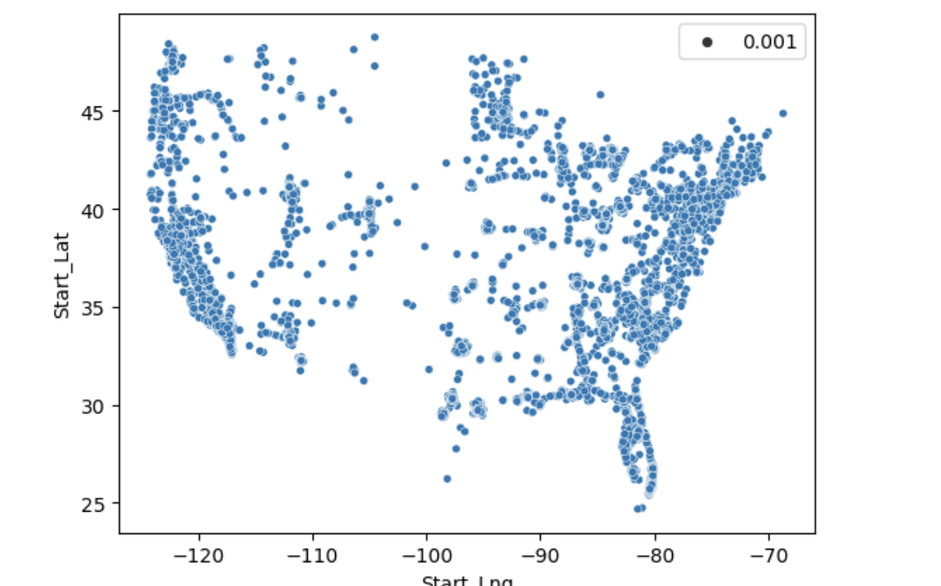
Map of US which shows the severity of the accidents.
Map of US which shows the density of the accidents.
The Heatmap ( on the map USA) show that in Coastal areas, the number of accidents is increasing while accidents
are comparatively lower in non costal region

Slide 14
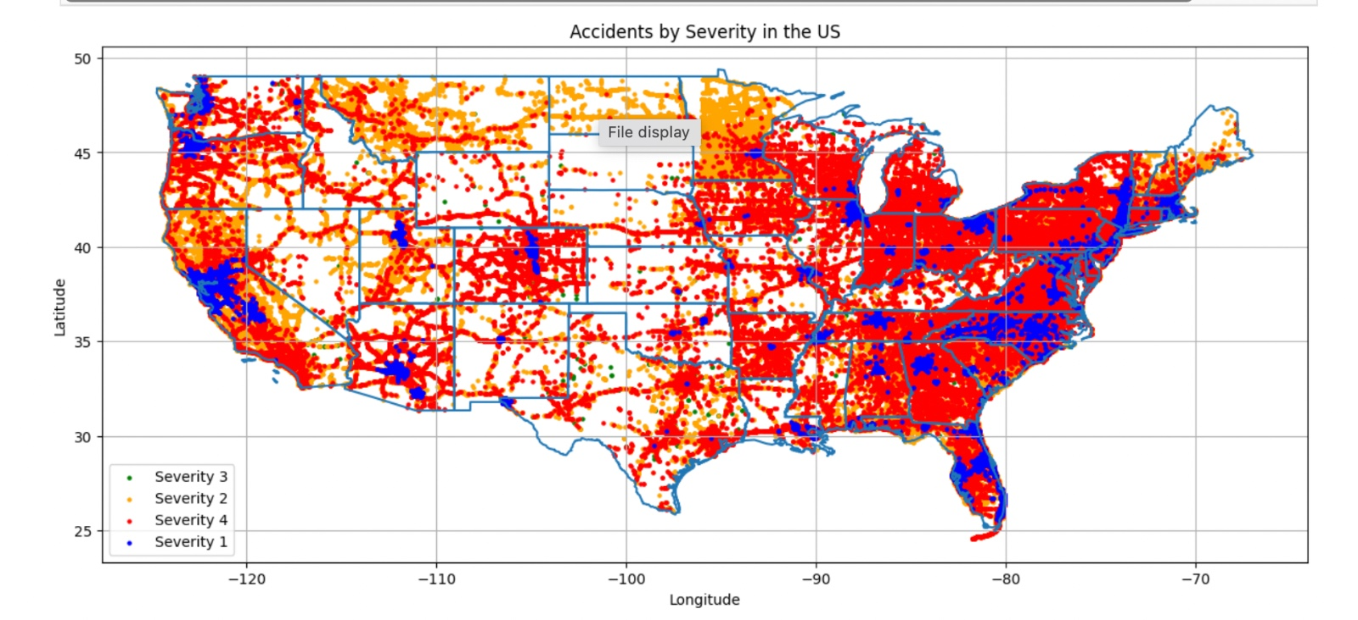

Slide 15
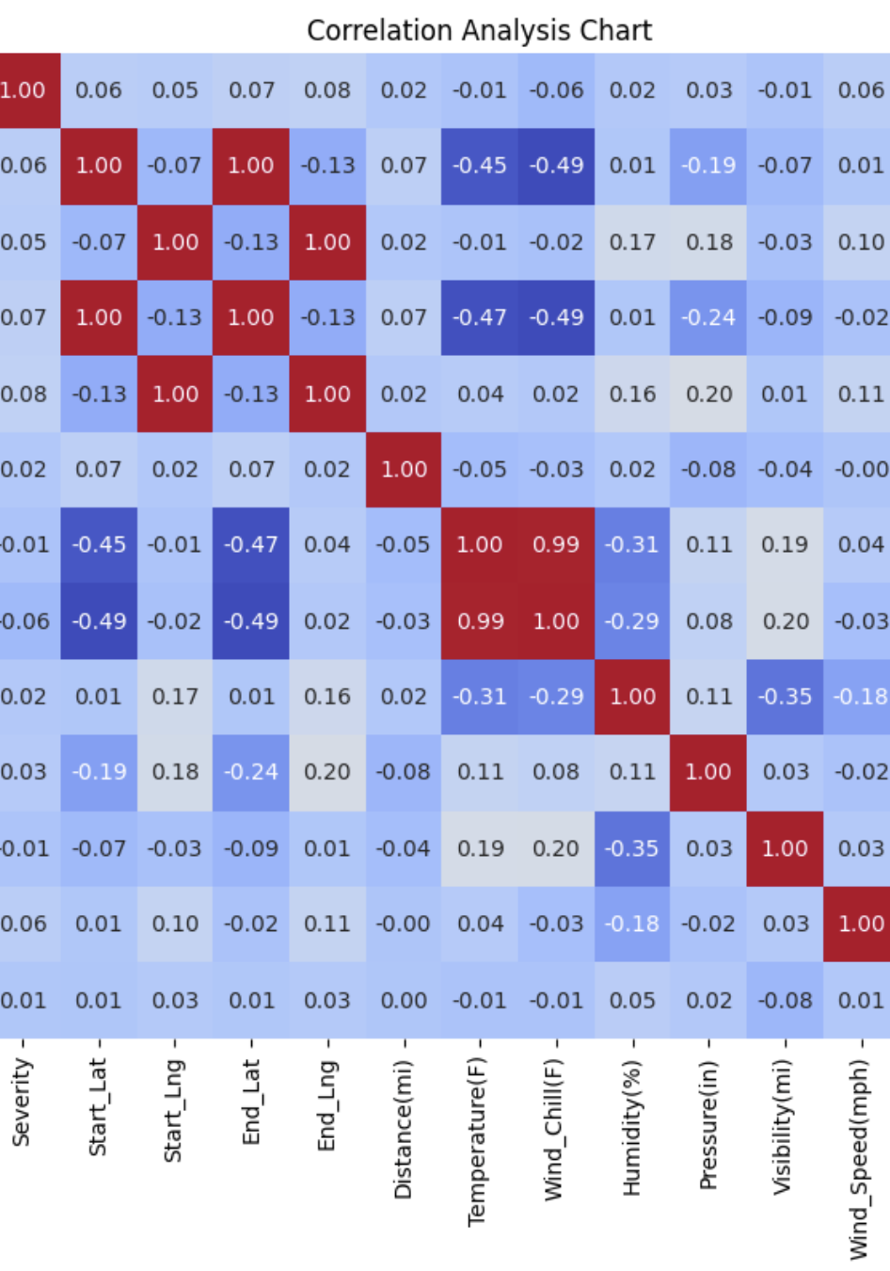
CORRELATION
The target variable, "Severity," shows very weak correlations with most of the other variables. The highest correlation values are around 0.08, suggesting that none of the other variables strongly predict severity alone.
And so, we will be using all the variables for training our model.
Start_Lng & End_Lng has a lot of correlation. Since End_Lng also has a lot of null values, it can be removed.
Start_Lat & End_Lat has a lot of correlation. Since End_Lat also has a lot of null values, it can be removed.
Windchill & Temperature as a lot of correlation. Since Windchill also has a lot of null values, it can be removed.

Slide 16
FEATURE ENGINEERING
Sampled dataset to 20k rows as its large with 7 million rows
Remove Irrelevant Features
Dropped unnecessary columns to reduce dimensionality and noise.
Weather Condition Processing
Convert to Object: Converted to categorical format.
Merge Conditions: Grouped similar weather types (e.g., "Rain" includes "Drizzle", "Showers").
Handled Missing Data
Categorical Processing
Convert to Object: Ensured categorical format.
Impute Missing Data
Combine Rare Categories: Merged rare values as 'other'.
Encoding: Applied One-Hot Encoding.
Handling Rare Categories
Separate Pipeline for Rare Categories: Specifically grouped high-frequency and low-frequency categories (e.g., "hub_of_few_accidents").

Slide 17
Numeric Processing
Convert to Numeric: Ensured numerical format.
Impute Missing Data: Filled nulls with 0.
Scaling: Standardized values using Minmax scalar (Normalization 0 to 1 )
Boolean Processing
Handle Missing Data: Replaced nulls with False for consistency.
Datetime Processing
Convert to Datetime: Converted to datetime format.
Split Components: Extracted date and time as separate features.
Time Encoding: Encoded hour information (0-23).
Impute Missing Data: Replaced nulls with 0 for datetime fields.

Slide 18
MODEL TRAINING
We have used these features for the model training('Severity', 'Start_Lat', 'Start_Lng', 'Distance(mi)','Temperature(F)', 'Humidity(%)', 'Pressure(in)', 'Visibility(mi)', 'Month', 'Hour', 'Weather_Condition_Label’]
Model Training and Results
We have normalized the numerical features using min-max scalar,for better model performance.
We initially trained the model using Random Forest with hyperparameter tuning via RandomSearchCV, achieving 70% accuracy. However, the model demonstrated very low precision and recall for the minority classes, indicating poor performance in handling imbalanced data.
Switching to XGBoost, we used RandomSearchCV for optimization and achieved 83% accuracy. While this was a significant improvement in overall accuracy, the precision and recall for minority classes remained very low, highlighting the need to address class imbalance.
Training the model with LightGBM yielded similar results to XGBoost, with an accuracy of 83%, but it did not provide notable improvements in handling the minority classes.
To tackle the class imbalance, we adopted XGBoost with SMOTE (Synthetic Minority Oversampling Technique). While the overall accuracy decreased slightly compared to the previous models, we observed a notable improvement in precision and recall for the minority classes, making it the most balanced and effective approach.
Final Decision: XGBoost with SMOTE was chosen as the final model for deployment due to its ability to handle imbalanced data effectively and improve predictions across all classes.

Slide 19
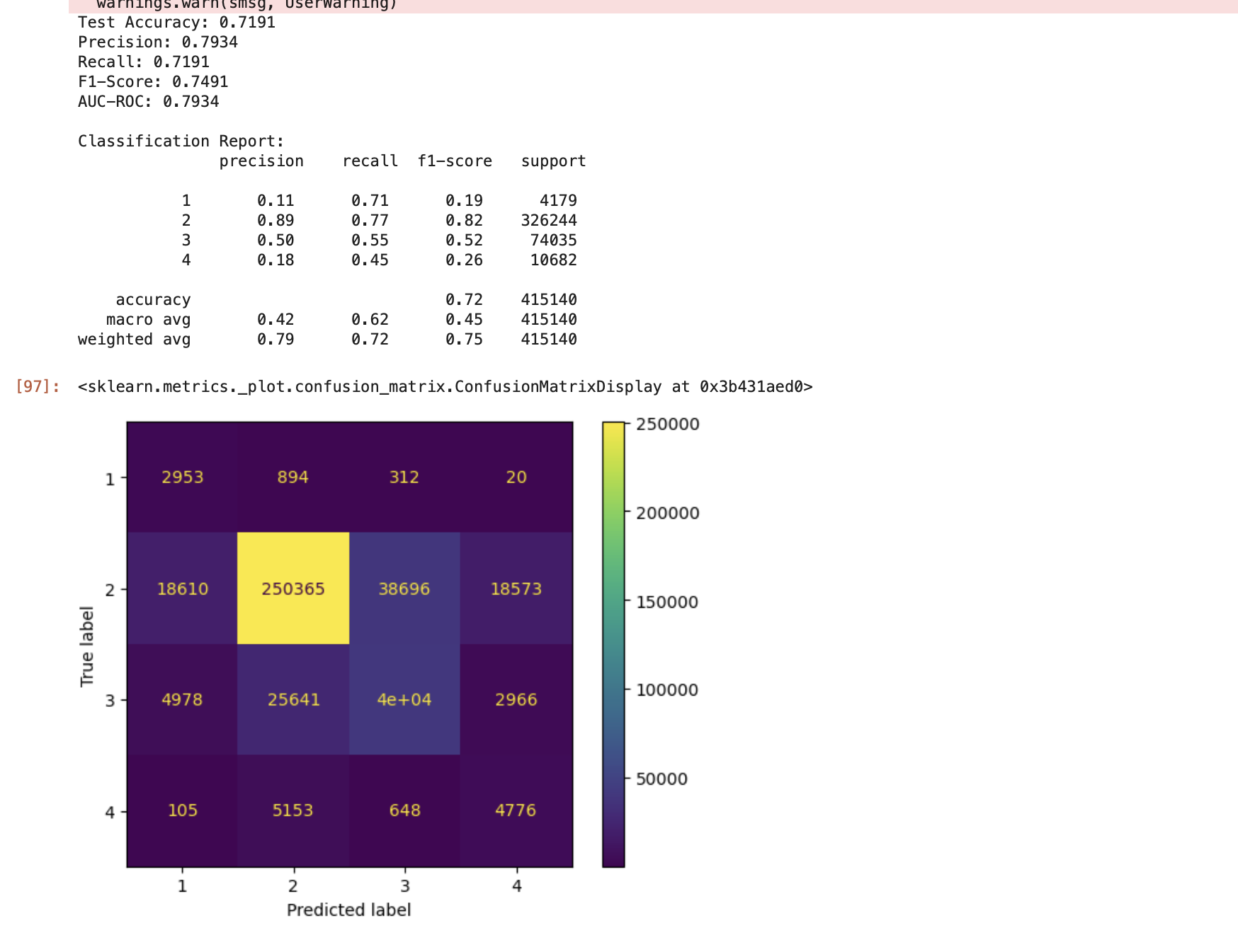
XG boost with random search cv (SMOTE)

Slide 20
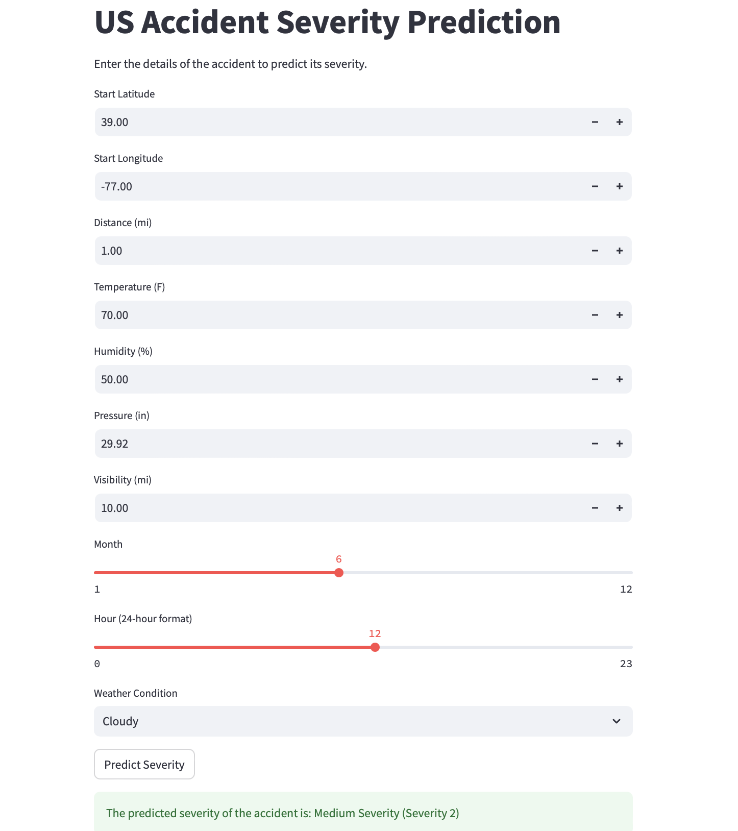
DEPLOYMENT
We deployed our accident severity prediction model using Streamlit, a user-friendly and interactive web framework. The application allows users to input relevant accident details, such as location (latitude and longitude), weather conditions, visibility, temperature, and time (month and hour). Based on these inputs, the model predicts the severity of an accident, providing outputs like "Medium Severity (Severity 2)" in real time.
To make the application accessible to everyone, we hosted it on Hugging Face Spaces, a robust and scalable platform for deploying machine learning models. This hosting enables seamless interaction with the model through a clean and intuitive interface, ensuring a smooth user experience. Users can easily explore various scenarios and receive predictions without requiring technical expertise, making it ideal for real-world applications.

Slide 21
Thank you

