Slide 1
Accident Analysis and Severity Prediction
Sreeja Eluka (SS95256)
Bhaswanth Aditya Kanaparthi (BN34971)
Bhargav Reddy Kummetha (AN85258)

Slide 2
Introduction:
The goal of this project is to analyze and predict road accident severity using real-time traffic and weather data. By analyzing historical accident records and integrating real-time data, we aim to build a machine learning model capable of predicting the likelihood and severity of accidents. The model will be deployed in an interactive web application, allowing users to input weather conditions, time of day, and location to view accident predictions and accident hotspots on a map.
Why did we choose this project?
This project was chosen because road accidents affect so many lives, causing injuries, loss of loved ones, and huge financial burdens. In a world where we use data science for everything from recommending what movie to watch next to optimizing shopping experiences, it's essential to use these powerful tools to tackle real problems like road safety. By predicting where and when accidents are likely to happen, we can help save lives and make our communities safer. It's about using technology for something that truly matters and making a difference in everyday life.

Slide 3
Existing Projects in Accident Prediction: A Brief Overview
Existing projects in accident prediction primarily utilize traditional machine learning models like logistic regression, decision trees, and random forests. These models work well with structured datasets, using factors such as weather, road conditions, and historical accident data. However, they often struggle with capturing complex interactions between variables. More recent efforts include deep learning models, such as LSTMs for time-series traffic data and CNNs for spatial data, which enhance prediction accuracy by learning non-linear relationships. While some platforms, like Google Maps, provide real-time traffic updates, they do not specifically predict accidents or analyze accident severity. Many research projects focus on predicting accidents based solely on historical data, often overlooking real-time data integration and failing to offer user-friendly visual insights.
How is it different?
Our project sets itself apart by incorporating real-time weather and traffic data using external APIs to make dynamic predictions. We aim not only to predict the occurrence of accidents but also to classify their severity (minor, major, fatal), offering a more comprehensive analysis. Additionally, we will create an interactive web application featuring a dynamic map that visualizes accident-prone areas. Users can input parameters like weather conditions and time of day to receive tailored accident risk predictions, making our project a practical tool for public use.

Slide 4
Introduction to Dataset:
Dataset: https://www.kaggle.com/datasets/sobhanmoosavi/us-accidents
Records:7.4M
Features:46
['ID', 'Source', 'Severity', 'Start_Time', 'End_Time', 'Start_Lat',
'Start_Lng', 'End_Lat', 'End_Lng', 'Distance(mi)', 'Description',
'Street', 'City', 'County', 'State', 'Zipcode', 'Country', 'Timezone',
'Airport_Code', 'Weather_Timestamp', 'Temperature(F)', 'Wind_Chill(F)',
'Humidity(%)', 'Pressure(in)', 'Visibility(mi)', 'Wind_Direction',
'Wind_Speed(mph)', 'Precipitation(in)', 'Weather_Condition', 'Amenity',
'Bump', 'Crossing', 'Give_Way', 'Junction', 'No_Exit', 'Railway',
'Roundabout', 'Station', 'Stop', 'Traffic_Calming', 'Traffic_Signal',
'Turning_Loop', 'Sunrise_Sunset', 'Civil_Twilight', 'Nautical_Twilight',
'Astronomical_Twilight']
This is a countrywide car accident dataset that covers All states of the USA. The accident data were collected from February 2016 to March 2023, using multiple APIs that provide streaming traffic incident (or event) data.

Slide 5
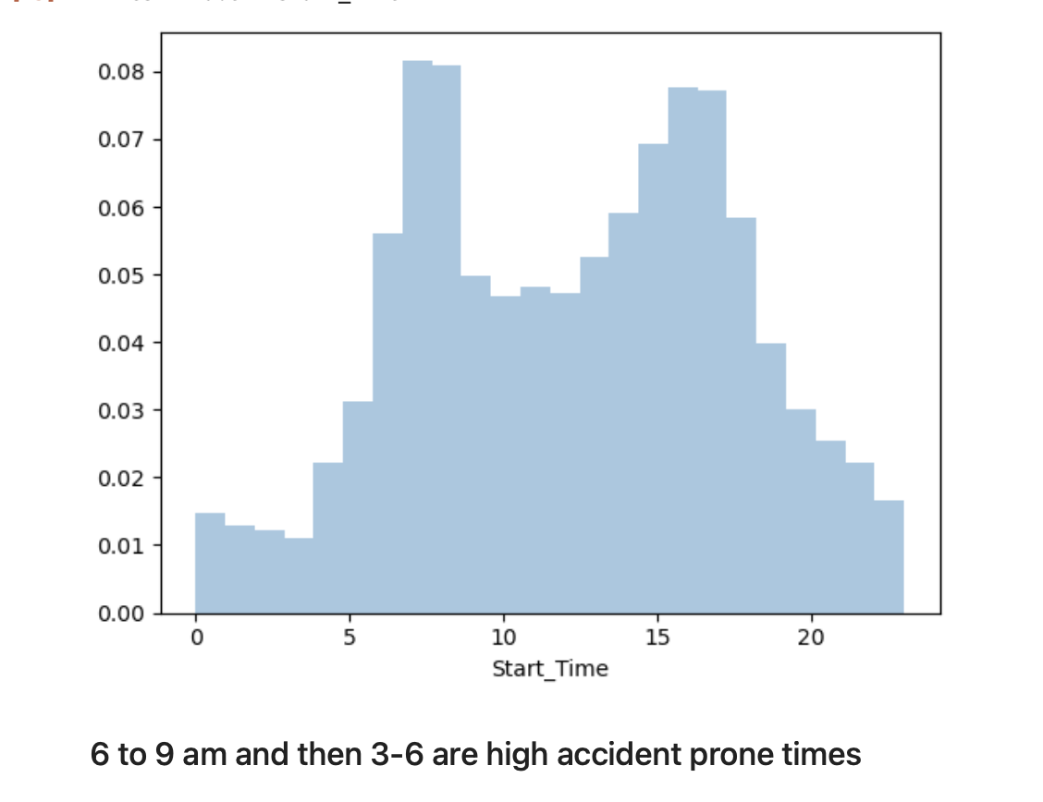
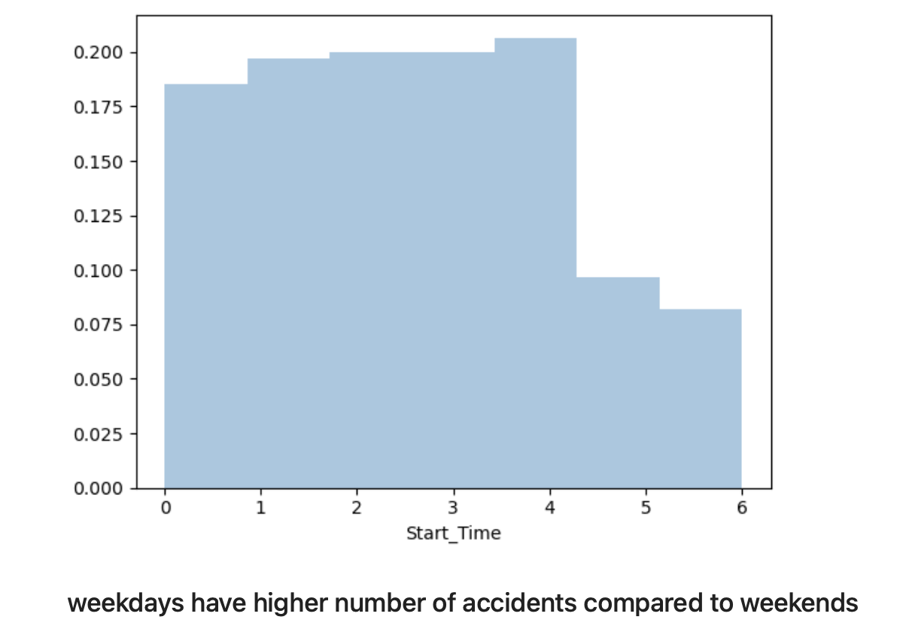
EXPLORATORY DATA ANALYSIS

Slide 6
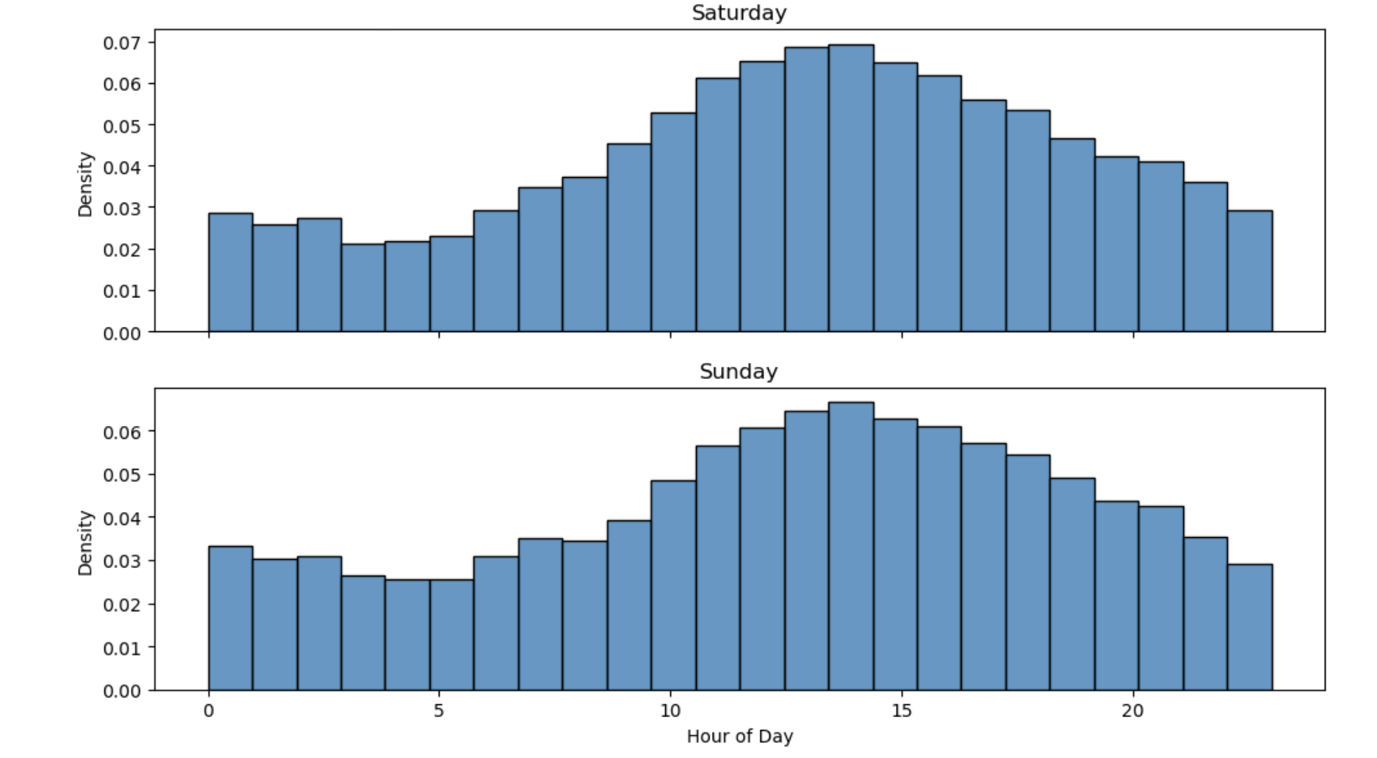
On weekends, the peak occurs between 10 am and 3 pm, unlike weekdays¶

Slide 7
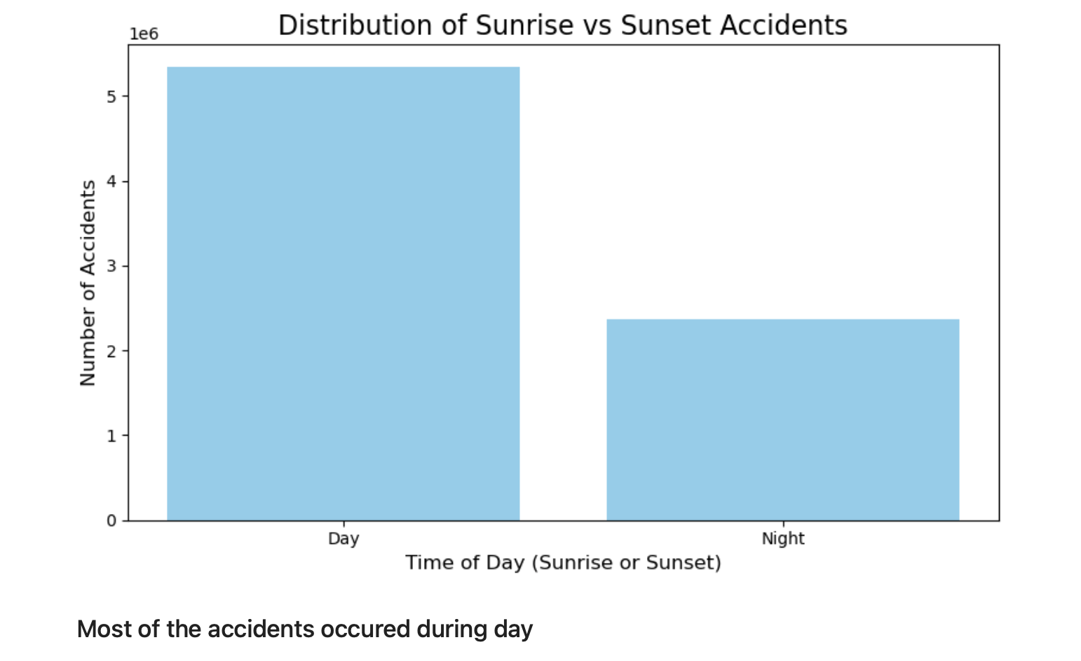

Slide 8
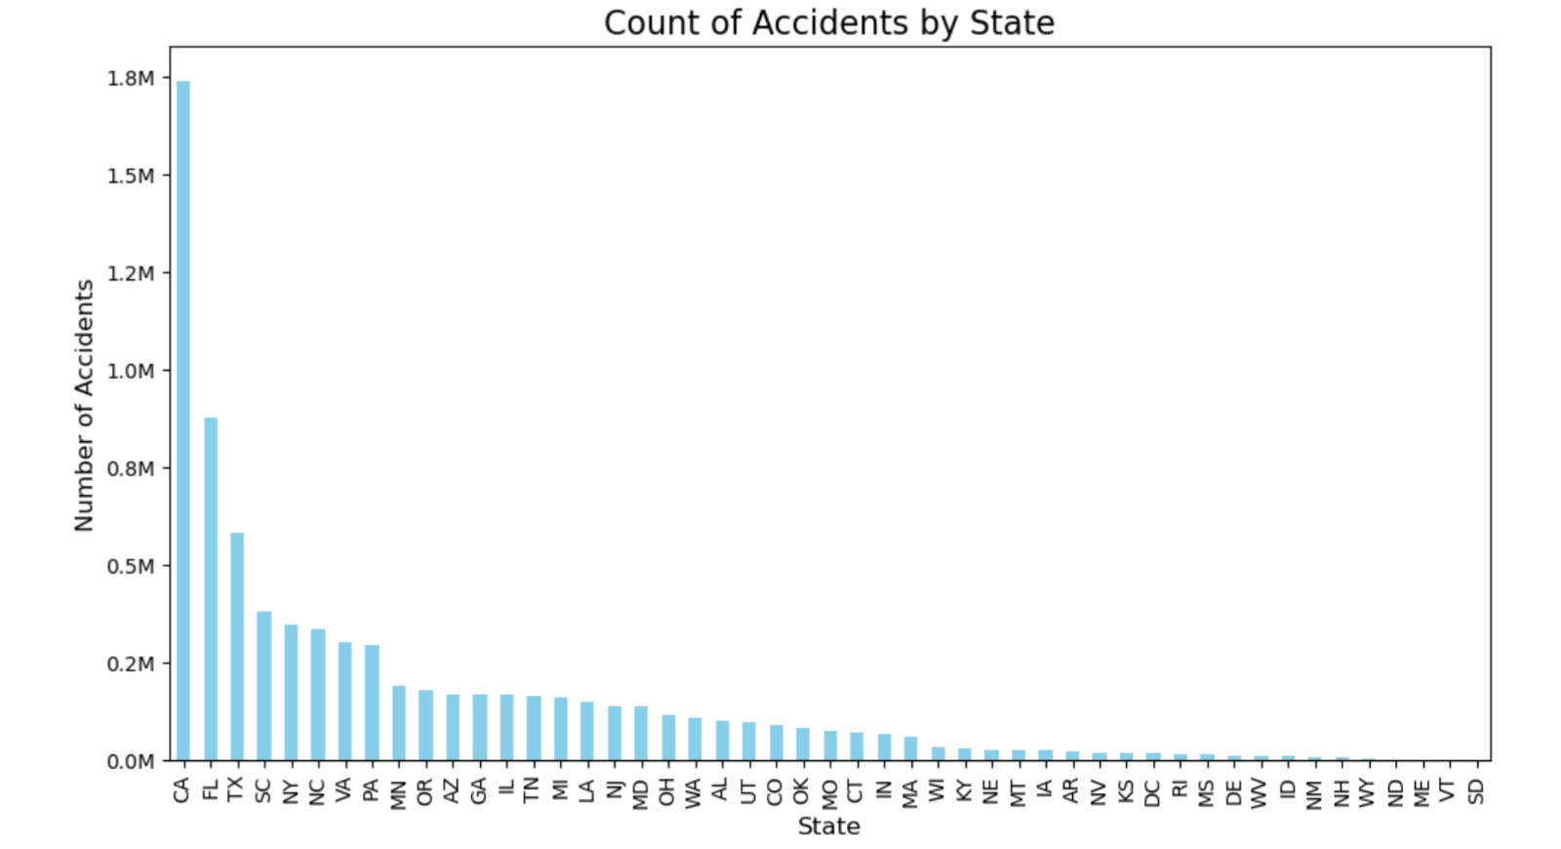

Slide 9
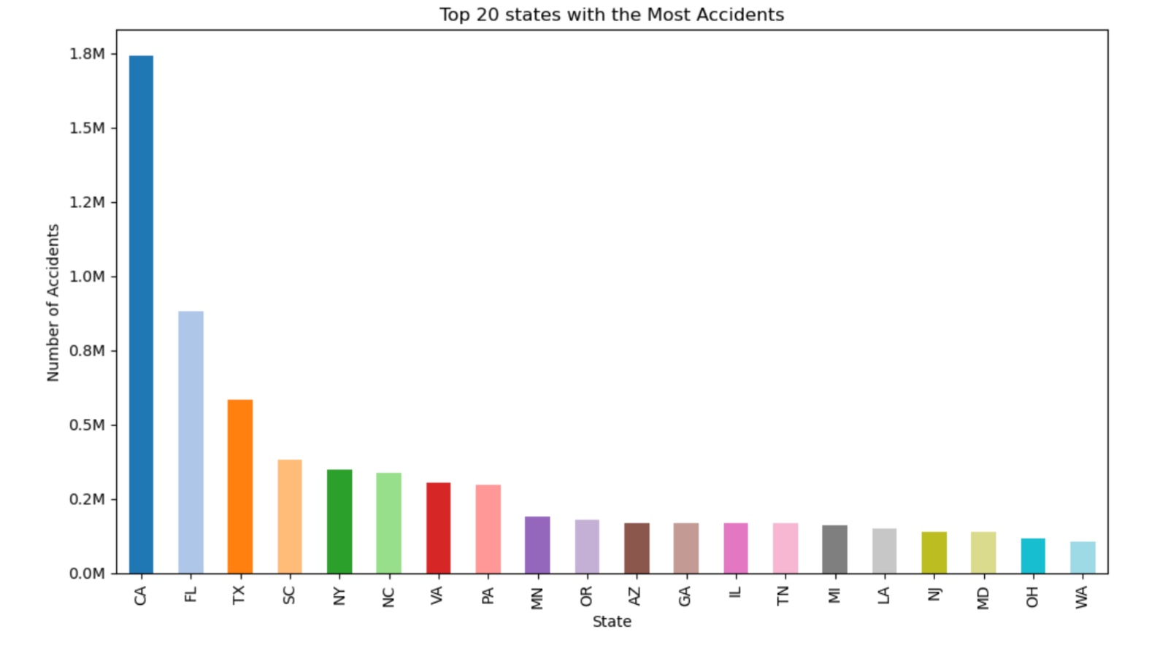

Slide 10
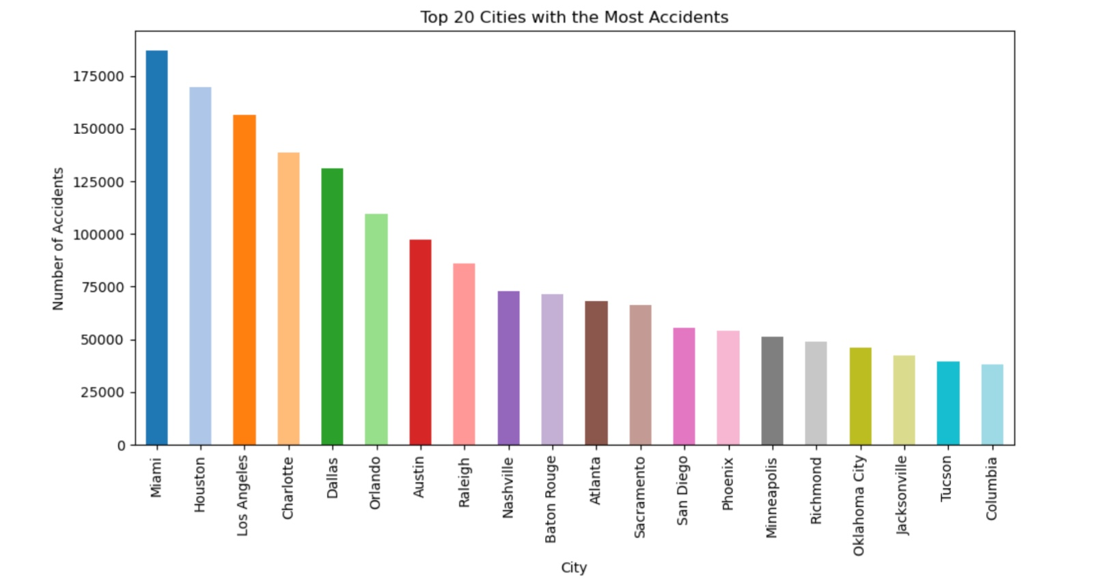

Slide 11
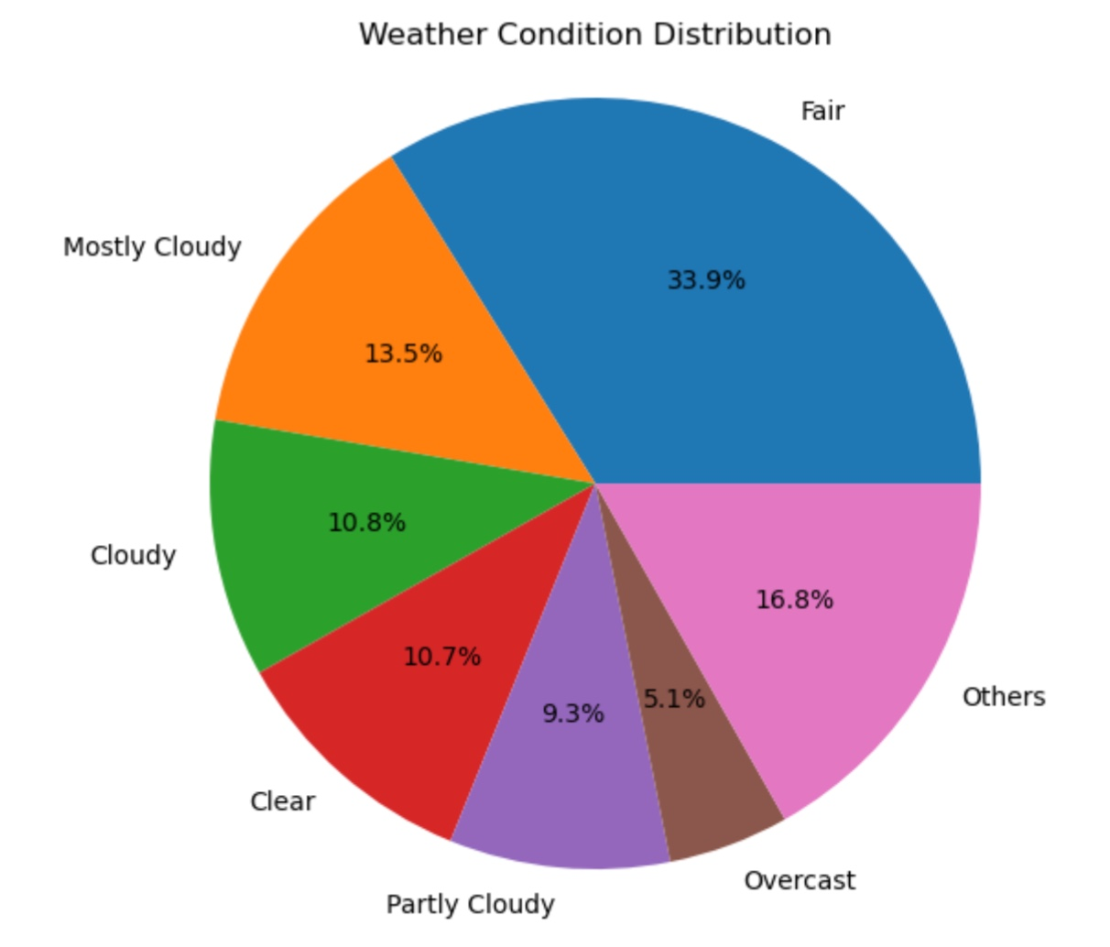

Slide 12
Conclusions from EDA
80% of accidents are of 2nd level Severity
8% of cities have more than 1000 yearly accidents.
Around one third of cities have less than 10 accidents
weekdays have higher number of accidents compared to weekends
Period of day :- Day(69%) & Night(31%)
Time zone based on the location of the accident :- US/Eastern(46%) & US/Pacific(27%)
Weather condition (rain, snow, thunderstorm, fog, etc.) :- Fair(33%) & Mostly Cloudy(13%)
Presence of crossing in a nearby location:- True(11%) & False(89%)
Presence of traffic signal in a nearby location:- True(15%) & False(85%)
A high percentage of accidents occur between 6 am to 10 am (probably people in a hurry to get to work) Next highest percentage is 3 pm to 6 pm
On weekdays, the peak occurs between 10 am and 3 pm, unlike weekdays
Weekdays have higher number of accidents compared to weekends
Much data is missing for 2016. Maybe even 2017.
December is the highest accident recorded month followed by November
Friday have the most accidents on week

Slide 13
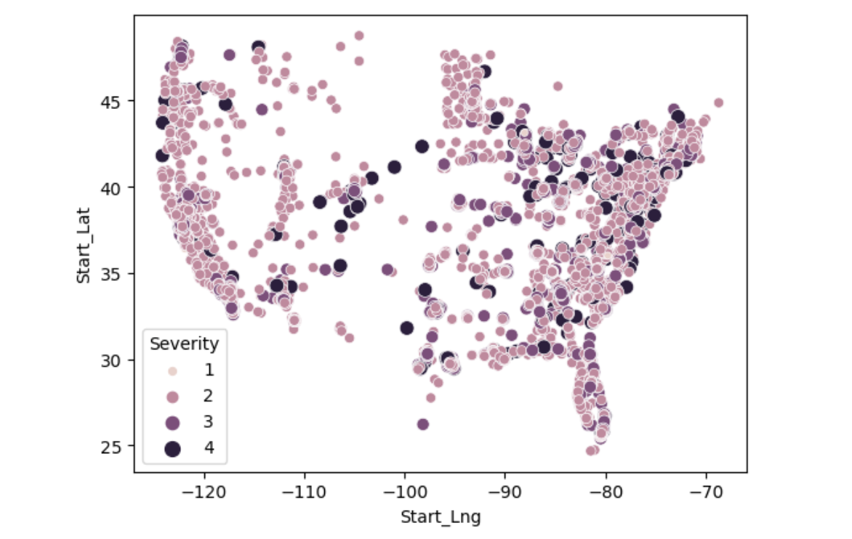
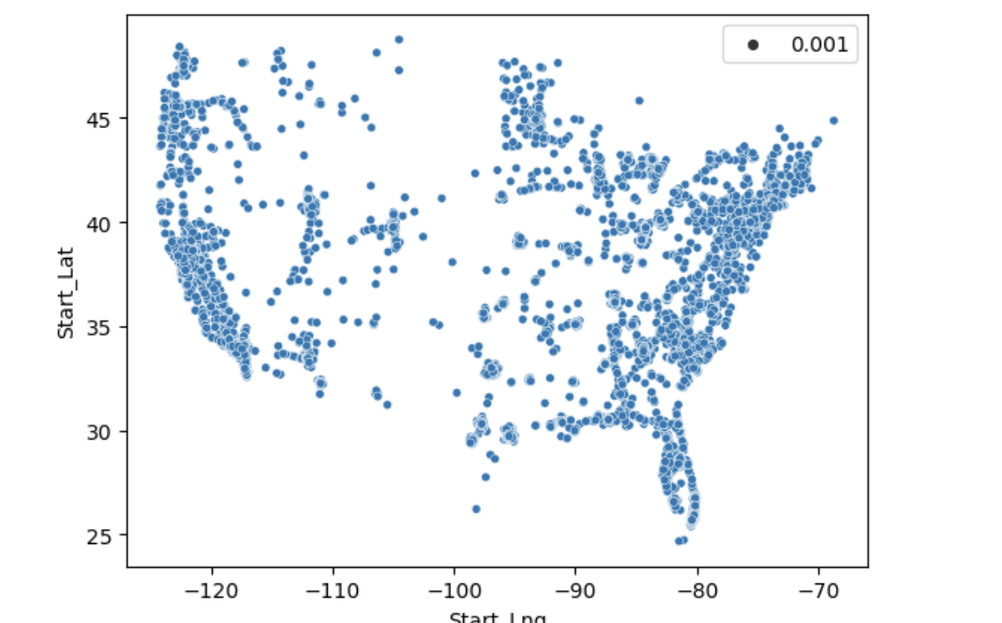
Map of US which shows the severity of the accidents.
Map of US which shows the density of the accidents.
The Heatmap ( on the map USA) show that in Coastal areas, the number of accidents is increasing while accidents
are comparatively lower in non costal region

Slide 14
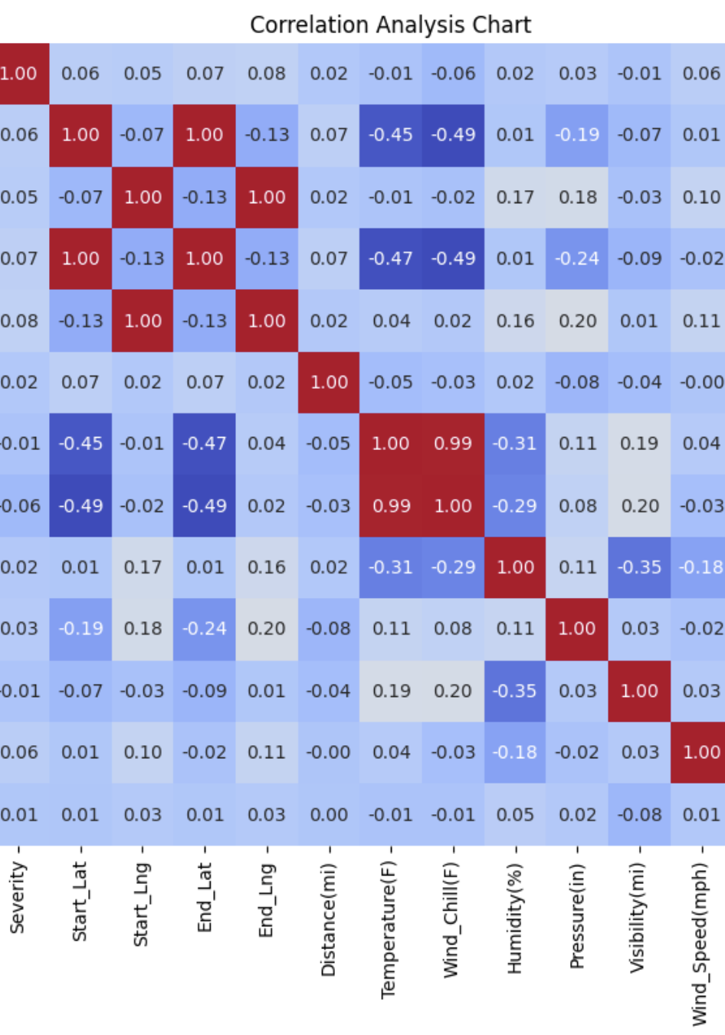
CORRELATION
The target variable, "Severity," shows very weak correlations with most of the other variables. The highest correlation values are around 0.08, suggesting that none of the other variables strongly predict severity alone.
And so, we will be using all the variables for training our model.
Start_Lng & End_Lng has a lot of correlation. Since End_Lng also has a lot of null values, it can be removed.
Start_Lat & End_Lat has a lot of correlation. Since End_Lat also has a lot of null values, it can be removed.
Windchill & Temperature as a lot of correlation. Since Windchill also has a lot of null values, it can be removed.

Slide 15
FEATURE ENGINEERING
Sampled dataset to 20k rows as its large with 7 million rows
Remove Irrelevant Features
Dropped unnecessary columns to reduce dimensionality and noise.
Weather Condition Processing
Convert to Object: Converted to categorical format.
Merge Conditions: Grouped similar weather types (e.g., "Rain" includes "Drizzle", "Showers").
Handled Missing Data
Categorical Processing
Convert to Object: Ensured categorical format.
Impute Missing Data
Combine Rare Categories: Merged rare values as 'other'.
Encoding: Applied One-Hot Encoding.
Handling Rare Categories
Separate Pipeline for Rare Categories: Specifically grouped high-frequency and low-frequency categories (e.g., "hub_of_few_accidents").

Slide 16
Numeric Processing
Convert to Numeric: Ensured numerical format.
Impute Missing Data: Filled nulls with 0.
Scaling: Standardized values using Minmax scalar (Normalization 0 to 1 )
Boolean Processing
Handle Missing Data: Replaced nulls with False for consistency.
Datetime Processing
Convert to Datetime: Converted to datetime format.
Split Components: Extracted date and time as separate features.
Time Encoding: Encoded hour information (0-23).
Impute Missing Data: Replaced nulls with 0 for datetime fields.

Slide 17
MODEL TRAINING
RANDOM FOREST CLASSIFIER
bootstrap: True
ccp_alpha: 0.0
class_weight: None
criterion: gini
max_depth: None
max_features: sqrt
max_leaf_nodes: None
max_samples: None
min_impurity_decrease: 0.0
min_samples_leaf: 1
min_samples_split: 5
min_weight_fraction_leaf: 0.0
n_estimators: 100
n_jobs: None
oob_score: False
random_state: None
verbose: 0
warm_start: False
KN
algorithm: ball_tree
leaf_size: 30
metric: minkowski
metric_params: None
n_jobs: None
n_neighbors: 10
p: 2
weights: uniform
ADA
algorithm: SAMME
base_estimator: deprecated
estimator: None
learning_rate: 0.1
n_estimators: 50
random_state: None

Slide 18
MODEL METRICS
RF: accuracy: 0.8188, f1: 0.7777228607467889, precision: 0.7699392175751457, recall: 0.8188
KN: accuracy: 0.7924, f1: 0.726371173320098, precision: 0.7037315230224321, recall: 0.7924
ADA: accuracy: 0.8024, f1: 0.7144316023080338, precision: 0.6438457599999999, recall: 0.802
Voting: accuracy: 0.8072, f1: 0.739355478693968, precision: 0.7474164576059313, recall: 0.8072

Slide 19
Thank you

