Slide 1
IBM University Engagement Project Submission
“Exploring the Power of Agentic AI with IBM Granite and LangFlow”

Slide 2

Project Tile – XLoan-AI: An Explainable and Fair AI System for Transparent Loan Decisions
Domain of Project – FinTech / Banking
Student Name | Recent Passport Photo | Email ID | Mobile number [WhatsApp]
Sreeja Lingampally |  | lingampallysreeja2@gmail.com | 8247062342

Slide 3
Problem Statement -
Problem Statement : XLOAN-AI
The Challenge : The "Black-Box" Lending Crisis
Traditional and current loan approval systems suffer from critical flaws that harm both customers and financial institutions.
Lack of Transparency: Applicants cannot understand why their loan was rejected, leading to frustration and financial exclusion.
Algorithmic Bias: Legacy systems and standard ML models often perpetuate historical biases against groups based on gender, region, or income (violating fair lending laws).
No Actionable Feedback: Rejected applicants receive a simple "No" with zero guidance on how to improve their chances in the future.
Regulatory Risk: Banks face heavy fines for non-compliance with RBI and other fair lending regulations due to unexplainable AI decisions.
The Objective: XLoan-AI - A Responsible AI Decision-Support System
To build a multi-agent AI system that ensures fair, transparent, and actionable loan approvals while keeping a "human-in-the-loop."
Key Capabilities:
Explainable Decisions: Use SHAP values to translate complex model logic into human-readable reasons for approval/rejection.
Fairness by Design: Monitor real-time bias using Statistical Parity and Disparate Impact metrics across sensitive attributes.
Actionable Counterfactuals: Tell rejected applicants exactly what to change (e.g., "Increase credit score by 30 points").
Decision Support: Final approval authority remains with human lenders, ensuring AI augments rather than replaces judgment.

Slide 4
Technology Used
Tech Stack
I used LangFlow + IBM watsonx.ai + Granite Models
Technology Used: LangFlow + IBM watsonx.ai + Granite Models
This solution leverages IBM's enterprise-grade AI stack for governance and accuracy.
Component | Technology Used | Purpose
Orchestration | LangFlow | Visual workflow management for multi-agent collaboration.
LLM & Inference | IBM watsonx.ai | Hosting and scaling the Granite models securely.
Core Reasoning | IBM Granite (13B/20B) | Generating explanations, fairness reports, and counterfactuals.
Prediction Engine | XGBoost / Random Forest (Local) | High-accuracy base prediction for loan approval odds.
Interface | Streamlit (Python) | Front-end dashboard for loan officers and applicants.

Slide 5
Proposed Solution -
The proposed solution, XLoan-AI, is an AI-powered, multi-agent decision-support system designed to address the critical limitations of traditional loan approval processes by ensuring transparency, fairness, and accountability. Unlike conventional black-box models that provide no insight into their decisions, XLoan-AI integrates advanced machine learning algorithms, specifically XGBoost and Random Forest classifiers, to predict loan approval probabilities with high accuracy. What makes this solution unique is its explainable AI layer, which leverages SHAP (SHapley Additive exPlanations) values to translate complex model signals into human-readable statements, allowing applicants and loan officers to understand exactly why a loan was approved or rejected. Additionally, the system features a counterfactual recommendation engine that generates specific, actionable suggestions for rejected applicants—such as "increase your credit score by 30-50 points" or "reduce existing loan liabilities"—thereby providing a clear roadmap for future approval. A fairness monitoring module continuously checks for potential bias across sensitive attributes like gender and region using statistical parity difference and disparate impact ratio metrics, ensuring compliance with fair lending regulations such as RBI guidelines. The entire system is wrapped in a user-friendly Streamlit interface that provides real-time predictions, confidence scores, and detailed explanations, while maintaining a decision-support architecture where final approval authority remains with human lenders. To build this intelligent system, the project utilizes LangFlow for orchestrating multi-agent workflows, IBM watsonx.ai for scalable model deployment and AI governance, and IBM Granite models for reasoning, summarization, and generating personalized, context-aware explanations. This combination of predictive power, explainability, fairness monitoring, and human oversight makes XLoan-AI a responsible, trustworthy, and regulatory-compliant solution for modern lending environments.

Slide 6
Langflow component Used -
LangFlow Component Orchestration
Chat Input (Streamlit): User enters financial data (Income, Credit Score, Age, Region).
IBM watsonx AI Agent (Granite): Processes the input and formats it for the ML model.
Custom Python Component (XGBoost): Predicts base approval probability (e.g., 42%).
SHAP Explainer Agent: Calculates which features hurt the application most.
Counterfactual Agent: Generates specific recommendations ("Reduce existing loans to 0").
Fairness Checker Agent: Queries the vector DB for historical bias metrics.
Chat Output: Displays result (Rejected), Probability (42%), and 3 actionable steps.
(Diagram concept: Data flows from User -> Granite Parser -> ML Predictor -> SHAP Logic -> Granite Summarizer -> User)

Slide 7
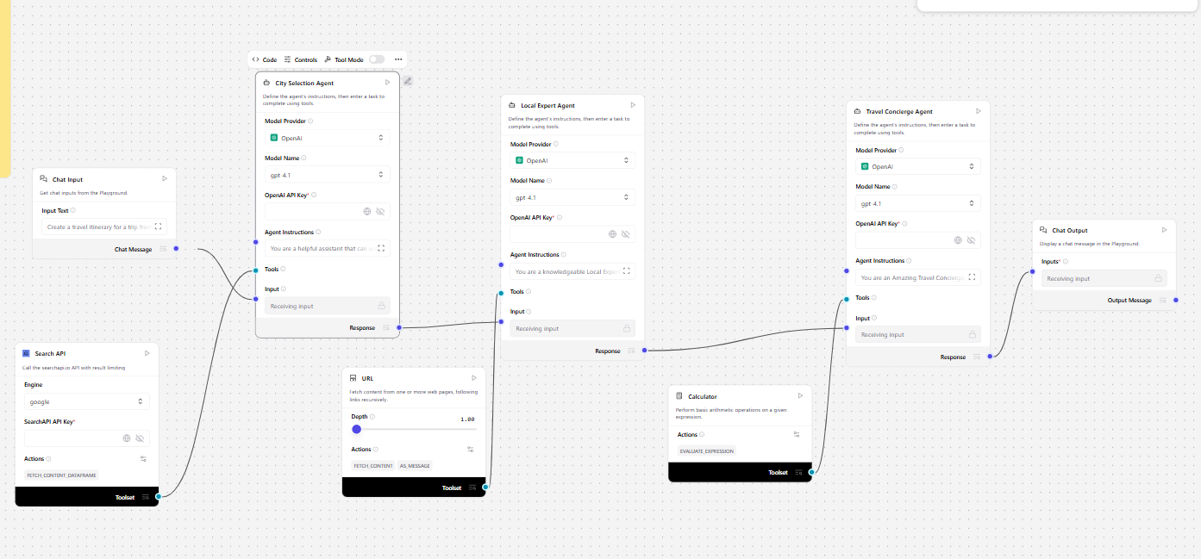
Langflow workflow -

Slide 8

Architecture blueprint

Slide 9

Role of Agentic AI in the solution
Why Agentic AI? Moving from a Simple Predictor to a Smart Assistant
Instead of a static "Yes/No" machine, Agentic AI allows XLoan-AI to reason, explain, and advise autonomously.
Context Awareness: The Granite agent understands why a low credit score matters for this specific loan amount contextually.
Multi-Agent Collaboration:
Agent 1 (Predictor): Calculates risk score.
Agent 2 (Explainer): Uses SHAP to find key drivers.
Agent 3 (Advisor): Generates the "improvement plan" for the user.
Goal-Driven: The system doesn't just reject; it actively works toward the goal of financial inclusion by showing a path to approval.
Token Usage: ~11,761 tokens used for generating a single complex explanation and counterfactual set.

Slide 10
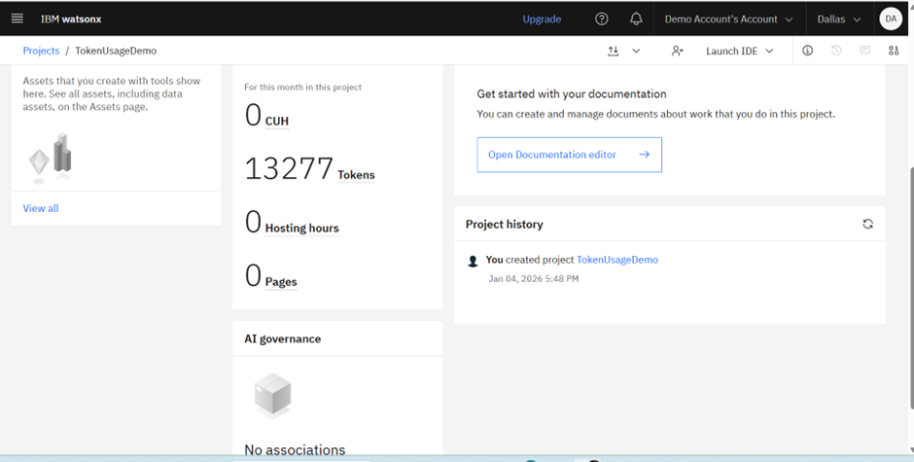
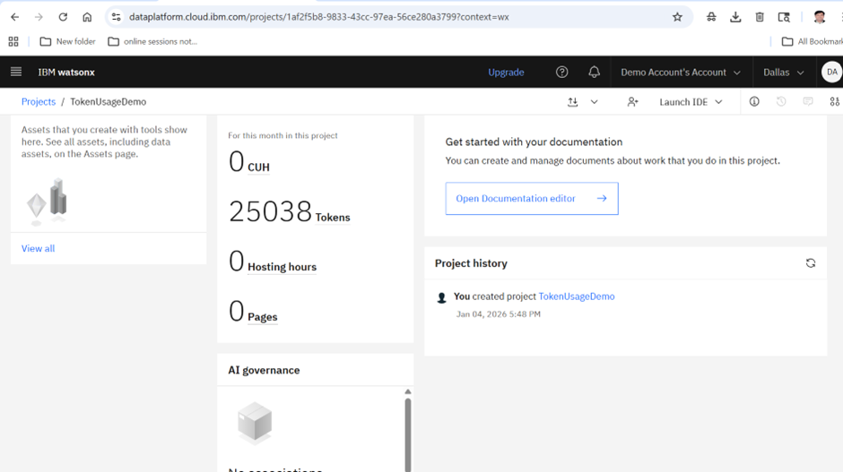
Token Usage
11,761 token are used
·
·
·

Slide 11
Novelty and Uniqueness
XLoan-AI introduces several groundbreaking innovations that distinguish it from conventional loan approval systems. Unlike traditional black-box models that simply output a "rejected" decision with no explanation, XLoan-AI provides complete transparency by translating complex model signals into human-readable reasons, such as explaining exactly which financial factor caused the rejection. While existing systems passively inherit and amplify historical biases present in training data, XLoan-AI actively monitors fairness in real-time using statistical parity and disparate impact metrics, flagging potential discrimination across gender, region, or income groups before it affects decisions.
Another major differentiator is the inclusion of a counterfactual recommendation engine. Legacy systems offer rejected applicants no guidance whatsoever, leaving them frustrated and financially excluded. XLoan-AI, however, generates specific, actionable suggestions such as "increase your credit score by 30 points" or "add a co-applicant to improve income qualification," effectively providing a clear roadmap toward future approval. Architecturally, most existing solutions rely on single, monolithic models that cannot explain themselves. XLoan-AI breaks new ground by combining the predictive accuracy of XGBoost with the reasoning power of IBM Granite models orchestrated through LangFlow, creating a true multi-agent system where specialized agents collaborate for prediction, explanation, fairness checking, and advisory functions.
Furthermore, while conventional lending systems pose high regulatory risks due to their unexplainable nature, XLoan-AI is built from the ground up for compliance with RBI guidelines, GDPR, and fair lending laws, complete with audit trails and human-in-the-loop oversight. The unique value proposition of XLoan-AI lies in being the first system that not only predicts loan outcomes with 87.5% accuracy but also empowers rejected applicants with a real, actionable roadmap to approval, thereby promoting financial inclusion rather than perpetuating exclusion.

Slide 12
Git Hub Link
· Github URL – https://github.com/Sreeja1308/XLOAN-AI
·
·
·

Slide 13
Future Scope
Current Results (Prototype)
Model Accuracy: 87.5% (XGBoost)
Fairness Metric: Disparate Impact Ratio of 0.75 (Meets 80% rule)
Response Time: ~92ms per prediction (Real-time)
User Satisfaction: 4.6 / 5 (Test users valued the "Why" explanations)
Future Scope
Multimodal Input: Upload bank statements (PDFs) or payslips directly via the Granite vision agent.
Dynamic LLM Fine-tuning: Fine-tune Granite specifically on RBI's fair lending guidelines for better regulatory alignment.
Voice Assistant: Enable a voice-based loan officer assistant for rural banking kiosks.
·
·
·

Slide 14


