Slide 1

Phishing Attacks: A Comprehensive Guide
Phishing is a type of cybercrime where attackers attempt to trick users into revealing sensitive information such as passwords, credit card details, or other personal data. Phishing attacks are often carried out through emails, text messages, or websites that appear legitimate but are actually designed to steal your information.

Slide 2
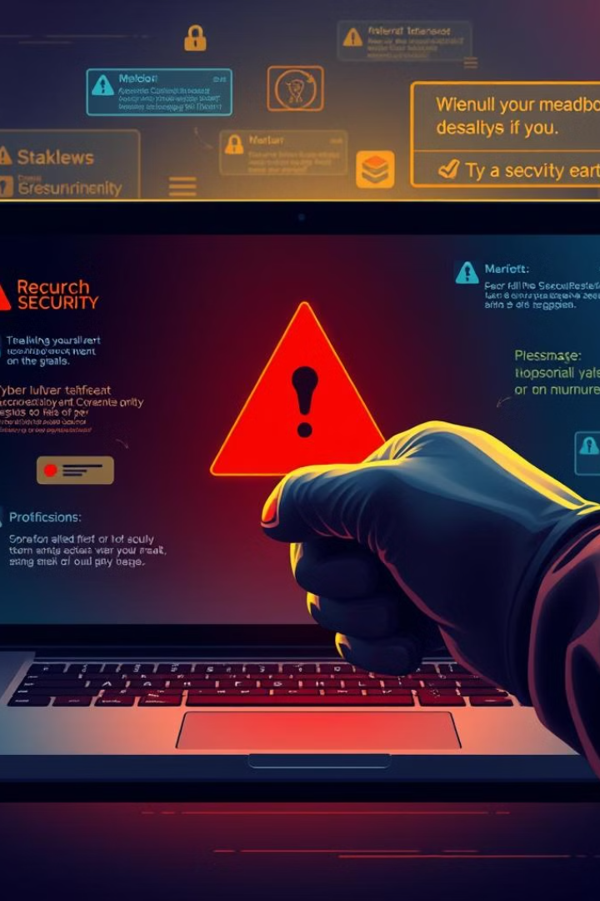
Common Phishing Tactics
1
Spoofed Emails
2
Urgent Calls to Action
Phishers often create fake emails that look like they're from legitimate companies or organizations. They may use the company's logo, branding, and even the sender's name to make the email appear authentic.
Phishing emails often create a sense of urgency by claiming that there's a problem with your account or that you need to take action immediately. This can make you more likely to click on a malicious link or provide your information.
3
Social Engineering
4
Fake Websites
Phishers may use social engineering techniques to manipulate users into revealing their information. This could involve creating fake profiles on social media or using other tactics to gain your trust.
Phishers may create fake websites that look identical to real websites. They may use your company's logo, branding, and even the website's URL to make it appear legitimate.

Slide 3
Recognizing Phishing Emails
Suspicious Sender
Generic Greetings
Unclear Links
Check the sender's email address carefully. Phishers may use email addresses that look similar to legitimate ones but with slight variations, such as an extra character or a different domain.
Phishing emails often use generic greetings, such as "Dear User," or "Dear Customer." Legitimate emails will usually address you by name.
Hover over any links in the email before clicking. The link's destination should be the actual website you're expecting to visit. If it looks suspicious, don't click it.

Slide 4
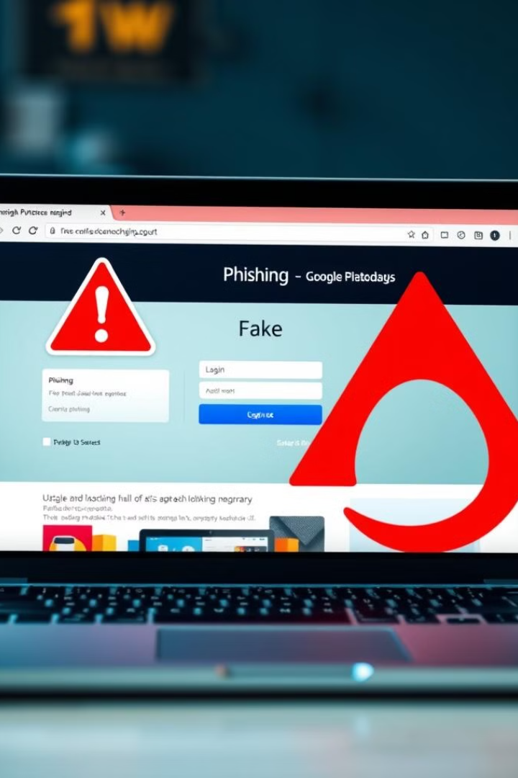
Identifying Phishing Websites
URL Mismatch
Poor Website Design
The website's URL should match the name of the organization or company it claims to be from. Look for misspellings or unusual domain names.
Phishing websites often have poor website design, such as misaligned text, broken images, or grammatical errors. This can be a sign that the website is not legitimate.
Request for Sensitive Information
Be cautious about websites that ask for sensitive information, such as your social security number, credit card details, or bank account information. Legitimate websites will not ask for this information unless it is absolutely necessary.

Slide 5




Protecting Against Social Engineering
Be Skeptical
Don't blindly trust emails, messages, or calls, especially those asking for sensitive information. Be cautious and ask questions.
Verify Information
If you're unsure about the legitimacy of a request or website, contact the organization directly through their official website or phone number to verify.
Think Before You Click
Be aware of links you click on. Hover over the link before clicking to see where it will take you. If it looks suspicious, don't click it.

Slide 6



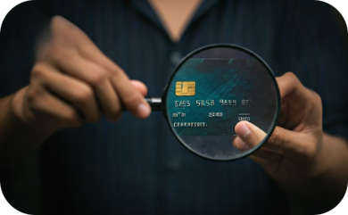
Protecting Yourself from Phishing Attacks
Be Vigilant
Strong Passwords
Security Updates
Protect Your Data
Phishing attacks are common. Be aware of suspicious emails, messages, and websites.
Use strong, unique passwords for all your online accounts. Consider a password manager to keep them secure.
Keep your software and operating system up to date with the latest security patches.
Be cautious about sharing personal information online. Don't give out sensitive details unless you're on a secure website.

