Slide 1

SPORTS ANALYSIS
Sreeja Bellamkonda
11547142
MS – Artificial Intelligence
University of North Texas

Slide 2
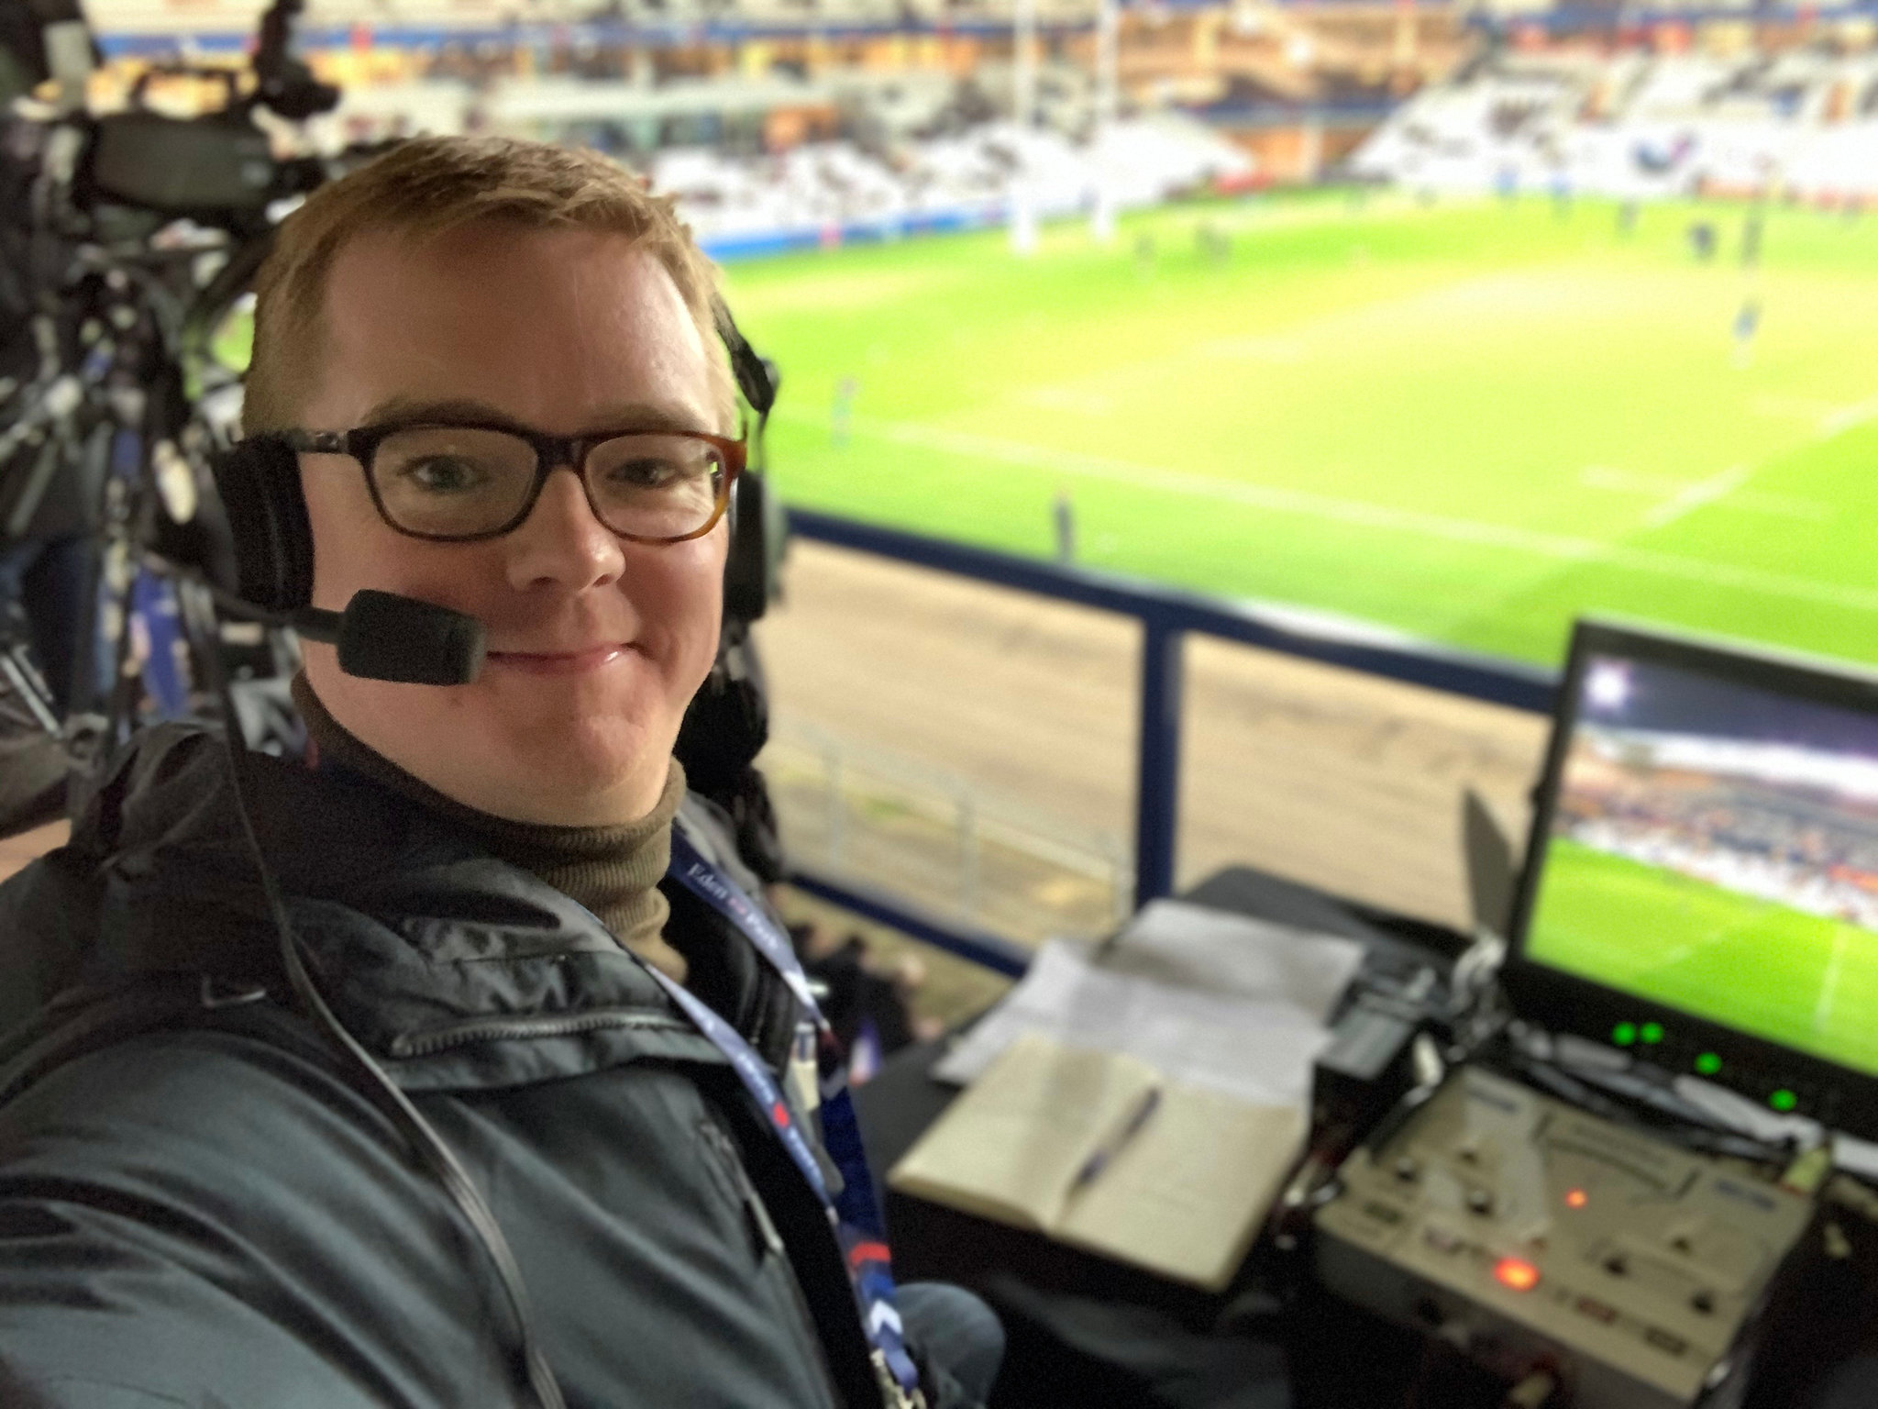
Problem statement
Every day, tens of thousands of athletic activities take place.
Despite their pattern form, most sports news is written by hand.
In this project, we want to see produce news based on the broadcast.

Slide 3
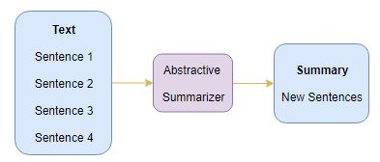
The data set is collected from the internet where we have two types of data sets raw_dataset and reference_summaries.

Slide 4
Data Preprocessing
First, collect the dataset which has the CSV and the text format.
Then they run the dataset. We use the regex method for getting all the contracted words in the dataset files.
Then convert them to lowercase sentences and expand the sentences.
After the conversion removes the punctuations from the sentences of the text. And remove the numbers from the text.
Then remove the stop words from the text.
After all the classifications clean the text for good performance.
Then finally save the cleaned dataset into the drive.

Slide 5
Implementation
In the implementation, we have four sessions they are
Modeling
Inference
Saving the model
Running all the three different models

Slide 6
Modeling
So, in the modeling, we use three different models are
Seq2Seq model with just LSTMs.
Seq2Seq model with Bidirectional LSTMs.
eq2Seq model with hybrid architecture.

Slide 7
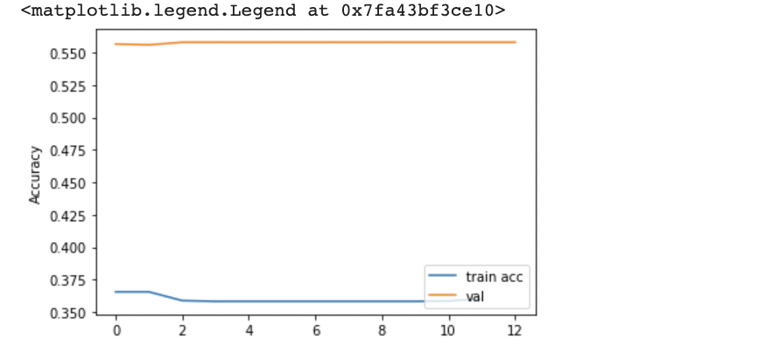
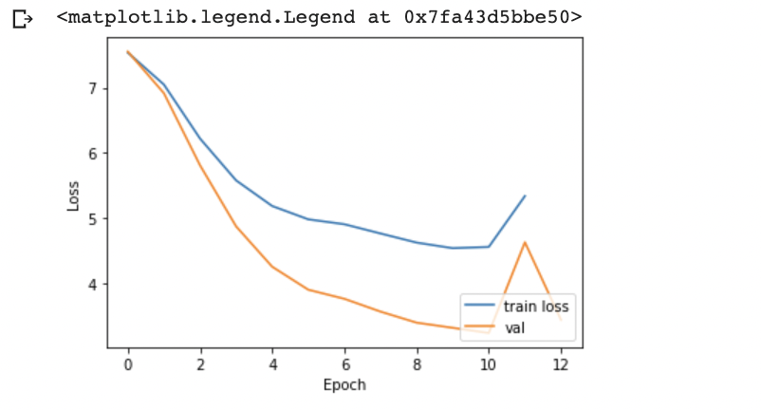
Conclusion
In this project, we conclude by implementing the three different models, and then inference. We also train the model. At last design the accurate and the loss value graphs.

Slide 8


