Slide 1

Employee Attrition Prediction
Sreeja Reddy Singidi

Slide 2

Introduction
Contains information about employees in a company and whether they have left or stayed with the company.
The dataset can explore the factors associated with employee attrition and build predictive models to identify employees at risk of leaving.
It can also analyze the relationship between demographic and employment-related variables and employee performance or job satisfaction.

Slide 3

Preliminary Exploration
Load the dataset
Check for missing values
Calculate basic statistics
Visualize the data
Check for outliers
Explore relationships between variables

Slide 4
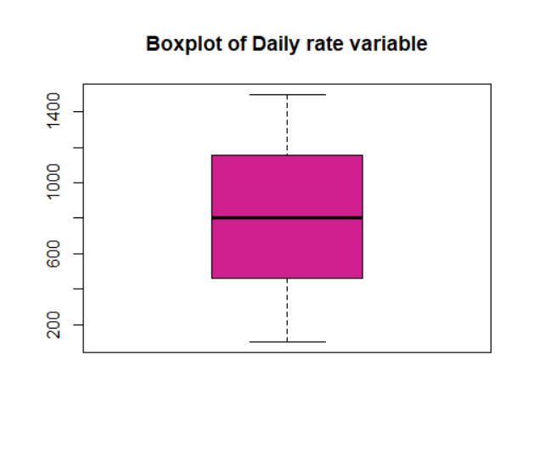
Outliers

Slide 5
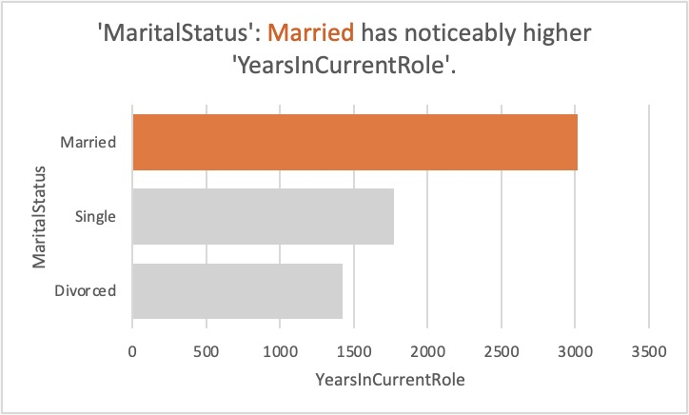
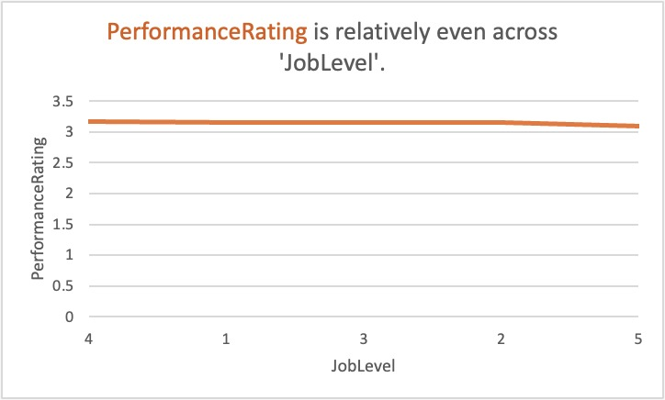

Slide 6
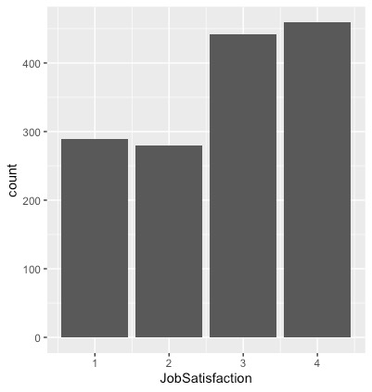
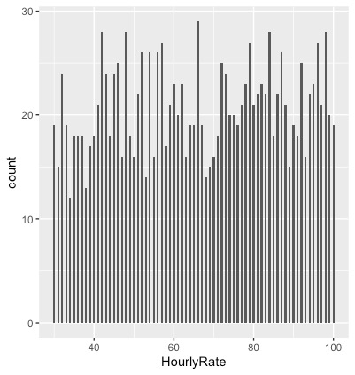

Slide 7
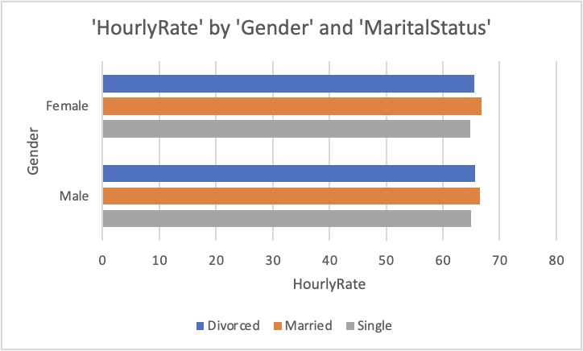

Slide 8
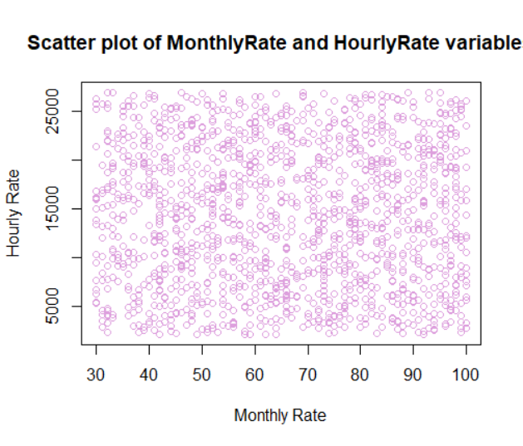
Scatter plot

Slide 9
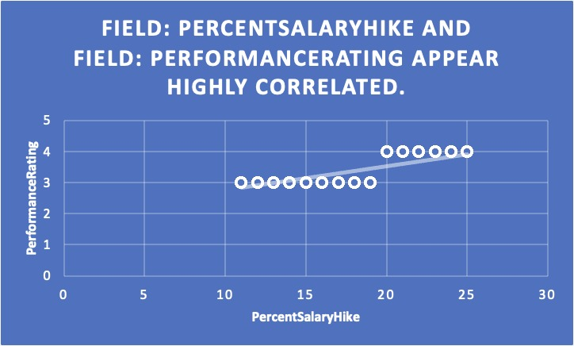
Correlation

Slide 10
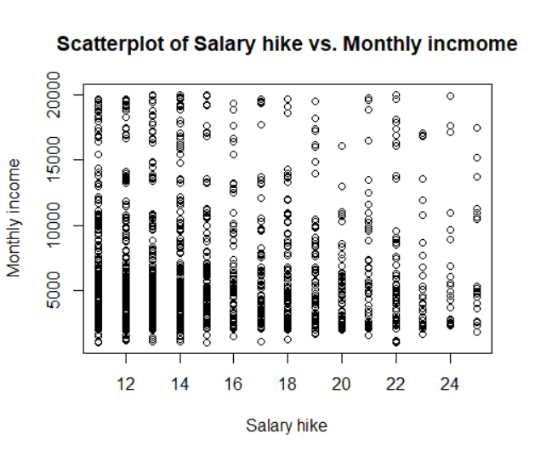
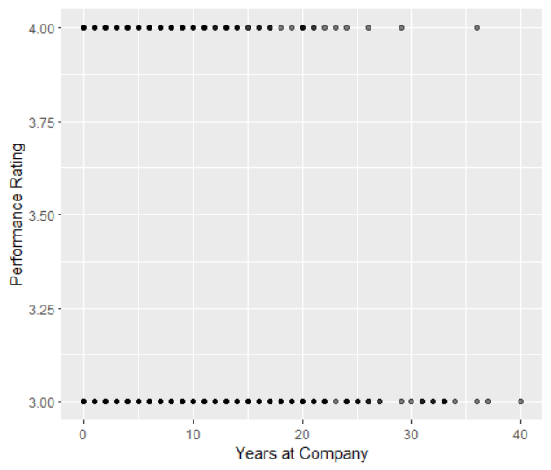

Slide 11
Conclusion
The dataset contains information about 1470 employees, out of which 237 (16.1%) have left the company. This attrition rate is relatively high and could cause concern for the company.
Accuracy predicted was 61% using the linear regression model with fields performance rating and salary hike.
Overall, employee attrition prediction is a valuable tool for organizations looking to improve their workforce management and retain their top talent.

