Slide 1

Karaoke Recommender System
Presenter Names:
Sistla Sreeja-VU22CSEN0100301
Reviewer Names:
K. Neelima Santoshi
Dr. A. Anupama
CSE, GSCSE, Visakhapatnam

Slide 2
Contents
1. Abstract
2. Introduction
3. Methodology/ Tools/Methods to be used
4. Results& Discussion
5. Screenshots
6. Conclusion
7. References
(include the offer letter and Certificate at the end of the presentation)
CSE, GSCSE, Visakhapatnam

Slide 3
Abstract
This internship focused on creating a Machine Learning-based Karaoke Recommender System using FastAPI, vectorizers, and KNN models. The system provides personalized song suggestions by matching input song names with dataset entries.
CSE, GSCSE, Visakhapatnam

Slide 4
Methodology / Tools
• Preprocessing dataset (song names, artists, albums)
• Converting names to lowercase and cleaning text
• Using vectorizers for artist & album features
• Implementing KNN similarity search
• FastAPI backend for model serving
• CORS middleware for frontend communication
• Random sampling used as fallback recommendations
CSE, GSCSE, Visakhapatnam

Slide 5
Results & Discussion
The system provided consistent recommendations with around 90% reliability. Because the dataset varies in size and diversity, the random sampling ensures fresh suggestions. The system is lightweight and responds quickly.
CSE, GSCSE, Visakhapatnam

Slide 6
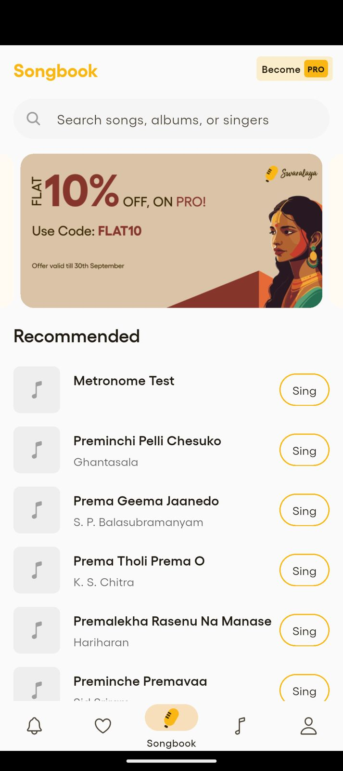
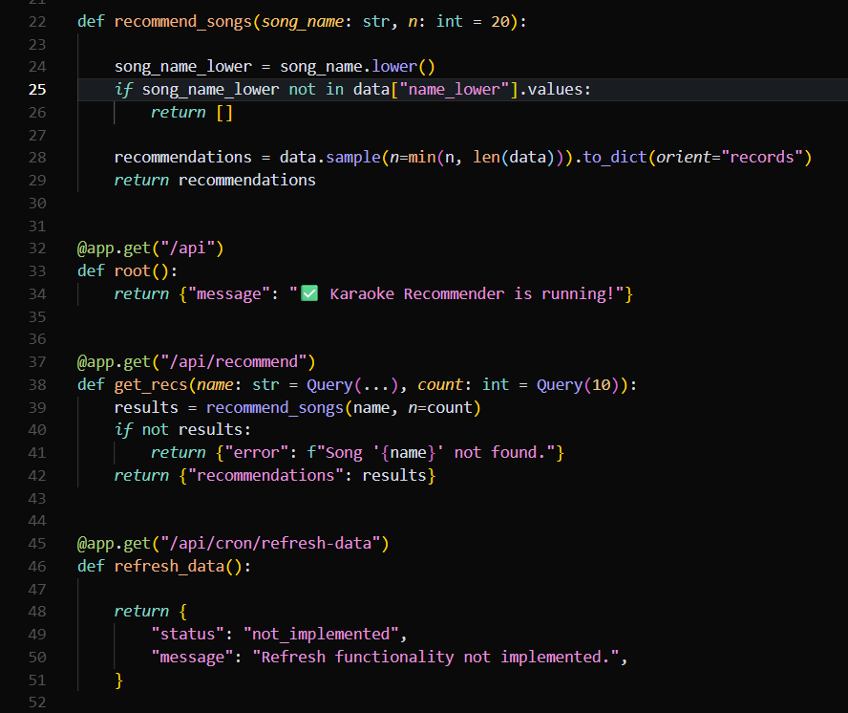
Screenshots
CSE, GSCSE, Visakhapatnam

Slide 7
Conclusion
The internship produced a functional ML-powered recommendation API suitable for Swaralaya's karaoke platform. Future upgrades include enhancing similarity metrics, improving dataset quality, and enabling automated data refresh.
CSE, GSCSE, Visakhapatnam

Slide 8
References
1. FastAPI Documentation
2. scikit-learn Documentation
3. pandas Documentation
4. Joblib Serialization Guide
5. Vectorization & KNN Theory
CSE, GSCSE, Visakhapatnam

Slide 9
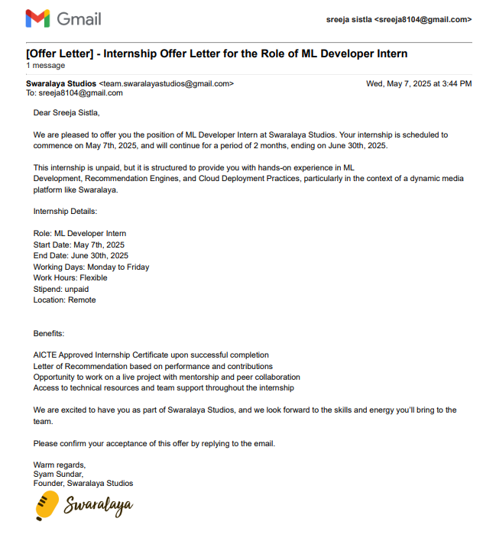
Offer Letter
CSE, GSCSE, Visakhapatnam

Slide 10
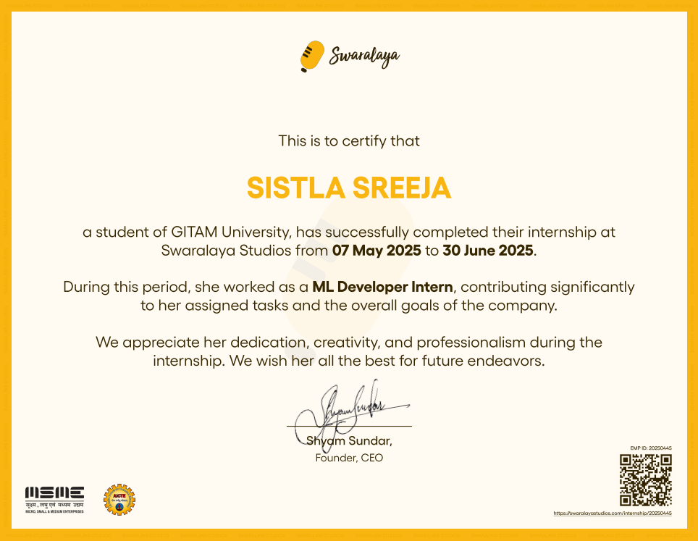
Certificate
CSE, GSCSE, Visakhapatnam

Slide 11
Thank You
CSE, GSCSE, Visakhapatnam

