Slide 1

A Semi- Supervised Active Learning Neural Network for Data Streams With Concept Drift
Capstone Project – Final: Review – 1 on
Presented by the Batch No. : 3
Sreeja Sistla
Sanjana Sripati
K. Lakshmi Nikhita
Arun Kumar Remella
VU22CSEN0100301(TL)
VU22CSEN0100563
VU22CSEN0100440
VU22CSEN0102106
Under the Guidance of Suneetha Dwarapu
Assistant Professor
Department of Computer Science and Engineering GITAM School of CSE, GITAM (Deemed to be University), Visakhapatnam.

Slide 2
CONTENTS
Recap of Capstone Project Introduction Review-2
Problem Statement
Objectives and Project Workflow
Feedback from Guide/Reviewers and actions taken after Review–2
Methodology/Algorithms
Status of Implementation
Conclusion
References

Slide 3
Problem Statement
Learning from streaming data is hard because labels are limited and the data keeps changing. Most existing methods handle semi-supervised learning and active learning separately or rely on fixed querying strategies, which makes them inefficient and unstable over time. Our work focuses on a closed-loop framework that tightly integrates semi-supervised and active learning, incrementally learns from partially labeled data streams, selectively queries only the most informative samples, and naturally adapts to concept drift without retraining from scratch.

Slide 4
Objectives
To design a semi-supervised learning framework for streaming data classification
To reduce labeling cost using active learning strategies
To improve sample selection reliability using a dual-teacher mechanism
To handle concept drift through incremental model updates
To evaluate model performance on real-world streaming datasets

Slide 5
Design Strategy
Project Workflow
The system is designed as a closed-loop learning framework combining semi-supervised learning, active learning, and neural networks. An RBF neural network is used as the main learner due to its fast convergence and nonlinear modeling ability. Two teacher models—KNN and RBF—are used to guide sample selection through disagreement measurement, ensuring both local and global data representation.

Slide 6
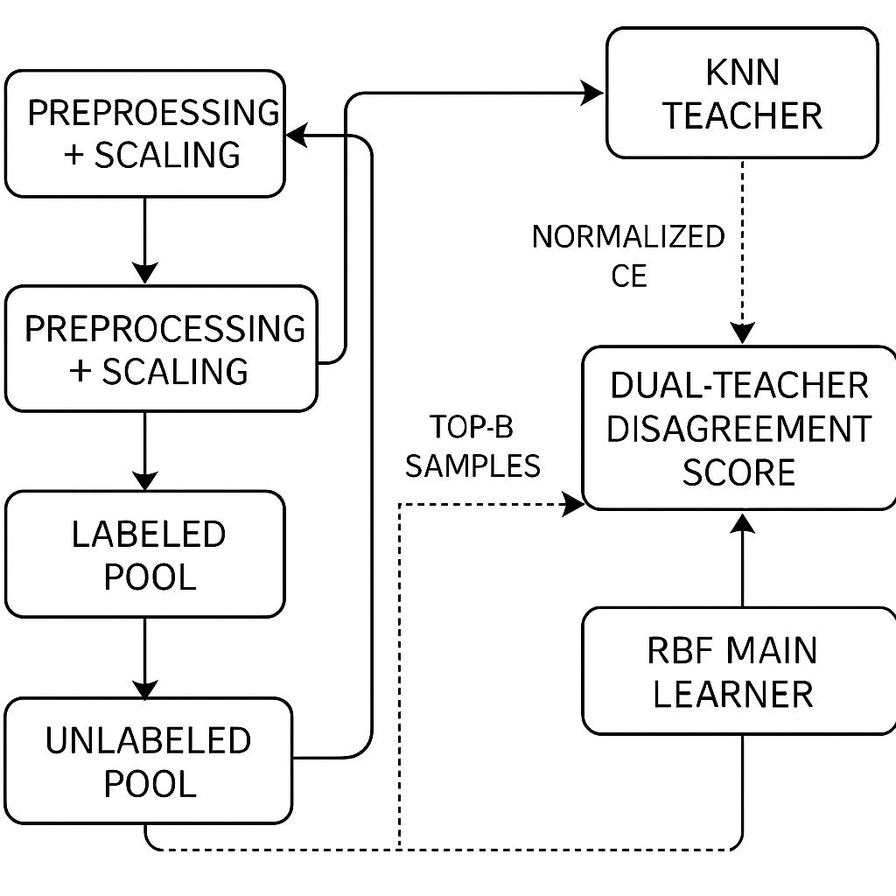
Design Strategy

Slide 7
Feedback from Guide/Reviewers and actions taken after Review–2
Feedback from Guide/Reviewers
1. Suggested strengthening the work by focusing on a tighter integration of semi-supervised learning and active learning as a unified framework.
2. Recommended enhancing the query strategy to be more adaptive over time, improving label efficiency and robustness in streaming scenarios.
Actions taken
1. Closed-Loop Integration: Closed-loop integration: SSL and AL are unified into a single iterative learning loop.
2. Adaptive Querying: Each queried label reshapes future uncertainty and query selection.
3. Drift resilience: Continuous updates enable natural adaptation to concept drift.

Slide 8
Methodology
The proposed approach brings together semi-supervised and active learning in a closed-loop system. It works on streaming data step by step, smartly picks the most useful unlabeled samples by comparing model predictions, asks for labels only when necessary, and continuously updates itself to adapt to changing data patterns.

Slide 9
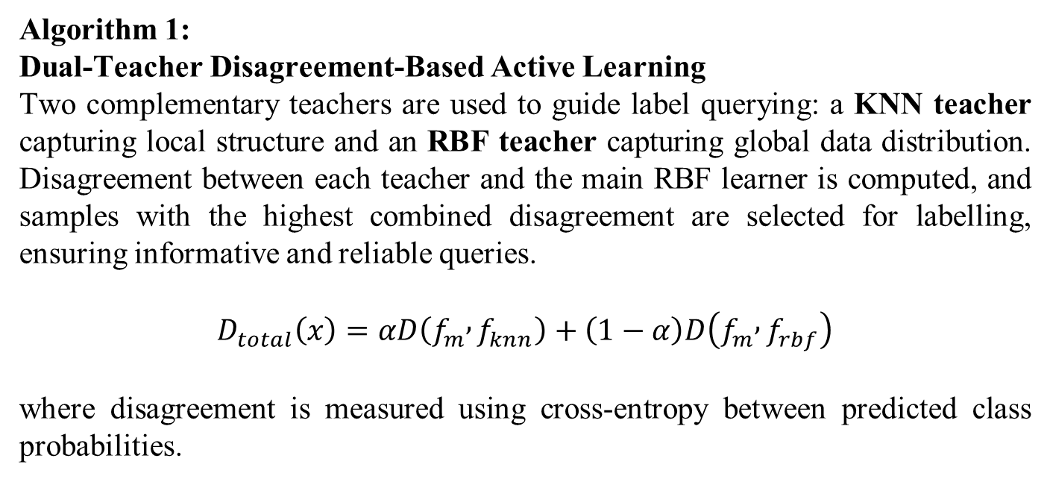
Algorithm (s)
Algorithm 1: Dual-Teacher Disagreement-Based Active Learning
Two complementary teachers are used to guide label querying: a KNN teacher capturing local structure and an RBF teacher capturing global data distribution. Disagreement between each teacher and the main RBF learner is computed, and samples with the highest combined disagreement are selected for labelling, ensuring informative and reliable queries.
$$D_{total}\left(x\right)=αD\left(f_{m} , f_{knn}\right)+\left(1−α\right)D\left(f_{m} , f_{rbf}\right)$$
where disagreement is measured using cross-entropy between predicted class probabilities.

Slide 10
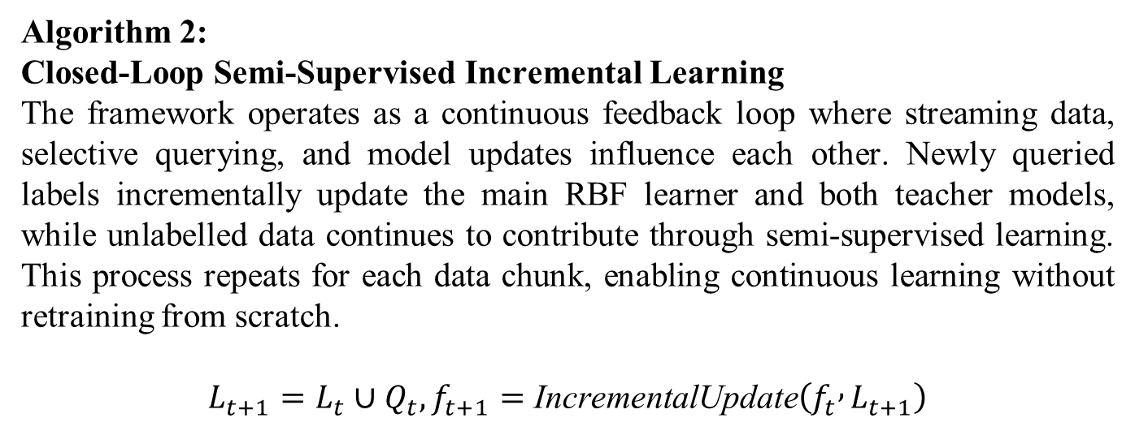
Algorithm (s)
Algorithm 2: Closed-Loop Semi-Supervised Incremental Learning
The framework operates as a continuous feedback loop where streaming data, selective querying, and model updates influence each other. Newly queried labels incrementally update the main RBF learner and both teacher models, while unlabelled data continues to contribute through semi-supervised learning. This process repeats for each data chunk, enabling continuous learning without retraining from scratch.
$$L_{t+1}=L_{t}∪Q_{t}, f_{t+1}=\text{IncrementalUpdate}\left(f_{t} , L_{t+1}\right)$$

Slide 11
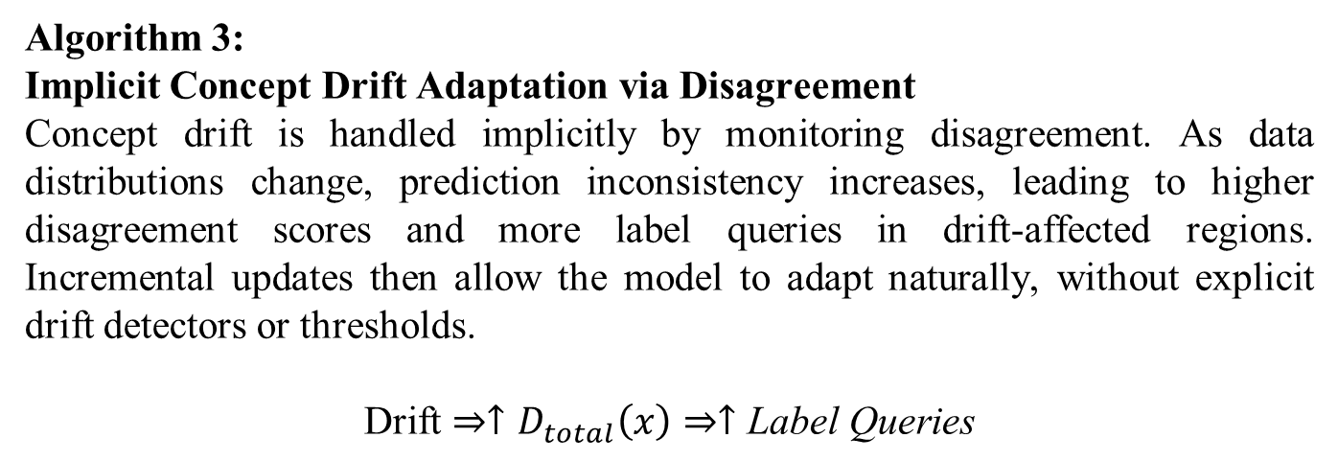
Algorithm (s)
Algorithm 3: Implicit Concept Drift Adaptation via Disagreement
Concept drift is handled implicitly by monitoring disagreement. As data distributions change, prediction inconsistency increases, leading to higher disagreement scores and more label queries in drift-affected regions. Incremental updates then allow the model to adapt naturally, without explicit drift detectors or thresholds.
$$\text{Drift}⇒↑D_{total}\left(x\right)⇒↑\text{Label} \text{Queries}$$

Slide 12
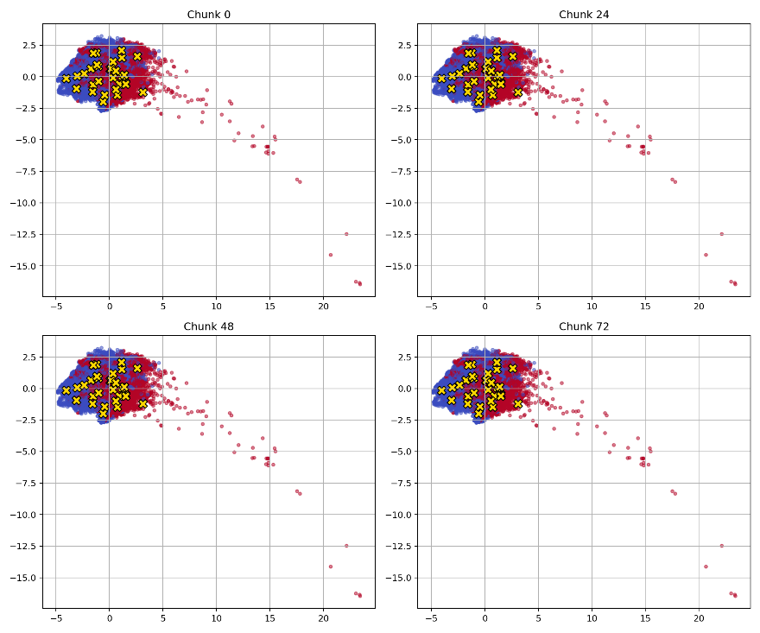
Status of Implementation
Objective-1
To demonstrate closed-loop learning behavior and model adaptation across streaming data chunks
Implementation Details
Chunk-wise streaming data processing
Incremental RBF neural network training
Dual teachers: KNN (local) and RBF (global)
Closed-loop update after each queried label

Slide 13
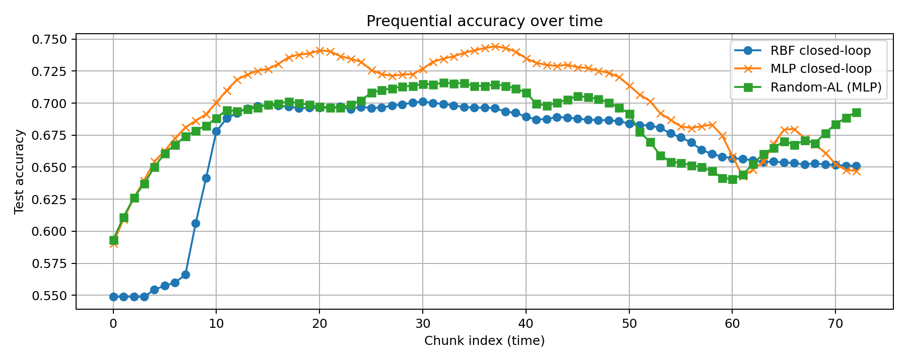
Status of Implementation
Objective-2
To evaluate closed-loop learning using prequential accuracy
Implementation Details
Prequential (test-then-train) evaluation
Accuracy tracked per chunk
Compared RBF closed-loop, MLP closed-loop, and Random-AL

Slide 14
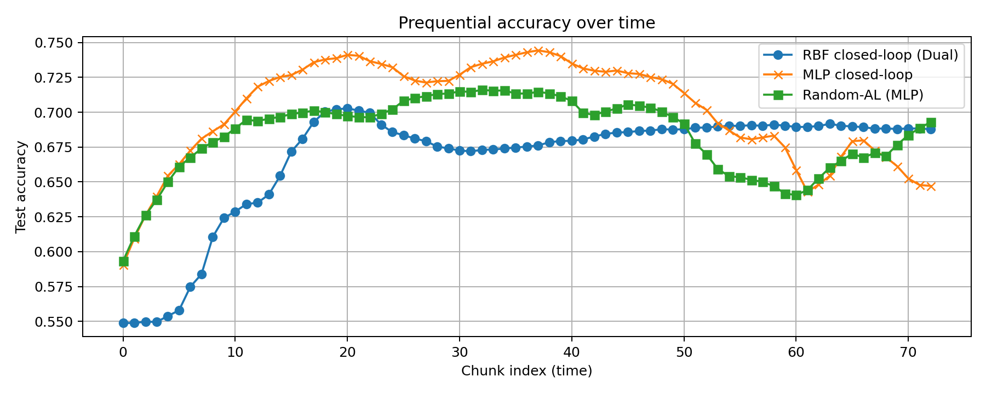
Status of Implementation
Objective-3
To compare proposed closed-loop SSL–AL with random querying under concept drift
Implementation Details
Disagreement-based querying vs random sampling
Fixed labeling budget per chunk
Same data stream for fair comparison

Slide 15
Conclusion
Summary of progress: Core closed-loop SSL–AL framework implemented, evaluated on streaming data, and validated through accuracy and adaptation results.
Team’s confidence on project completion: The team is confident in completing the project on time, supported by stable performance, incremental learning capability, and effective handling of concept drift.
Expected outcomes or impact: Efficient, label-aware, and drift-resilient learning framework suitable for real-world data streams.

Slide 16
References
Journals
Z. Tong, W. Li, B. Zhang, F. Jiang, and G. Zhou, “Online bearing fault diagnosis based on a novel multiple data streams transmission scheme,” IEEE Access, vol. 7, pp. 66644–66654, 2019.
A. Preece et al., “Sentinel: A codesigned platform for semantic enrichment of social media streams,” IEEE Trans. Comput. Social Syst., vol. 5, no. 1, pp. 118–131, Mar. 2018.
G. Ditzler and R. Polikar, “Incremental learning of concept drift from streaming imbalanced data,” IEEE Trans. Knowl. Data Eng., vol. 25, no. 10, pp. 2283–2301, Oct. 2013.
B. Jiao, Y. Guo, C. Yang, J. Pu, Z. Zheng, and D. Gong, “Incremental weighted ensemble for data streams with concept drift,” IEEE Trans. Artif. Intell., vol. 5, no. 1, pp. 92–103, Jan. 2024.
Y. Song, J. Lu, A. Liu, H. Lu, and G. Zhang, “A segment-based drift adaptation method for data streams,” IEEE Trans. Neural Netw. Learn. Syst., vol. 33, no. 9, pp. 4876–4889, Sep. 2022.

