Slide 1

Capstone Project – I: Review – 2 on
A Semi- Supervised Active Learning Neural Network for Data Streams With Concept Drift
Presented by the Batch No. : 3
Sreeja Sistla VU22CSEN0100301 (TL)
K. Lakshmi Nikhita VU22CSEN0100440
Sanjana Sripati VU22CSEN0100563
Arun Kumar Remella VU22CSEN0102106
Under the Guidance of
Suneetha Dwarapu
Assistant Professor
Department of Computer Science and Engineering
GITAM School of CSE, GITAM (Deemed to be University),
Visakhapatnam.

Slide 2
CONTENTS
Recap of Capstone Project Introduction Review-1
  Problem Statement
  Objectives
  Feedback from Guide/Reviewers and actions taken after Review–1
Requirement Analysis
Identification of tools/technology/algorithms
Design Strategy (project workflow/ system design/ DFD/UML design)
Conclusion
References

Slide 3
Problem Statement
“To develop a dual-teacher active learning framework using an RBF network that can selectively query the most informative streaming data points, reducing human labeling while improving model accuracy.”

Slide 4
Objectives
Integrate SSL and AL into a closed-loop system.
Use two teachers (KNN + RBF) for stable disagreement estimation.
Train RBF incrementally over time.
Compare against MLP and Random baselines.
Visualize RBF center dynamics.

Slide 5
Feedback from Guide/Reviewers and actions taken after Review–1
Feedback from Guide/Reviewers
1. Closed-Loop SSL–AL Integration: Combine semi-supervised learning and active learning in a unified, iterative framework for continuous improvement.
2. Must focus on one core contribution.
3. Remove unnecessary complexity.
Actions taken
1. Focused solely on dual-teacher AL.
2. Built RBF-based closed-loop system.
3. Designed clear experiment pipeline.

Slide 6
Requirement Analysis
Hardware Requirements
Any i5/i7 laptop
8GB RAM recommended
Software Requirements
Python
Jupyter Notebook,
Scikit-Learn,
NumPy, Pandas.

Slide 7
Identification of tools/technology/algorithms
Tools:
Python
Jupyter Notebook
Technologies:
Machine Learning
Semi-Supervised Learning
Active Learning

Slide 8
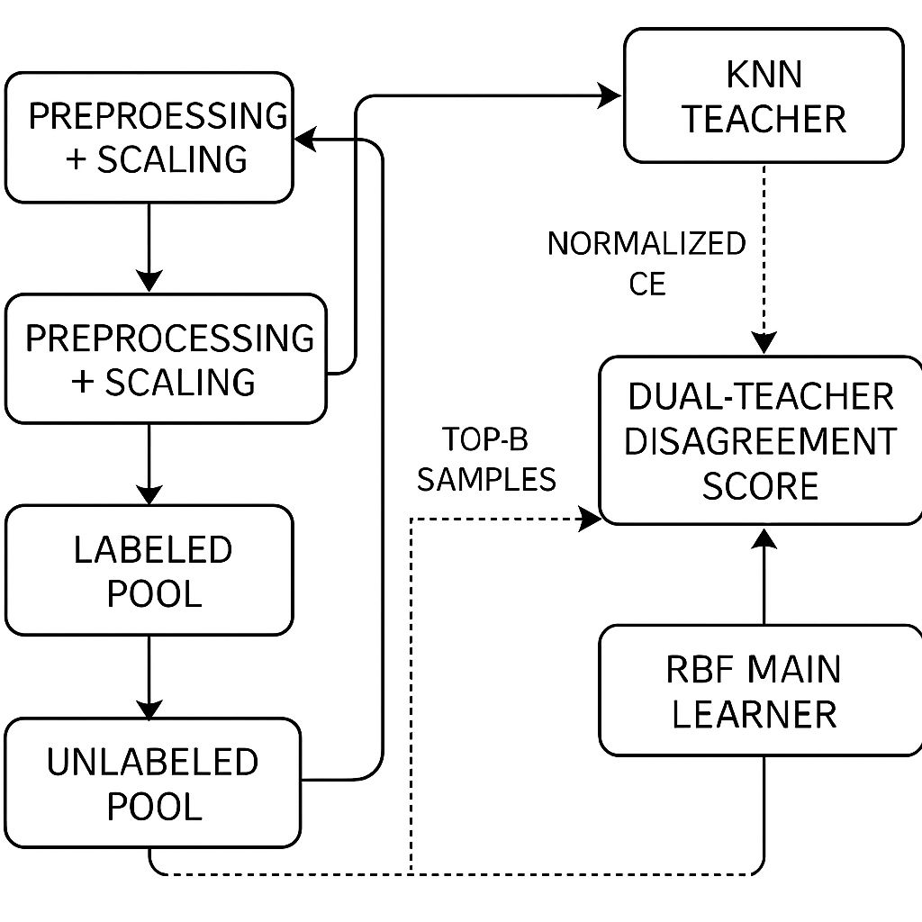
Identification of tools/technology/algorithms
Algorithms:
RBF Network
KNN
MLP
Dual-Teacher Disagreement Score

Slide 9
Design Strategy
Project Workflow
Load stream → Preprocess → RBF init
Each chunk: get teachers → compute score → query labels → update model
Evaluate test accuracy in prequential manner

Slide 10
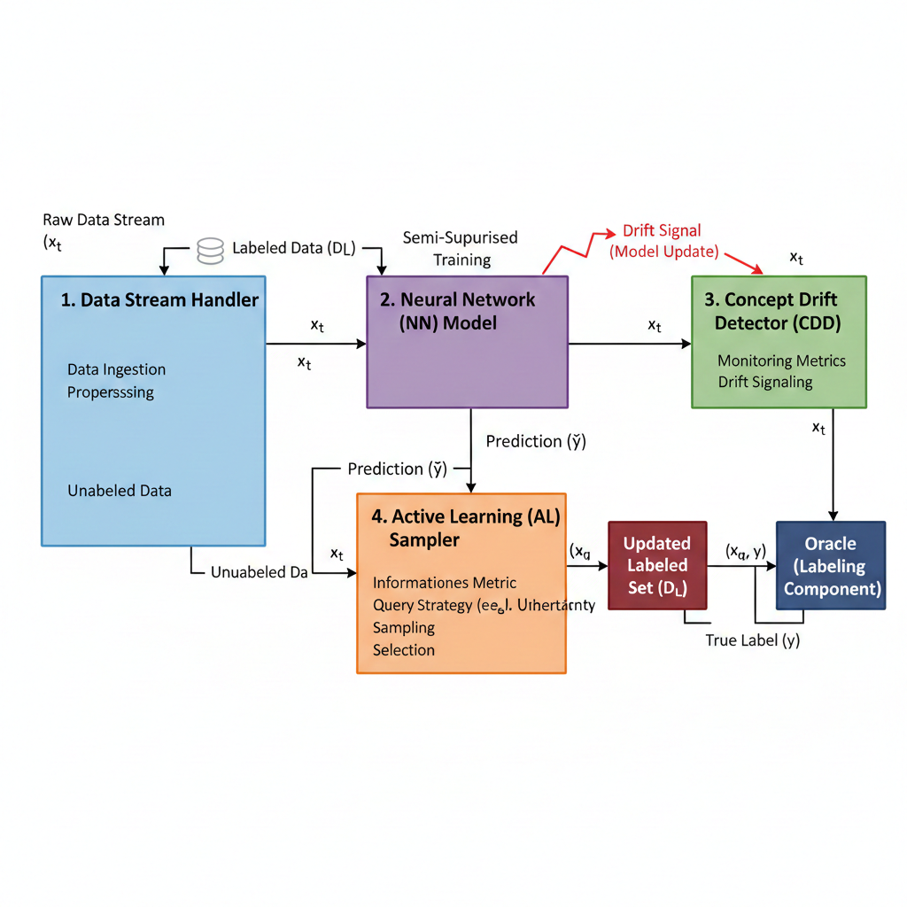
Design Strategy
System Design

Slide 11
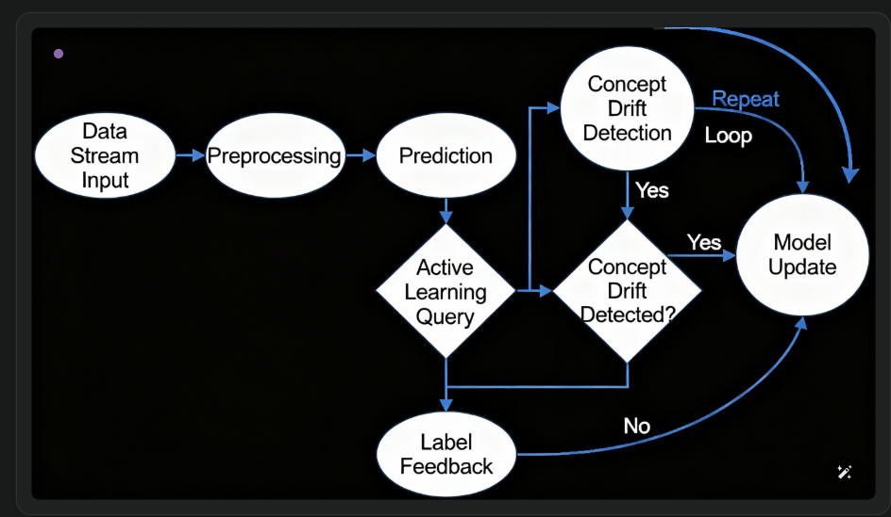
Design Strategy
Data Flow Diagram/ER Diagram

Slide 12
Conclusion
Completed full experimental pipeline.
Achieved stable active learning with dual teachers.
Improved accuracy and label efficiency.
On track for final implementation and paper writing

Slide 13
References
Journals
[1] Z. Tong, W. Li, B. Zhang, F. Jiang, and G. Zhou, “Online bearing fault diagnosis based on a novel multiple data streams transmission scheme,” IEEE Access, vol. 7, pp. 66644–66654, 2019.
[2] A. Preece et al., “Sentinel: A codesigned platform for semantic enrichment of social media streams,” IEEE Trans. Comput. Social Syst., vol. 5, no. 1, pp. 118–131, Mar. 2018.
[3] G. Ditzler and R. Polikar, “Incremental learning of concept drift from streaming imbalanced data,” IEEE Trans. Knowl. Data Eng., vol. 25, no. 10, pp. 2283–2301, Oct. 2013.
[4] B. Jiao, Y. Guo, C. Yang, J. Pu, Z. Zheng, and D. Gong, “Incremental weighted ensemble for data streams with concept drift,” IEEE Trans. Artif. Intell., vol. 5, no. 1, pp. 92–103, Jan. 2024.
[5] Y. Song, J. Lu, A. Liu, H. Lu, and G. Zhang, “A segment-based drift adaptation method for data streams,” IEEE Trans. Neural Netw. Learn. Syst., vol. 33, no. 9, pp. 4876–4889, Sep. 2022.

