Slide 1
ORACLE
PROJECT CASE STUDY
Internet Banking
System
A full-stack digital banking platform designed for secure customer services and controlled administrative operations.
Oracle JET
Submitted By:
Gokul Krishnan
Prakriti Yadav
Sreeja Pamu
Meghana Nanavala
Confidential - Oracle Restricted | Employees Only
1

Slide 2
What the platform does
A full-stack digital banking platform with separate customer and administrative journeys.
C
Customer journey
A
Administrative journey
IB
Registration, authentication, account management, transfers, bills, scheduled payments, cards, loans and statements.
KYC verification, approvals, audit monitoring, reports and an operational dashboard.
Internet Banking
Core Platform
Secure by design
Auditable
Controlled admin
Customer capabilities
Controlled administration
Platform backbone
• Two-factor authentication
• Fund transfers
• Beneficiary management
• Bill & scheduled payments
• KYC verification
• Approvals
• Audit monitoring
• Reports & dashboard
Centralized API Gateway + microservices orchestration connecting customer channels to domain services and data.
Confidential - Oracle Restricted | Employees Only
2

Slide 3
Technology stack
Layered stack designed for modular development, secure APIs and scalable service ownership.
Experience
Application
Security
Data & Messaging
Oracle JET 20.1.2
JavaScript
MVVM / Knockout.js
Java 17
Spring Boot 3.5.4
Spring Cloud 2025.0.0
Spring Cloud Gateway
Spring Security
JWT • RBAC • 2FA
BCrypt • AES-GCM
Oracle Database
JPA / Hibernate
Apache Kafka
Delivery
Architecture signal
Maven
Podman Compose
Modular services → secured APIs → owned data → asynchronous processing
Modular
Secure
Observable
Scalable
Confidential - Oracle Restricted | Employees Only
4

Slide 4
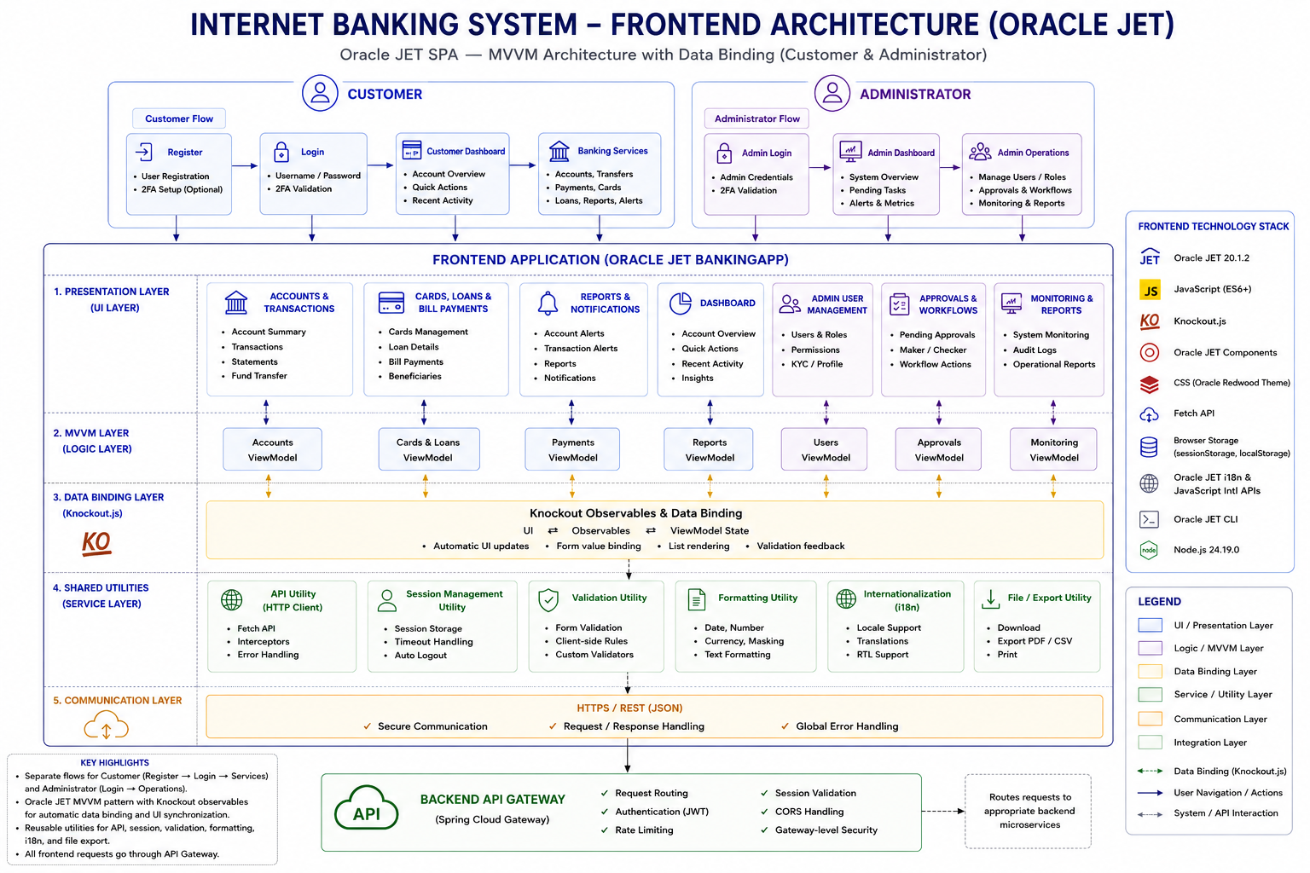
Architecture
Controlled interaction between channels, services, workflows and data.
DATA + TRUST
Confidential - Oracle Restricted | Employees Only
3

Slide 5
Three complete end-to-end MVP workflows
The most complete demonstrated journeys in the project.
Biller Management & Bill Payments
Scheduled Payments
KYC Document Verification
01
02
03
1
Biller registration
1
Create future / recurring payment
1
Upload KYC document
2
Source-account selection
2
Configure execution schedule
2
Associate with KYC request
3
Payment initiation
3
Manage / cancel schedules
3
Admin views document
4
Payment tracking / history
4
Scheduler triggers workflow
4
Approve / reject KYC
5
Workflow-based execution
5
Customer status updated
Payment journey
Scheduler-driven journey
Review & approval journey
Why this matters
The MVP demonstrates complete business outcomes—not just isolated screens or APIs.
Confidential - Oracle Restricted | Employees Only
5

Slide 6
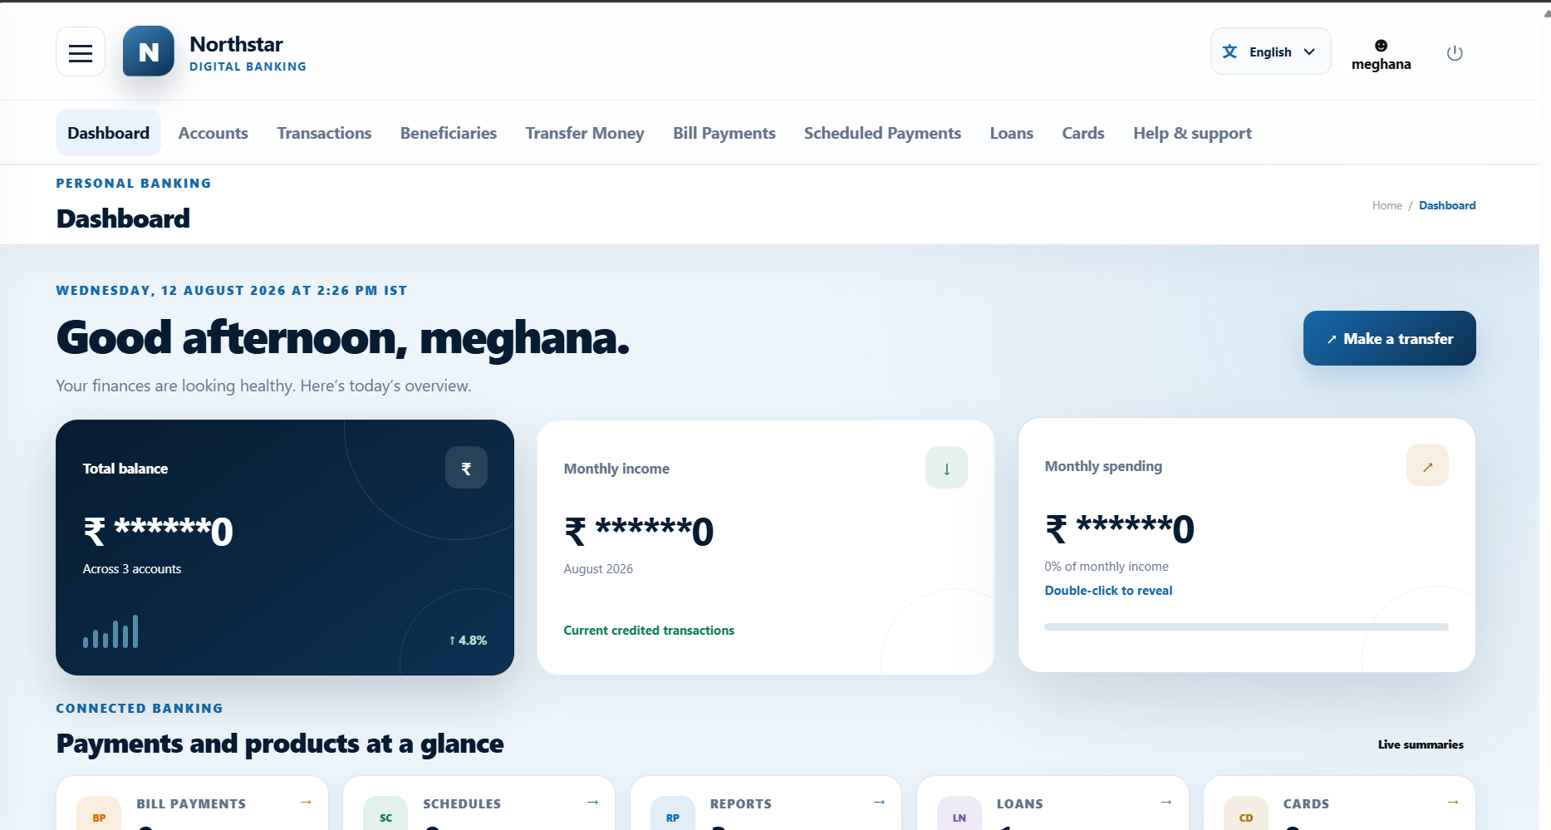
Snapshot of Frontend
Confidential - Oracle Restricted | Employees Only
3

Slide 7
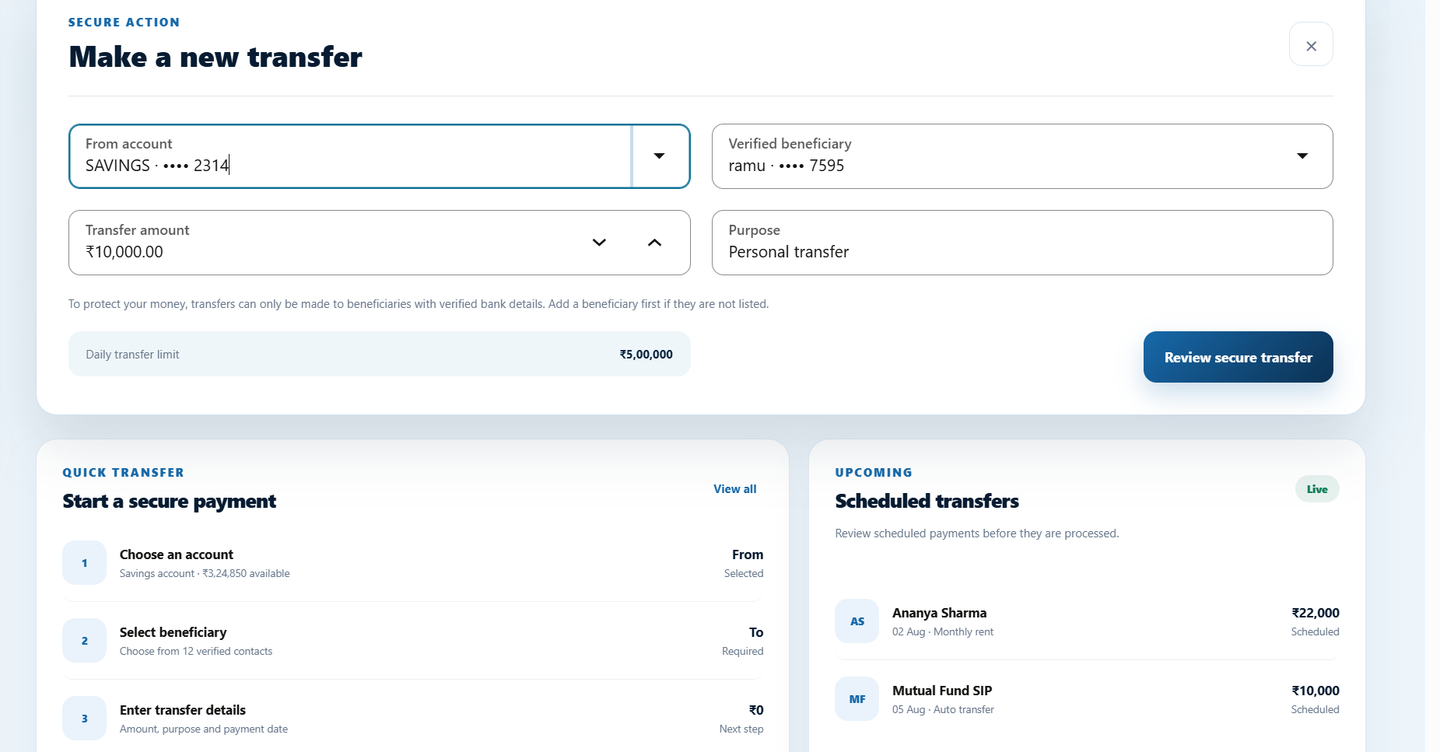
Snapshot of Frontend
Confidential - Oracle Restricted | Employees Only
3

Slide 8
Challenges & solutions
Preserving security, consistency and correct financial behavior across independent services.
Managing multiple microservices
Clear domain boundaries + API Gateway
Maintaining financial integrity
Controlled Account Service operations + Workflow Service
Secure authentication
JWT + Spring Security + BCrypt + 2FA
Cross-service communication
Secured internal APIs
Duplicate financial requests
Idempotency keys
Asynchronous processing
Apache Kafka
Consistent errors
Centralized exception handling + ApiError
Role-based access
RBAC + role-aware frontend navigation
“The main challenge was coordinating independent services while preserving security, consistency and correct financial behavior.”
Confidential - Oracle Restricted | Employees Only
6

Slide 9
Future scope
A practical roadmap for deeper payments, observability, security and production readiness.
Security
External Payments
Notifications
Enhanced card blocking / unblocking and fraud detection
Integrate UPI and external payment gateway integration
SMS, push notifications, WebSockets / SSE
DevOps
Monitoring
Deployment
CI/CD and expanded automated testing
Centralized logs, metrics, alerts + distributed tracing
Secure cloud deployment
Confidential - Oracle Restricted | Employees Only
7

Slide 10
AI usage — transparent and bounded
AI supported selected project work; outputs were reviewed and validated by the team.
Dummy data
Documentation
Testing
DATA
DOCS
TEST
Representative non-production data for development and testing
Structuring, refining and formatting technical documentation
Test scenarios, edge cases and test-data variations
Supportive — not authoritative
Supportive — not authoritative
Supportive — not authoritative
Prompt: Act as a Solution Architect and describe the high-level architecture of the Internet Banking System, covering the Oracle JET frontend, Spring Boot microservices backend, Spring Cloud API Gateway, Oracle Database, Apache Kafka, and external systems, and briefly explain how these components communicate and interact securely.
Prompt: Compare the original and refactored implementations of the Internet Banking System, focusing on the Oracle JET frontend and Spring Boot microservices backend. For each refactoring improvement, explain what was changed, why it was required, how it improves code quality, and whether existing functionality remains unchanged, and present the results in a concise comparison table.
Validation: AI-assisted outputs were reviewed and validated by the project team before use.
Confidential - Oracle Restricted | Employees Only
8

Slide 11
CONCLUSION
A secure and modular foundation
for future banking capabilities.
1
3
5
What is delivered
Channel
Services
Data
Secure + modular digital banking platform
Oracle JET
Microservices
Oracle Database
Oracle JET + Spring Boot microservices
2
4
Centralized communication through API Gateway
Gateway
Workflow
JWT, RBAC, 2FA, encryption, idempotency & audit controls
API Gateway
Kafka + orchestration
Kafka for asynchronous notification and audit processing
Three demonstrated MVP journeys
Biller + Bills
Scheduled Payments
KYC Verification
Thank you • Questions / comments
Confidential - Oracle Restricted | Employees Only
9

