Slide 1

Shopping made easy-Grab and Go( Leveraging Computer Vision for Intelligent Shopping)
GUIDED BY: Prof. Manjunath Joshi PRESENTED BY : Jyoti Kumari (202318049)
Sreejesh Nair (202318001)
November 22, 2024

Slide 2
Introduction:
This project explores the use of object detection techniques to streamline grocery inventory management, enabling efficient product tracking and stock control.
Introduction to the problem:
The traditional shopping process with barcodes and cashiers is inefficient, leading to long queues and slow payment processes.
Overview of the approach:
Leveraging computer vision for automatic product detection using YOLO models (V8) instead of expensive RFID sensors which was used by AMAZON GO [3].
Importance and relevance of the problem:
A cost-effective solution to implement contactless shopping in developing countries.

Slide 3
Problem Statement
Description of the problem:
How to eliminate physical checkout and payment delays in stores.
Input data specifics:
Supermarket product images for detection.
Expected output:
Accurate product identification and automated checkout without cashier involvement.
Dataset to be used:
Products-6K dataset of grocery items.

Slide 4
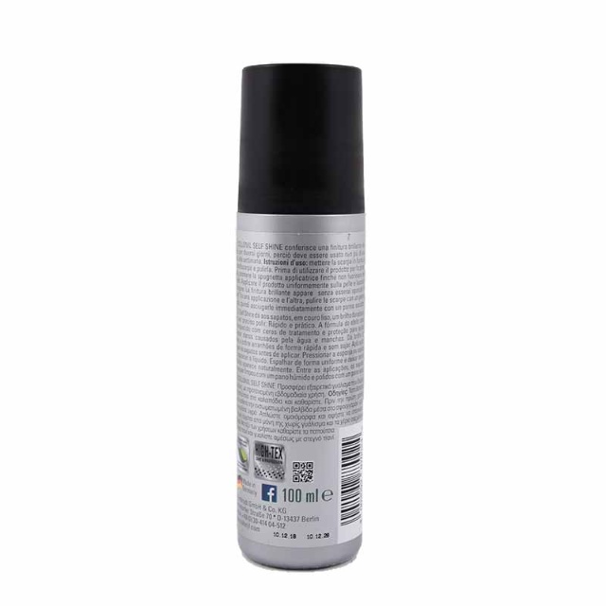
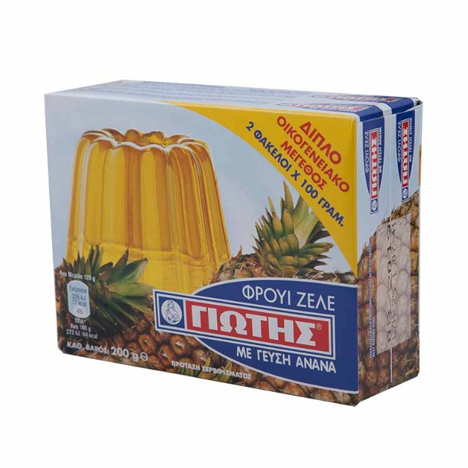
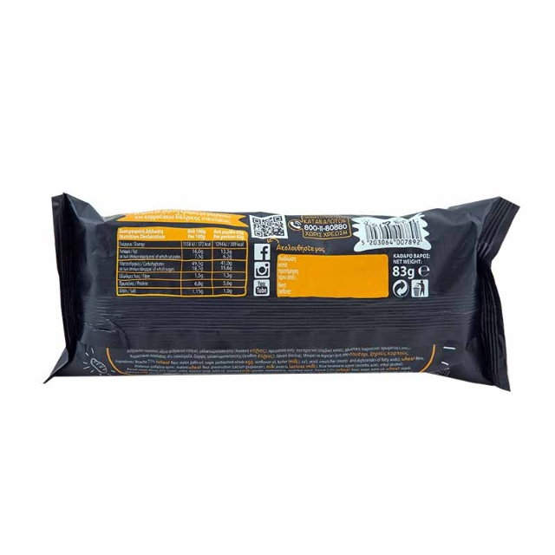
Dataset Description
Source of the dataset: Products-6K dataset [2], featuring iconic (lab-controlled) and natural (real-world) images.
Size and type of data:1,247 candidate images and 373 query images.
Preprocessing steps:Images resized to 640x640, augmentations applied to increase diversity in product detection.
Fig-1

Slide 5
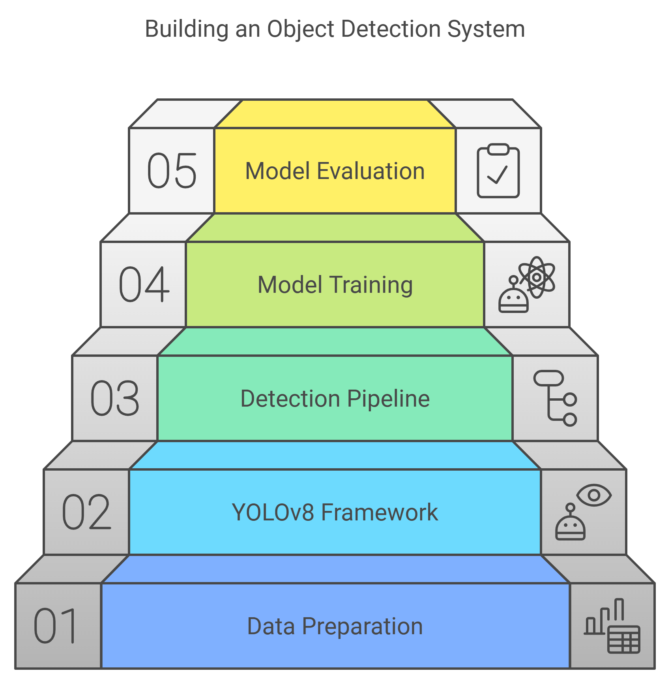
METHOD OVERVIEW:
OBJECT DETECTION PIPELINE:
Develop a comprehensive workflow for object detection, from data preprocessing to model deployment
YOLO V8 FRAMEWORK:
Utilize the latest version of the YOLO (You Only Look Once) deep learning model for efficient and accurate object detection
DATA PREPARATION:
Gather, clean, and annotate a diverse dataset of images for training the object detection model.
MODEL TRAINING:
Fine-tune the YOLOv model on the prepared dataset to optimize its performance for the target application.
MODEL EVALUATION:
Thoroughly evaluate the trained model's accuracy, precision, and recall on a separate test dataset.
Fig-2

Slide 6
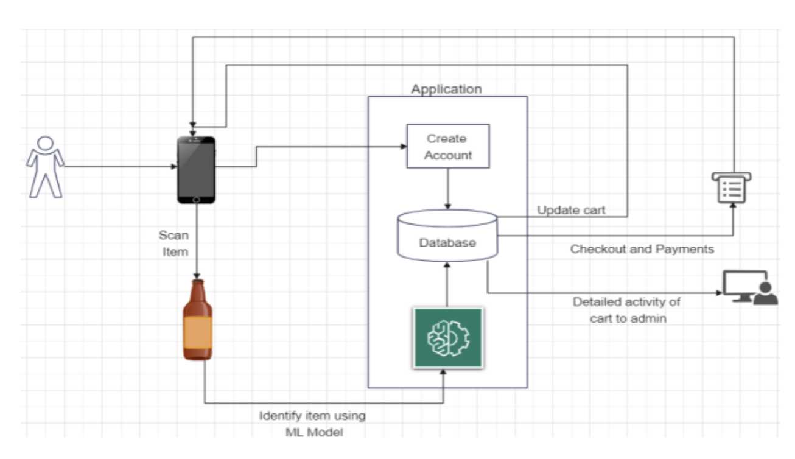
Overall system Architecture:
Fig-3: G. Awad et al., "Grab and Go: Leveraging Computer Vision for Intelligent Shopping,"
.

Slide 7
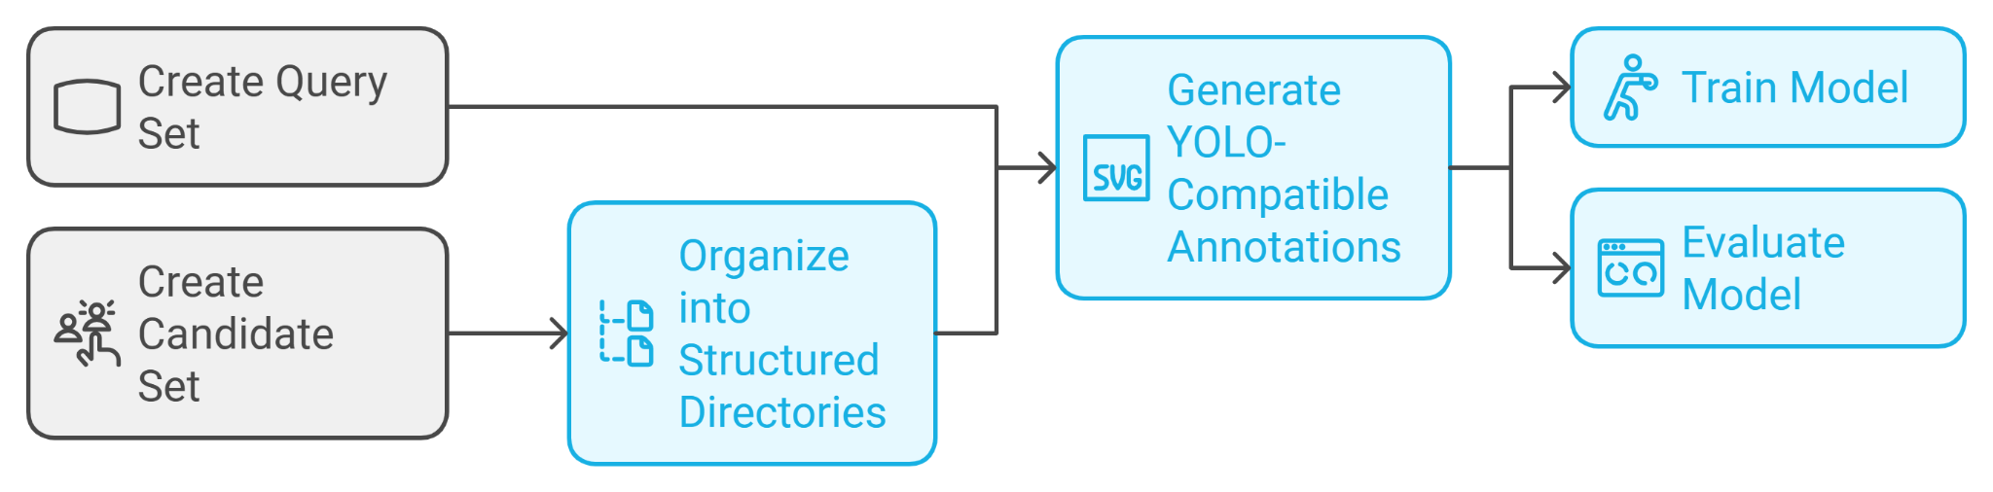
PREPROCESSING:
PREPROCESSE DATASETS: Cleaned, formated, and organized the datasets to be compatible with the YOLOv8 object detection model.
GENERATED YOLO-COMPATIBLE ANNOTATIONS: Created bounding box annotations for the objects of interest in the datasets, following the YOLO format.
Fig-4

Slide 8
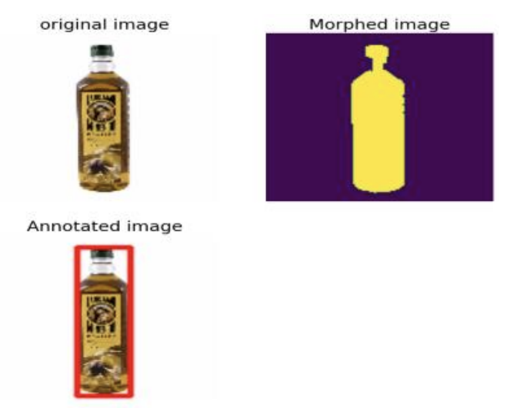
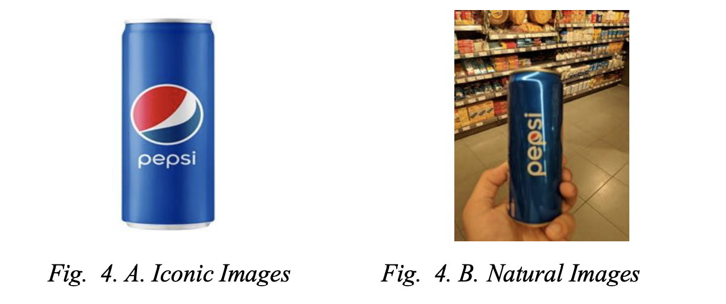

Technical Approach
Method: You Only Look Once(YOLO V8)
A deep learning model used for object detection.
YOLO is ideal for real-time object detection, crucial for a fast-paced shopping environment.
Product images from both iconic and natural environments was annotated and trained.
Fig-5
Fig-6

Slide 9
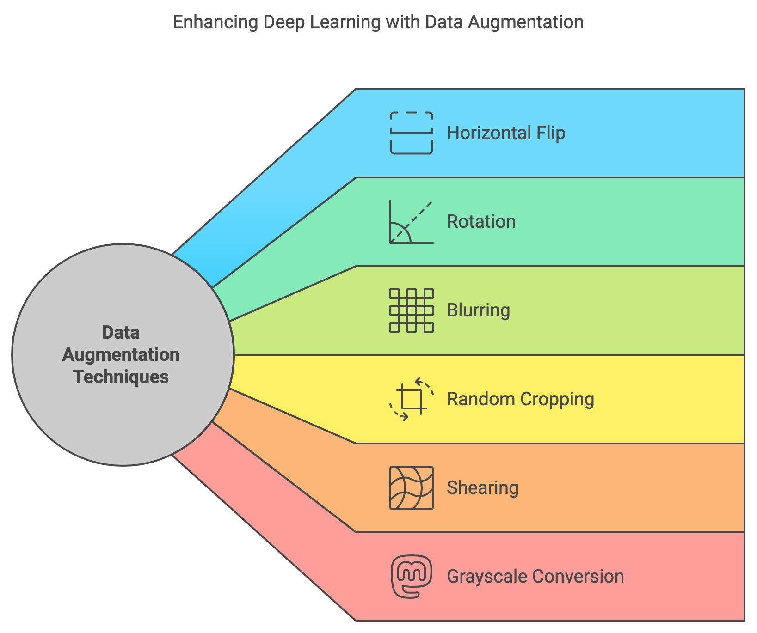
DATA AUGMENTATION:
Data Augmentation increases training data diversity, model robustness, and performance, especially when datasets are limited. Here’s a rundown of essential augmentation techniques:
Horizontal Flip Mirrors the image for perspective variation.
Rotation Rotates the image by a specified angle, improving orientation invariance.
Blurring Applies Gaussian blur to reduce noise, creating texture variations.
Random Cropping Randomly crops a region, enhancing robustness to scale and positional variations.
Shearing Distorts the image spatially, allowing the model to recognize skewed perspectives.
Grayscale Conversion Converts the image to grayscale, emphasizing shape and structure over color.
Gaussian Noise Adds random noise, improving resilience to noisy data.
Combining these augmentations ensures the model sees varied, realistic representations of data, enhancing adaptability to real-world variations.
Fig-7

Slide 10
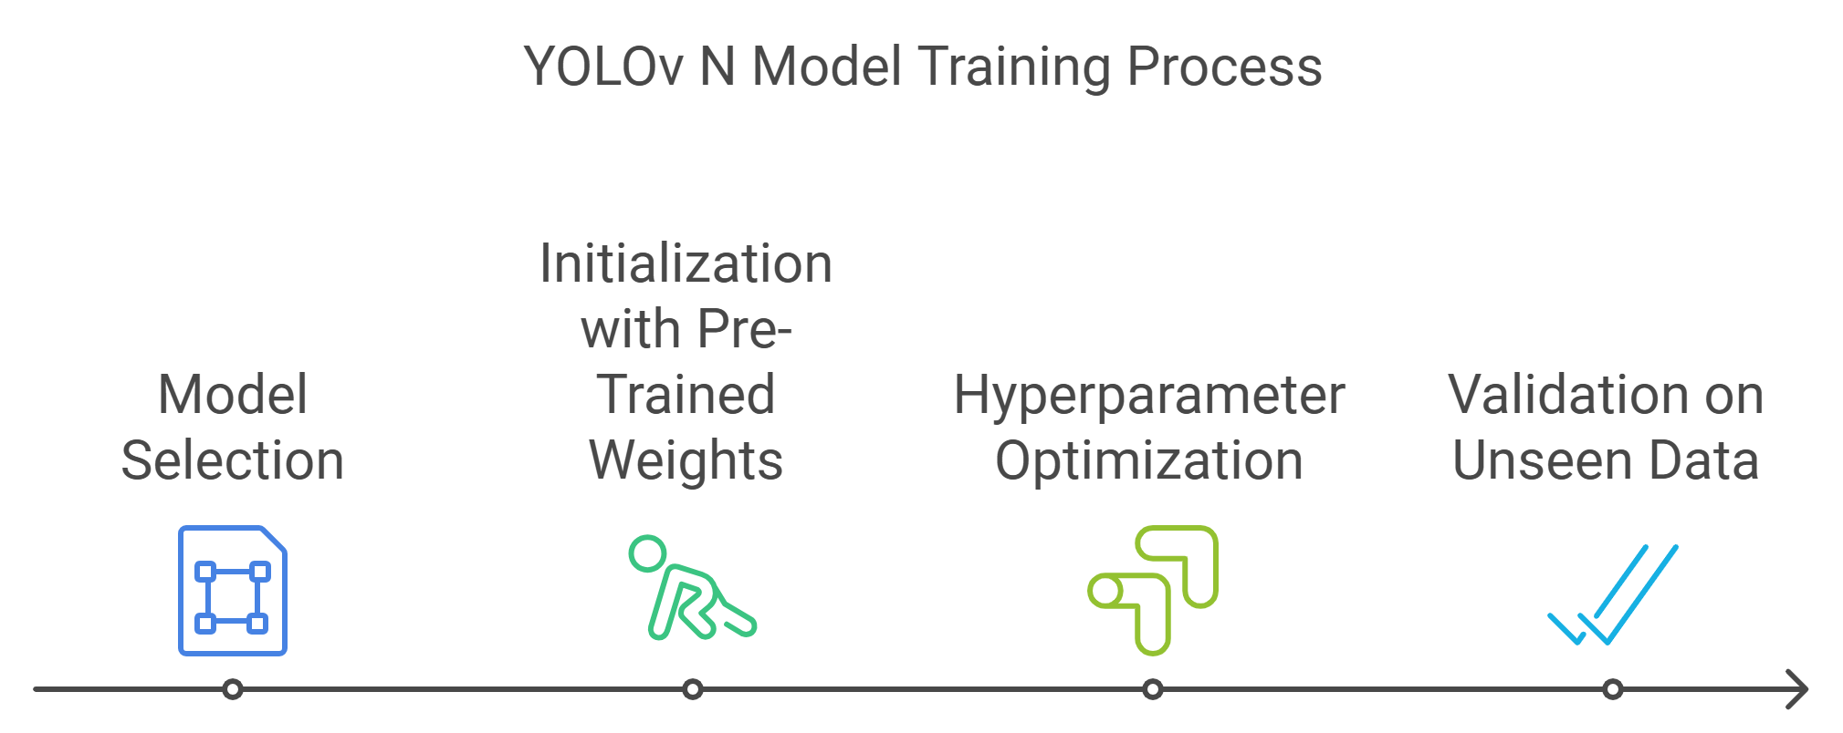
Model training:
YOLOV N MODEL:
The YOLOv8n model is a state-of-the-art object detection model, known for its speed and accuracy.
PRE-TRAINED WEIGHTS:
The model was initialized with pre-trained weights, which are the result of training the model on a large dataset, providing a strong starting point for further optimization.
OPTIMIZED PARAMETERS:
The model's hyperparameters, such as learning rate, batch size, and regularization, were carefully tuned to achieve the best performance on the specific task and dataset.
VALIDATION ON UNSEEN DATA:
The trained model was evaluated on a separate, unseen dataset to ensure its generalization capability and prevent overfitting to the training data.
Fig-8

Slide 11
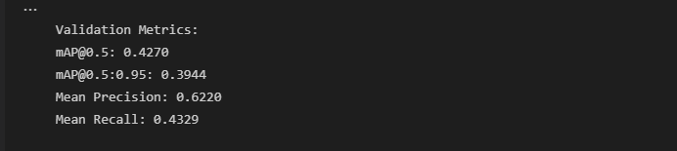
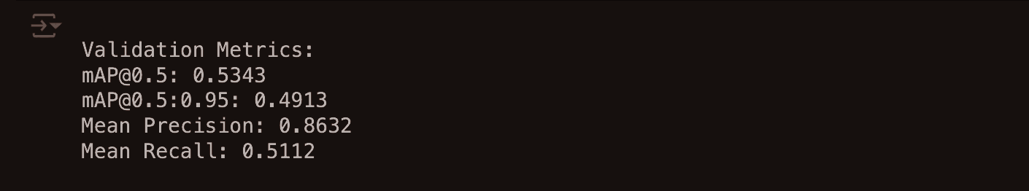
Evaluation Scheme:
Metrics to be used for evaluation: Precision, recall, and mAP.
Validation techniques: Cross-validation between iconic and natural images.
Performance benchmarks: Expected to surpass 78% mAP with improved detection from a balanced dataset, when the model is trained on the entire dataset with augmented data.
Fig-9
Fig- 10

Slide 12
Conclusion
The project replaces expensive hardware (RFID) with computer vision models to automate shopping.
Expected impact: Enhances efficiency in shopping experiences, particularly in developing countries.
Future work: Explore further dataset expansion and security measures through product weight verification.

Slide 13
References
E. Rydén, "Instance-level Object Detection of Grocery Store items using R-CNN."
K. Georgiadis, "Products-6K: A Large-Scale Groceries Product Recognition Dataset."
R. Molla, "Amazon cashierless Go stores could be a $4 billion business by 2021."
G. Awad et al., "Grab and Go: Leveraging Computer Vision for Intelligent Shopping,"
https://app.napkin.ai/

