Slide 1
Benford’s Law in Speech and synthetic speech classification
Submitted By
Sreejesh S. Nair
Under the guidance of
Dr. Prof. Hemant Patil
M.Sc. Data Science

Slide 2

Introduction
Deepfakes have emerged as a powerful tool for generating synthetic media, primarily audio and video, that can be manipulated to appear real.
With the advancements in artificial intelligence (AI), particularly deep learning techniques like Generative Adversarial Networks (GANs), deepfakes have become increasingly sophisticated, blurring the lines between reality and fabrication.
Hence it is essential to come up with new strategies to continuously improve the detection of deepfake media.
One such method, Natural Law of Anomalous number (Benford’s Law), could be efficiently used in detecting the variation of deepfake representations with that of natural representations of data.
Benford's Law observes a surprising pattern in real-world data. It suggests the leading digit "1" appears more frequently (around 30%) than others in various datasets, with the frequency decreasing for higher leading digits. This unexpected yet consistent distribution helps identify anomalies in data, potentially including artificial manipulations like deepfakes.
Previously Benford’s Law has been utilized in detecting fake images, scientific fraud, e-commerce price analysis, and even macroeconomics.

Slide 3
Problem Statement
With the advancements in deepfake audios in real life, we aim to propose a method to identify deepfakes using Benford’s Law. To do this it is essential to determine the effectiveness of Benford’s Law in audio signals. Hence, we aim to:
Analyze whether speech complies with Benford’s Law.
Secondly, we extract a set of new features from the speech data and empirically establish whether these features are able to distinguish between real speech and fake speech.

Slide 4
Dataset
To verify compliance with Benford’s Law as well as for the classification task we use the TTS corpus dataset.
To verify Benford’s Law we use 1000 real speech sample from the TTS corpus. The empirical distribution is created by passing these samples through the pipeline and extracting the magnitude spectra from this.
For the classification task we use the above 1000 real speech samples and also using 1000 more fake speech samples from the same corpus.

Slide 5
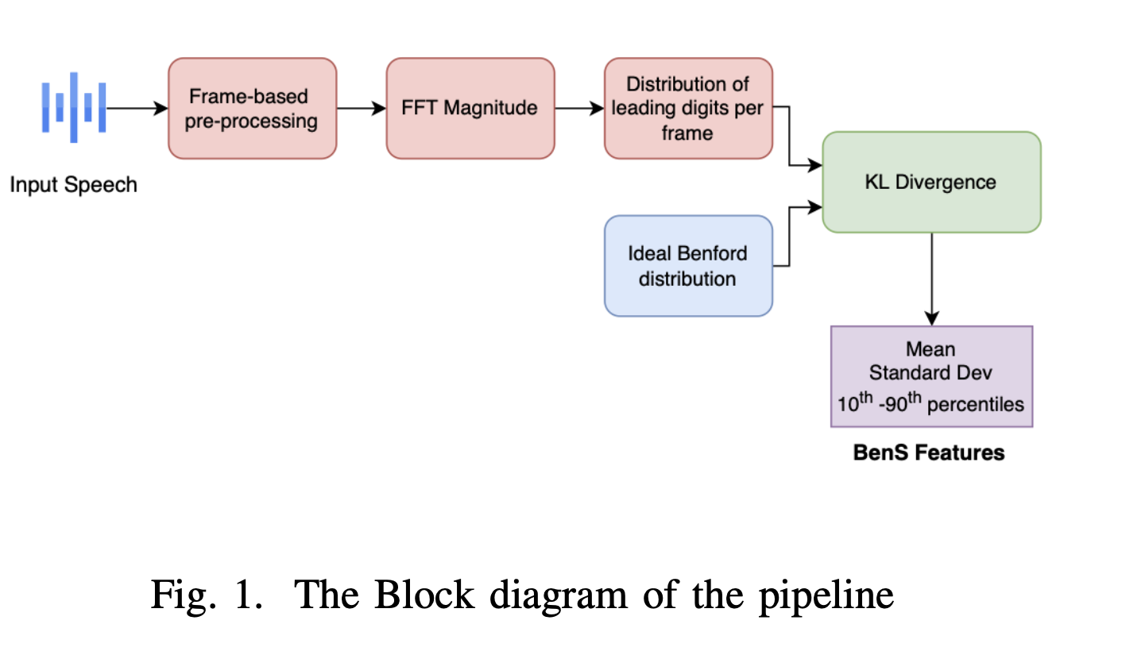
Methodology
Firstly, we propose a pipeline to preprocess the data for both the task of verifying whether speech follows Benford’s Law, and also extract features from the empirical distribution.

Slide 6
Firstly we perform Short Time Fourier Transform having 25ms as the frame length with an overlap of 10ms to prevent any loss of data at the edges.
Then we remove the mean of voice signal frame so as to remove any constant offset in the signal that is contributed by microphone or any other recording device.
The first DC component is removed from the signal as it is zero after de-meaning.
Finally, the magnitude spectrum is scaled using the inverse of the lowest value to make sure that all values exceed 1.
From this resulting vector we extract the leading digits to estimate their respective probabilities.
This process is repeated for all frames of an audio; then across all audio sample from the TTS corpus.

Slide 7
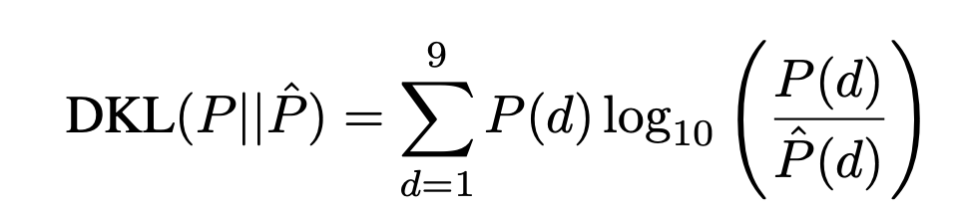
Firstly, to verify whether the speeches'’ empirical distribution follows Benford’s Distribution we use Kullback- Leibler (KL) divergence to compute the distance between both the distributions.
We further compute the probability distribution for each audio sample and we get the empirical estimate by averaging the distribution over all the audio samples.
A small value of KL divergence implies that speech follows Benford’s Distribution whereas larger value implies that it doesn’t follow Benford’s Law.

Slide 8
Following this, the KL Divergence is calculated for each frame in a speech sample, resulting in a sequence of KL divergence values.
To capture the characteristics of the remaining KL divergence values across the entire speech sample, a set of 11 statistics is extracted. These statistics include:
Mean of the KL Divergence values
Standard deviation of KL Divergence values
Percentiles of the KL Divergence distribution (10th, 20th,..., 90th)
We call these feature set BenS features containing 11 statistics for each frame.
Note: It’s important to note that some frames might have zero estimates for less frequent leading digits in the Benford distribution. Hence, it is essential to remove these estimated for the computation of KL Divergence

Slide 9
After extracting BenS features we build a machine learning model to classify fake and real audio samples.
Here we use K-folds validation to evaluate the models accuracy.
That is, we partition the whole dataset into K equal subsets and then we train the model on K-1 subsets. After the model is trained on these subsets, we test the model using the one subset that was not used in training. We repeat the training by keeping another subset for testing and all the rest for training. This is done until all the subsets have been used in testing once, i.e, K number of times. Then we find the average of all the K folds to find the accuracy.
The model we used to train our data was the quadratic SVM (Support Vector Machine) that is used for classification tasks.

Slide 10
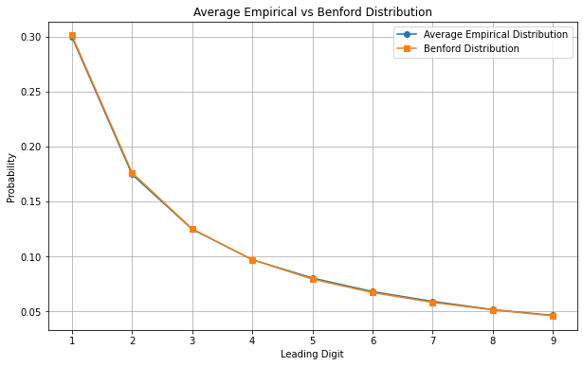
Result
When examining each sample separately to verify Benford’s Law, it becomes apparent that the distribution of the samples varied somewhat from the ideal Benford’s Distribution.
However, when averaged over all the samples it becomes obvious that there is a strong agreement between the Benford’s distribution and empirical distribution.

Slide 11
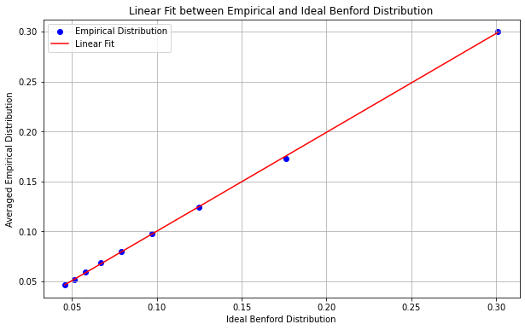

We can also verify the agreement between empirical distribution(E) and Benford distribution (I) by analyzing the linear regression plot between both.
The linear equation obtained is:
Where p value obtained is < 0.05.
Also, since slope and intercept between the distributions is 0.9895 and 0.0012. We can conclude that the distributions are identical because slope is close to 1 and intercept is close to 0.

Slide 12
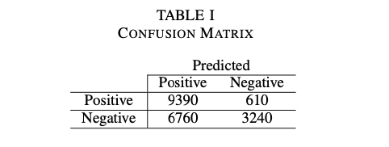
Whereas in the classification task using
K-fold validation and Support Vector
Machine (SVM), the accuracy obtained
is 63.15% which is a very moderate result.
The confusion matrix further clarifies that the model is able to classify the real audio sample with very high accuracy, but since there is very less difference between the BenS features of real audio samples and fake audio samples the model is miss-classifying many of the fake audios as real.

Slide 13
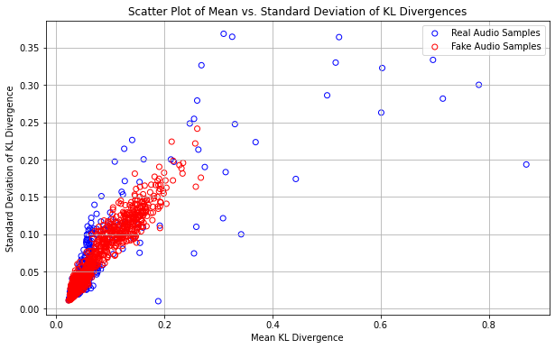
Scatter plot between two statistic of the BenS feature (means of KL divergence and Standard deviation of KL divergence) for real and fake samples was plotted to understand clearly why the accuracy is so low.
Upon studying the scatter plot it was found that the two statistics for the the real and fake samples were very close to each which in turn hindered the classification model to separate them accurately.

Slide 14
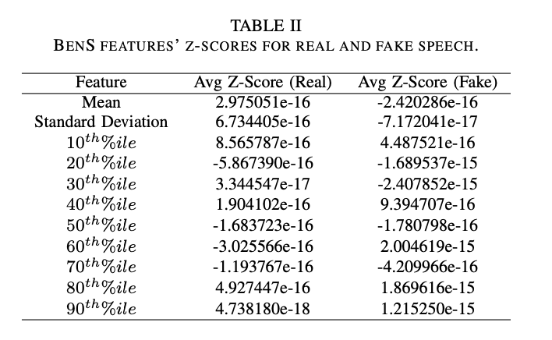
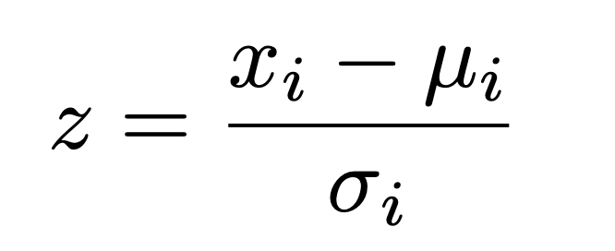
To understand the BenS features for real and fake samples properly, we computed z-score for each statistic of real and fake sample to see if there is any statistic good enough to improve the classification process.
It was seen that there is insignificant deviance between the statistics for both type of samples, due to which classification accuracy is low.

Slide 15
Conclusion
Firstly, through a comprehensive analysis of speech magnitude spectra, it was established that human speech, on average, exhibits adherence to Benford’s Law.
While there existed some variability among individual speech samples, the overall agreement between the empirical distribution and the theoretical prediction was substantial.
Secondly, leveraging the insights gained from the adherence of speech spectra to Benford’s Law, a novel feature set termed Benford Similarity (BenS) features was proposed. These features, derived from the analysis of leading digits in speech spectra, aimed to capture the degree of adherence to Benford’s Law on a frame-by-frame level.
However, the practical application of BenS features in the classification of real and synthetic speech posed challenges. Despite employing sophisticated machine learning techniques such as quadratic SVM and K-fold cross-validation, the classification accuracy remained moderate.

Slide 16
Future Directions
For future works, investigating additional features derived from speech spectra beyond Benford Similarity (BenS) features and exploring other statistical measures and transformations to capture subtle differences between real and synthetic speech more effectively can be useful. Incorporating deep neural networks along with these features could also lead to better deepfake detection.

Slide 17
References
[1] L. Hsu and V. Berisha, ”Does Human Speech Follow Benford’s Law?,” ICASSP 2023 - 2023 IEEE International Conference on Acoustics, Speech and Signal Processing (ICASSP), Rhodes Island, Greece, 2023, pp. 1-5, doi: 10.1109/ICASSP49357.2023.10094603.
[2] P. D. Scott and M. Fasli, “CSM-349-Benford’s Law: An Empirical Investigation and a Novel Explanation,” Technical Report, CSM-349, University of Essex, Colchester, 2001.
[3] F. Benford, ”The Law of Anomalous Numbers,” Proc. American Philo- sophical Society, vol. 78, no. 4, pp. 551-772, 1938.
[4] J. M. Nigrini, “Benford’s Law: Applications for forensic accounting, auditing, and fraud detection,” John Wiley & Sons, vol. 586, 1989.

Slide 18
Thank You

