Slide 1





TNWISE2025
HACKATHON FOR WOMEN IN SCIENCE & ENGINEERING
THEME:
Cyber Empowerment
TITLE:
AuraSheild - AI-Powered Self-Defense & Cyber Awareness Platform for Women
COLLEGE:
Sri Eshwar College of Engineering
TEAM LEADER NAME:
Sreejha Jagadees

Slide 2

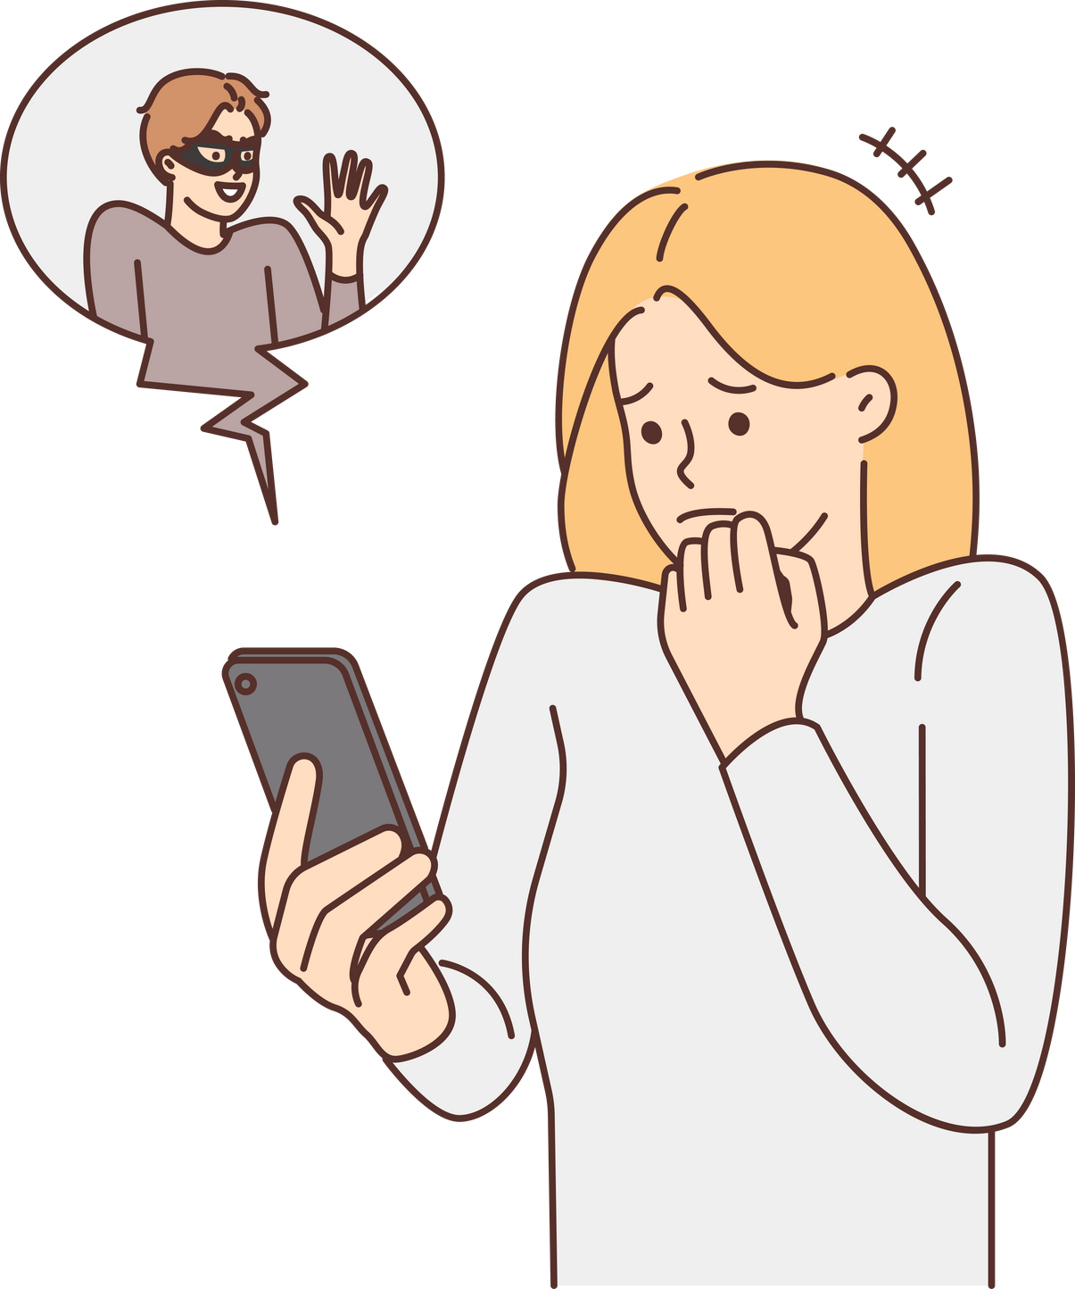

PROBLEM STATEMENT :
Rising digital scams targeting women, like OTP fraud, phishing, and fake job offers
Lack of accessible, real-time safety solutions during physical emergencies
Low awareness about identifying and reacting to online threats
No single platform providing both cyber safety education and physical protection tutorials

Slide 3












SOS
Cybershield
Community
Self defense

Slide 4




PROJECT DESCRIPTION:
CONCLUSIONS:
✅ AuraSheild web app with an SOS alert system for quick emergency help.
Empower women with tools for both physical and digital safety.
✅"CyberShield" gamified learning to train women on spotting and handling online scams.
Raise awareness through interactive learning on cyber threats.
✅Real-time GPS tracking and safe zone mapping for location-based safety.
Build a sustainable, all-in-one safety platform for real-world impact.
✅ Self-defense tutorials and safety resources to boost both physical and digital protection.

Slide 5
TEAM MEMBER DETAILS:
TEAM MEMBER 1 :
TEAM MENTOR :
NAME:
Sreejha Jagadees
NAME:
Dr S Sumathi
SEMESTER:
VI
DESIGNATION :
HOD - CSE(AIML)
COLLEGE :
Sri Eshwar College of Engineering
YEAR :
III
DEPARTMENT:
CSE (AIML )
DEPARTMENT:
CSE (AIML)

