Slide 1
Predicting Customer Life-time Values for an Auto Insurance Company

Slide 2
Objective
Framing a regression model on the data provided by the Insurance company to predict Customer Life Time Value of customers, thereby predicting the most profitable customers to the company.
Considering this objective, we are running a Multiple Linear Regression Model on Customer Lifetime Value (Y), to analyse the influence of several independent factors that affect Y.

Slide 3
There are 24 variables and 9134 observations. The variables are as follows:
Customer | Monthly Premium Auto
State | Months Since Last Claim
Customer Lifetime Value | Months Since Policy Inception
Response | Number of Open Complaints
Coverage | Number of Policies
Education | Policy Type
Effective To Date | Policy
EmploymentStatus | Renew Offer Type
Gender | Sales Channel
Income | Total Claim Amount
Location Code | Vehicle Class
Marital Status | Vehicle Size

Slide 4
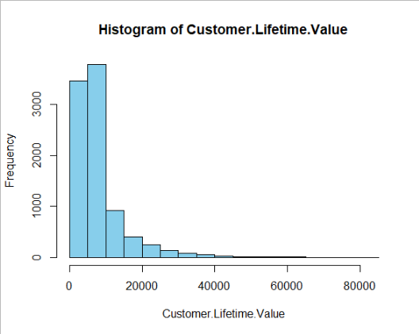
Customer Life Time Value(CLV)
The dependent variable CLV is the total revenue the client will derive from their entire relationship with a customer. The Company seeks to increase its revenue, which can be achieved if they can increase the CLV derived from each of its customer, and by focusing on customers with higher CLVs.

Slide 5
Significant Variables
Coverage Premium
Education: Doctor, Education: High School or Below, Education: Master
Employment Status: Employed
Employment Status: Unemployed
Income
Marital Status: Married
Marital Status: Single
Monthly Premium Auto
Number of Policies
Gender Male
Number of Open Complaints

Slide 6
Insignificant Variables
Customer
Coverage: Extended
State
Response
Education: College
Effective to Date
Employment Status: Retired, Employment Status: Medical Leave
Location Code
Months Since Last Claim
Months Since Policy Inception
Renew Offer Type
Policy Type
Policy
Sales Channel
Total Claim Amount
Vehicle Class
Vehicle Size

Slide 7
Explanation of Significant Variables
1. Coverage: Premium
Coverage is a categorical variable consisting of 3 classes: Basic, Premium and Extended, among which Coverage Premium is significant.
Coverage is the amount of risk or liability that is covered for a customer by the Insurance Company. Our client provides 3 types of coverage as mentioned above.
Coverage: Basic is considered as the reference group, to compare the results of Premium Coverage with.

Slide 8
Average CLV of customers having Premium Coverage is much higher than the CLV of customers having the more popular Basic coverage

Slide 9
2. Education (Doctor, High School and Below, Master)
Education is a categorical variable having 5 categories, among which Education type: Doctor, High School and Below, Master is significant.
It is the educational qualification of the customer. Education Bachelor is considered as the reference group.
High School or Below ,College and Bachelor are the popular qualifications among customers, Masters and Doctor being the least popular. Customer having a masters degree has much higher CLV than someone with a Bachelors. Customers with qualification of High school or below has the highest CLV among all.

Slide 10
3. Employment Status ( Employed and Unemployed)
Employment Status is a categorical variable with 5 categories, among which Employed and Unemployed is Significant
It is the state of Employment the customer is in. Employment Status Disabled is considered as the reference variable
Most customers are employed, followed by unemployed customers.
Employed customers have higher CLV

Slide 11
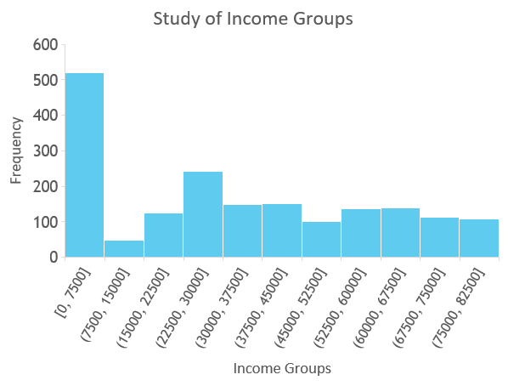
4. Income
It is the income level of the customer.
Most customers have belong to the income group 0-75000, followed by group 22500-30000.
The zero income points in the scatter diagram belong to unemployed customers

Slide 12
5. Marital Status (Married and Single)
Signifies the marital status of the customer.
It is a categorical variable of 3 categories, among which Married and Single are significant, while the third category, Divorced is considered as the reference group.
Most customers are married , followed by single, and finally divorced.
Married customers have the highest CLV , while single customers have the lowest

Slide 13
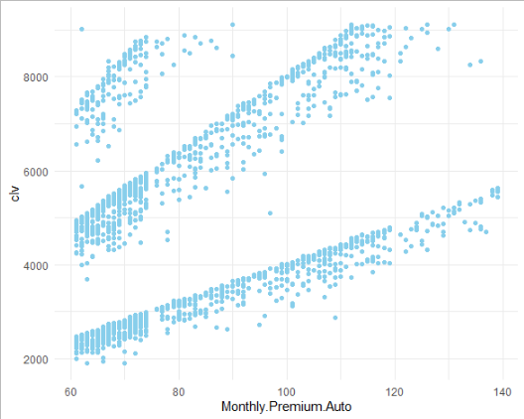
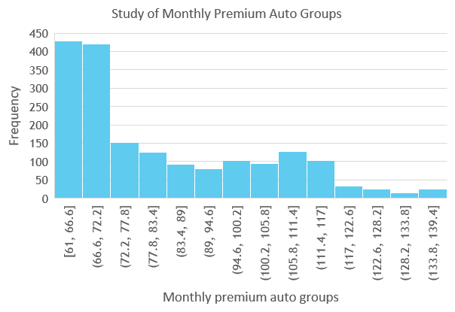
6. Monthly Premium Auto
It is the monthly amount paid by the customer for the insurance.
Most customers give monthly premium auto between 61 to 77.8.

Slide 14
7. Number of Policies
It is the number of policies the customer holds.
It is a categorical variable with 9 identified sub categories, among which one category, number of policy = 1, is considered as the reference group. Rest all sub categorical variables are significant.
Most customers have number of policies equal to 1.Customers holding more number of policies have higher CLV compared to holding just one policy.

Slide 15
8. Gender (Male)
Gender of the customer.
It is a categorical variable with 2 categories, category Male (M) is significant, category Female (F) is considered as the reference group.
Most customers are female. Males have a lower CLV value compared to females.

Slide 16
9. Total Number of Open Complaints
It is a categorical variable, with 6 categories. All categories are significant, except open complaint number 0, which is considered as the reference group.
It is the number of complaints made by the customer.
Most customers have made 0 complaints. Customers with higher complaints seem to have a lower a CLV

Slide 17
Results Obtained
R – square value is 0.9631. Adjusted R- square value is 0.9626.
R square determines the proportion of the variance of the dependent variable that is explained by variables in the regression model. Adjusted R square is a modified version of R-square that has been adjusted for the number of predictors in the model.Thus, the model can explain about 96.3% of the variance in the dependent variable; Customer Lifetime Value
To check for homoscedasticity, Breusch-Pagan test is done.
The p value ( or the probability of rejecting the null hypothesis ) came very low , causing it to be significant. Thus null hypothesis is rejected, null hypothesis for Breusch- Pagan test is that there is constant variance in model, or homoscedasticity is present. Rejecting the null hypothesis means ,that there is non- constant variance or heteroscedasticity in the model.

Slide 18
To check for normality , Anderson- Darling test is conducted. The p value ( or the probability of rejecting the null hypothesis ) came very low , causing it to be significant. Thus null hypothesis is rejected. The null hypothesis for Anderson- Darling test is that there is errors are normally distributed. Rejecting the null hypothesis means ,that errors are not normally distributed.
To check for autocorrelation, Durbin Watson test is conducted. Durbin Watson test statistic is 1.98, and p value is 0.68, which is high, thus the null hypothesis is accepted. Null hypothesis for Durbin Watson test is that there is no presence of autocorrelation among residuals. Thus our model has no autocorrelation.

Slide 19
Next to check for multicorrelation among the independent variables, variable inflation factor (v.i.f) is checked, if value of v.i.f for a variable is above 2 then multicollinearity should be present among the variables. All the independent variables in the model has v.i.f value below 2, thus no multicollinearity is present in the model.
The Mean Absolute Percentage Error (M.A.P.E) is 7.16%. MAPE is a measure of the prediction accuracy of a model. A MAPE below 10% is preferred for a good model. Our model MAPE satisfies this condition

Slide 20
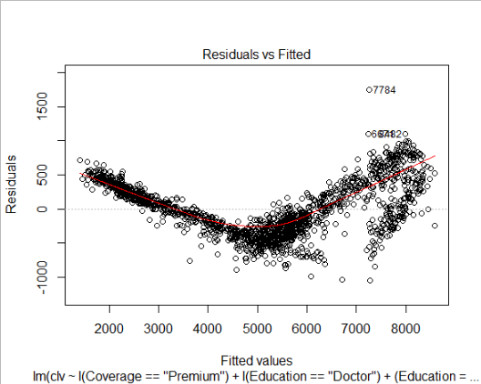
This scatter plot shows the distribution of residuals (errors) vs fitted values (predicted values) in the model.

Slide 21
Variable Relationships
Variables having positive coefficient value, thus having a positive relationship with CLV
Coverage Premium
Education: Doctor, Education: High School or Below, Education: Master
Employment Status: Employed
Income
Marital Status: Married
Monthly Premium Auto
Number of Policies

Slide 22
Variables having negative coefficient value, or a negative relationship with CLV
Employment Status: Unemployed
Gender Male
Marital Status: Single
Number of Open Complaints

Slide 23
Business Recommendations
Customers should be encouraged to take up Premium Coverage.
Customers with higher education qualification background like masters or doctor should be targeted along with those who have completed high school or below.
Employed customers, with higher income should be targeted more.
Customers paying higher monthly premium auto should be focused on, and new or potential customers should be encouraged to pay higher.

Slide 24
More married customers should be targeted.
More Female customers should be targeted.
Customers should be encouraged to hold more than one policy.
Number of complaints made by the customer should be reduced

Slide 25
Thank You!

