Slide 1
Object Detection with YOLO

Slide 2
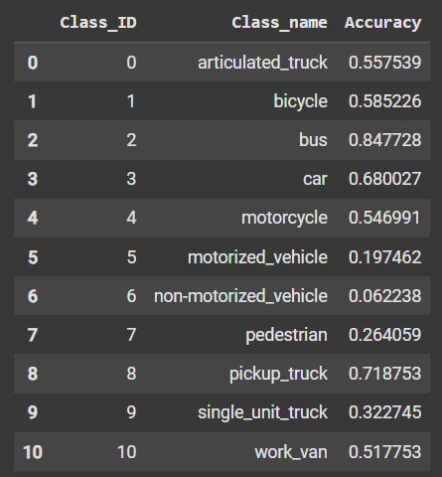
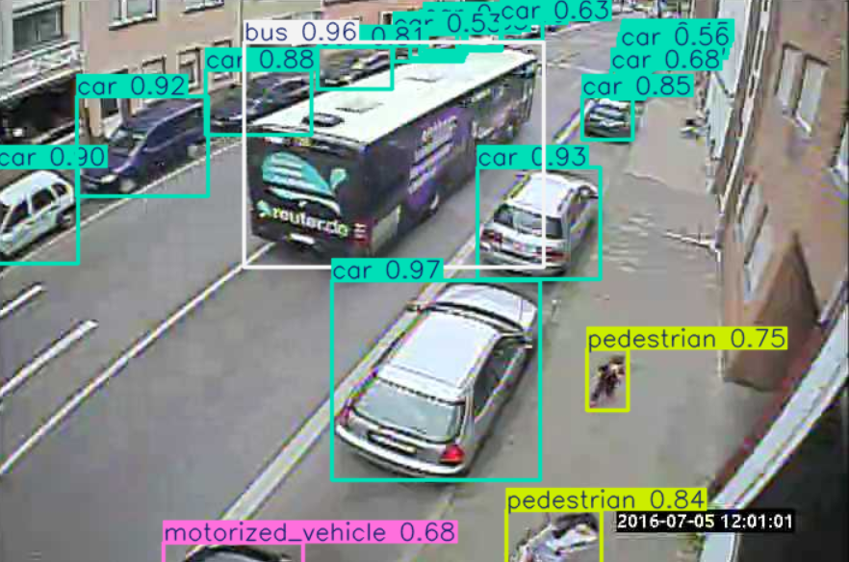
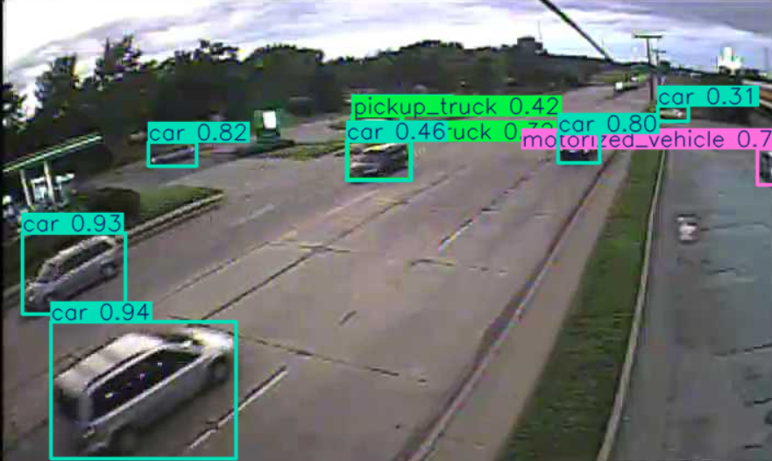
Part 1: Train Object Detection Model with YOLO
Folder structure was created and the labels are converted to YOLO format.
YOLOv8n was trained on random 4500 images with epoch chosen as 25, image size=672 and batch size=16
The model was able to detect various objects with the below mentioned accuracies.

Slide 3
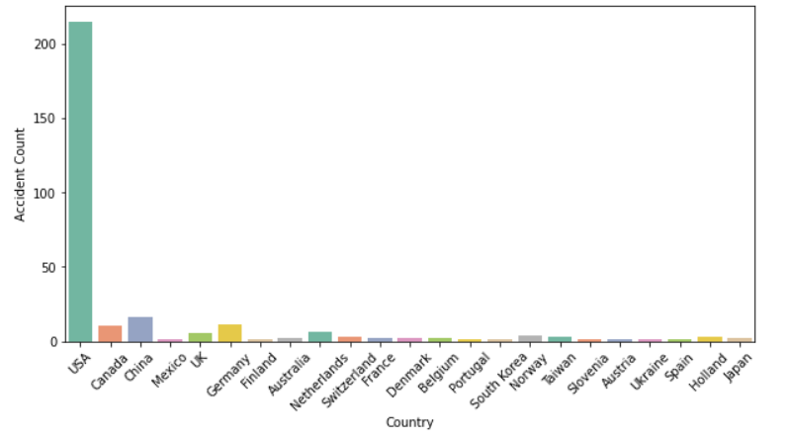
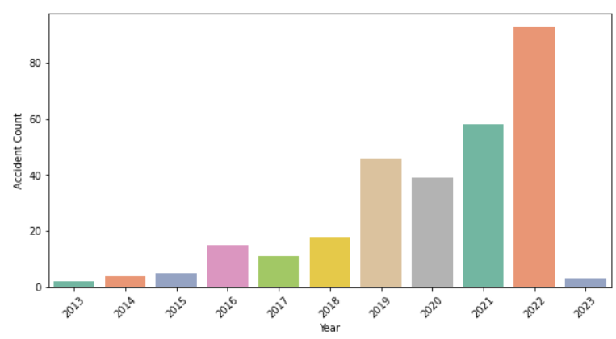
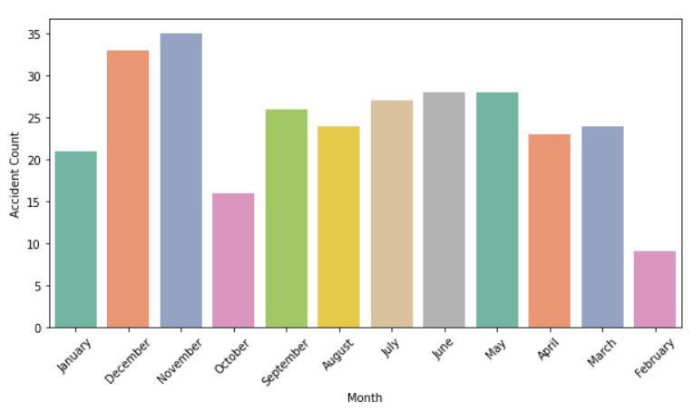
Part 2: Analyzing Tesla accidents
Data preprocessing and EDA was carried out to analyze tesla accidents.
Observation period: April'13 to Jan'23
1. During the period, majority of the accidents happened in USA.
2. California is the US state that witnessed the maximum number of accidents.
3. The number of accidents is found to increase of the years although a drop was observed in 2020, which could be due to pandemic lockdown.
4. The number of accidents increased in November and December. This may be related to seasonal factors such as poor weather or increased holiday travel, both of which can raise accident risk. Tesla accidents followed a similar trend.
5. More accidents happened on Saturdays and Sundays.

Slide 4
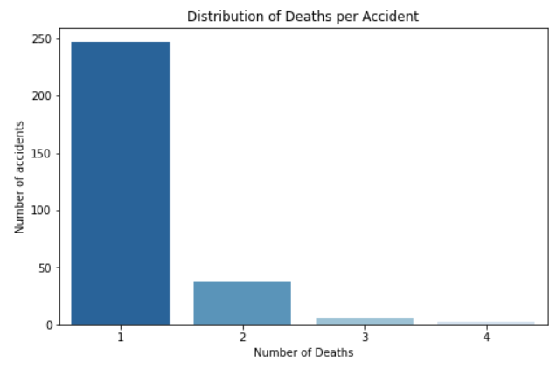
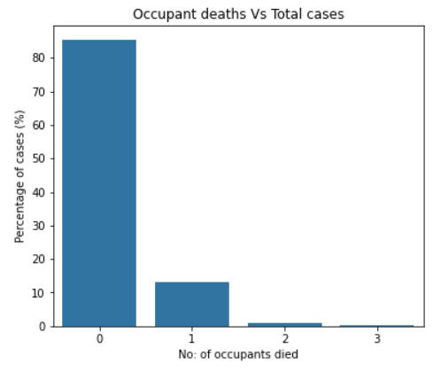
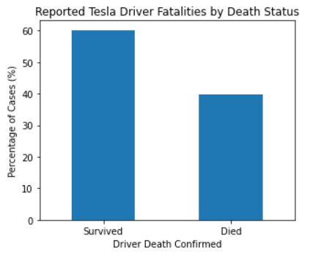
Part 2: Analyzing Tesla accidents

