Slide 1
Program
Input Data
Output Data

Slide 2
General syntax to define a data
<Datatype> <variable_name> = <value>

Slide 3
Adding two number
<Datatype> <variable_name> = <value>
int a = 10
int b = 20
float c = a+b
a
10
0x10000
b
20
0x20000
c
30.00000
0x100

Slide 4
Adding two number
<variable_name> = <value>
a = 10
b = 20
c = a+b
a = 10
b = 20
C = a+b

Slide 5
10
100
20

Slide 6
Type int
a = 10
RC 2
Value 10
0x1000000
Type float
b = 20.5
RC 1
Value 20.5
c = 10
0x20000

Slide 7
Type int
a = 10
RC 2
Value 10
0x1000000
Type float
b = 20.5
RC 1
Value 20.5
c = 10
0x20000

Slide 8
Data Type Classification
Number X
Strings
Tuple
Dict
List
Boolean ➔ True is Non-zero value/ False is a Zero value

Slide 9
List
A list is a collection elements /items
To define a list we can use square brackets
Examples
X = [ ] -→ X is a empty list
Y = [10, 20, 30, 40, 50]
A = 10
B = 20
C = 30
D = 40
E = 50

Slide 10
Y = [10, 20, 30, 40, 50]
Y is a list object
SIZE of Y is 5 (Total number of elemnets)

Slide 11
X = [10, 20, 30, 40, 50]
SIZE OF X is 5
X
10
20
30
40
50
Indexes
0 1 2 3 4
0 to SIZE-1

Slide 12
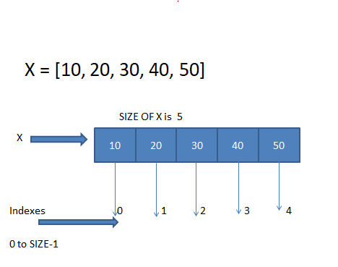
X[0] ➔ returns 1st elemet i.e 10
X[1] ➔ returns 2nd elemenet i.e 20
X[4] ➔ returns 5th elemeyt i.e 50

Slide 13
List Operations
Using indexing we can access and we can change elements from the list object
Concatenation : Combining two list objects
Slicing : Extracting sublist from the given list
Using len() function we can get size of an list object
Repetetion : Repeat the sequnce scalar times
Ex: x * 3 the elements from x will repat three times

Slide 14
Strings
Group of characters , used to represent text infromation
To define a string ➔ “It’s a string”
‘Its a string ’
‘“LG Soft India Pvt Ltd” Company ‘

Slide 15
X = [10, 20, 30, 40, 50, 60, 70, 80, 90]
10
20
30
40
50
60
70
80
90
0 1 2 3 4 5 6 7 8
SYNTAX: var[lower_INDEX : upper_INDEX+1]
X[4:8] ➔ [50, 60, 70, 80]

Slide 16
Python Objects Classification
Mutable → List
Immutable → Tuple , Strings

Slide 17
Is Numbers are mutable or immutable
A = 10
Type int
Value 10 20
RC 1
A = 20
0x100000

Slide 18
Is Numbers are mutable or immutable
A = 10
Type int
Value 20
RC 1
Type int
Value 10
RC 1
A = 20
0x190000
0x100000

Slide 19
List
Add Items → append(), insert()
Delete Items → pop(), remove()
Arrange Items → sort(), reverse()
- Other functions

