Slide 1
High LEVEL Requirements
System should anonymously alert users if they have been in close contact with another user who has tested positive for coronavirus (COVID-19).
System should allow restaurant, store, or any public event admin to register and create a QR code for venue.
System should allow QR code scanning for venue check in/outs

Slide 2
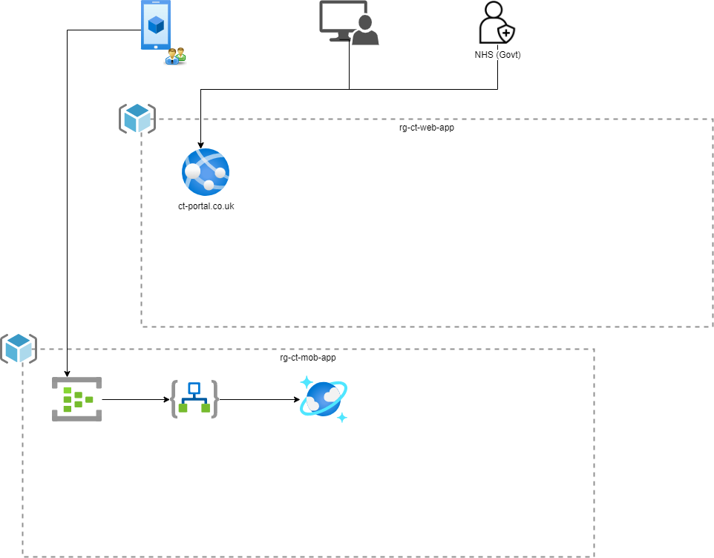
PROPOSED SOLUTION 1

Slide 3
PROPOSED SOLUTION 2

Slide 4
KEY DESIGN Considerations
Client Authentication recommended for Mobile app
Sharing Personal Health Data with CT portal
Cost & Timelines(Indicative)

