Slide 1
High LEVEL Requirements
System should anonymously alert users if they have been in close contact with another individual who has tested positive for coronavirus (COVID-19).
System should allow restaurant, store, or any public event administrators to register and create a QR code for venue.
System should allow QR code scanning for venue check in
System should produce reports with details of hotspots , rate at which the virus is spreading etc.

Slide 2
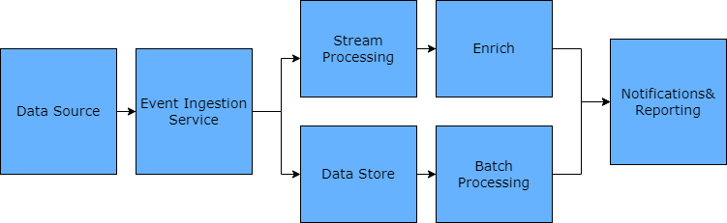
Solution OVERVIEW
Data source consists of details such as entry to events/restaurants/stores by users , test results & venue details.
The data is moved to the data store via an event ingestion component
The lambda architecture approach is suggested to have two paths, the hot path (speed ) & cold path (batch)
The batch processing logic looks for individuals tested +ve during an certain period, and retrieves the possible individuals who could be infected
The stream processing helps in identifying the rate at which the virus is spreading, hotspots based on post codes etc.
The final step is to notify individuals who could potentially be exposed to the virus and also generate reports that could help health officials in decision making such as imposing lock downs
The system is designed to handle the ingestion, storage, processing, and analysis of data that would be too large

Slide 3
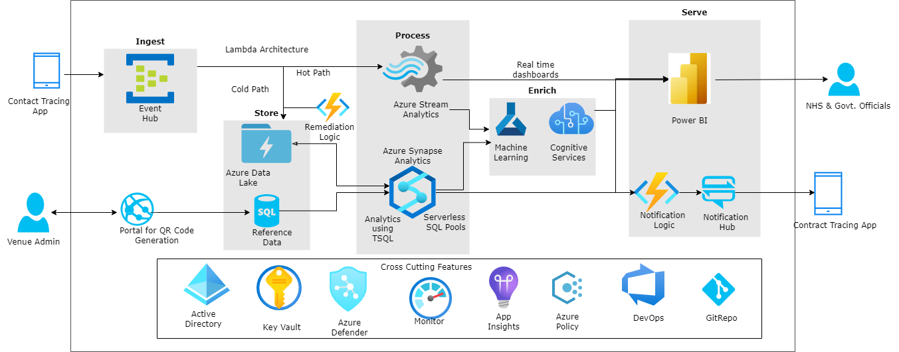
Proposed Solution

Slide 4
KEY DESIGN Considerations
Microsoft Azure Well-Architected Framework
Security
Encryption at rest and encryption at transit to secure PI data
Monitoring controls to prevent attacks from hackers
Control access to Azure resources using RBAC & ACL
Operational Excellence
Use monitoring tools Azure Monitor and App Insights to identify infrastructure and app issues
Disaster recovery & rehearse failure.
Event Hubs Capture, enables you to focus on data processing rather than on data capture.
Performance Efficiency
Design patterns for performance efficiency
CQRS Pattern – separate read and writes
Lambda architecture ( Hot & Cold Path)
Auto-scaling, data partition, remediation and background jobs
Cost Optimization
Start with low cost model, and scale up as needed, rather than delivering a large investment-first version
Data Lake is a cost-effective solution to run big data workloads.
Consider trade-off and do cost benefit analysis with stake holders
Reliability
Design for failure, self healing and scale out
Drive automation to minimize human errors
Data Lake is built to handle high volumes of writes at low latency, and are optimized for massive throughput.

Slide 5
MISC
Other option
Blue-tooth based contact tracing app
The app uses Bluetooth signal strength between different devices to estimate the distance between people. When someone tests positive for Covid-19 the system can send out alerts to people they have had encounters with.
Each day it creates a new code for your device which is stored on your phone. Then every 15 minutes it produces another random code that is shared and stored on the devices it communicates with via Bluetooth.
When someone tests positive they can allow their phone to share the daily codes with other app users. The app does this by sharing the codes related to your phone with a server that pushes the codes to every other phone with the app installed. If there are matches and the risk score is high enough, people will get an alert saying they’ve been in touch with someone who tested positive.
References
Azure Well Architected Framework - https://docs.microsoft.com/en-us/azure/architecture/framework/
Microsoft Azure documentation - https://docs.microsoft.com/en-us/azure/
THANK YOU

