Slide 1
RetailMart Profitability Review
Where we make money, where we lose it, and what to change
Analysis by [Your Name] | Excel, SQL and Power BI
Notes:
Introduce yourself. Say: I analysed a store's sales data to find where it makes money and where it loses money.

Slide 2
The manager's question
"Sales have grown for four years, but profit does not feel like it is growing as fast. Where do we make money, where do we lose it, and what should we change?"
Which products lose money?
1
Do discounts hurt profit?
2
Which regions and customers cost us money?
3
Notes:
Read the manager's question. These three questions guided all of my work.

Slide 3
The data and the tools
9,994
2014-2017
order lines
four years of sales
793
$2.30M
customers
sales, with $286K profit
Excel Cleaning and pivot tables
SQL Questions answered with queries
Power BI 3-page dashboard
Notes:
This is the Sample Superstore dataset. I used three tools, and all three gave the same totals, so I trust the numbers.

Slide 4
Cleaning the data first
0
YYYY-MM-DD
duplicate rows and 0 empty cells
dates changed so they cannot be misread
+3
449
new columns: year, month, days to ship
postal codes repaired (lost leading zero)
Negative profits were kept: they are real losses, not mistakes.
Notes:
Cleaning means checking the data for mistakes before trusting it. The negative profits are the interesting part, so I did not delete them.

Slide 5
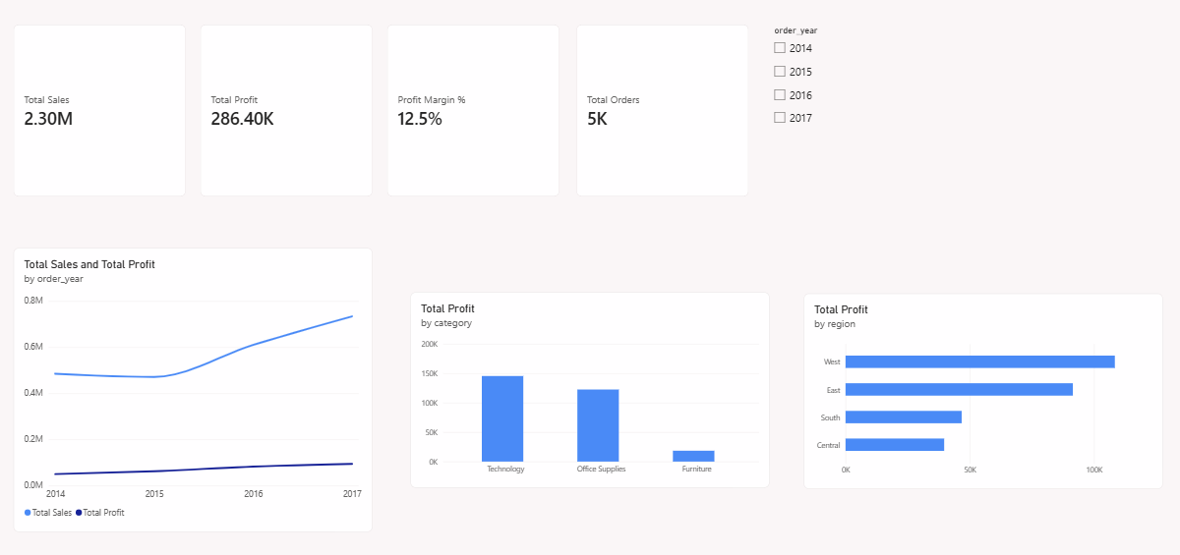
2017 profit slowed down
-2.8%
sales fell in 2015, yet profit grew 24%
14.2% vs 20.4%
2017 profit growth vs sales growth
10.2% to 12.7%
Page 1 of my Power BI dashboard
profit margin, 2014 to 2017
Notes:
The manager is partly right. Profit grew overall, but in 2017 it grew slower than sales.

Slide 6
Furniture keeps little profit
$742K to $18K
Furniture sales vs profit
-$17.7K
Tables lose money overall
+$13.3K
Tables at full price (no discount)
Notes:
Furniture sells more than Office Supplies but keeps only 2.5 cents of profit per dollar. Tables are the main reason.

Slide 7
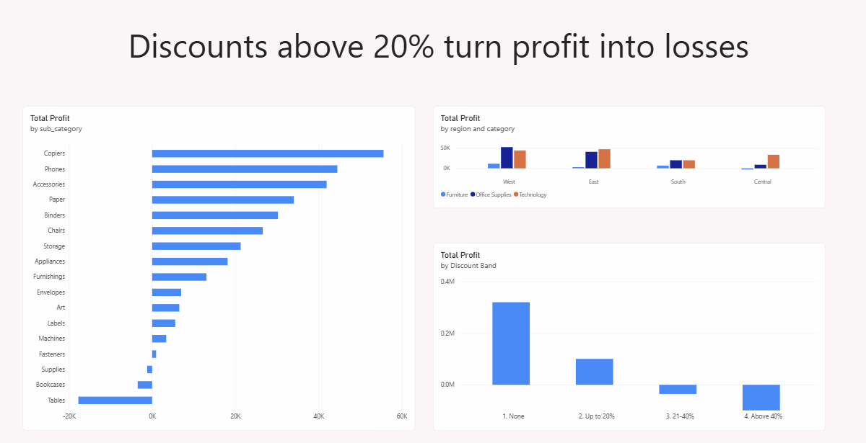
Big discounts cause losses
30%
discount where profit first turns negative
-$99.6K
lost on lines with discounts above 40%
+$100.8K
Page 2 of my Power BI dashboard
profit with discounts up to 20%
Notes:
Discounts up to 20% were still profitable. From 30% upward, the store loses money.

Slide 8
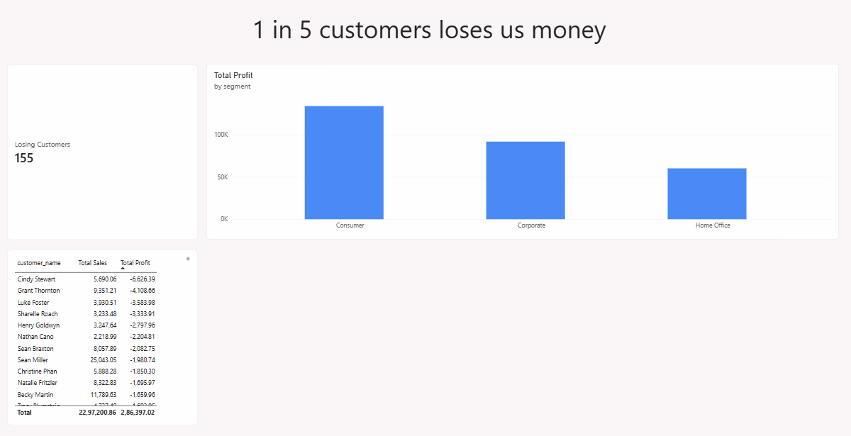
More places we lose money
-$2.9K
Furniture in the Central region, the only losing combo
155 of 793
customers lose money (about 1 in 5)
-$71K
Page 3 of my Power BI dashboard
their combined loss
Notes:
Out of 12 region and category pairs, only Central Furniture loses money. And 155 customers have negative total profit.

Slide 9
What RetailMart should do
Cap discounts at 20%
1
Lines above 40% lost $99.6K
Review Table and Bookcase prices
2
Tables lose $17.7K, Bookcases $3.5K
Check Central Furniture discounts
3
The only region and category that loses money
Notes:
Each action is backed by a number from my analysis.

Slide 10
Heavy discounts are the biggest profit leak
Capping discounts at 20% could stop most of the loss.
Limits: only four years of data, and no product cost information. Test the discount cap on one product line first.
Notes:
Summarise in one sentence. Mention the limits honestly, then say what you would test next.

