Slide 1

Department of Civil Engineering | Major project review 2 | Batch 120ABR
Digital twin for live condition monitoring and retrofit decision support of reinforced concrete members
Submitted by
P. Sahasra Reddy (1601-23-732-015)
M. Bhagirath Reddy (1601-23-732-046)
P. Sreekar Aditya Reddy (1601-23-732-048)
Under the guidance of
Dr. A. Balaji Rao
Associate Professor, Civil Engineering

Slide 2
Contents
Aim and objectives
Methodology
Specimen details and design
Model verification and validation
Preliminary results
Retrofit decision
Summary
Work done and work to be done
References

Slide 3
Aim and objectives
Aim
To develop and experimentally validate a digital twin that measures damage in reinforced concrete beams and recommends retrofitting
Objectives
To design and instrument under-reinforced beams to IS 456:2000 for staged four-point load tests with automated sensing
To develop a digital twin that fuses static and vibration data by Bayesian updating to estimate flexural stiffness and predict service deflection
To develop a retrofit decision framework from IS 456 checks on simulated beams
To validate the twin's predictions and the recommended strengthening by service-load and failure tests
Notes:
Hypotheses tested: H1 damage must be measured, not inferred from load history; H2 vibration over-estimates the stiffness of a cracked beam; H3 the combined twin predicts service deflection within 5%; H4 the recommended repair meets the target capacity. Polymer strengthening = fibre-reinforced polymer laminates. Codes: jacketing IS 15988:2013; polymer ACI PRC-440.2-23 (guide); steel plate by IS 456 limit-state assumptions (clause 38.1). Four objectives, one outcome each, no overlap: 1 the experimental programme (beams designed to IS 456, sensors for load, deflection, vibration, temperature and crack width by automated camera scan); 2 the digital twin (stiffness by Bayesian fusion of deflection and frequency, service deflection prediction); 3 the retrofit decision framework; 4 validation of the twin and of the strengthening on our own beams. Objective 3: 10,000 beams designed to IS 456, damaged from the Monte Carlo study, checked before and after each scheme (clauses 38.1, 40, 23.2, Annex F); least intrusive compliant scheme chosen; a decision tree learned from them (slide 11).

Slide 4
Methodology
Design & casting
Sensors & cloud
Reference test
Repeated for each damage stage
Prediction check,
crack scan
Twin update
Damage stage
Repair decision
Strengthening
Failure test
Notes:
Design & casting: IS 456 under-reinforced beams; cubes for actual strength.
Sensors & cloud: accelerometer, deflection sensor, temperature sensor, automatic tapper; load from the 500 kN frame. ESP32 sends data over 4G to a cloud database; the twin runs in the cloud; alerts go to phones.
Reference test: 15 kN load (below cracking, 26.5 kN) gives stiffness from deflection; tap test gives the natural frequency.
Damage stage: 35, 50, 65, 72 kN, below yield; cracks recorded.
Twin update: Bayesian inference combines the deflection and frequency estimates of stiffness with the previous estimate.
Prediction check, crack scan: the twin predicts the 30 kN service deflection before the test; 30 kN is below the previous maximum load. During the 30 kN hold the ESP32 triggers a camera scan of the constant-moment zone; crack widths are measured from the images (printed scale markers) and sent to the cloud with the other readings. No manual readings.
Repair decision by rule: crack width 0.3 mm (IS 456 cl 35.3.2, from the image scan), permanent set 25% of peak deflection (ACI 318 Chapter 27), stiffness left from the twin; strengthening after the 65 kN stage; failure test in displacement control.

Slide 5
Instrumentation and data flow
Sensors, crack camera
ESP32 + 4G
Cloud database
Simulated readings (temporary)
Repair
decision
Dashboard,
alerts
Digital twin
Crack width
from images
Simulated now, sensors swap in later
Built
Planned
Notes:
Sensors on beam (planned, instrumentation budget about Rs 20,000 to 30,000, low-cost): accelerometer at quarter span, deflection sensor at midspan, temperature sensor, automatic tapper; load is read from the 500 kN servo-hydraulic frame.
Crack camera (planned): one camera on a motorised rail along the middle third (constant-moment zone), framing the bottom strip of the front face where flexural cracks are widest; printed markers of known size on the beam give millimetres per pixel in every image. Flexural cracks run from the soffit up both side faces, so one face is enough. About Rs 1,200 for an ESP32 camera board (5 MP); a higher-quality camera if the pilot test needs it.
ESP32 + 4G (planned): logs the sensors, triggers the tapper, drives the camera rail and triggers the scan at each 30 kN hold, and sends readings and images to the cloud so data reaches the team without a laptop in the lab.
Crack width from images (planned): Python with OpenCV finds each crack, traces its centre line and measures its width in mm; output is maximum width, position, count and spacing. Accuracy proved once on a printed target with lines of known width (0.1 to 1.0 mm) before testing. After Review 2 the crack finder is replaced by a segmentation network (SegFormer) fine-tuned on public concrete crack datasets (Özgenel, 2019: 458 pixel-labelled images of concrete building surfaces). The width ratio (crack width / IS 456 limit) feeds the repair decision, the same ratio as the slide 11 simulation.
Simulated readings (built): sensors are expensive, so the whole pipeline was proven first on simulated readings from the verified fibre model, with sensor noise added (0.01 mm deflection, 0.3 Hz frequency). When the sensors arrive they replace this source; nothing else changes.
Cloud database (built): set up on Supabase (PostgreSQL); not yet connected to the twin. Next step: write the simulated readings into it.
Digital twin (built): stiffness from deflection and frequency, learned vibration bias, Bayesian combination, prediction with 90% interval. Runs on the simulated readings now; moves to the cloud with the data link.
Dashboard and alerts (planned): alert logic was first tested on simulated monitoring data (1000 sequences) in the earlier twin engine.
Repair decision: monitor, repair for serviceability, or strengthen. Crack-width and permanent-set limits are from IS 456 and ACI 318; the stiffness threshold is calibrated on the first tested beam. All inputs arrive automatically: no manual readings.

Slide 6
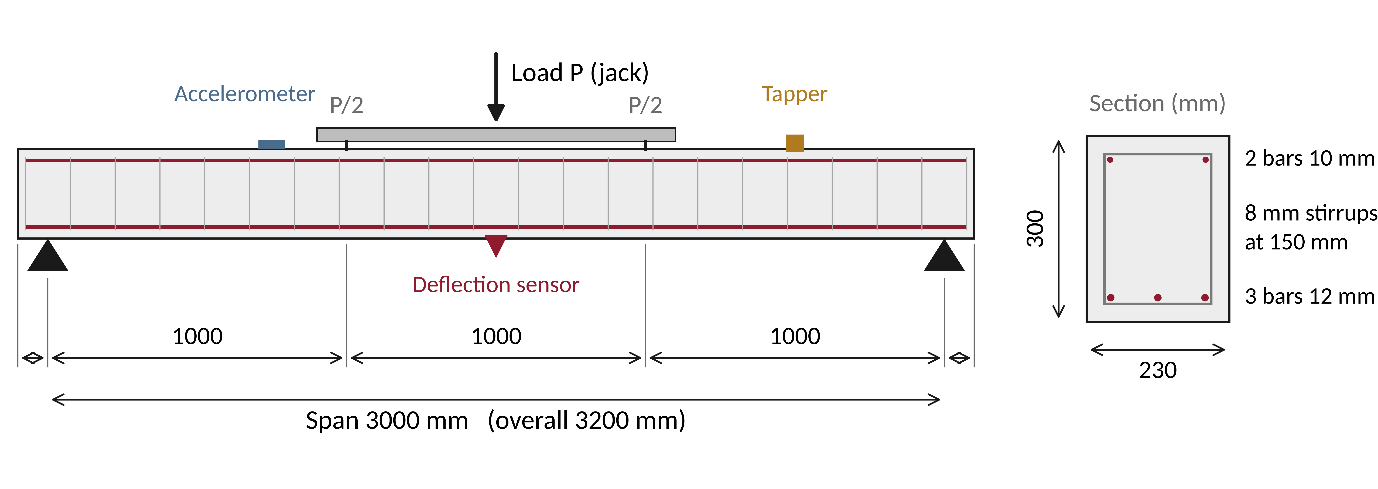
Specimen details
Fig. 1: elevation and cross-section; dimensions in mm
Concrete M30; main bars Fe500; stirrups Fe415; clear cover 25 mm
Simply supported, four-point bending; shear span a = 1000 mm
Notes:
Section 230 x 300 mm uses standard formwork widths. Length 3200 mm, span 3000 mm. Load P from the 500 kN servo-hydraulic frame through a steel spreader beam, P/2 at each third point. Accelerometer at quarter span (away from nodes of modes 1 and 2), deflection sensor at midspan, tapper at a marked point. These sizes are used in all simulations; cast specimens may be scaled to lab constraints.

Slide 7
Specimen design (IS 456:2000)
Step | Expression | Result | Clause
Effective depth d | 300 − 25 − 8 − 12/2 | 261 mm | 26.4
Steel area A_{st} | 3 × π × 12² / 4 | 339 mm² | —
Neutral axis x_{u} | 0.87 f_{y} A_{st} / (0.36 f_{ck} b) | 59.4 mm | G-1.1(a)
Limit x_{u,max} | 0.46 d (Fe500) | 120 mm | 38.1
Moment capacity M_{u} | 0.87 f_{y} A_{st} (d − 0.42 x_{u}) | 34.8 kN·m | G-1.1(b)
Jack load at M_{u} | 2 M_{u} / a, a = 1.0 m | 70 kN | —
Cracking load P_{cr} | 2 f_{cr} I_{g} / (y_{t} a), f_{cr} = 0.7 √f_{ck} | 26.5 kN | 6.2.2
Shear capacity | V_{c} + V_{us} = 31.4 + 63.2 | 94.6 kN | 40.4
Span / effective depth | 3000 / 261 | 11.5 < 20 | 23.2.1
Under-reinforced; shear capacity 2.7 × demand: flexure governs
Notes:
fck = 30 MPa, fy = 500 MPa, b = 230 mm. In four-point bending the moment between the load points is (P/2) x a, so P = 2Mu/a. Mu < Mu,lim = 0.133 fck b d^2 = 62.5 kN m. Self-weight (1.73 kN/m) adds 1.9 kN m at midspan, about 5% of Mu; including it, Mu is reached at a jack load of 65.8 kN. 70 kN is the capacity expressed as a jack load, not a load added to factored self-weight. STAAD.Pro check: for 1.5 x self-weight plus 70 kN (37.9 kN m) it requires 365.8 mm2 of steel; IS 456 by hand for the same moment gives 365.6 mm2.
Cracking: fcr = 3.83 MPa, Ig = b h^3 / 12 = 5.18 x 10^8 mm^4, yt = 150 mm, Mcr = 13.2 kN m (Annex C-2.1).
Shear at the design load: Vu = P / 2 = 34.8 kN; tau_c = 0.52 MPa (Table 19, pt = 0.57%, M30). Stirrups 2-legged 8 mm Fe415 at 150 mm: Vus = 0.87 fy Asv d / sv = 63.2 kN; spacing 150 mm < 0.75d = 196 mm (26.5.1.5); Asv = 100.5 mm2 > minimum 38.2 mm2 (26.5.1.6).

Slide 8
Model verification and blind validation
Our beam, with bars | STAAD.Pro | OpenSeesPy | Difference
First frequency | 50.7 Hz | 52.1 Hz | +2.8%
Deflection at 15 kN | 0.483 mm | 0.470 mm | −2.7%
Shear deformation | included | not included | —
Published beams | Test | Prediction | Difference
Free-free frequency | 88.4 Hz | 85.5 Hz | −3.3%
Peak load | 57.4 kN | 55.7 kN | −3.0%
Polymer, Musiał et al. (2021) | 90, 116 kN | 80, 107 kN | −11%, −8%
Polymer, Ozturkoglu et al. (2024) | 52, 66 kN | 51, 64 kN | −3%, −3%
Published inputs used as given: no tuning
Path from 12 to 45 kN off by up to 29 points
Notes:
Top table: STAAD.Pro (frame model, member stiffness from the section with bars, I = 5.56 x 10^8 mm4, includes shear deformation and lumped mass) against the OpenSeesPy fibre model (bending only). The 2.7 to 2.8% gaps are shear deformation and mass lumping: STAAD's shear deflection is 0.011 mm, so without it STAAD gives 0.472 mm against 0.470 mm. Hand values for the same section: 0.472 mm bending only, 0.483 mm with shear; 51.9 Hz simple beam theory, 51.0 Hz with shear and rotary inertia.
STAAD.Pro (gross section, no bars, includes shear deformation): deflection at 15 kN 0.518 mm against 0.519 mm by hand (-0.2%); first frequency 48.97 Hz against 49.3 Hz (-0.7%); reactions and moments exact. OpenSeesPy with the bars removed: 0.511 mm and 50.02 Hz against 0.507 mm and 50.0 Hz by simple beam theory. With the bars (second STAAD.Pro run, I = 5.56 x 10^8 mm4): 0.483 mm against 0.483 mm by hand with shear (0.0%), 50.71 Hz against 51.0 Hz (-0.5%). So hand, STAAD.Pro and OpenSeesPy agree section for section; screenshots in 05_staad.
Our beam: hand values use the transformed section (n = Es/Ec = 7.3, I = 5.56 x 10^8 mm^4); model is the OpenSeesPy force-based fibre beam, 24 elements, same results with 12 and 48 elements. Ec = 5000 sqrt(fck) (IS 456 cl 6.2.3.1).
Published beams: Musiał et al. (2021). 150 x 250 mm, span 3.0 m, three-point bending, tension steel 1.01% (3 bars of 12 mm). Measured fcm 50.8 MPa, Ec 27.3 GPa, splitting tensile 6.7 MPa, fy 558 MPa. Our modelling rules applied unchanged (blind prediction). Top bars are not reported: 6, 8 or 10 mm changes frequency by under 1%, peak load by 0.3% and stiffness left by under 1.5 points.
Test stiffness values were digitised from their Figure 22 by pixel (reading uncertainty 0.05 MN m2, about 1 to 2%), both beams.
Stiffness left at 45 kN: test 54%, model 55%. Second series, Ozturkoglu et al. (2024): four 150 x 250 mm beams, span 3.0 m, glass and carbon polymer laminates applied before or after damage; our strengthening method predicted the ultimate loads of the beams strengthened before damage as 50.6 and 64.0 kN against 51.9 and 66.2 kN tested (conservative by 2.6 to 3.3%), and those strengthened after damage within 3%. Polymer capacity (Musiał et al., 2021): beams B-II-1 and B-II-2, predicted with our strengthening method (ACI PRC-440.2-23 debonding strain 0.0054 and strain compatibility, mean strengths, no reduction factors): conservative by 8 to 11%.
Limitation, quantified: the test beams lose stiffness from 12 kN, the model from about 20 kN; root-mean-square gap 19 points, worst 29 points at 20 kN. We tried 14 other tension laws with the tensile strength taken from the measured cracking load: the best still leaves 10 to 11 points, and the best law changes with how the test's setup compliance is treated. So the path is not identifiable from this test: a smeared fibre beam cannot reproduce early discrete cracking. This is why the twin measures stiffness instead of predicting it from a model (H1).

Slide 9
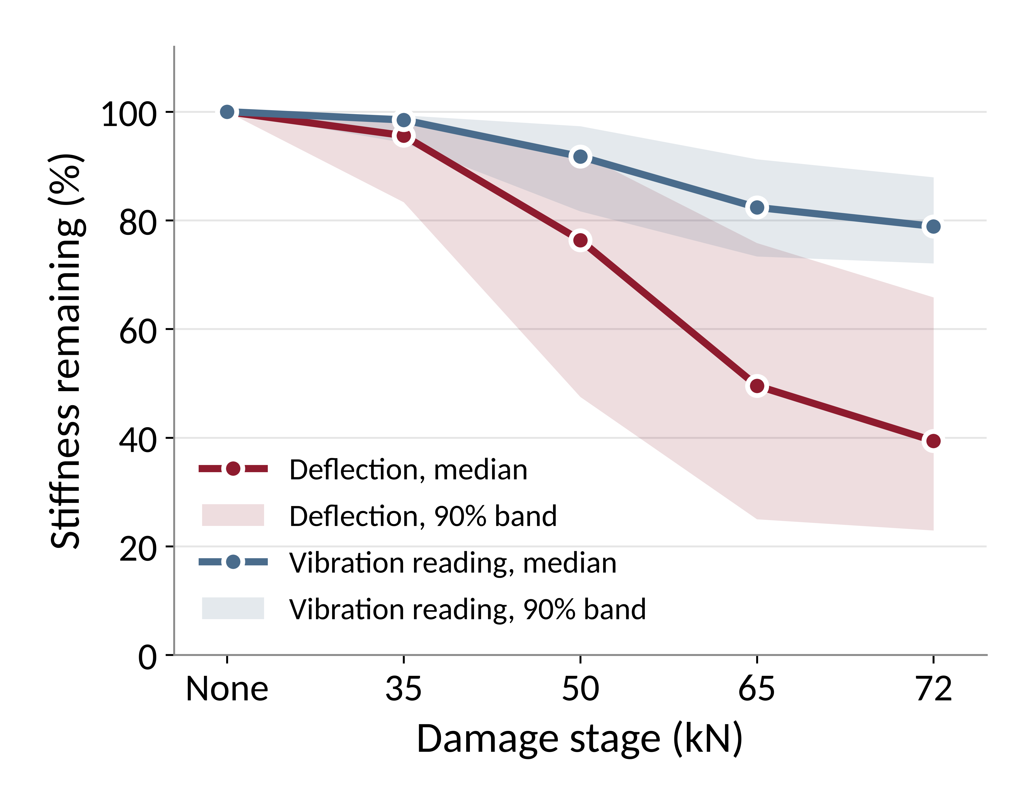
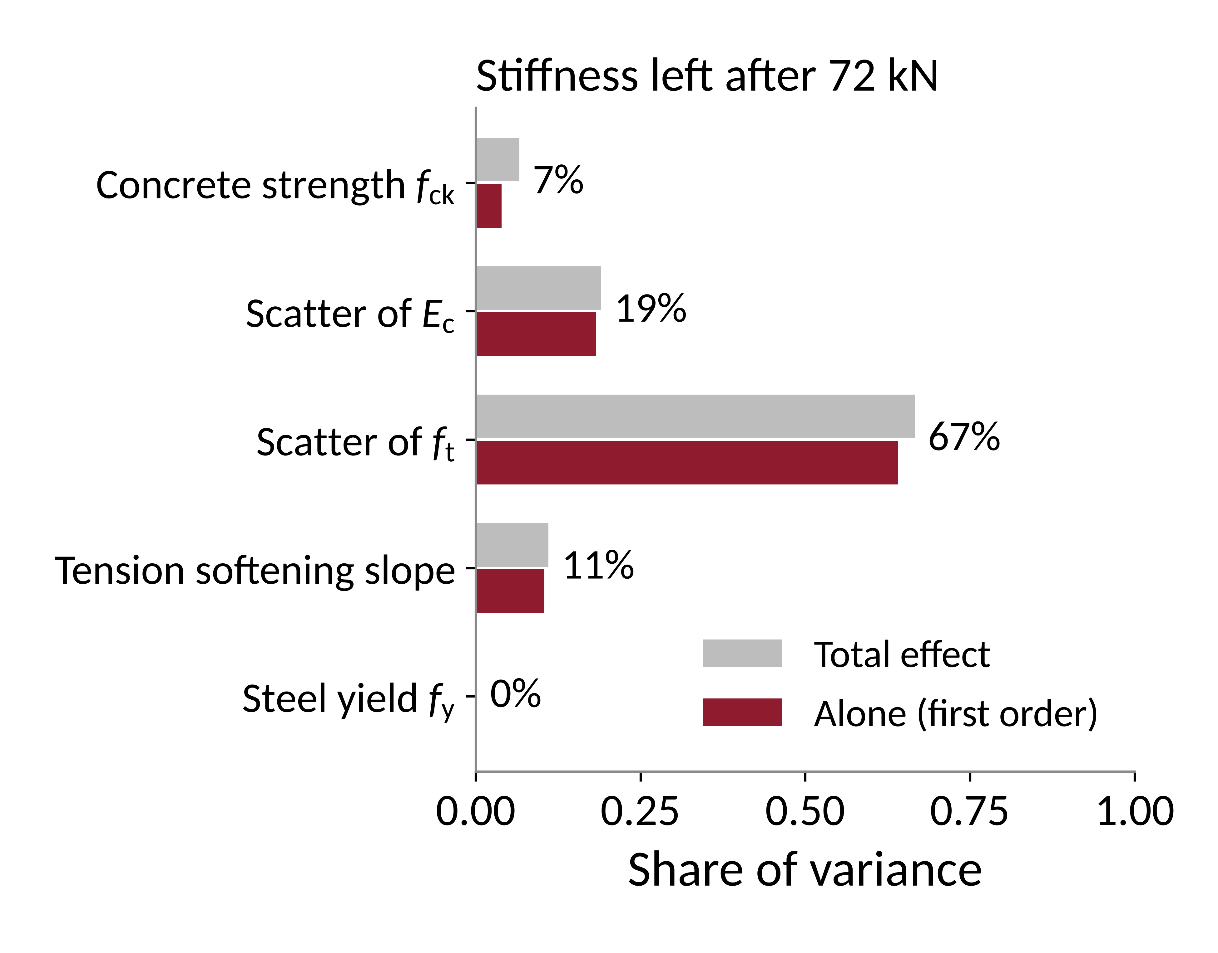
Results: stiffness loss in 300 simulated beams
Fig. 2: median and 90% band
Fig. 3: Sobol sensitivity (R² = 0.95)
Same loads: 23–66% left (simulated), 51% vs 57% (test)
Notes:
Monte Carlo: 300 beams with random material properties, each run through the full damage history (35, 50, 65, 72 kN, with a 15 kN check and a tap test after each). All 300 converged: beam 56 first stopped numerically and was rerun with a more patient solver (same model and inputs; three other beams rerun the same way gave identical results). It is the stiffest beam in the sample and keeps only 17.7% after 72 kN, the lowest of all 300.
Inputs: fck normal (mean 30, standard deviation 5 MPa, IS 456 Table 8); Ec = 5000 sqrt(fck) x lognormal scatter (coefficient of variation 15%); ft = 0.7 sqrt(fck) x lognormal (15%); tension softening slope uniform 0.05 to 0.10 Ec; fy normal (500, 25 MPa).
Left: median and 90% band of stiffness remaining. After 72 kN: 39% median (23 to 66%) from deflection; the vibration reading (scaled by kappa = 0.31 to 0.39 from the published tests) still shows 79% (72 to 88%).
Right: variance-based (Sobol) sensitivity from a quadratic surrogate of the 300 runs (cross-validated R² = 0.95, training 0.97), inputs made independent by using the scatter factors of Ec and ft. Scatter of tensile strength explains 67% of the variance of stiffness left, Ec scatter 19%, tension softening 11%, concrete strength 7%, steel yield 0%.
Real evidence for H1: the two identical published beams (B-I-1, B-I-2) with the same load history kept 51% and 57% of their static stiffness at 45 kN; two identical bare beams of Ozturkoglu et al. (2024) at the same drift kept 98% and 88% of their vibration stiffness.

Slide 10
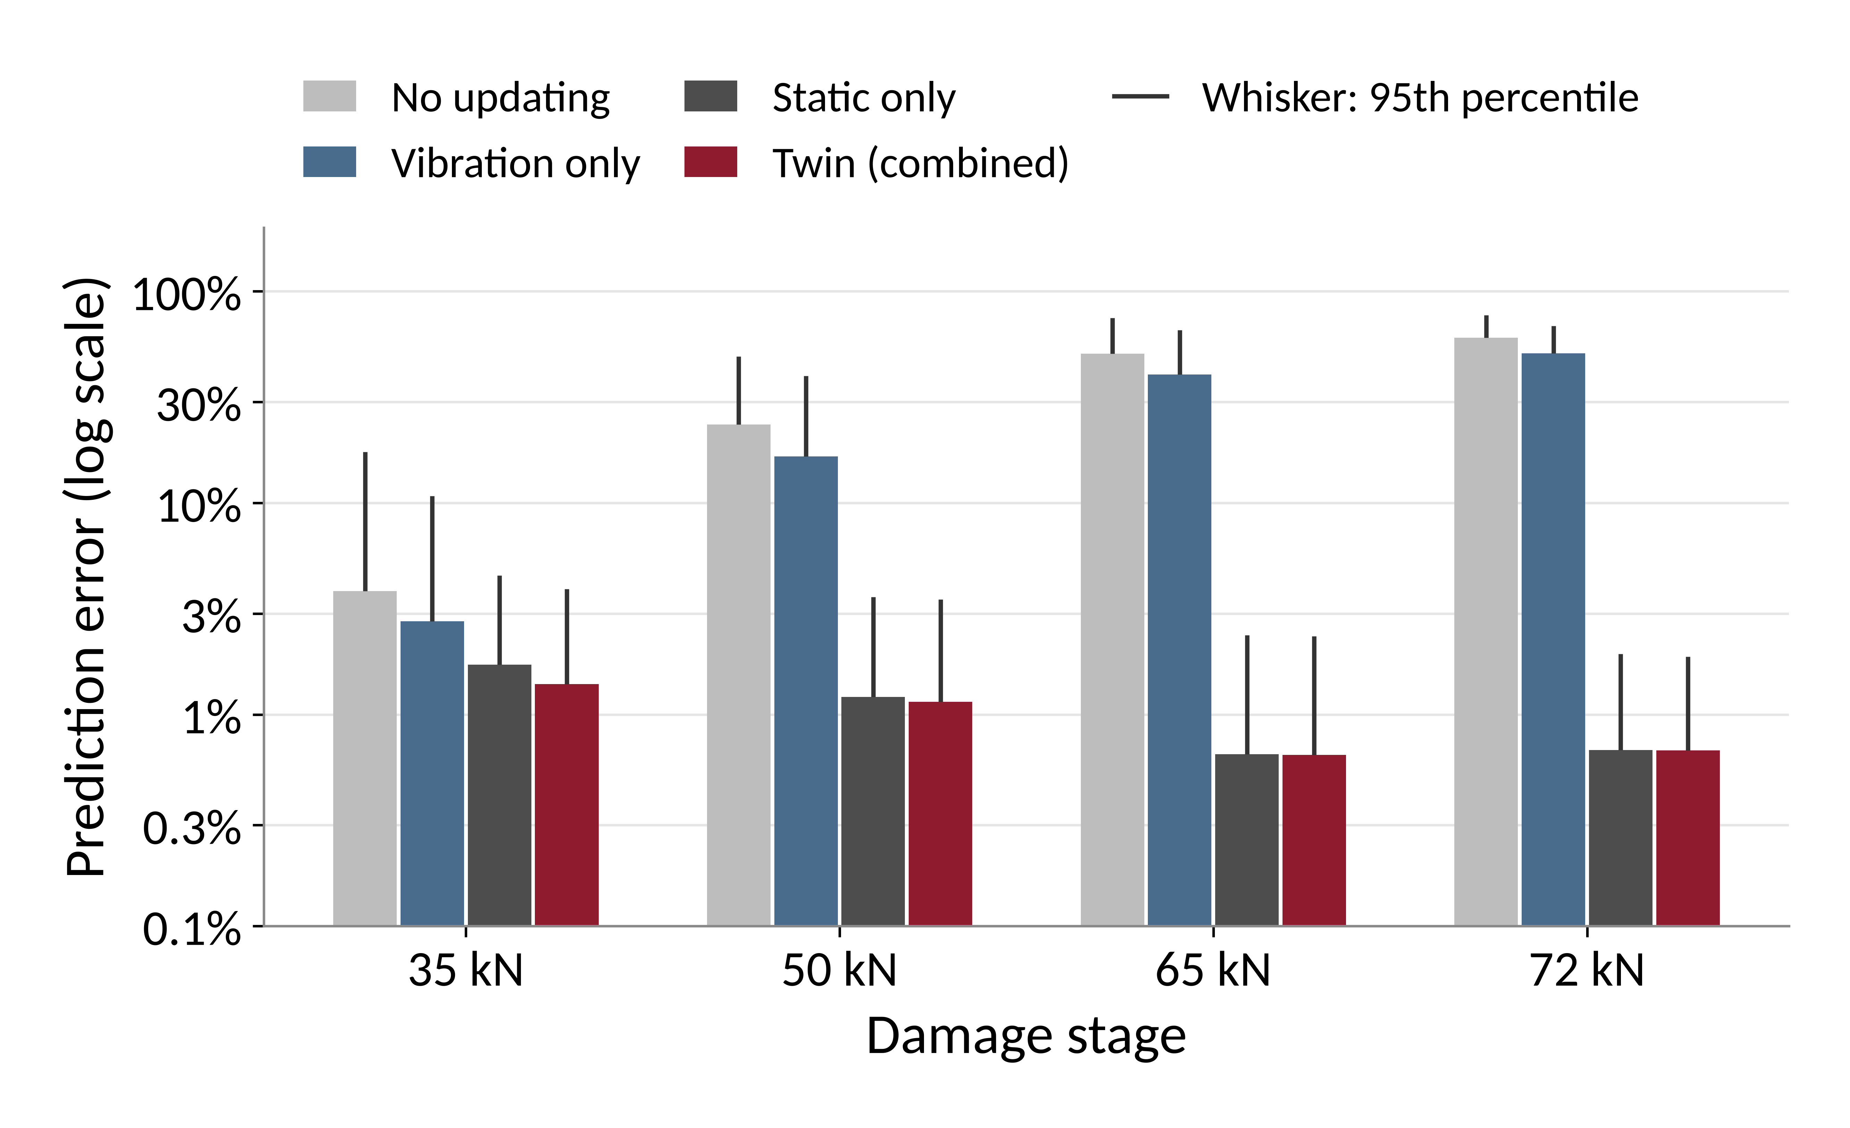
Results: accuracy of the twin's deflection prediction
Median error at 72 kN
No updating: 60%
Vibration only: 51%
Twin: 0.7%
90% band holds: 81–93%
Fig. 4: prediction error on 150 simulated test beams
Published test data: learned bias most accurate at every step
Notes:
Simulation: the twin predicts the 30 kN deflection before each test from sensor readings with noise (frequency 0.3 Hz, displacement 0.01 mm). Vibration is made realistic: the fibre model cannot show cracks closing under small vibrations, so the vibration reading sees only a fraction kappa of the stiffness loss, kappa = 0.31 to 0.39, fitted to the published beams.
The twin learns the vibration bias at every load check and combines it with the deflection estimate; its uncertainties were calibrated on beams 0 to 149 and tested on beams 150 to 299. Bars: median absolute error on the 150 test beams; whiskers: 95th percentile.
At 72 kN: no updating 60%, vibration only 51%, deflection only 0.7%, twin 0.7% (bootstrap 95% interval of the median 0.57 to 0.78%). Twin better than vibration only (Wilcoxon p < 0.001); not different from deflection only (p = 0.052): the twin keeps the deflection accuracy and adds continuous vibration tracking between load checks.
90% intervals contain the true deflection in 81 to 93% of test beams: 89 to 93% at 50, 65 and 72 kN, but 81% at 35 kN, below the nominal 90% (with 150 test beams, 85% or more would be expected by chance). The first stage is slightly over-confident; it will be recalibrated on our own beams.
Second series (Ozturkoglu et al., 2024; damage levels far beyond yield, 15 mm of extra deflection per step): learned bias 24% error, holding the last check 27%, vibration alone 67%. Across both series (19 predictions) the learned bias was the most accurate at every step; the error grows with the damage added between load checks, so our protocol checks after every stage. Real data (Musiał et al., 2021; both beams, 14 load steps): predicting the deflection stiffness from vibration alone erred by 30% (median); with the bias learned at the previous check, 4% (holding the previous check: 5.5%). Reading uncertainty about 3%.
The twin uses only measured data and beam theory; the fibre model only plays the real beam. H3 is still to be confirmed on our own beams.

Slide 11
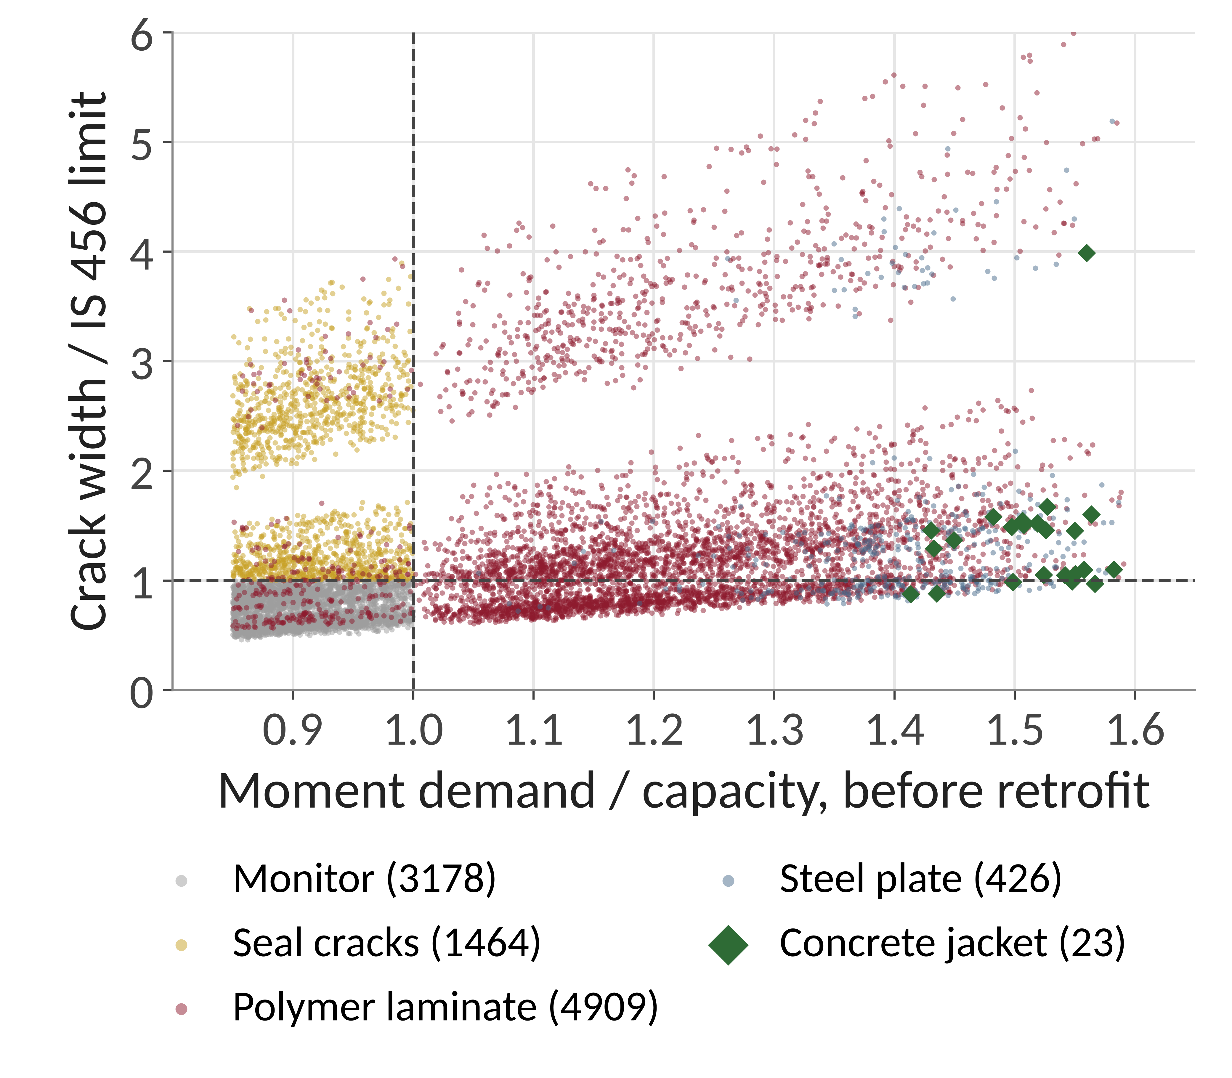
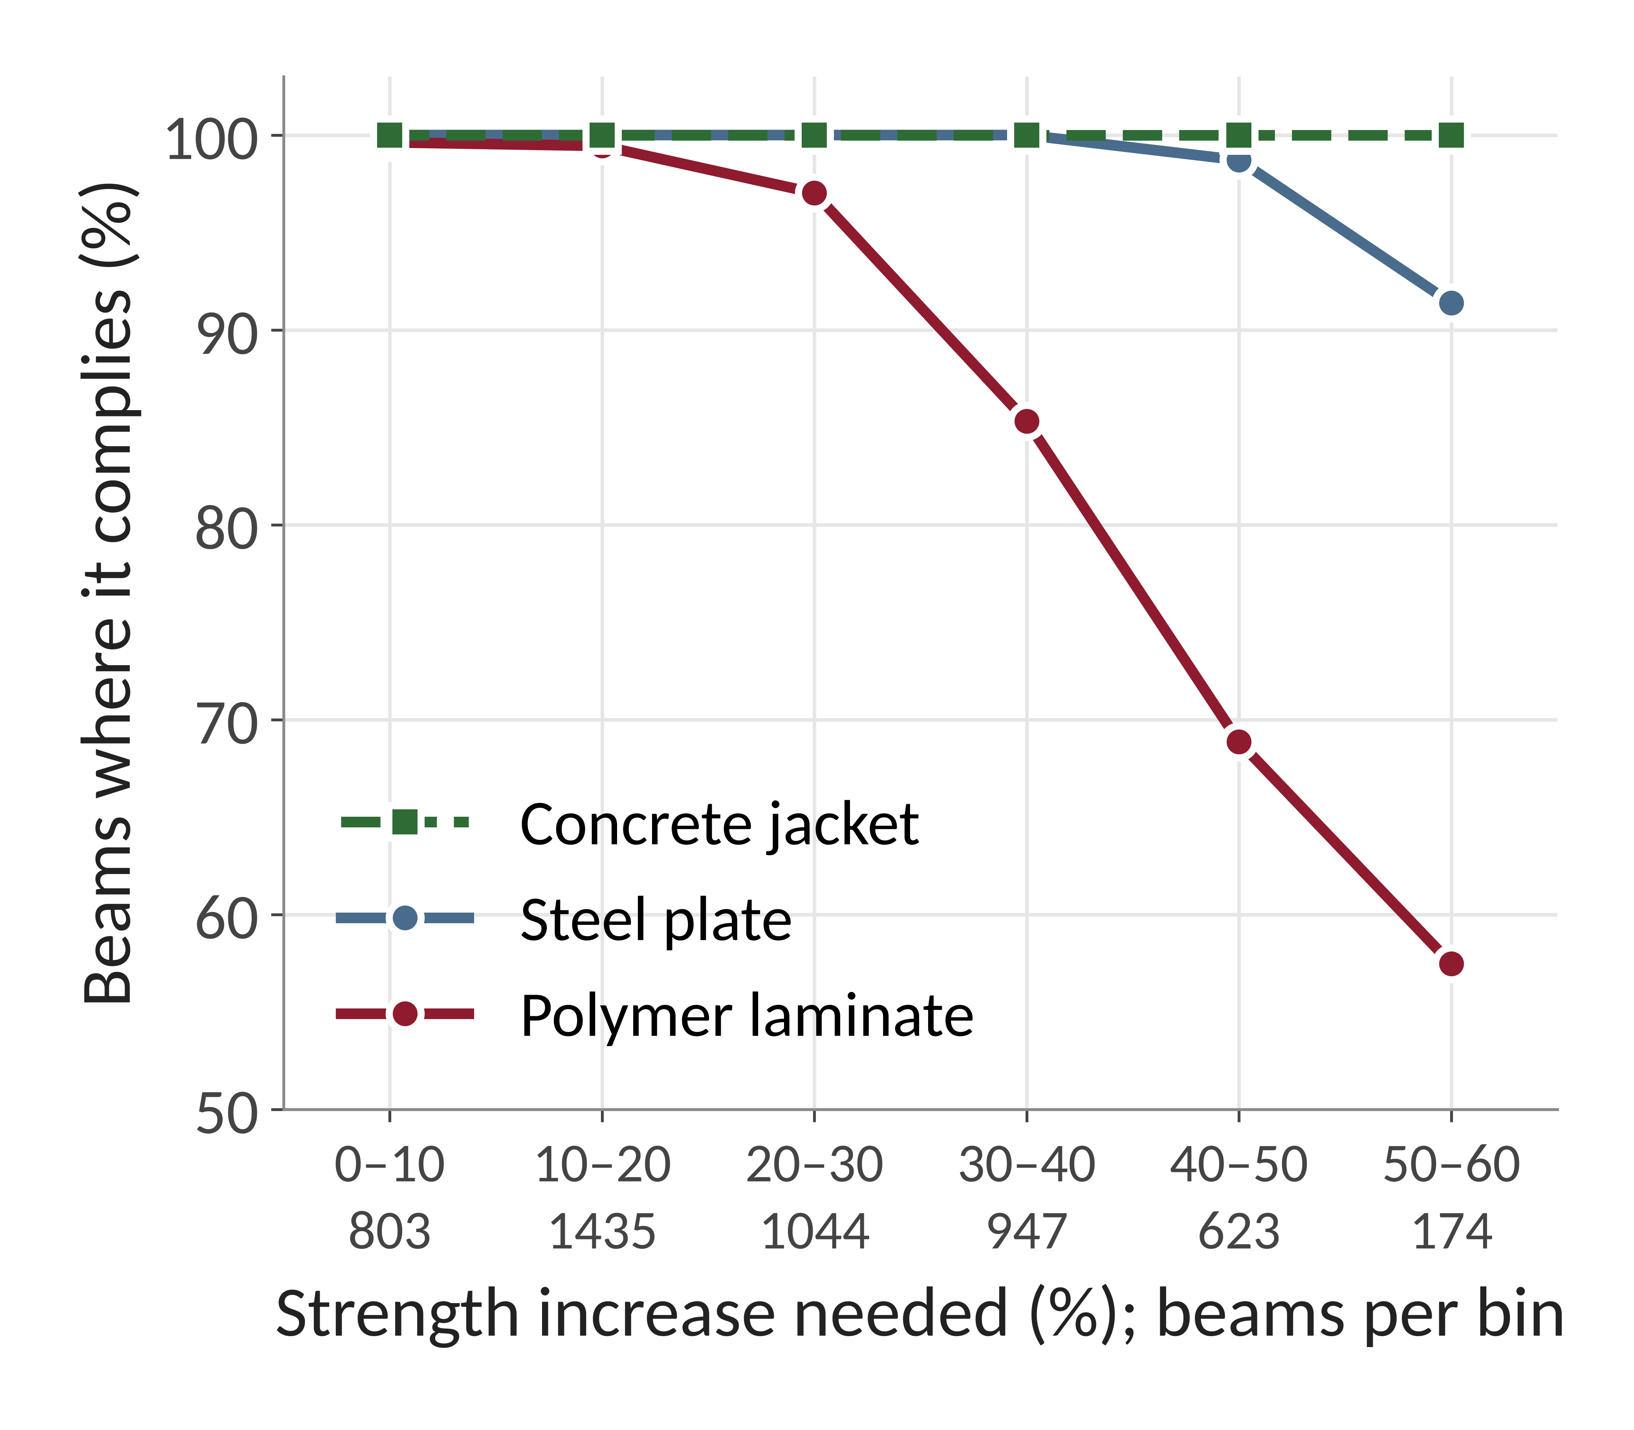
Retrofit decision: 10,000 simulated beams
Fig. 5: least intrusive compliant scheme
Fig. 6: compliance by strength needed
Decision tree learned from the simulation: 90% correct on 3000 unseen beams
Notes:
What it is: 10,000 beams designed to IS 456 (simply supported, uniform load, span 3 to 8 m, width 230 or 300 mm, span/depth 10 to 13, M20 to M30, Fe500, steel 0.5 to 1.2%, all three exposure classes). Each beam passed every IS 456 check when new, then received damage drawn from our Monte Carlo of 300 beams (stiffness left, 5th to 95th percentile 26 to 98%) and, for half of them, a change of use (live load x 1.5 or x 2.0).
Each damaged beam was checked before retrofit and after each retrofit: flexure (cl 38.1), shear (cl 40), deflection (cl 23.2 a and b, with creep and shrinkage, Annex C), crack width (Annex F, crack limits 0.3, 0.2 or 0.1 mm, cl 35.3.2). The twin's stiffness is used at its lower 95% bound.
Schemes: polymer laminates (1 or 2 plies, 1 to 4 strips of 50 x 1.2 mm carbon, ACI PRC-440.2-23 debonding strain and initial substrate strain, U-wraps for shear), steel plate 3 to 6 mm, concrete jacket 75 to 125 mm (IS 15988:2013). Retrofit is applied unpropped (dead load stays on the damaged section); propping is tried only if unpropped fails. Crack sealing accompanies every scheme. The least intrusive compliant scheme is chosen: monitor, seal cracks, polymer, plate, jacket.
Results (Fig. 5): monitor 3178, seal cracks 1464, polymer laminates 4909, steel plate 426, concrete jacket 23; none was beyond all schemes. Propping was needed in 501 beams. Without a change of use, damage that leaves the steel elastic never needed strengthening for strength: crack sealing, or laminates in 332 beams for deflection.
Fig. 6: polymer laminates comply in 97 to 100% of beams needing up to 30% more strength, 85% at 30 to 40%, 69% at 40 to 50% and 58% at 50 to 60% (debonding limits them). Steel plate 91 to 100%, jacket 100%. Sample size of each bin is printed under the axis.
Decision tree (scikit-learn, depth 3, at least 20 beams per leaf, classes weighted because plate or jacket beams are rare): trained on 7000 beams, tested on 3000 never seen: 90.1% correct (91.0% on the training beams), balanced accuracy 91.5%; it catches 115 of 135 beams that need a plate or jacket (an unweighted tree scores 95.7% but catches only 60 of them). Its splits: moment demand / capacity (1.00 and 1.34), crack width / limit (1.00), deflection / limit (0.96, 1.00 and 1.17), span / effective depth (13.3). Mostly safe-side errors: 249 polymer beams sent to plate, 20 plate or jacket beams sent to polymer. Every beam and prediction is in StrucIQ_decision_tree_beams.xlsx, where Excel predicts each beam with the tree as formulas.
Check with 3000 beams (same simulation and tree settings): scheme shares 33 / 15 / 48 / 4.1 / 0.1% against 32 / 15 / 49 / 4.3 / 0.2% here; polymer limit the same (97 to 100% up to 30% more strength, 86% at 30 to 40%); tree 89.6% correct on 900 unseen beams. The result does not depend on the number of beams. With 3000 beams the tree also split on the twin's stiffness left (0.30); with 10,000 that split disappears, so it is not a finding.
Our own specimens (four-point bending, not in this population): two 50 x 1.2 mm strips 107 kN, 100 x 5 mm Fe250 plate 125 kN, 75 mm jacket with 2 bars of 12 mm 131 kN, against 70 kN unstrengthened; polymer method within 11% on 6 published beams.
Limits: damage before yield only; simply supported, uniformly loaded beams; checks are IS 456 design checks, not a replacement for an engineer's judgement on site.

Slide 12
Summary of work done
Reviewed the literature on digital twins, damage measurement and strengthening
Designed the test beam to IS 456, under-reinforced so that flexure governs
Verified the beam model against hand calculation and STAAD.Pro
Predicted a published beam test blind, before seeing its results
Showed by simulation that identical loading damages beams differently
Showed from published tests that vibration alone underestimates damage
Developed the digital twin and tested it on simulated and published data
Checked the polymer strengthening calculation against published beams
Developed a retrofit decision framework from IS 456 checks on simulated beams
Notes:
Numbers behind each point, if asked.
H1: two identical published beams with the same load history kept 51% and 57% of their stiffness (Musiał et al., 2021); simulation: 23 to 66% (90% band, 300 beams); the model itself misses the path by up to 29 points, so damage must be measured.
H2: published test: after 45 kN, vibration showed 80% of stiffness left, deflection 54% (mean of two beams); vibration registers only 31 to 39% of the loss. Second independent series (Ozturkoglu et al., 2024): vibration registers 35% of the loss (95% interval 31 to 48%), and read the beam stiffer in 10 of 11 comparisons. After strengthening, the first frequency fell 9% (glass) and rose 1% (carbon), so repairs are verified by a static load check, not by vibration. Ozturkoglu et al. (2024): bare beams kept 88 to 98% of their vibration stiffness after yielding.
H3: twin error 0.7% median at 72 kN with realistic vibration bias; 90% intervals hold in 81 to 93% of test beams (81% at 35 kN, slightly over-confident there). On real published data the bias-learning step cut vibration error from 30% to 4%. To be confirmed on our beams.
H4: after repair each beam is load tested at service load (stiffness, crack width) and then to failure (capacity). Status of H3 is 'simulation only' until our own beams are tested; the 4% is on published measurements.
Strengthening: design capacities of our specimen 107 to 131 kN against 70 kN unstrengthened. Retrofit simulation: polymer laminates comply in 97 to 100% of beams needing up to 30% more strength; plate or jacket beyond about 30%.

Slide 13
Work done and work to be done (2026–27)
Jul
Aug
Sep
Oct
Nov
Dec
Jan
Feb
Mar
Apr
Literature review
Twin algorithm
Design and modelling
Simulation studies
Instrumentation
Casting and curing
Load testing
Retrofit and retesting
Analysis and report
Work done
To be done
Review 2 (14 Oct)
Notes:
Project period: mid-July 2026 to April 2027. Twin algorithm (03_damage_and_twin/twin.py): Bayesian stiffness updating, monitoring alerts and the cloud database, built and tested on simulated data (alerts: 1000 simulated sequences).
Design and modelling: IS 456 design of the beam and of the polymer, plate and jacket schemes; OpenSeesPy fibre model, verified against hand calculations within 0.4%.
Simulation studies: damage stages and twin prediction, Monte Carlo study (300 beams), Sobol sensitivity, comparison with two published test series. Load testing: reference test, damage stages 35 to 72 kN with a deflection check and tap test after each. Retrofit and retesting: chosen repair applied, service-load test, then test to failure.
Thesis submission April 2027. Casting in November allows 28-day curing before the pilot test; jacket curing falls in February to March.

Slide 14
References
American Concrete Institute. (2023). Design and construction of externally bonded fiber-reinforced polymer (FRP) systems for strengthening concrete structures: Guide (ACI PRC-440.2-23).
Bureau of Indian Standards. (2000). Plain and reinforced concrete: Code of practice (IS 456:2000, 4th rev.).
Bureau of Indian Standards. (2013). Seismic evaluation and strengthening of existing reinforced concrete buildings: Guidelines (IS 15988:2013).
Capozucca, R. (2013). Assessment of CFRP strengthened RC beams through dynamic tests. Composites Part B: Engineering, 46, 69–80. https://doi.org/10.1016/j.compositesb.2012.10.010
Lu, X. Z., Teng, J. G., Ye, L. P., & Jiang, J. J. (2005). Bond-slip models for FRP sheets/plates bonded to concrete. Engineering Structures, 27(6), 920–937. https://doi.org/10.1016/j.engstruct.2005.01.014
Maeck, J., Abdel Wahab, M., Peeters, B., De Roeck, G., De Visscher, J., De Wilde, W. P., Ndambi, J. M., & Vantomme, J. (2000). Damage identification in reinforced concrete structures by dynamic stiffness determination. Engineering Structures, 22(10), 1339–1349. https://doi.org/10.1016/S0141-0296(99)00074-7
Musiał, M., Trapko, T., & Grosel, J. (2021). Static and dynamic stiffness of reinforced concrete beams strengthened with externally bonded CFRP strips. Materials, 14(4), Article 910. https://doi.org/10.3390/ma14040910
Ozturkoglu, O., Yucel, U., Karademir, C., & Durmazgezer, E. (2024). An experimental study on the effect of GFRP and CFRP strengthening on the static and dynamic behavior of R/C beams under progressive damage. Applied Sciences, 14(21), Article 9920. https://doi.org/10.3390/app14219920
Torzoni, M., Tezzele, M., Mariani, S., Manzoni, A., & Willcox, K. E. (2024). A digital twin framework for civil engineering structures. Computer Methods in Applied Mechanics and Engineering, 418, Article 116584. https://doi.org/10.1016/j.cma.2023.116584
Xu, T., & Castel, A. (2016). Modeling the dynamic stiffness of cracked reinforced concrete beams under low-amplitude vibration loads. Journal of Sound and Vibration, 368, 135–147. https://doi.org/10.1016/j.jsv.2016.01.007
Notes:
References in APA 7th edition style: alphabetical by first author, hanging indent, journal name and volume in italics, DOI as a link. Corporate authors (ACI, BIS) are also the publishers, so the publisher is not repeated.

Slide 15
Thank you

