Slide 1

Department of Civil Engineering
A Vibration-Driven Structural Digital Twin for
Uncertainty-Aware Retrofit Decision Making
Major Project Review 1
Batch: ABR120
P. Sahasra Reddy
160123732015
M. Bhagirath Reddy
160123732046
P. Sreekar Aditya Reddy
160123732048
Project Guide: Dr. A. Balaji Rao, Associate Professor
Notes:
[Sources]
- /Users/sreekaraditya/Downloads/Project_Summary_ABR120.docx
[/Sources]

Slide 2
Contents
1
Introduction
8
Decision Layer
2
Literature Review
9
Experimental Campaign
3
Literature Review(Continued)
10
Summary of Findings
4
Research Gap Identification
11
Work Done
5
Aim and Objectives
12
Work Remaining
6
Architecture — Chain
13
Roadmap & Timeline
7
Two-Tier State
14
References
02
Notes:
[Sources]
- User-provided slide structure and the current presentation sequence
[/Sources]

Slide 3
Introduction
1
Reinforced-concrete structures deteriorate through changes in load-bearing stiffness and in the condition of the concrete cover.
2
Vibration measurements provide non-destructive information about structural response and member-level mechanical condition.
3
Crack width, crack orientation and water sorptivity provide complementary information about durability-related transport through concrete.
4
Mechanical deterioration and cover deterioration may require different interventions, such as strengthening or cover repair.
5
The project therefore integrates sensing, uncertainty-aware state estimation, experimental calibration and constrained retrofit planning in one workflow.
03
Notes:
[Sources]
- /Users/sreekaraditya/Downloads/Project_Summary_ABR120.docx
- User-provided team briefing document, Sections 2 and 4
[/Sources]

Slide 4
Literature review
Title
Author
Year
Journal · publisher
Methodology · inputs → outputs
Key finding
Damage detection under environmental and operational variability using cointegration
Pirrò et al.
2025
Engineering Structures
Elsevier
31,326 vibration datasets + temperature/water level + FE damage → EOV-normalised novelty indicators
Cointegration separated environmental variation using about 6 months of training; PCA required about 12 months.
Autoencoders for unsupervised real-time bridge health assessment
Giglioni et al.
2023
Computer-Aided Civil and Infrastructure Engineering
Wiley
Healthy raw acceleration sequences → autoencoder reconstruction-loss damage indicators
Reported up to 96% accuracy and AUC 0.99; 10 s sequences processed in under 1 s.
SHM under varying environmental conditions: model order reduction and deep learning
Torzoni et al.
2022
Computers & Structures
Elsevier
Simulated vibration + temperature/load + stiffness loss → damage class/location
Physics-generated training data separated temperature effects from damage and located small stiffness reductions.
Multi-fidelity surrogate model for SHM using model reduction and neural networks
Torzoni et al.
2023
Mechanical Systems and Signal Processing
Elsevier
High-fidelity FE + low-fidelity ROM + operational noise → sensor histories and Bayesian state
Multi-fidelity learning improved surrogate accuracy while reducing the cost of Bayesian updating.
04
Notes:
[Sources]
- https://doi.org/10.1016/j.engstruct.2025.119700
- https://doi.org/10.1111/mice.12943
- https://doi.org/10.1016/j.compstruc.2022.106790
- https://doi.org/10.1016/j.ymssp.2023.110376
[/Sources]

Slide 5
Literature review(Continued)
Title
Author
Year
Journal · publisher
Methodology · inputs → outputs
Key finding
Structural health monitoring of civil structures powered by deep metric learning
Torzoni, Manzoni et al.
2022
Computers & Structures
Elsevier
Physics-generated vibration under varied damage positions → low-dimensional metric features
Damage localisation remained robust to operational variation, measurement noise and model inaccuracies.
Value of information from vibration-based SHM via Bayesian model updating
Kamariotis et al.
2022
Mechanical Systems and Signal Processing
Elsevier
Accelerations + OMA modal data + deterioration/cost models → reliability, lifecycle cost and VoI
Shows how monitoring information can be valued by the maintenance decisions it changes.
Bridging POMDPs and Bayesian decision making for robust maintenance planning
Arcieri et al.
2023
Reliability Engineering & System Safety
Elsevier
Railway indicators + model uncertainty + actions → robust maintenance policy
Explicit model uncertainty prevents overconfident maintenance policies and supports sequential decisions.
Water transport through cracked concrete structures
Mengel, Krauss et al.
2022
Materials
MDPI
Mixture proportion + µCT crack geometry → tortuosity, internal width and water flow
Mixture-controlled crack geometry changes water transport; larger aggregate increased tortuosity and reduced flow.
05
Notes:
[Sources]
- https://doi.org/10.1016/j.compstruc.2022.106858
- https://doi.org/10.1016/j.ymssp.2021.108465
- https://doi.org/10.1016/j.ress.2023.109496
- https://doi.org/10.3390/ma15175807
[/Sources]

Slide 6
Research Gap Identification
1.
Structural health monitoring
Many studies identify a damage indicator, but do not propagate its uncertainty to a member-level state.
2.
Digital-twin updating
Model updating is often reported without retaining the full posterior covariance needed for later decisions.
3.
Durability evidence
Crack–water transport studies are rarely linked to vibration-inferred structural states.
4.
Maintenance planning
Maintenance optimisation is commonly separated from experimentally measured structural and cover condition.
5.
Research gap
An experimentally anchored workflow is needed to connect vibration, uncertain state estimation, water transport and retrofit sequencing.
06
Notes:
Present the gap as a synthesis of the reviewed limitations; avoid claiming that any individual component is new.
[Sources]
- Eight-paper review on slides 4–5
- User-provided team briefing document, Sections 2, 5 and 7
[/Sources]

Slide 7
Aim and Objectives
Aim
Develop and experimentally calibrate a vibration-driven structural digital twin for retrofit and inspection decisions under uncertainty.
Objectives
1.
Extract modal parameters while correcting environmental and operational variability.
2.
Estimate per-member stiffness ratio α together with its posterior covariance.
3.
Relate α, crack width and orientation to ASTM C1585 water sorptivity.
4.
Map the estimated state to component performance and acceptance levels.
5.
Select inspection, repair, sequencing and scheduling actions subject to hard constraints.
07
Notes:
State each objective as an input-output commitment; avoid calling unmeasured coefficients results.
[Sources]
- /Users/sreekaraditya/Downloads/Project_Summary_ABR120.docx
- User-provided team briefing document, Sections 5, 7 and 9
[/Sources]

Slide 8
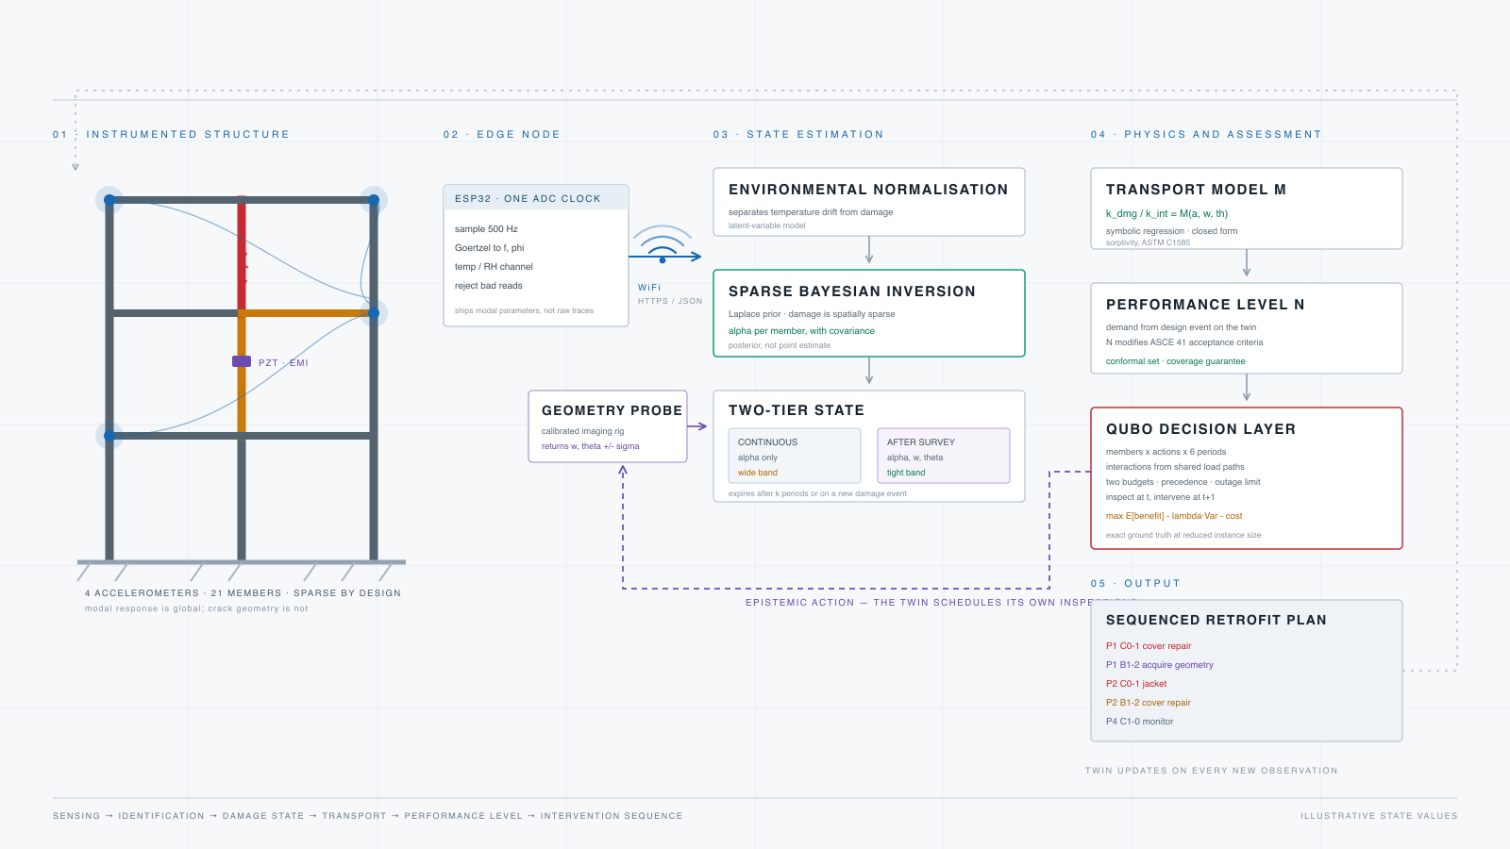
Architecture · the chain from sensing to retrofit
DEFINED ARCHITECTURE · EXPERIMENTAL COEFFICIENTS PENDING
08

Slide 9
Two-Tier State
1.
Continuous tier
Use vibration response and environmental variables to estimate α, with posterior covariance.
2.
Reduced model
When crack geometry is unavailable, use M(α) and retain deliberately wider uncertainty.
3.
Inspection tier
After a directed crack survey, augment the state to (α, w, θ) and use the full transport model.
4.
Acquisition rule
Geometry remains valid for k periods or until a new damage event; a new survey is therefore a timed decision.
09
Notes:
Emphasise that the full transport model is never used when crack geometry has not been measured.
[Sources]
- User-provided team briefing document, Section 6
- User-provided session summary, Section 3
[/Sources]

Slide 10
Decision Layer
Decision variables are evaluated against uncertainty, cost and constructability constraints
1.
Inputs
Member stiffness estimates α with covariance, together with cover-condition information.
2.
Candidate actions
Inspection, injection, coating, jacketing and monitoring are represented as selectable actions.
3.
Objective
Compare expected benefit against uncertainty penalty and intervention cost: benefit − λ variance − cost.
4.
Constraints
Enforce separate budgets, repair precedence, one-period information delay and limits on members out of service.
5.
Output
Return a feasible intervention schedule identifying who, what action and in which period.
The exact MILP solution is retained as the classical benchmark for the decision formulation.
10
Notes:
Do not claim quantum speedup. The contribution is the decision formulation and its exact classical benchmark.
[Sources]
- User-provided team briefing document, Sections 9 and 12
- /Users/sreekaraditya/Desktop/Demo-Sim/results/milp_solver_summary.csv
[/Sources]

Slide 11
Experimental campaign · cast, damage, measure, calibrate
PLANNED · REVIEW 2 METHODOLOGY
01
02
03
04
05
Cast
Baseline
Grade damage
Survey
Transport
RC members with controlled geometry and sensor locations
Modal response + environment + intact reference
UTM displacement control in fixed shallow increments
Crack width w and orientation θ with calibrated imaging
Cut specimens and measure ASTM C1585 sorptivity
Primary loading route
Primary response
UTM displacement control; shake-table loading remains an optional extension.
Water sorptivity—not chloride ingress—paired with α, w and θ for held-out model comparison.
11
Notes:
Methodology is included to demonstrate project readiness; no physical calibration result is claimed yet.
[Sources]
- User-provided team briefing document, Sections 7–8
- ASTM C1585/C1585M, Standard Test Method for Measurement of Rate of Absorption of Water by Hydraulic-Cement Concretes
[/Sources]

Slide 12
What we have learned computationally
2
19 / 21
50
SENSORS
MEMBERS SEPARABLE
INDEPENDENT SEEDS
Mode shapes break the left/right symmetry; extra channels gave little precision gain in the 3-parameter portal study.
A sparse prior reduced mean posterior SD from 0.164 to 0.096 in the illustrative 21-member case.
Flat, sparse and oracle planning distributions were tested rather than judged from one annealing run.
Design consequence
Measure better, parameterise by physical member, retain covariance, and report solver distributions—not a single favourable run.
12
Notes:
All numbers on this slide are computational evidence, not physical validation.
[Sources]
- /Users/sreekaraditya/Desktop/Demo-Sim/results/REPORT.md
- /Users/sreekaraditya/Desktop/Demo-Sim/results/prior_comparison_summary.csv
- /Users/sreekaraditya/Desktop/Demo-Sim/results/prior_plan_solver_50_seed_summary.csv
[/Sources]

Slide 13
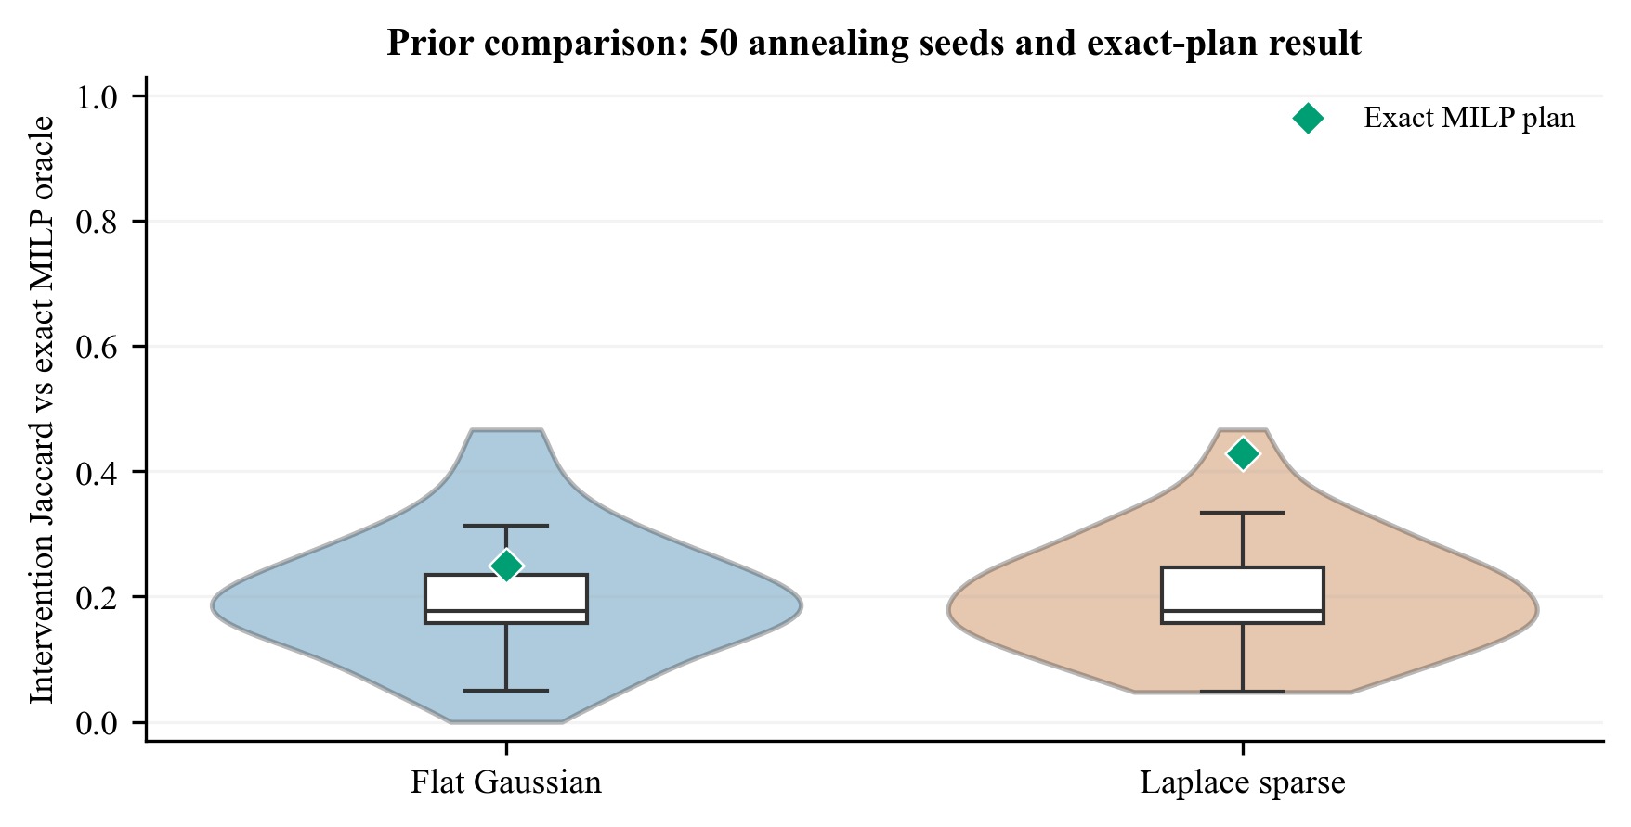
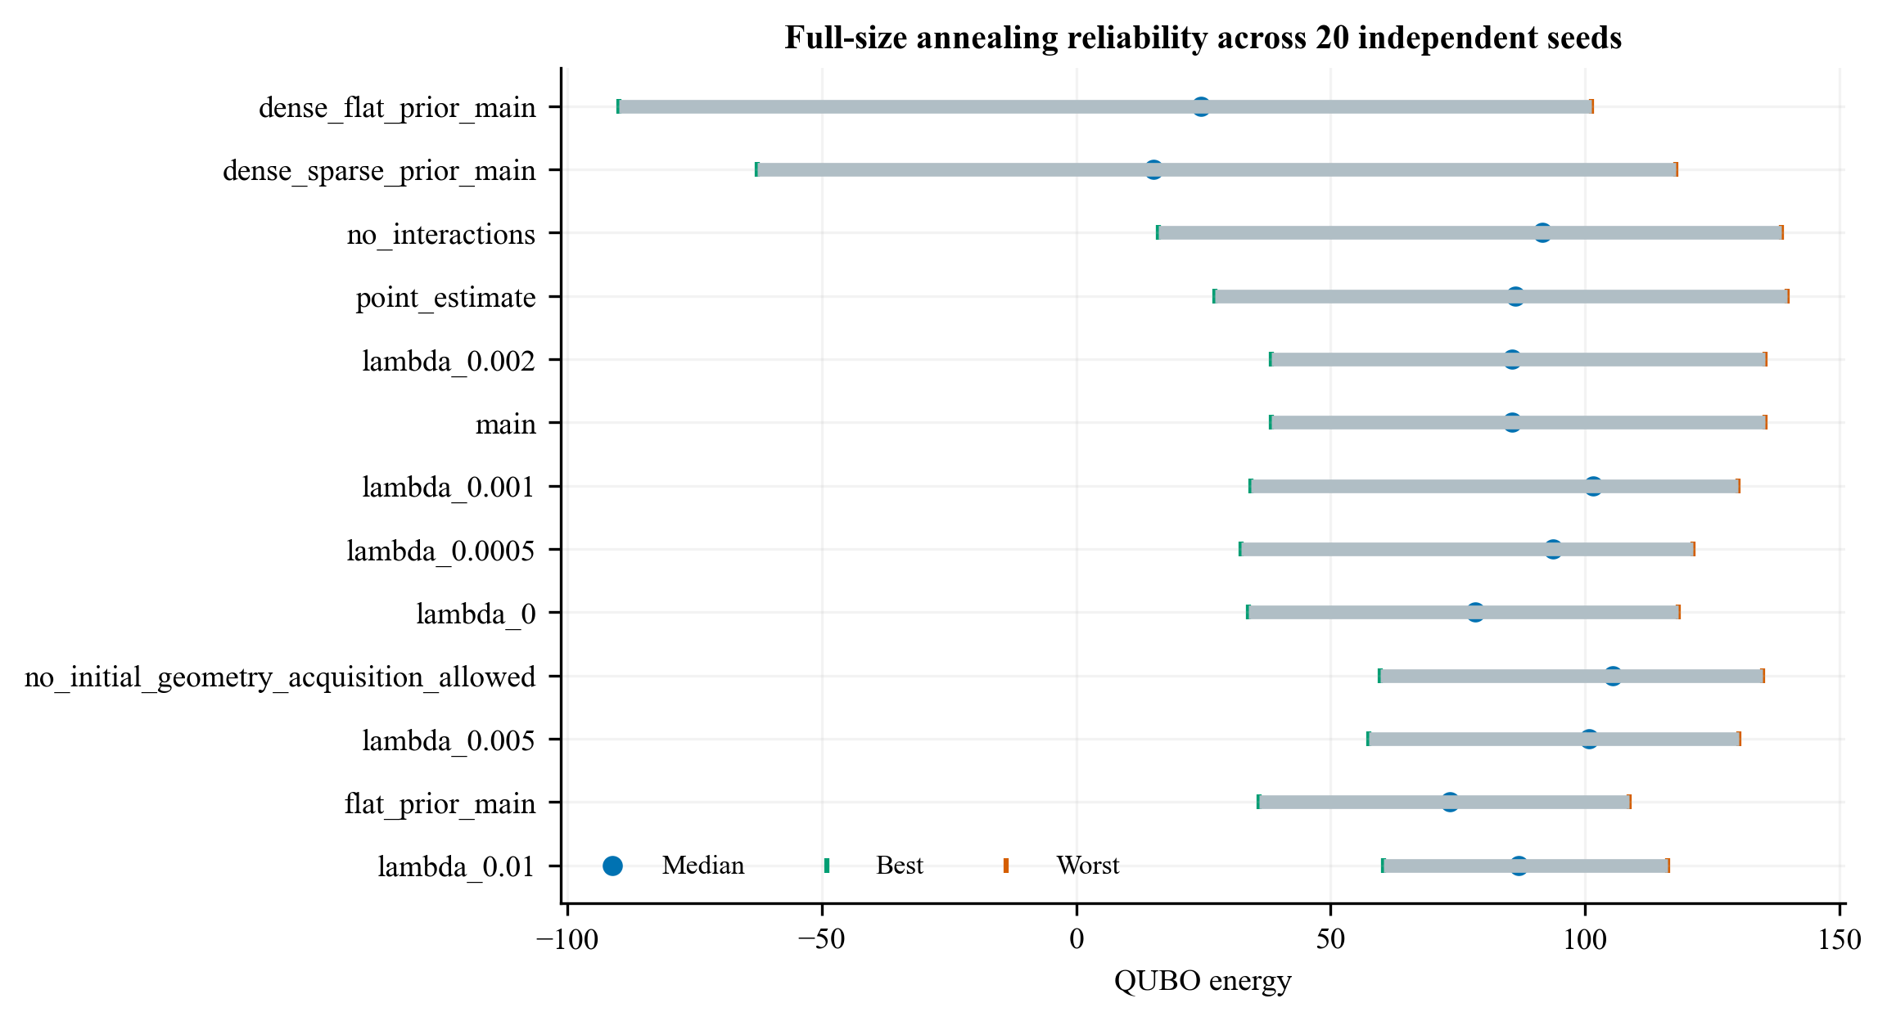
Work done · executable evidence already produced
✓
Portal-frame FE model and modal benchmark
✓
Fisher-information sensor and parameterisation study
✓
Sparse Bayesian member-state estimation with covariance
✓
21-member, 6-period decision instance: 504 primary / 678 total bits
✓
Independent feasibility checker and penalty negative control
✓
Exact MILP benchmark + exact enumeration ladder
✓
50-seed prior/oracle planning diagnosis
Verification evidence: exact optimum is known only on reduced ladders; full-scale QUBO optimality is benchmarked against exact MILP.
13
Notes:
Say simulation has been run over 50 independent seeds for the prior/oracle diagnosis; separately, the general reliability protocol uses 20 seeds per configuration.
[Sources]
- /Users/sreekaraditya/Desktop/Demo-Sim/results/prior_plan_jaccard_50_seeds.csv
- /Users/sreekaraditya/Desktop/Demo-Sim/results/solver_reliability_seeds.csv
- /Users/sreekaraditya/Desktop/Demo-Sim/results/milp_solver_summary.csv
[/Sources]

Slide 14
Work to be done · experimental evidence
NOW → OCT 2026
NOV 2026 → JAN 2027
FEB → APR 2027
Freeze experiment
Run campaign
Validate and integrate
1
Specimen and damage-grade design
1
Cast and cure specimens
1
Held-out comparison of M models
2
Sensor clock and OMA protocol
2
Baseline modal characterisation
2
Physical calibration of N
3
Imaging calibration + uncertainty
3
Controlled graded damage
3
End-to-end decision case
4
Pre-register nested M models
4
Crack survey and sorptivity tests
4
Final report, code and defence
Review 2 endpoint: methodology frozen and pilot measurements demonstrated—not a forced claim of full physical validation.
14

Slide 15
Roadmap · Review 1 to April 2027 submission
AUG 2026
JAN 2027
APR 2027
Review 1
Campaign complete
Submission
Gap + objectives
Architecture + simulation
Damage + sorptivity data
Report + code + data
OCT 2026
MAR 2027
Review 2
Integrated validation
Frozen methodology
Pilot sensing protocol
Held-out M / N evaluation
Decision checks
The critical path is experimental—not slideware: freeze protocol → collect paired measurements → hold out validation → integrate decisions.
15

Slide 16
References · APA style
Pirrò, M., Pereira, S., Gentile, C., Magalhães, F., & Cunha, Á. (2025). Damage detection under environmental and operational variability using the cointegration technique. Engineering Structures, 328, 119700. https://doi.org/10.1016/j.engstruct.2025.119700
Torzoni, M., Manzoni, A., & Mariani, S. (2022). Structural health monitoring of civil structures: A diagnostic framework powered by deep metric learning. Computers & Structures, 271, 106858. https://doi.org/10.1016/j.compstruc.2022.106858
Giglioni, V., Venanzi, I., Poggioni, V., Milani, A., & Ubertini, F. (2023). Autoencoders for unsupervised real-time bridge health assessment. Computer-Aided Civil and Infrastructure Engineering, 38, 959–974. https://doi.org/10.1111/mice.12943
Kamariotis, A., Chatzi, E., & Straub, D. (2022). Value of information from vibration-based structural health monitoring extracted via Bayesian model updating. Mechanical Systems and Signal Processing, 166, 108465. https://doi.org/10.1016/j.ymssp.2021.108465
Torzoni, M., Rosafalco, L., Manzoni, A., Mariani, S., & Corigliano, A. (2022). SHM under varying environmental conditions: An approach based on model order reduction and deep learning. Computers & Structures, 266, 106790. https://doi.org/10.1016/j.compstruc.2022.106790
Arcieri, G., Hoelzl, C., Schwery, O., Straub, D., Papakonstantinou, K. G., & Chatzi, E. (2023). Bridging POMDPs and Bayesian decision making for robust maintenance planning under model uncertainty: An application to railway systems. Reliability Engineering & System Safety, 239, 109496. https://doi.org/10.1016/j.ress.2023.109496
Torzoni, M., Manzoni, A., & Mariani, S. (2023). A multi-fidelity surrogate model for structural health monitoring exploiting model order reduction and artificial neural networks. Mechanical Systems and Signal Processing, 197, 110376. https://doi.org/10.1016/j.ymssp.2023.110376
Mengel, L., Krauss, H.-W., & Lowke, D. (2022). Water transport through cracked concrete structures—Effect of mixture proportion on separating crack geometry and permeability. Materials, 15, 5807. https://doi.org/10.3390/ma15175807
16

