Slide 1

Department of Civil Engineering
A Vibration-Driven Structural Digital Twin for
Uncertainty-Aware Retrofit Decision Making
Batch: ABR120
Team Members
P. Sahasra Reddy
160123732015
M. Bhagirath Reddy
160123732046
P. Sreekar Aditya Reddy
160123732048
Project Guide: Dr. A. Balaji Rao, Associate Professor
Notes:
[Sources]
- /Users/sreekaraditya/Downloads/Project_Summary_ABR120.docx
[/Sources]

Slide 2
DEPARTMENT OF CIVIL ENGINEERING
Contents
01
Introduction — The Two-Axis Problem
08
Decision Layer
02
Literature Review — SHM and Digital Twins
09
Experimental Campaign
03
Literature Review — Decision and Transport
10
Summary of What Was Learnt
04
Research Gap
11
Work Done
05
Aim & Objectives
12
Work to Be Done
06
Architecture — The Chain
13
Roadmap & Timeline
07
Two-Tier State
14
References
02
Notes:
[Sources]
- User-provided slide structure and the current presentation sequence
[/Sources]

Slide 3
STRUCIQ · REVIEW 1
Introduction · one structure, two deterioration axes
THE ENGINEERING PROBLEM
α
Mechanical state
S
Cover condition
Stiffness and capacity loss
Water permeability / sorptivity
≠
Measured through vibration response, modal parameters and member-level stiffness ratios with uncertainty.
Measured through crack geometry and ASTM C1585 water absorption on laboratory specimens.
Capacity intervention
Durability intervention
A stiffness-only diagnosis can choose the wrong repair. The twin must distinguish strengthening from cover repair—and sequence both when required.
03
Notes:
Use the three-case intervention logic: poor mechanical/fine cover; fine mechanical/poor cover; both poor.
[Sources]
- /Users/sreekaraditya/Downloads/Project_Summary_ABR120.docx
- /Users/sreekaraditya/Downloads/StrucIQ_Team_Briefing.docx, Sections 2 and 4
[/Sources]

Slide 4
STRUCIQ · REVIEW 1
Literature review · SHM and digital twins
The first link is not merely damage detection—it is damage detection that remains usable under environment, noise and model cost.
Title
Author
Year
Journal · publisher
Methodology · inputs → outputs
Key finding
Damage detection under environmental and operational variability using cointegration
Pirrò et al.
2025
Engineering Structures
Elsevier
31,326 vibration datasets + temperature/water level + FE damage → EOV-normalised novelty indicators
Cointegration separated environmental variation using about 6 months of training; PCA required about 12 months.
Autoencoders for unsupervised real-time bridge health assessment
Giglioni et al.
2023
Computer-Aided Civil and Infrastructure Engineering
Wiley
Healthy raw acceleration sequences → autoencoder reconstruction-loss damage indicators
Reported up to 96% accuracy and AUC 0.99; 10 s sequences processed in under 1 s.
SHM under varying environmental conditions: model order reduction and deep learning
Torzoni et al.
2022
Computers & Structures
Elsevier
Simulated vibration + temperature/load + stiffness loss → damage class/location
Physics-generated training data separated temperature effects from damage and located small stiffness reductions.
Multi-fidelity surrogate model for SHM using model reduction and neural networks
Torzoni et al.
2023
Mechanical Systems and Signal Processing
Elsevier
High-fidelity FE + low-fidelity ROM + operational noise → sensor histories and Bayesian state
Multi-fidelity learning improved surrogate accuracy while reducing the cost of Bayesian updating.
Eight recent journal articles selected for direct relevance to the project chain; chloride transport is intentionally excluded.
04
Notes:
[Sources]
- https://doi.org/10.1016/j.engstruct.2025.119700
- https://doi.org/10.1111/mice.12943
- https://doi.org/10.1016/j.compstruc.2022.106790
- https://doi.org/10.1016/j.ymssp.2023.110376
[/Sources]

Slide 5
STRUCIQ · REVIEW 1
Literature review · decision and transport
The second link asks whether state estimates change maintenance decisions—and anchors the durability axis in water transport, not chloride ingress.
Title
Author
Year
Journal · publisher
Methodology · inputs → outputs
Key finding
Structural health monitoring of civil structures powered by deep metric learning
Torzoni, Manzoni & Mariani
2022
Computers & Structures
Elsevier
Physics-generated vibration under varied damage positions → low-dimensional metric features
Damage localisation remained robust to operational variation, measurement noise and model inaccuracies.
Value of information from vibration-based SHM via Bayesian model updating
Kamariotis, Chatzi & Straub
2022
Mechanical Systems and Signal Processing
Elsevier
Accelerations + OMA modal data + deterioration/cost models → reliability, lifecycle cost and VoI
Shows how monitoring information can be valued by the maintenance decisions it changes.
Bridging POMDPs and Bayesian decision making for robust maintenance planning
Arcieri et al.
2023
Reliability Engineering & System Safety
Elsevier
Railway indicators + model uncertainty + actions → robust maintenance policy
Explicit model uncertainty prevents overconfident maintenance policies and supports sequential decisions.
Water transport through cracked concrete structures
Mengel, Krauss & Lowke
2022
Materials
MDPI
Mixture proportion + µCT crack geometry → tortuosity, internal width and water flow
Mixture-controlled crack geometry changes water transport; larger aggregate increased tortuosity and reduced flow.
Eight recent journal articles selected for direct relevance to the project chain; chloride transport is intentionally excluded.
05
Notes:
[Sources]
- https://doi.org/10.1016/j.compstruc.2022.106858
- https://doi.org/10.1016/j.ymssp.2021.108465
- https://doi.org/10.1016/j.ress.2023.109496
- https://doi.org/10.3390/ma15175807
[/Sources]

Slide 6
STRUCIQ · REVIEW 1
Research gap · the chain exists in pieces, not as one decision system
01
02
03
04
SHM
Digital twin
Durability
Maintenance
→
→
→
Detects change, but often stops at a damage indicator.
Updates a model, but may not carry full posterior covariance.
Crack–water studies rarely connect to vibration-inferred member states.
Optimises actions, but is usually detached from experimentally earned structural states.
THE GAP
No reviewed study closes vibration → uncertainty-aware member state → present water-transport condition → code-referenced performance → constrained retrofit sequencing in one experimentally anchored chain.
06
Notes:
Present the novelty as integration with experimentally earned interfaces—not a generic claim that SHM, twins, or optimisation are new.
[Sources]
- Eight-paper review on slides 4–5
- /Users/sreekaraditya/Downloads/StrucIQ_Team_Briefing.docx, Sections 2, 5 and 7
[/Sources]

Slide 7
STRUCIQ · REVIEW 1
Aim & objectives
AIM
Develop and experimentally calibrate a vibration-driven structural digital twin that converts uncertain member states into defensible retrofit and inspection decisions.
1
Sense and identify
2
Infer member state
3
Calibrate transport
Extract modal parameters while correcting environmental and operational variability.
Estimate per-member stiffness ratio α with full posterior covariance.
Relate α, crack width and orientation to ASTM C1585 sorptivity.
4
Classify performance
5
Optimise decisions
Map state to N-modified component acceptance and conformal performance levels.
Jointly select acquisition, repair, sequencing and scheduling under hard constraints.
Primary experimental readout: water sorptivity. Primary computational output: a feasible intervention schedule with quantified uncertainty.
07
Notes:
State each objective as an input-output commitment; avoid calling unmeasured coefficients results.
[Sources]
- /Users/sreekaraditya/Downloads/Project_Summary_ABR120.docx
- /Users/sreekaraditya/Downloads/StrucIQ_Team_Briefing.docx, Sections 5, 7 and 9
[/Sources]

Slide 8
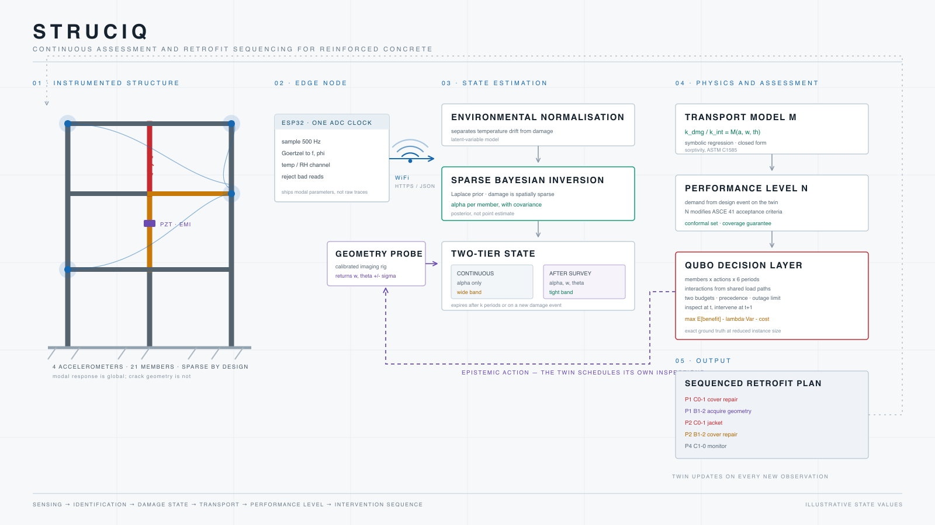
STRUCIQ · REVIEW 1
Architecture · the chain from sensing to retrofit
DEFINED ARCHITECTURE · EXPERIMENTAL COEFFICIENTS PENDING
08
Notes:
Walk left to right: sensing, identification, environmental correction, inference, two-tier transport, classification, decision.
[Sources]
- /Users/sreekaraditya/Downloads/arch_light.svg (user-provided architecture asset)
- /Users/sreekaraditya/Downloads/StrucIQ_Team_Briefing.docx, Section 5
[/Sources]

Slide 9
STRUCIQ · REVIEW 1
Two-tier state · use only the information that actually exists
CONTINUOUS TIER
INSPECTION TIER
Vibration + environment
Directed crack survey
↓
↓
GATE
α with covariance
α + w + θ
Reduced M(α) · deliberately wider uncertainty
Full M(α,w,θ) · tighter experimental band
Geometry remains valid for k periods or until a new damage event. Acquisition is therefore a decision with cost and timing—not a permanent assumption.
09
Notes:
Emphasise that the full transport model is never used when crack geometry has not been measured.
[Sources]
- /Users/sreekaraditya/Downloads/StrucIQ_Team_Briefing.docx, Section 6
- /Users/sreekaraditya/Downloads/StrucIQ_Session_Summary.md, Section 3
[/Sources]

Slide 10
STRUCIQ · REVIEW 1
Decision layer · uncertainty becomes an action
STATE
OPTIONS
QUBO
PLAN
→
→
→
α covariance
+ cover condition
Inspect · inject
coat · jacket
Expected benefit
− λ variance − cost
Who · what
which period
Separate budgets
Inspection and intervention resources are not fungible.
Hard precedence
Cover repair must precede jacketing on the same member.
Temporal separation
Geometry at period t can inform intervention no earlier than t+1.
Operational limit
Cap members simultaneously taken out of service.
Exact MILP provides the benchmark; QUBO provides the interaction-aware formulation and scaling study.
10
Notes:
Do not claim quantum speedup. The contribution is the decision formulation and its exact classical benchmark.
[Sources]
- /Users/sreekaraditya/Downloads/StrucIQ_Team_Briefing.docx, Sections 9 and 12
- /Users/sreekaraditya/Desktop/Demo-Sim/results/milp_solver_summary.csv
[/Sources]

Slide 11
STRUCIQ · REVIEW 1
Experimental campaign · cast, damage, measure, calibrate
PLANNED · REVIEW 2 METHODOLOGY
01
02
03
04
05
Cast
Baseline
Grade damage
Survey
Transport
RC members with controlled geometry and sensor locations
Modal response + environment + intact reference
UTM displacement control in fixed shallow increments
Crack width w and orientation θ with calibrated imaging
Cut specimens and measure ASTM C1585 sorptivity
Primary loading route
Primary response
UTM displacement control; shake-table loading remains an optional extension.
Water sorptivity—not chloride ingress—paired with α, w and θ for held-out model comparison.
11
Notes:
Methodology is included to demonstrate project readiness; no physical calibration result is claimed yet.
[Sources]
- /Users/sreekaraditya/Downloads/StrucIQ_Team_Briefing.docx, Sections 7–8
- ASTM C1585/C1585M, Standard Test Method for Measurement of Rate of Absorption of Water by Hydraulic-Cement Concretes
[/Sources]

Slide 12
STRUCIQ · REVIEW 1
What we have learned computationally
2
19 / 21
50
SENSORS
MEMBERS SEPARABLE
INDEPENDENT SEEDS
Mode shapes break the left/right symmetry; extra channels gave little precision gain in the 3-parameter portal study.
A sparse prior reduced mean posterior SD from 0.164 to 0.096 in the illustrative 21-member case.
Flat, sparse and oracle planning distributions were tested rather than judged from one annealing run.
Design consequence
Measure better, parameterise by physical member, retain covariance, and report solver distributions—not a single favourable run.
12
Notes:
All numbers on this slide are computational evidence, not physical validation.
[Sources]
- /Users/sreekaraditya/Desktop/Demo-Sim/results/REPORT.md
- /Users/sreekaraditya/Desktop/Demo-Sim/results/prior_comparison_summary.csv
- /Users/sreekaraditya/Desktop/Demo-Sim/results/prior_plan_solver_50_seed_summary.csv
[/Sources]

Slide 13
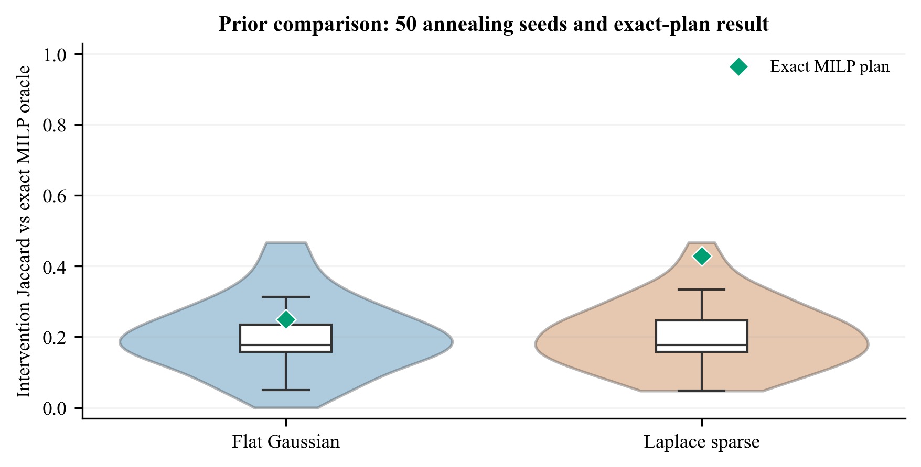
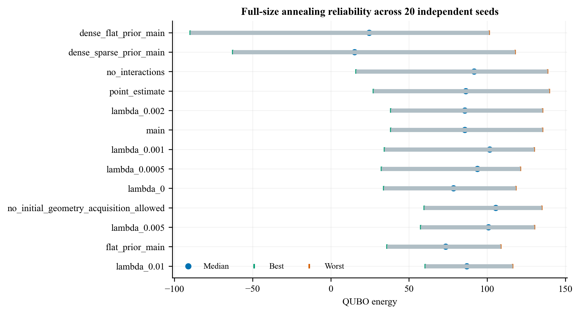
STRUCIQ · REVIEW 1
Work done · executable evidence already produced
✓
Portal-frame FE model and modal benchmark
✓
Fisher-information sensor and parameterisation study
✓
Sparse Bayesian member-state estimation with covariance
✓
21-member, 6-period decision instance: 504 primary / 678 total bits
✓
Independent feasibility checker and penalty negative control
✓
Exact MILP benchmark + exact enumeration ladder
✓
50-seed prior/oracle planning diagnosis
Verification evidence: exact optimum is known only on reduced ladders; full-scale QUBO optimality is benchmarked against exact MILP.
13
Notes:
Say simulation has been run over 50 independent seeds for the prior/oracle diagnosis; separately, the general reliability protocol uses 20 seeds per configuration.
[Sources]
- /Users/sreekaraditya/Desktop/Demo-Sim/results/prior_plan_jaccard_50_seeds.csv
- /Users/sreekaraditya/Desktop/Demo-Sim/results/solver_reliability_seeds.csv
- /Users/sreekaraditya/Desktop/Demo-Sim/results/milp_solver_summary.csv
[/Sources]

Slide 14
STRUCIQ · REVIEW 1
Work to be done · experimental evidence
NOW → OCT 2026
NOV 2026 → JAN 2027
FEB → APR 2027
Freeze experiment
Run campaign
Validate and integrate
1
Specimen and damage-grade design
1
Cast and cure specimens
1
Held-out comparison of M models
2
Sensor clock and OMA protocol
2
Baseline modal characterisation
2
Physical calibration of N
3
Imaging calibration + uncertainty
3
Controlled graded damage
3
End-to-end decision case
4
Pre-register nested M models
4
Crack survey and sorptivity tests
4
Final report, code and defence
Review 2 endpoint: methodology frozen and pilot measurements demonstrated—not a forced claim of full physical validation.
14
Notes:
This separates current computational readiness from the physical evidence still to be earned.
[Sources]
- /Users/sreekaraditya/Downloads/StrucIQ_Team_Briefing.docx, Sections 8, 13 and 14
- User-provided milestones: Review 2 by end-October 2026; submission April 2027
[/Sources]

Slide 15
STRUCIQ · REVIEW 1
Roadmap · Review 1 to April 2027 submission
AUG 2026
JAN 2027
APR 2027
Review 1
Campaign complete
Submission
Problem · gap · objectives
Architecture + simulation evidence
Graded damage, imaging
and sorptivity dataset
Final report · code · data
Presentation and viva
OCT 2026
MAR 2027
Review 2
Integrated validation
Frozen methodology
Pilot sensing and test protocol
Held-out M / N evaluation
Decision study and exact checks
The critical path is experimental—not slideware: freeze protocol → collect paired measurements → hold out validation → integrate decisions.
15
Notes:
Keep April 2027 as the fixed endpoint; the experimental campaign is the critical path.
[Sources]
- User-provided submission and Review 2 dates
- /Users/sreekaraditya/Downloads/StrucIQ_Team_Briefing.docx, Section 13
[/Sources]

Slide 16
STRUCIQ · REVIEW 1
References · APA style
Pirrò, M., Pereira, S., Gentile, C., Magalhães, F., & Cunha, Á. (2025). Damage detection under environmental and operational variability using the cointegration technique. Engineering Structures, 328, 119700. https://doi.org/10.1016/j.engstruct.2025.119700
Torzoni, M., Manzoni, A., & Mariani, S. (2022). Structural health monitoring of civil structures: A diagnostic framework powered by deep metric learning. Computers & Structures, 271, 106858. https://doi.org/10.1016/j.compstruc.2022.106858
Giglioni, V., Venanzi, I., Poggioni, V., Milani, A., & Ubertini, F. (2023). Autoencoders for unsupervised real-time bridge health assessment. Computer-Aided Civil and Infrastructure Engineering, 38, 959–974. https://doi.org/10.1111/mice.12943
Kamariotis, A., Chatzi, E., & Straub, D. (2022). Value of information from vibration-based structural health monitoring extracted via Bayesian model updating. Mechanical Systems and Signal Processing, 166, 108465. https://doi.org/10.1016/j.ymssp.2021.108465
Torzoni, M., Rosafalco, L., Manzoni, A., Mariani, S., & Corigliano, A. (2022). SHM under varying environmental conditions: An approach based on model order reduction and deep learning. Computers & Structures, 266, 106790. https://doi.org/10.1016/j.compstruc.2022.106790
Arcieri, G., Hoelzl, C., Schwery, O., Straub, D., Papakonstantinou, K. G., & Chatzi, E. (2023). Bridging POMDPs and Bayesian decision making for robust maintenance planning under model uncertainty: An application to railway systems. Reliability Engineering & System Safety, 239, 109496. https://doi.org/10.1016/j.ress.2023.109496
Torzoni, M., Manzoni, A., & Mariani, S. (2023). A multi-fidelity surrogate model for structural health monitoring exploiting model order reduction and artificial neural networks. Mechanical Systems and Signal Processing, 197, 110376. https://doi.org/10.1016/j.ymssp.2023.110376
Mengel, L., Krauss, H.-W., & Lowke, D. (2022). Water transport through cracked concrete structures—Effect of mixture proportion on separating crack geometry and permeability. Materials, 15, 5807. https://doi.org/10.3390/ma15175807
16
Notes:
[Sources]
- Crossref metadata retrieved by DOI on 26 August 2026
- DOI links printed on this slide
[/Sources]

