Slide 1

PACKET SNIFFER

Slide 2
Team Members K Sreekar Reddy 19BCE1227 Bollineni Nishanth 19BCE1805 Naga Chandan 19BCE1604

Slide 3

ABOUT
PACKET SNIFFER
Packet sniffing is a process of monitoring and capturing all data packets passing thorough a given network using a software application or a hardware device. Sniffers can be used to monitor all sorts of traffic either protected or unprotected. Using sniffers, attacker can gain information which might be helpful for further attacks. In this project we are going to know the basic working of a packet sniffer, network protocols that are many vulnerable to sniffing, various software that can be used for sniffing. there are possible defensive techniques used to defend against sniffing attacks. Sniffers are not hacking tools but they can help a hacker to launch further attacks such as session hijacking, DOS attacks, MITM attacks etc.

Slide 4
Introduction
In the past few decades, computer networks have been increasing all over the world very rapidly. Number of its users have increased and also the traffic flow in these networks. So, it is very important to keep an eye on the traffic that flows between many servers and systems. It is also necessary to maintain the user's privacy and to keep the network smooth and it's a very tough task to maintain and monitor the network, because of the large amount of data available. For this purpose, packet sniffing is used. Packet sniffing is the process of capturing the information transmitted across networks. In this process NIC captures all traffic that flows inside or outside the network. Packet Sniffing mainly used in network management, monitoring and ethical hacking. To perform sniffing we use a tool named packet sniffer. A packet sniffer, sometimes referred to as a network analyzer, which can be used by a network administrator to monitor and troubleshoot network traffic.
Sniffers work by examining streams of data packets that flow between computers on a network as well as between networked computers and the larger Internet. These packets are intended for — and addressed to — specific machines, but using a packet sniffer in "promiscuous mode" allows IT professionals, end users or malicious intruders to examine any packet, regardless of destination. It's possible to configure sniffers in two ways. The first is "unfiltered," meaning they will capture all packets possible and write them to a local hard drive for later examination. Next is "filtered" mode, meaning analysers will only capture packets that contain specific data elements.

Slide 5
EXPECTED RESULT
We are required to capture the packets from the system that are transferred over the network using packet sniffer that has been implemented using python and gain the information about the packets like its source and destination MAC addresses and IP addresses. It should also the describe the protocol of IP packets like TCP, UDP, ICMP and also raw data in encrypted form.

Slide 6
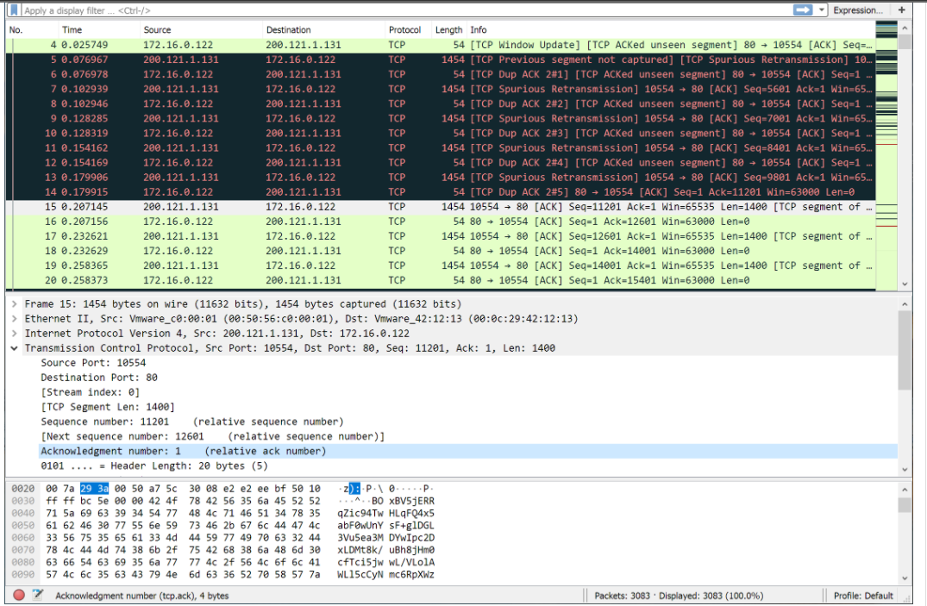
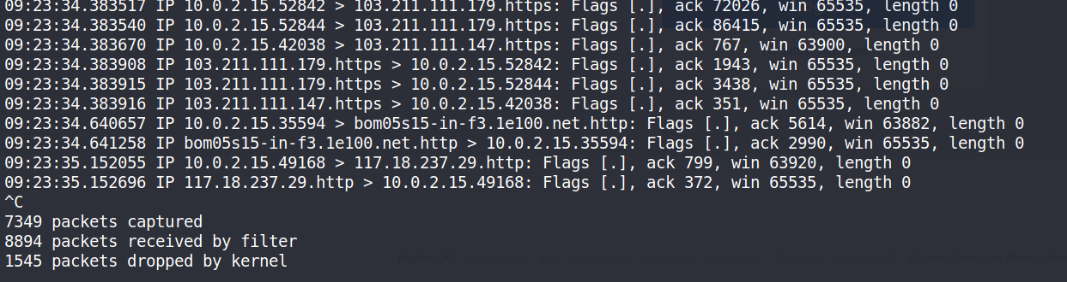
EXISTING PACKET SNIFFER
#1
WIRESHARK
#2
TCPDUMP

Slide 7
IMPLEMENTATION OF PACKET SNIFFER
#1
Capturing packets using sockets library
#2
Parsing the packets
#3
Protocol Identification
#4
Unpacking packets

Slide 8
IMPLEMENTATION OF PACKET SNIFFER
Capturing packets using sockets library
Importing socket library in python, A simple packet sniffer in Python can be
created with the help socket module. We can use the raw socket type to
get the packets. A raw socket provides access to the underlying protocols, which
support socket abstractions. Since raw sockets are part of the internet socket API,
they can only be used to generate and receive IP packets.
conn = socket.socket(socket.AF_PACKET, socket.SOCK_RAW, socket.ntohs(3))

Slide 9
Capturing packets using sockets library
Both reading and writing to a raw socket require creating a raw socket first. Here we use the INET family raw socket.
The family parameter for a socket describes the address family of the socket. The following are the address family constants:
Family of socket | Description
AF_LOCAL | Used for local communication
AF_UNIX | Unix domain sockets
AF_INET | IP version 4
AF_INET6 | IP version 6
AF_IPX | Novell IPX
AF_NETLINK | Kernel user-interface device
AF_X25 | Reserved for X.25 project
AF_APPLETALK | Appletalk DDP
AF_PACKET | Low-level packet interface
AF_ALG | Interface to kernel crypto API

Slide 10
Capturing packets using sockets library
The next parameter passed is the type of the socket. The following are the possible values for the socket type:
Type of Socket | Description
SOCK_STREAM | Stream (connection) socket
SOCK_DGRAM | Datagram (connection-less) socket
SOCK_RAW | RAW socket
SOCK_RDM | Reliably delivered message
SOCK_SEQPACKET | Sequential packet socket
SOCK_PACKET | Linux-specific method of getting packets at the development level

Slide 11
IMPLEMENTATION OF PACKET SNIFFER
Parsing the packets:
Now we can try to parse the data that we sniffed, and unpack the headers. To parse a packet, we need to have an idea of the Ethernet frame and the packet headers of the IP. The Ethernet frame structure is as follows:
The first six bytes are for the Destination MAC address and the next six bytes are for the Source MAC. The last two bytes are for the Ether Type. The rest includes DATA and CRC Checksum. According to RFC 791, an IP header looks like the following:
Protocol Version (four bits): The first four bits. This represents the current IP protocol.
Header Length (four bits): The length of the IP header is represented in 32-bit words. Since this field is four bits, the maximum header length allowed is 60 bytes. Usually the value is 5, which means five 32-bit words: 5 * 4 = 20 bytes.

Slide 12
IMPLEMENTATION OF PACKET SNIFFER
Parsing the packets:
Type of Service (eight bits): The first three bits are precedence bits, the next four bits represent the type of service, and the last bit is left unused. • Total Length (16 bits): This represents the total IP datagram length in bytes. This a 16-bit field. The maximum size of the IP datagram is 65,535 bytes.
Flags (three bits): The second bit represents the Don't Fragment bit. When this bit is set, the IP datagram is never fragmented. The third bit represents the More Fragment bit. If this bit is set, then it represents a fragmented IP datagram that has more fragments after it.
Time To Live (eight bits): This value represents the number of hops that the IP datagram will go through before being discarded.
Protocol (eight bits): This represents the transport layer protocol that handed over data to the IP layer.

Slide 13
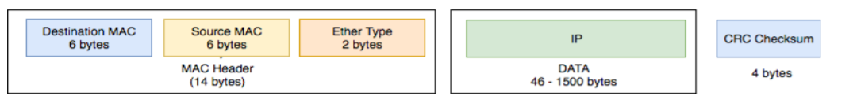
IMPLEMENTATION OF PACKET SNIFFER
Ethernet Frame Layout

Slide 14
IMPLEMENTATION OF PACKET SNIFFER
Protocol Identification:
Now that we have the internet layer unpacked, the next layer we have to unpack is the transport layer. We can determine the protocol from the protocol ID in the IP header. The following are the protocol IDs for some of the protocols:
• TCP: 6
• ICMP: 1
• UDP: 17

Slide 15
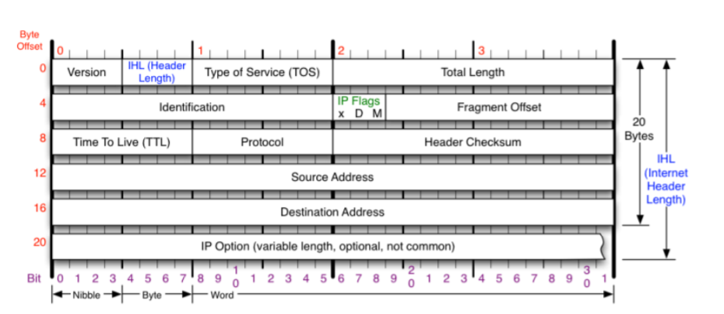
IMPLEMENTATION OF PACKET SNIFFER
TCP PACKET Layout

Slide 16
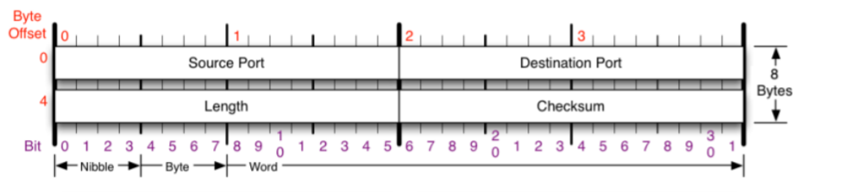
IMPLEMENTATION OF PACKET SNIFFER
UDP PACKET Layout

Slide 17
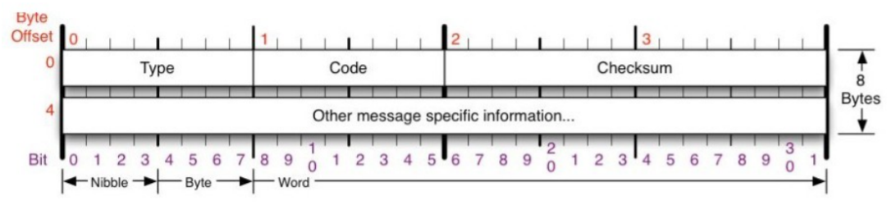
IMPLEMENTATION OF PACKET SNIFFER
ICMP PACKET Layout

Slide 18
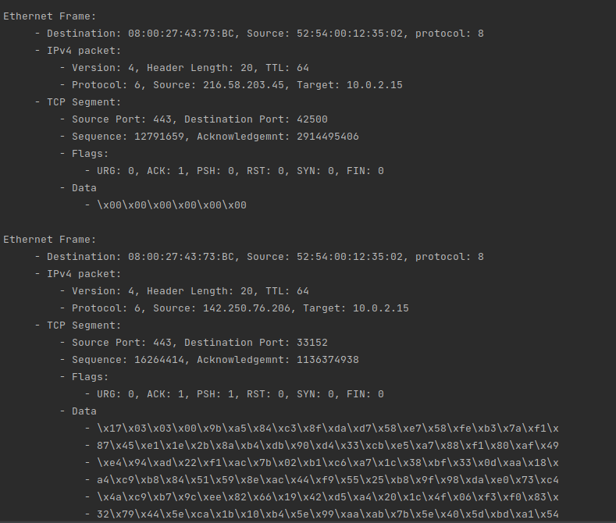
OUTPUT SCREENSHOTS

Slide 19

THANK YOU

