Slide 1
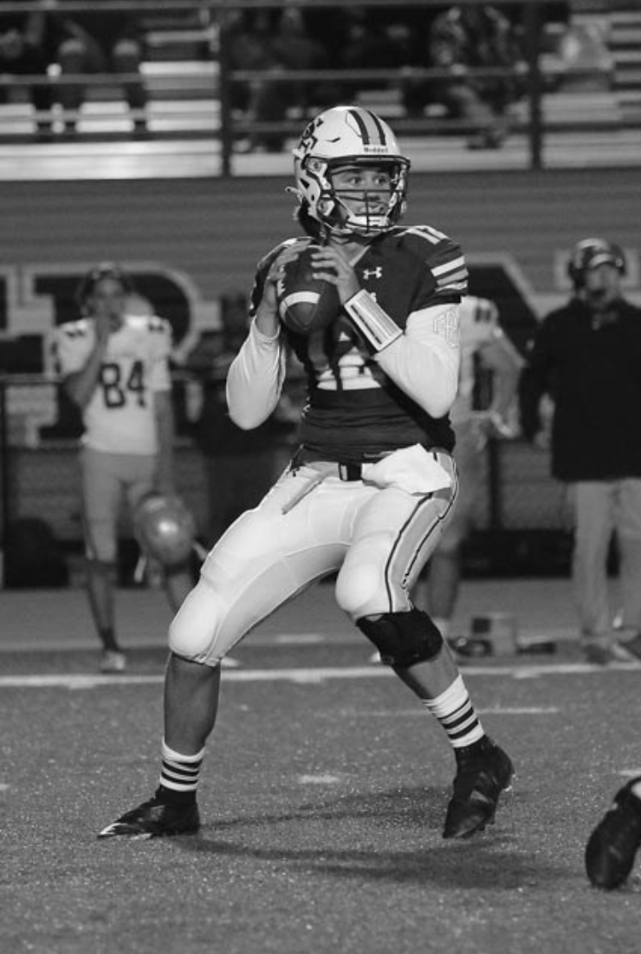
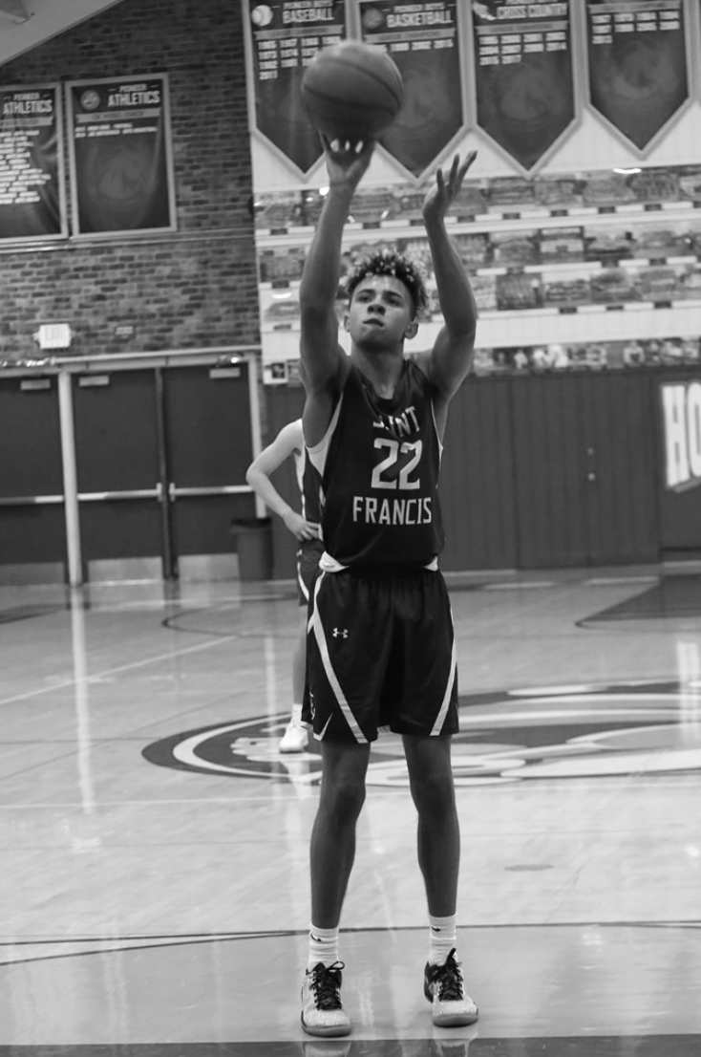
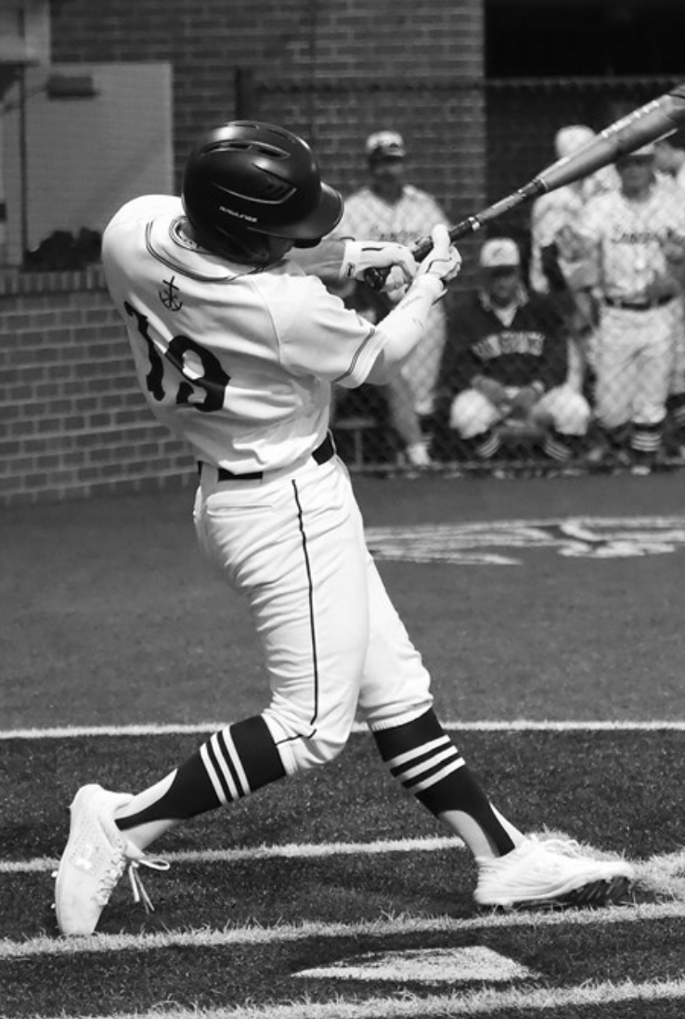
Sreekar Kutagulla Lancer Analytics, Co-Founder Sports Analytics Portfolio sreekarkutagulla@sfhs.com Saint Francis High School ‘23

Slide 2

Football Breakdown
Deliverables
Run/Pass Percentage
Full Pipeline Automation
Formation Frequency
Raw Game Data
Formation Analysis
Formation Situational Efficiency
Sourced from HUDL
Game tape analysis
Play call and results
Redzone Analysis
Midfield Analysis
Backed Up Analysis
Formation Efficiency Search System
Quarter Based Zone Analysis
Competitive Edge: Data Driven Decision Making For Coaches

Slide 3

Use Case – DLS Game
Pre-Game Formation
Analysis
Changes Made to Offensive Game-plan
Collected data from HUDL database
Developed script to analyze formations
Found pass-formation X to be the most efficient
Found heavily used run-formation Y to be the least efficient
Pass-formation X was used 33% more
Pass- formation X efficiency increased by 22.5%
Passing overall increased by 50%
Run-formation Y was used 10% less
Run-formation Y’s efficiency increased by 5%
Outcomes
Won 31-28
Broke DLS 30 Year Win Streak
Became 1st in CCS division
Remained Undefeated

Slide 4



Use Case – VCHS Game
Game film analysis
Scheme Analysis
Watched game-film and collected data using HUDL
Developed script to analyze play types(run or pass)
80% of passes thrown to number 13
81% of plays were runs
If offense comes out in bunch formation, >60% chance number 13 runs a slant
If number 13 is alone, >70% chance he runs a fade
Solution: double team using free safety or ROLB/LOLB
Outputs
41-27 Win
#13 held to 1 catch over 15 yards

Slide 5
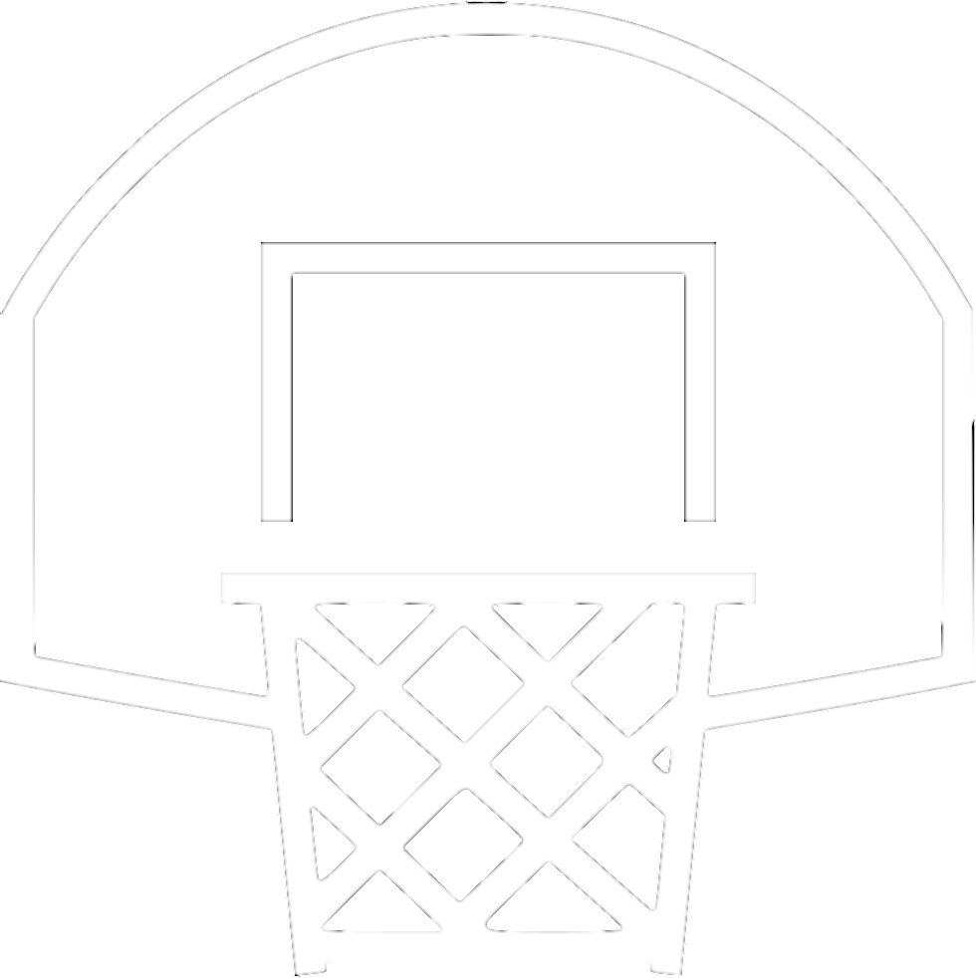





Basketball Breakdown
Shooting Quality and Efficiency
Rebounding and Defensive Efficiency
Data Collection
Sourced data sets from HUDL
Gathered historical data from CCS
Spider Chart of player strengths and weaknesses
Player Efficiency Metric called Lancer Analytic Score
Player Profiles and Reports

Slide 6

Lineup Optimization
Pre-Game
Lineup Analysis
Practice Analysis
Collected data from HUDL database
Developed script to analyze player efficiencies(PER, RBE, DER)
Developed script to analyze shooting performance
Developed script to create spider charts to help coaching decisions
Eye Test: “chemistry between new lineup
Data: collect efficiency ratings per player
Execution: Compare older practice efficiency ratings vs newer ones
If newer ratings are higher, the new lineup will play more minutes
Outcomes
Came back from
Relegation last season
Made CCS playoffs

