Slide 1
Sign In
First name:
Last Name:
Email:
Password:
Contact:
Address:
Register
Already registered? login

Slide 2
Login
Email:
Password:
Login
New user? Click here to sign up!

Slide 3
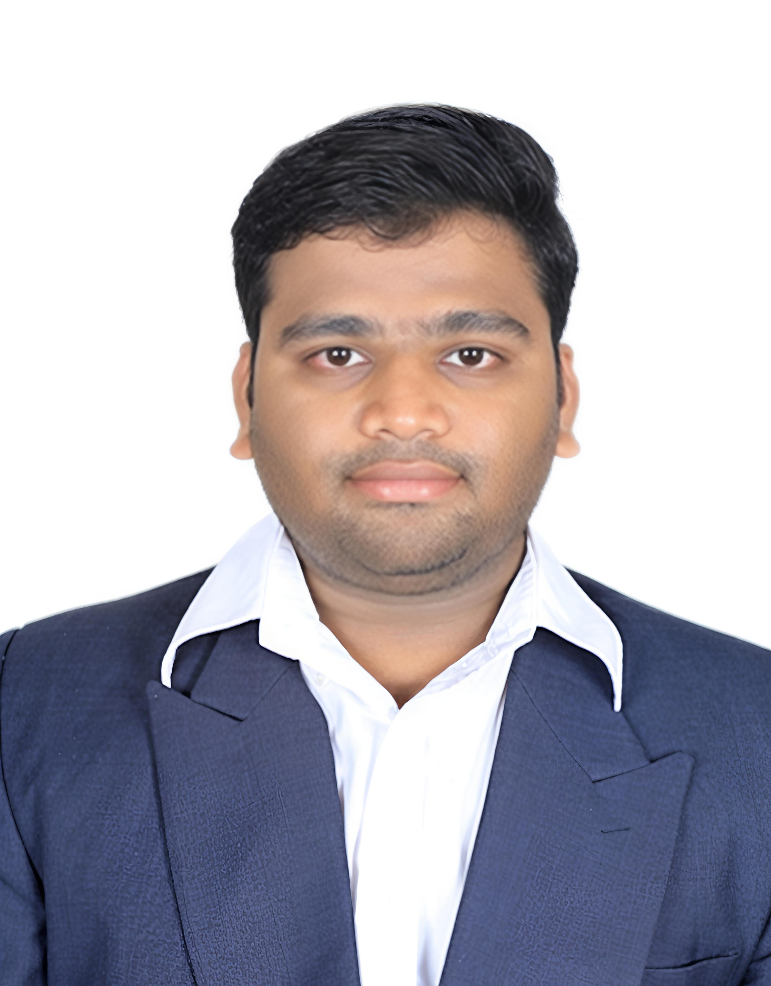
Welcome to Role Management App
Super Admin: Sreekar Nakka
My profile
Logout
Search User
All Users
Create User

