Slide 1
ML-Based Prediction of Antenna Array Gain and Bandwidth to Avoid Grating Lobes
A Machine Learning Surrogate for Antenna Array Design
Sreekar Balagoni
B.E. ECE, Vasavi College of Engineering
November 2026
1

Slide 2
Why ML for Antenna Arrays?
▸ Traditional EM simulation (ADS, CST) requires hours per design iteration
▸ Antenna array gain and bandwidth depend on N, spacing, and scan angle in complex ways
▸ Grating lobes are a critical failure mode — spatial aliasing destroys beam quality
Goal: Train ML models to predict gain, bandwidth, and grating lobe onset — instantly
2

Slide 3
Grating Lobe Physics
d ≤ λ / (1 + |sin θmax|)
Condition | Maximum spacing
Broadside only (θ = 0°) | d < λ
Full scan (θ = 90°) | d < λ/2
±50° scan | d < 0.566λ
This equation defines the binary classification boundary used in Phase 4.
3

Slide 4
Dataset Generation — ULA Analytical Model
Parameter | Swept values
N (elements) | 2, 4, 8, 16, 32
d/λ (spacing) | 0.3 → 1.2, step 0.1
θ (scan angle) | 0°, 15°, 30°, 45°, 60°
250 total
combinations
5 × 10 × 5
full factorial
Feature engineering
▸ log_N = log₂(N) — linearises the aperture term
▸ gl_margin = threshold − d/λ — signed distance to the grating-lobe boundary
Generated analytically from ULA physics — no EM simulator required.
4

Slide 5
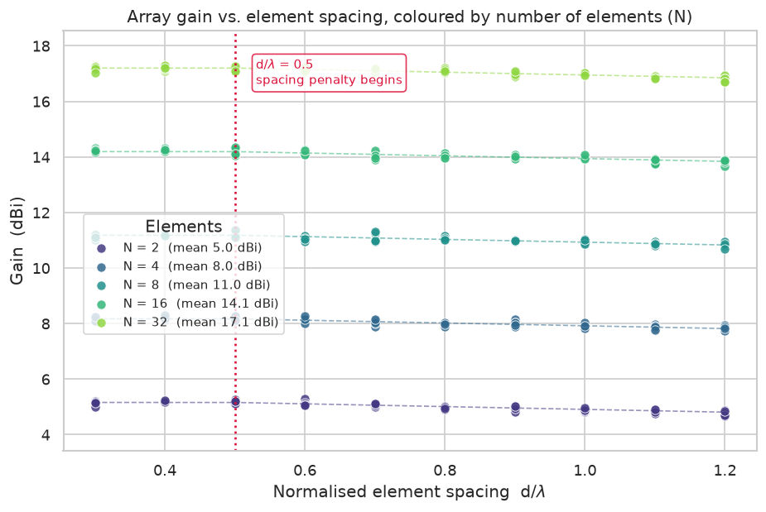
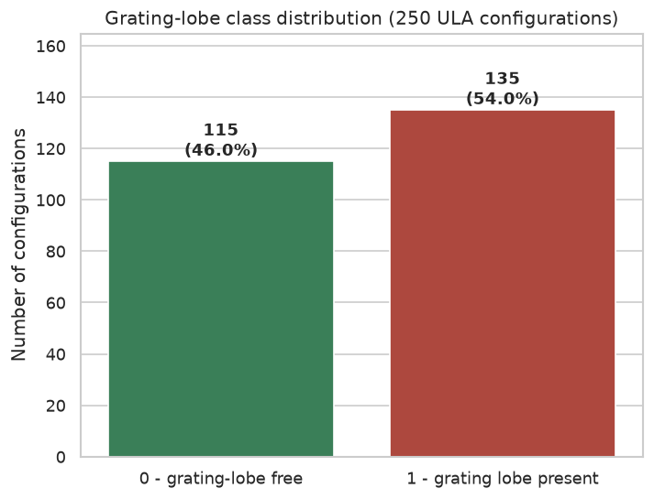
Exploratory Data Analysis
Gain rises ~3 dB per doubling of N; a −0.5 dB/λ penalty
appears beyond d/λ = 0.5 (mutual coupling).
Class balance 115 / 135 (1.17 : 1) —
mild enough for accuracy to be a meaningful metric.
5

Slide 6
Machine Learning Pipeline
Regression (9 models)
Classification (6 models)
Linear Regression
Ridge Regression
Decision Tree
Random Forest
Extra Trees
Gradient Boosting
XGBoost
KNN (k=5)
Gaussian Process
Logistic Regression
Random Forest
Gradient Boosting
XGBoost
SVM (RBF, probability=True)
KNN (k=5)
Regression metrics
Classification metrics
R² · Variance Score · MAE · MSE · RMSE
Accuracy · F1 · ROC-AUC · Confusion matrix
All models: 80/20 split (random_state=42) · StandardScaler fitted on train only
6

Slide 7
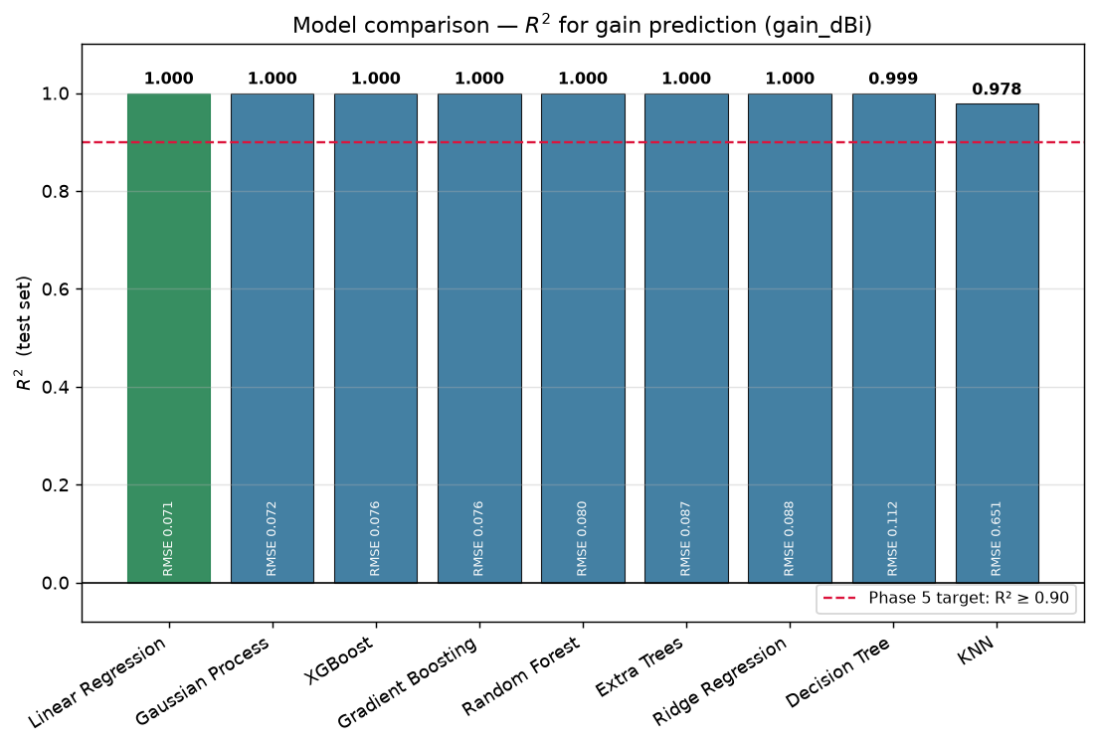
Gain Prediction Results
Best: Linear Regression
R² = 0.9997
Gain follows 10·log₁₀(N) — a near-linear relationship — so linear regression is not merely adequate but optimal.
RMSE 0.071 dBi · MAE 0.054 dBi
7

Slide 8
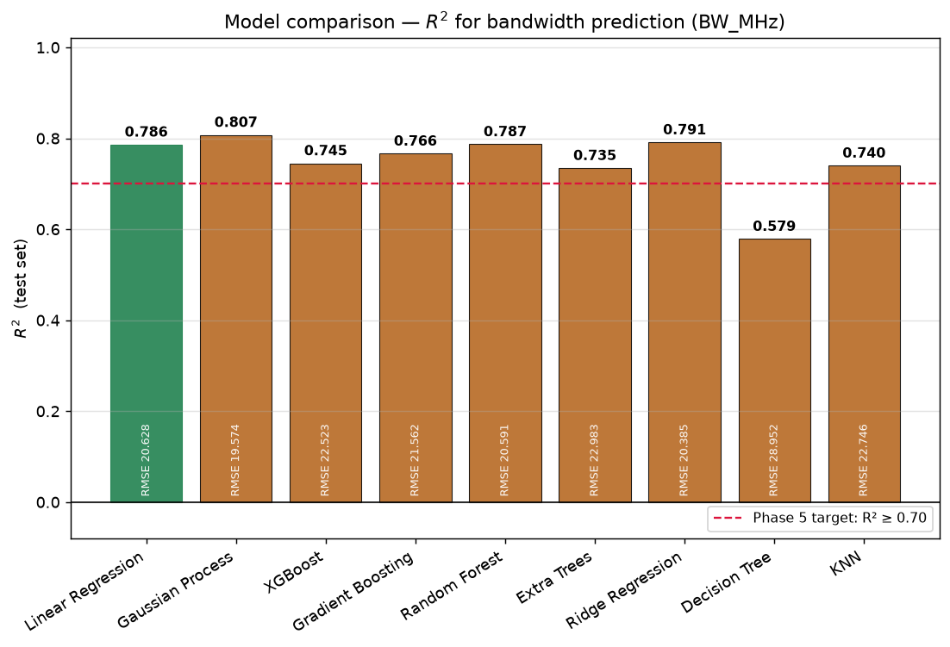
Bandwidth Prediction Results
Best: Gaussian Process
R² = 0.8075
Bandwidth carries 20 MHz of irreducible noise, so 0.81 is the theoretical ceiling — not a modelling shortfall.
RMSE 19.6 MHz · clears the 0.70 spec bar
8

Slide 9
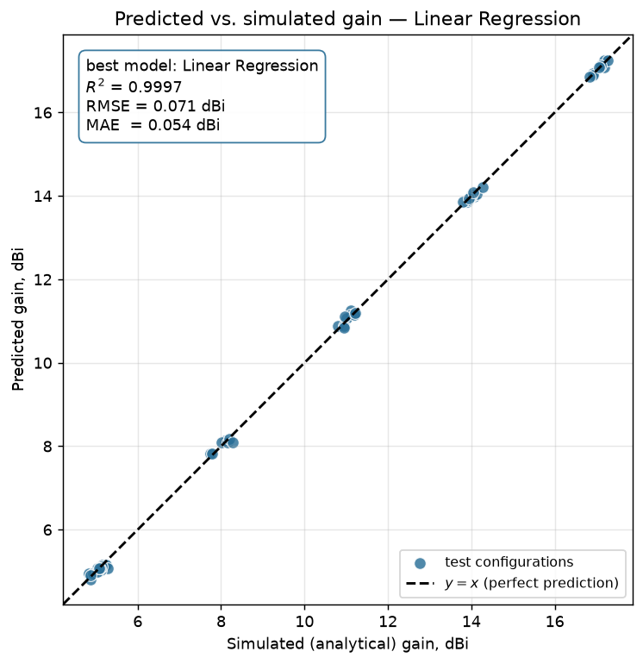
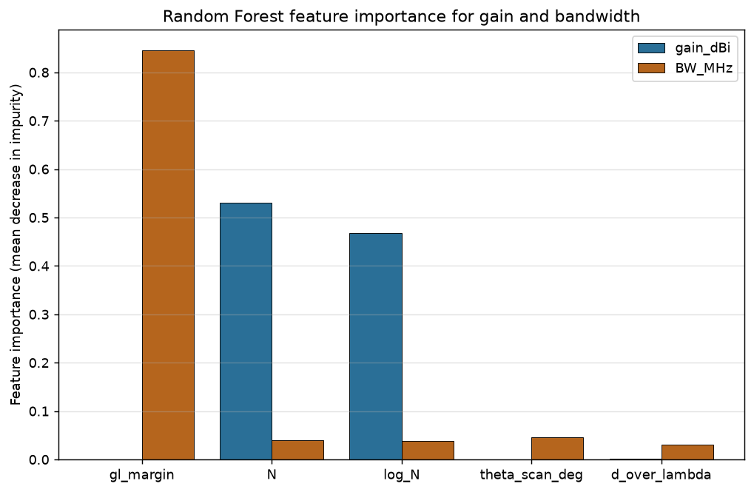
Model Validation — Predicted vs. Simulated
Test configurations track y = x
across 4.7 – 17.3 dBi.
Gain is driven by N / log_N; bandwidth by gl_margin (0.85 importance) — the physics is recovered.
9

Slide 10
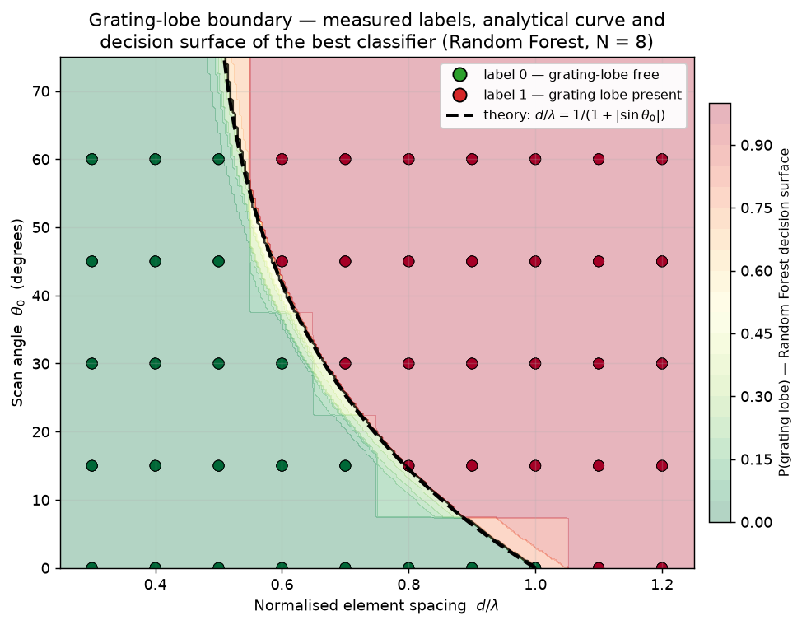
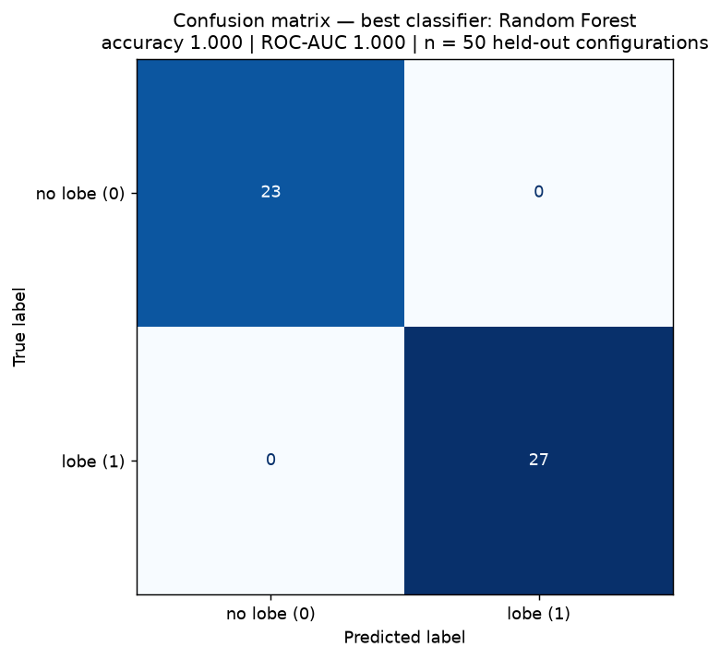
Grating Lobe Classification Results
Metric | RF
Accuracy | 1.0000
ROC-AUC | 1.0000
F1 | 1.0000
Deterministic boundary learned perfectly — the classifier rediscovers the physics equation.
Orange = grating lobe, green = safe.
Labels hug the theoretical curve.
Random Forest · Gradient Boosting · XGBoost all score 1.000 · SVM 0.960 · KNN 0.960 · Logistic 0.880
10

Slide 11
Summary
Target | Best model | Score
Gain (R²) | Linear Regression | 0.9997
Bandwidth (R²) | Gaussian Process | 0.8075
Grating lobe (acc.) | Random Forest | 1.0000
Conclusions
▸ ML can replace repeated ADS sweeps for array design exploration
▸ Grating lobe onset is learnable from (N, d/λ, θ) with perfect accuracy
▸ gl_margin is the most informative feature — it encodes the physics directly
37/37 verification checks passed
Labels re-derived from the analytical formula independently
of the generator; results reproducible from a clean clone.
11

Slide 12
Future Work & References
Future work
References
▸ Replace analytical model with full-wave ADS/CST EM simulation data
▸ Extend to 2D planar arrays and mutual coupling effects
▸ Hide gl_margin to force classifier to learn boundary from raw parameters
[1] M. A. Haque et al., “Machine learning-based technique for gain prediction of mm-wave miniaturized 5G MIMO slotted antenna array,” Scientific Reports, 2025. DOI: 10.1038/s41598-024-84182-w
[2] M. A. Haque et al., “Machine learning-based technique for gain and resonance prediction of mid band 5G Yagi antenna,” Scientific Reports, 13:12590, 2023. PMC10400634
[3] P. Jain, P. K. Sahoo, A. D. Khaleel, A. J. A. Al-Gburi, “Enhanced prediction of metamaterial antenna parameters using advanced machine learning regression models,” Progress In Electromagnetics Research C, 146, 1–12, 2024. DOI: 10.2528/PIERC24060901
Repository: github.com/Sreekarji/ml-array · All code seeded to 42 for reproducibility
12

