Slide 1
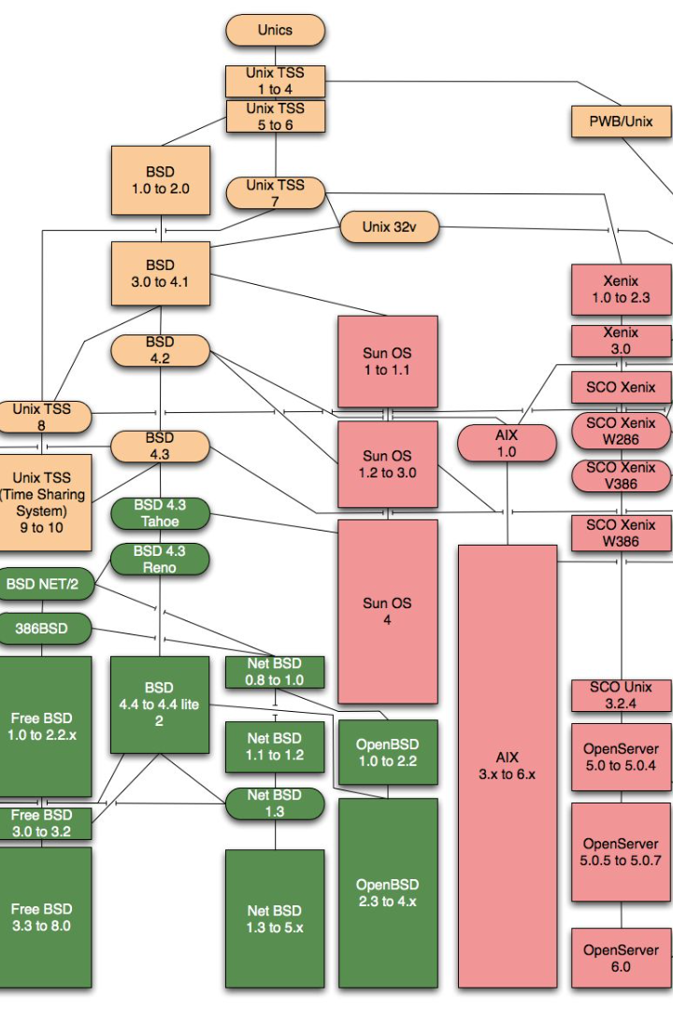


Unix-like Operating Systems: Managing Permissions and Processes
Unix-like operating systems provide a range of commands to effectively manage and monitor processes and permissions. In this guide, we will explore some of the commonly used commands and examples.
by sreekar

Slide 2
Managing Permissions with chmod
1
Change Permissions for Owner
2
Change Permissions for Group
To give read, write, or execute permission to the owner of a file: chmod u+r/w/x filename
To give read, write, or execute permission to the group of a file: chmod g+r/w/x filename
3
Change Permissions for Others
4
Change Permissions for Everyone
To give read, write, or execute permission to others: chmod o+r/w/x filename
To give read, write, or execute permission to everyone: chmod a+r/w/x filename
5
Change Permissions using Octal Notation
6
Change Permissions Recursively
To change permissions for a directory and its contents recursively: chmod -R u+w directoryname
To set specific permissions using octal notation: chmod 644/755 filename

Slide 3
Monitoring Processes
ps
top
Displays information about running processes. Use ps aux to list all processes on the system.
Provides a dynamic view of system processes, CPU usage, memory usage, and more.
htop
kill
An interactive version of top that allows you to interactively manage and monitor processes.
Used to send signals to processes, allowing you to stop or control them. Use kill PID to terminate a process by its process ID, and killall to terminate processes by their names rather than PIDs.

Slide 4
Process Identification and Control
1
pgrep
Finds the process IDs of processes matching a specified name.
2
pkill
Sends signals to processes based on their names.
3
renice
Used to change the priority of running processes.
4
nice
Used to start a process with a specified priority.

Slide 5
Scheduling Tasks
at and batch
cron
Allow you to schedule tasks to run at a specific time or when system load permits.
Used for scheduling recurring tasks.

Slide 6

Checking Disk Space Usage
1
df
Displays information about available disk space on mounted filesystems.
2
du
Estimates and displays the disk space usage of files and directories.

Slide 7

Finding Large Files
To find large files within a directory, you can use commands like find in combination with du. For example, to find the largest files in the current directory:
find . -type f -exec du -h {} + | sort -rh | head -n 10
This command will list the top 10 largest files in the current directory and its subdirectories.

Slide 8

In Summary
In summary, when managing permissions and processes in Unix-like operating systems, the chmod command enables you to change file and directory permissions. Process utilities like ps, top, and kill help you monitor and control running processes. Utilize df and du to check disk space usage and finding large files. With these commands at your disposal, you can effectively manage and optimize your system.

